Slide 1
REGARD: Real-time GNSS-based
Crustal Deformation Monitoring with
GEONET in Japan
TAKAMATSU Naofumi, OHNO Keitaro, MIYAZAKI Takayuki
Geospatial Information Authority of Japan
OHTA Yusaku
Research Center for Prediction of Earthquakes and Volcanic Eruptions,
Graduate School of Science, Tohoku University
IGS Symposium & Workshop, Session 5: GNSS-Enabled Applications
2024-07-04 10:30-10:45
Notes:
Thank you, chair parson.
My name is Naofumi Takamatsu from GSI.
Today, I’d like to talk about real-time GNSS-based crustal deformation monitoring system, named REGARD, including the result of Noto peninsula earthquake in Japan at this new year’s day.

Slide 2
Outline
Overview
The 2024 Noto Peninsula Earthquake
Future development
Summary
Notes:
This is an outline of my presentation

Slide 3
Overview
Notes:
At first, I’ll give brief introduction about REGARD system.

Slide 4
Advantage of a GNSS-based early warning
Blewitt et al. (2009)
The larger an earthquake is, the more dominant the lowest frequency band becomes.
GNSS can sample static offsets and so can directly estimate moment magnitude (Mw).
Free from saturation even for huge earthquakes
Notes:
The primary advantage of GNSS-based early warning is unsaturation in representing earthquake size.
In principle, if an earthquake becomes larger, the lowest frequency band more prevails, as you can see the red curve.
Compared to seismic data, GNSS has greater sensitivity in the lowest frequency band.
This means GNSS can detect co-seismic displacement and, by inverting this, provide moment magnitude directly.
As you can see the right figure, while the magnitude based on seismic data saturate at around 8.0, moment magnitude well represent actual size of earthquakes, even for a megathrust earthquake, which is very likely to excite devastating tsunami.

Slide 5
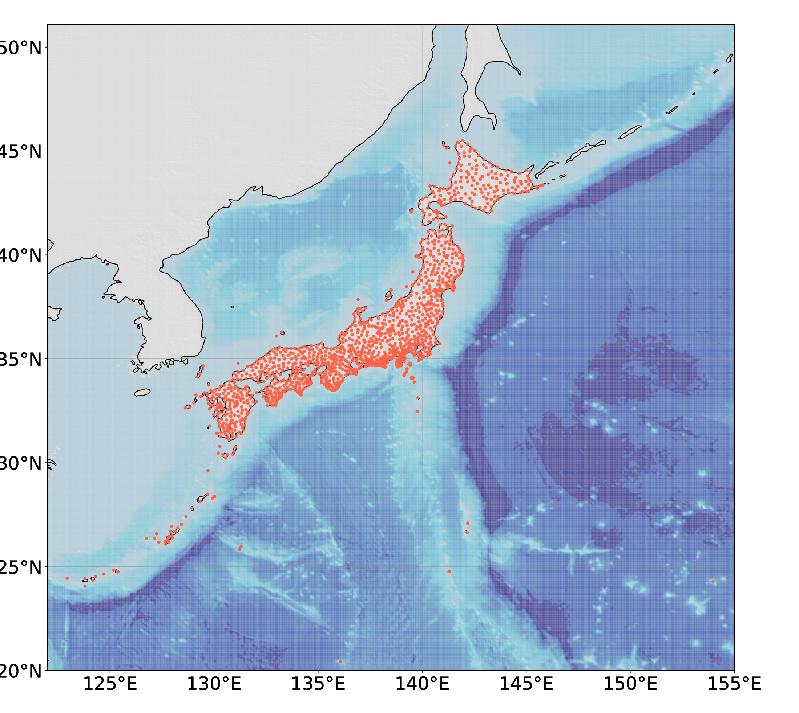
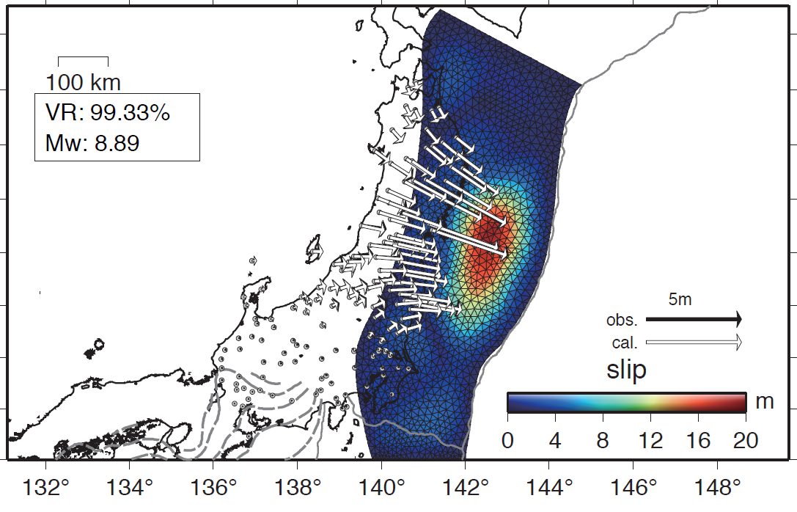
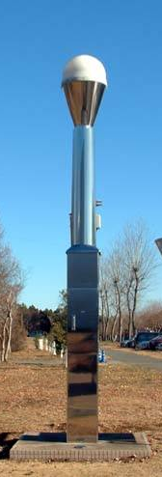
What’s REGARD?
REGARD: REal-time GEONET Analysis system for
Rapid Deformation monitoring
offers finite fault model based on high-rate GNSS data in Japan.
● GEONET station
GEONET
GNSS stations covering
entire domain of Japan
- # of station: 1,318
- spacing: 20km
- sampling intvl: 1Hz
source
determination
Kawamoto et al. (2017)
Progress
Soon after the 2011 Tohoku-Oki earthquake :
The joint development with Tohoku university was initiated.
April 2016 : went into full operation
Current : utilized for tsunami warning (for reference only),
initial assessment of the damage, and train operation
Notes:
After 2011 Tohoku-Oki earthquake, we developed GNSS-based real-time fault estimation system, REGARD, in collaboration with Tohoku University.
In Japan, a dense GNSS observation network is operated by GSI and their high-rate data is acquired in real-time.
By processing this, REGARD offers a finite fault model within several minutes from earthquake origin time.
Since the full operation in 2016, we've shared results within the government for tsunami warning and initial assessments of the damage.
Moreover, we recently started the collaboration with private sectors; Specifically speaking, the estimated fault model is used in considering operation of bullet train immediately after the Nankai trough earthquake in Japan.

Slide 6
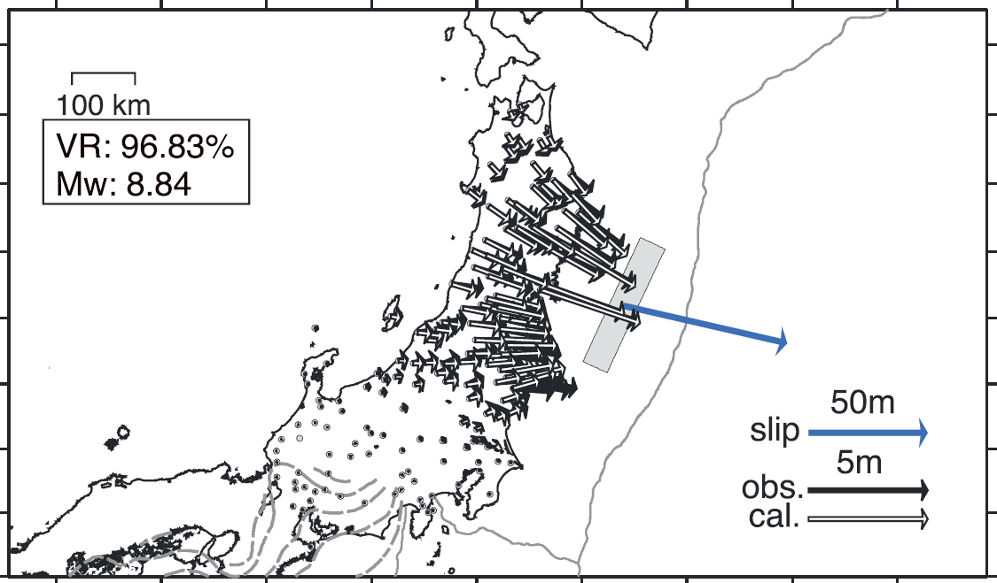
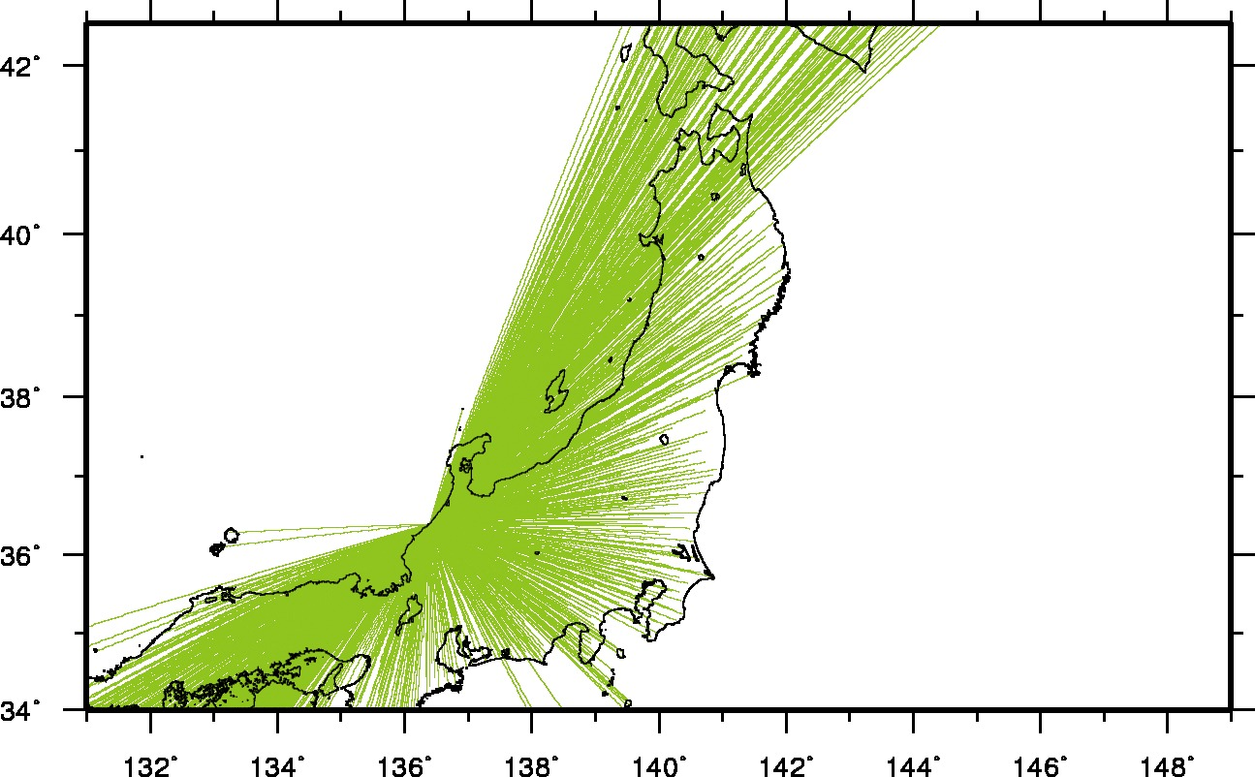
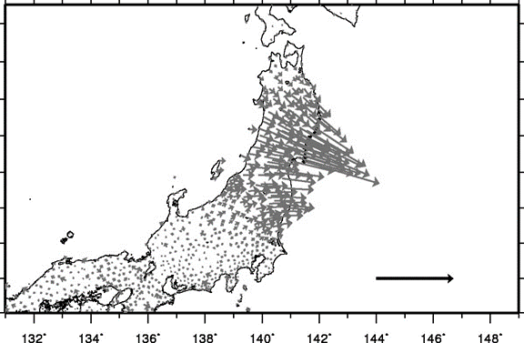
Processing flow
Anytime …
When an event occurs …
① Positioning (1 Hz)
② Event detection
③ Fault model inversion
Reference
station
5 m
Kawamoto et al. (2017)
Station positions w.r.t. the reference station are provided based on real-time kinematic (RTK) positioning technique.
triggered by either algorithms:
- Earthquake early warning
issued by Japan Meteorological Agency
- Displacement time series
(RAPiD: Ohta et al., 2012)
- Single rectangle
applicable for inter, intra, and
inland earthquakes
- Slip distribution
specialized for interplate ones
- Max. likelihood estimation for both
Notes:
REGARD consists of 3 sub-systems: real-time positioning, event detection, and fault model inversion.
In real-time positioning sub-system, RTK is employed.
This offers continuous 1Hz displacement data with respect to a single reference station.
The event detection sub-system has 2 types of algorithms.
One is the earthquake early warning issued by Japan Meteorological Agency and the other is RAPiD algorithm, which monitors 1Hz displacement by STA/LTA method.
Once an event is detected, 2 types of fault model inversion are initiated.
The single rectangular model is applicable for any types of earthquakes and the slip distribution model is specialized for megathrust earthquake.
Both are based on maximum likelihood estimation.

Slide 7
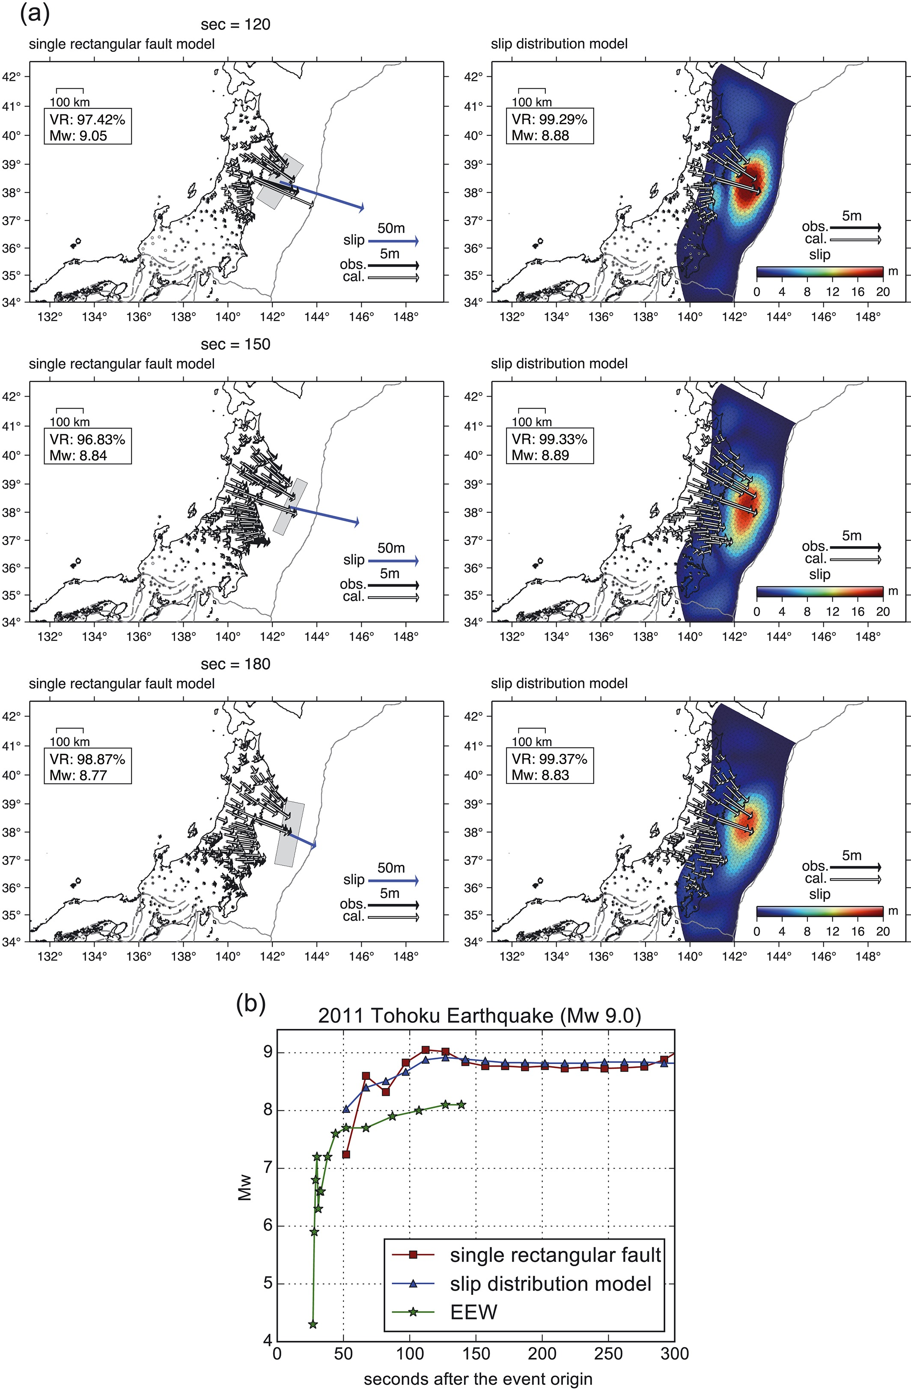
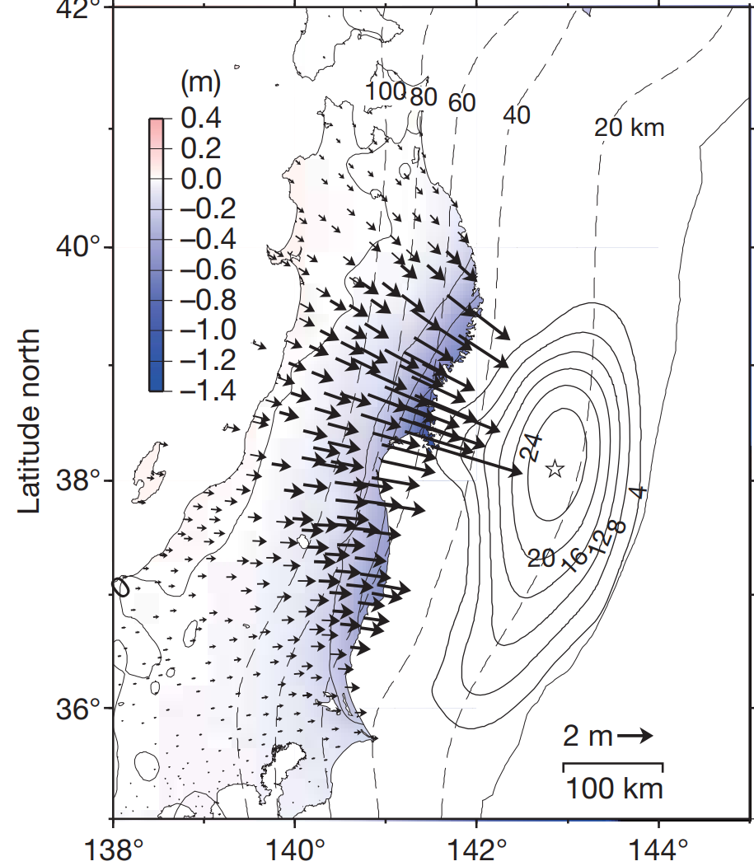
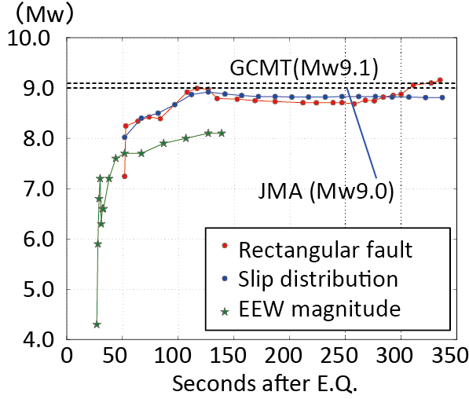
Performance assessment (2011 Tohoku-Oki earthquake)
Post-processed model
Growth of magnitudes
Ozawa et al. (2011)
Kawamoto et al. (2017)
Mw comes close to the post-processed values in 120 seconds from origin time.
The slip distribution well agrees with
the post-processed model
Kawamoto et al. (2017)
Notes:
This is a performance assessment of REGARD.
In case of Tohoku-Oki earthquake, the fault models well agree with the post-processed GNSS model.
Also, the moment magnitudes come close to the post-processed results in 2 minutes from the origin time while the EEW saturates around 8.0.

Slide 8
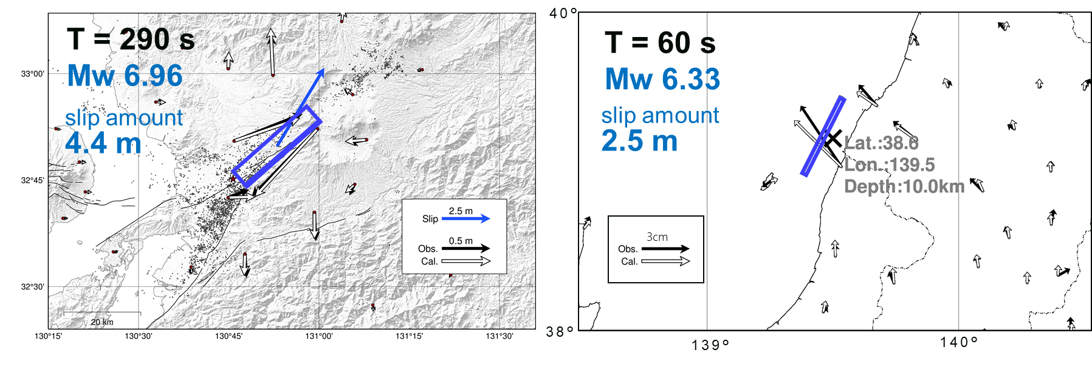
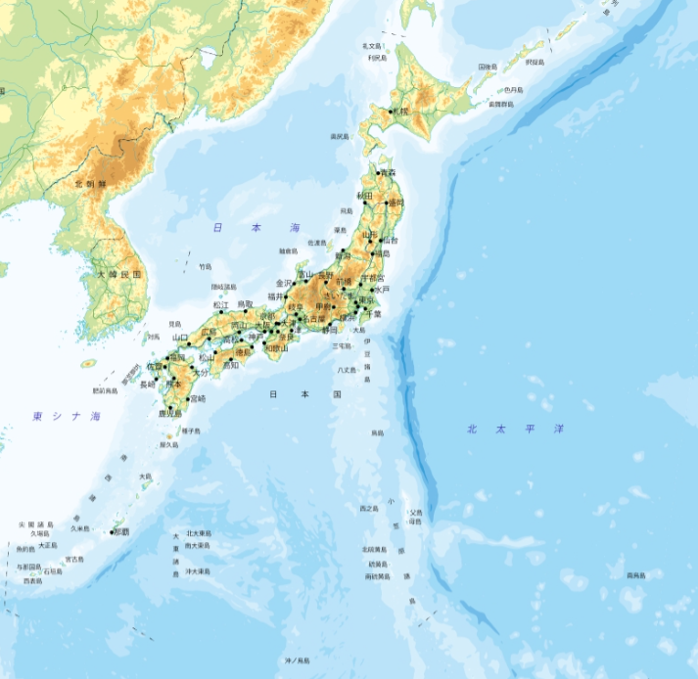
Results in operational term
2016 Kumamoto earthquake (M7.3)
2019 Yamagata-Oki earthquake (M6.7)
Kawamoto et al. (2016)
2019 Yamagata-oki
REGARD works well even for M6.5~7 earthquake thanks to the dense deployment of GEONET
2016 Kumamoto
Notes:
For inland earthquakes, REGARD successfully provided reasonable fault models as well.
The sizes of these two cases are not so significant, magnitude 6.5 to 7, but co-seismic displacement fields were well captured and appropriate fault models were obtained thanks to the dense deployment of GEONET.

Slide 9
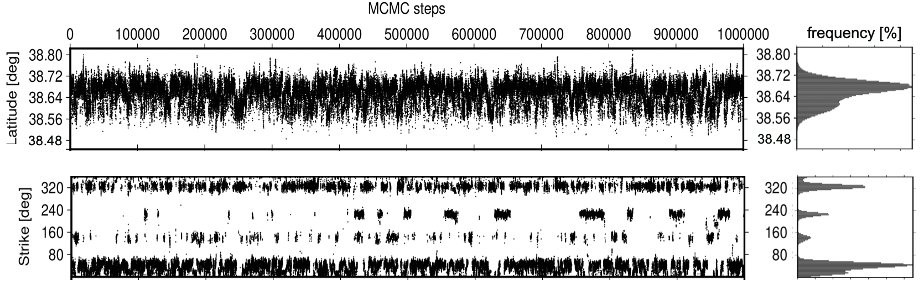
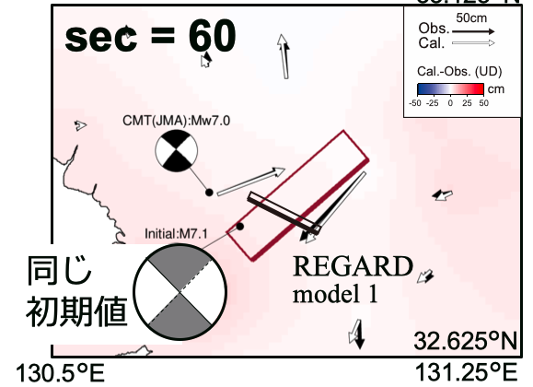
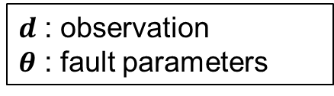

MCMC-based fault model inversion (with support of Tohoku univ.)
Bayes’ Theorem
$$p\left(θ | d\right) ∝p\left(d | θ\right) p\left(θ\right)$$
$d$ : observation
𝜽 : fault parameters
in operation from 2024JFY
less dependent upon an
initial model
provide uncertainty by means of probability density function (PDF)
fault parameters
…
2016 Kumamoto earthquake
Fault model in T=60s
Posterior PDFs in T=60s
MCMC
…
initial model
MLE
Ohno et al. (2021)
Notes:
In parallel to maximum likelihood estimation, MCMC-based fault inversion system is implemented for rectangle fault model estimation.
In this method, each parameter of rectangle fault is efficiently searched from wide range of parameter space.
So, the set of estimated parameter is robust against an earthquake even if its mechanism is quite different to initial model.
In case of 2016 Kumamoto earthquake, the model based on maximum likelihood estimation was strongly bound to the initial model and resulted in a conjugated fault model at the beginning of the estimation sequence.
By contrast, MCMC-based approach successfully provides the true model from the beginning of estimation as you can see the red rectangle.

Slide 10
The 2024 Noto Peninsula Earthquake
Notes:
Now, I’d like to move on to the application for Noto peninsula earthquake.

Slide 11
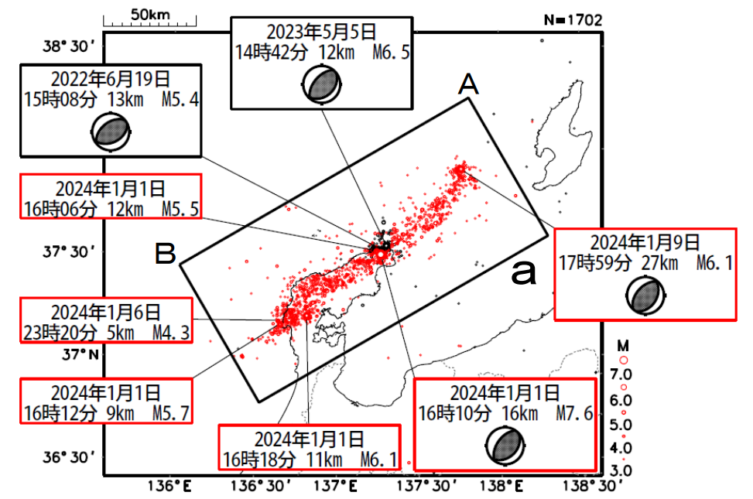
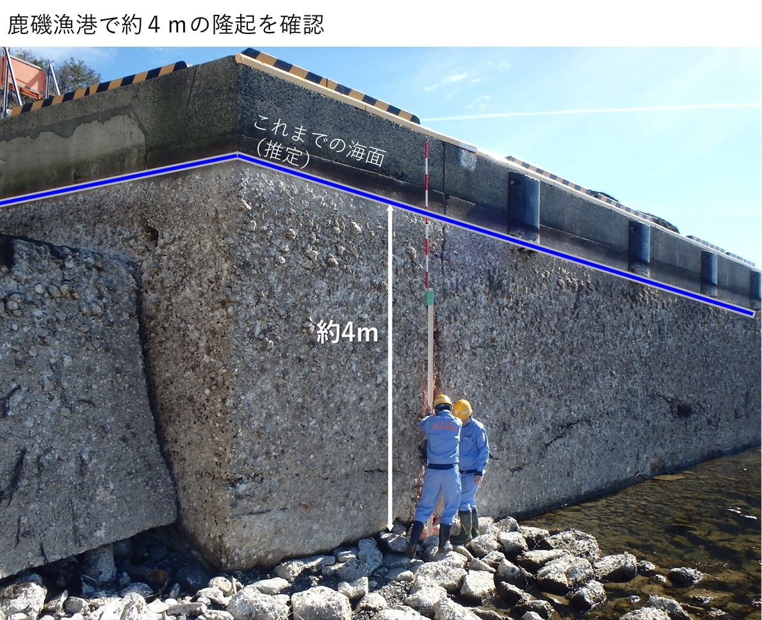
The 2024 Noto Peninsula Earthquake
2023-05-05
14:42LT 12km M6.5
2022-06-19
15:08LT 13km M5.4
2024-01-01
16:06LT 12km M6.5
0053
2024-01-09
17:59LT 27km M6.1
0253
2024-01-06
23:20LT 5km M4.3
former sea level
~4m uplift
2024-01-01
16:12LT 9km M5.7
2024-01-01
16:10LT 16km M7.6
2024-01-01
16:18LT 11km M6.1
Earthquake Research Committee:
https://www.static.jishin.go.jp/resource/monthly/2024/20240101_noto_3.pdf
GSI Web: https://www.gsi.go.jp/BOUSAI/20240101_noto_earthquake.html#8
Huge intraplate earthquake (M7.6)
Reverse fault with SE uplifting
Notes:
The Noto peninsula is located in the central part of Japan.
The earthquake is caused by reverse fault along the northern shoreline of the peninsula.
Its magnitude is 7.6, quite large as a intraplate earthquake, and southeast region experienced uplifting of 4m, at most.
Prior to this earthquake, smaller earthquakes had successively occurred, such as magnitude 6.5 of May 2023 and 5.4 of June 2022.
The blue two dots represent GEONET stations, which successfully recorded co-seismic displacement as I will show you in the next slide.

Slide 12
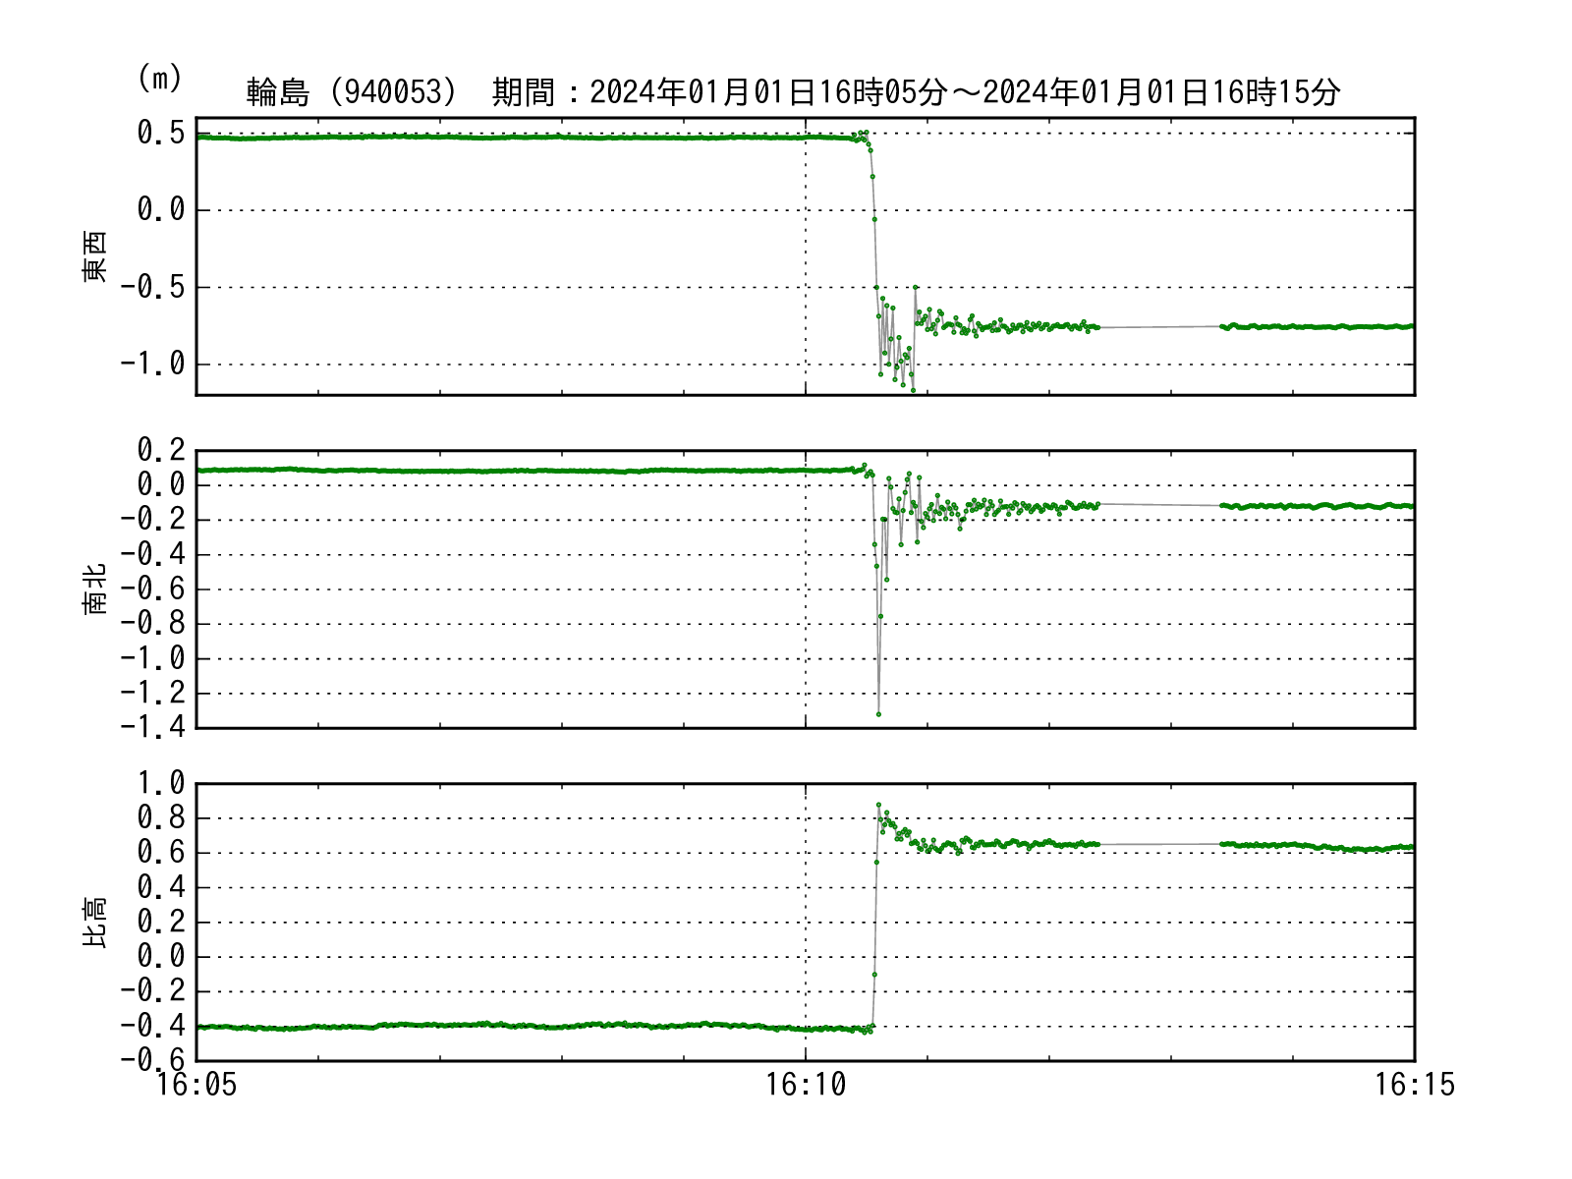
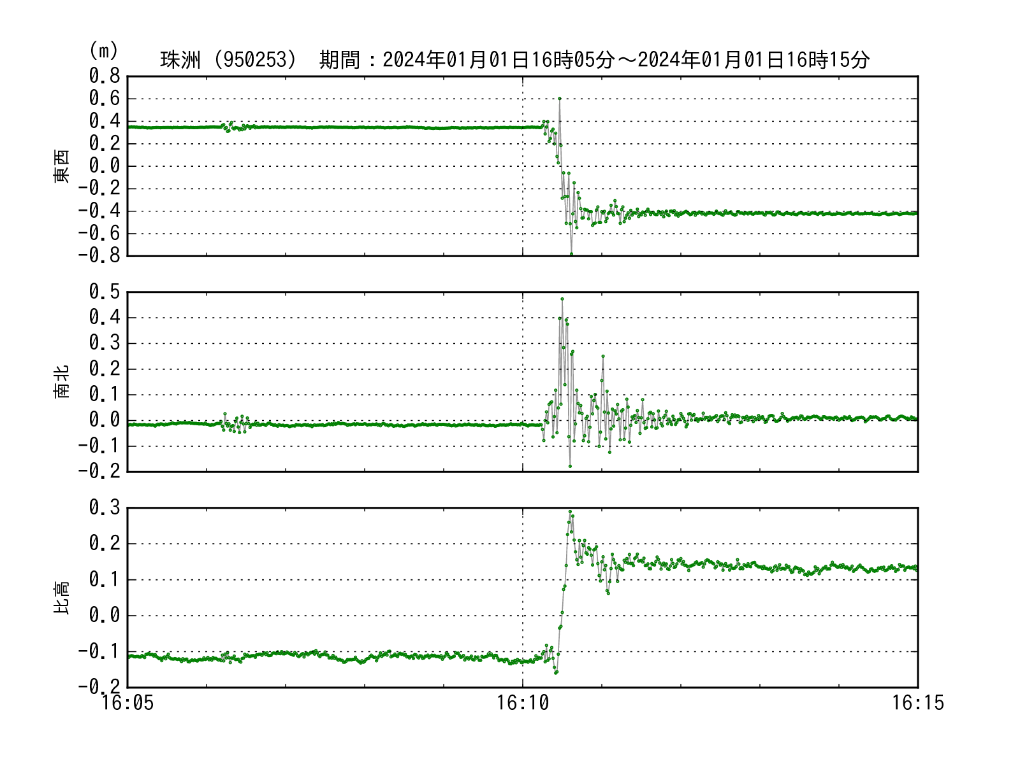
1Hz displacement time series
[m]
[m]
0253 (Suzu)
0053 (Wajima)
Co-seismic
displacement
EW
Co-seismic
displacement
Strong ground shaking
NS
Strong ground shaking
UD
data
lack
Local time
Local time
Co-seismic displacement : ~1.3m (horizontal), decimeter to 1m (vertical)
Strong ground shaking is well captured following to co-seismic displacement
Notes:
The horizontal displacement reaches to 1.3 m as recorded at Wajima station.
And the vertical displacement corresponds to tens of centimeters to 1 m.
As you can see, following to the co-seismic displacement, strong ground shaking is captured as fluctuation.

Slide 13
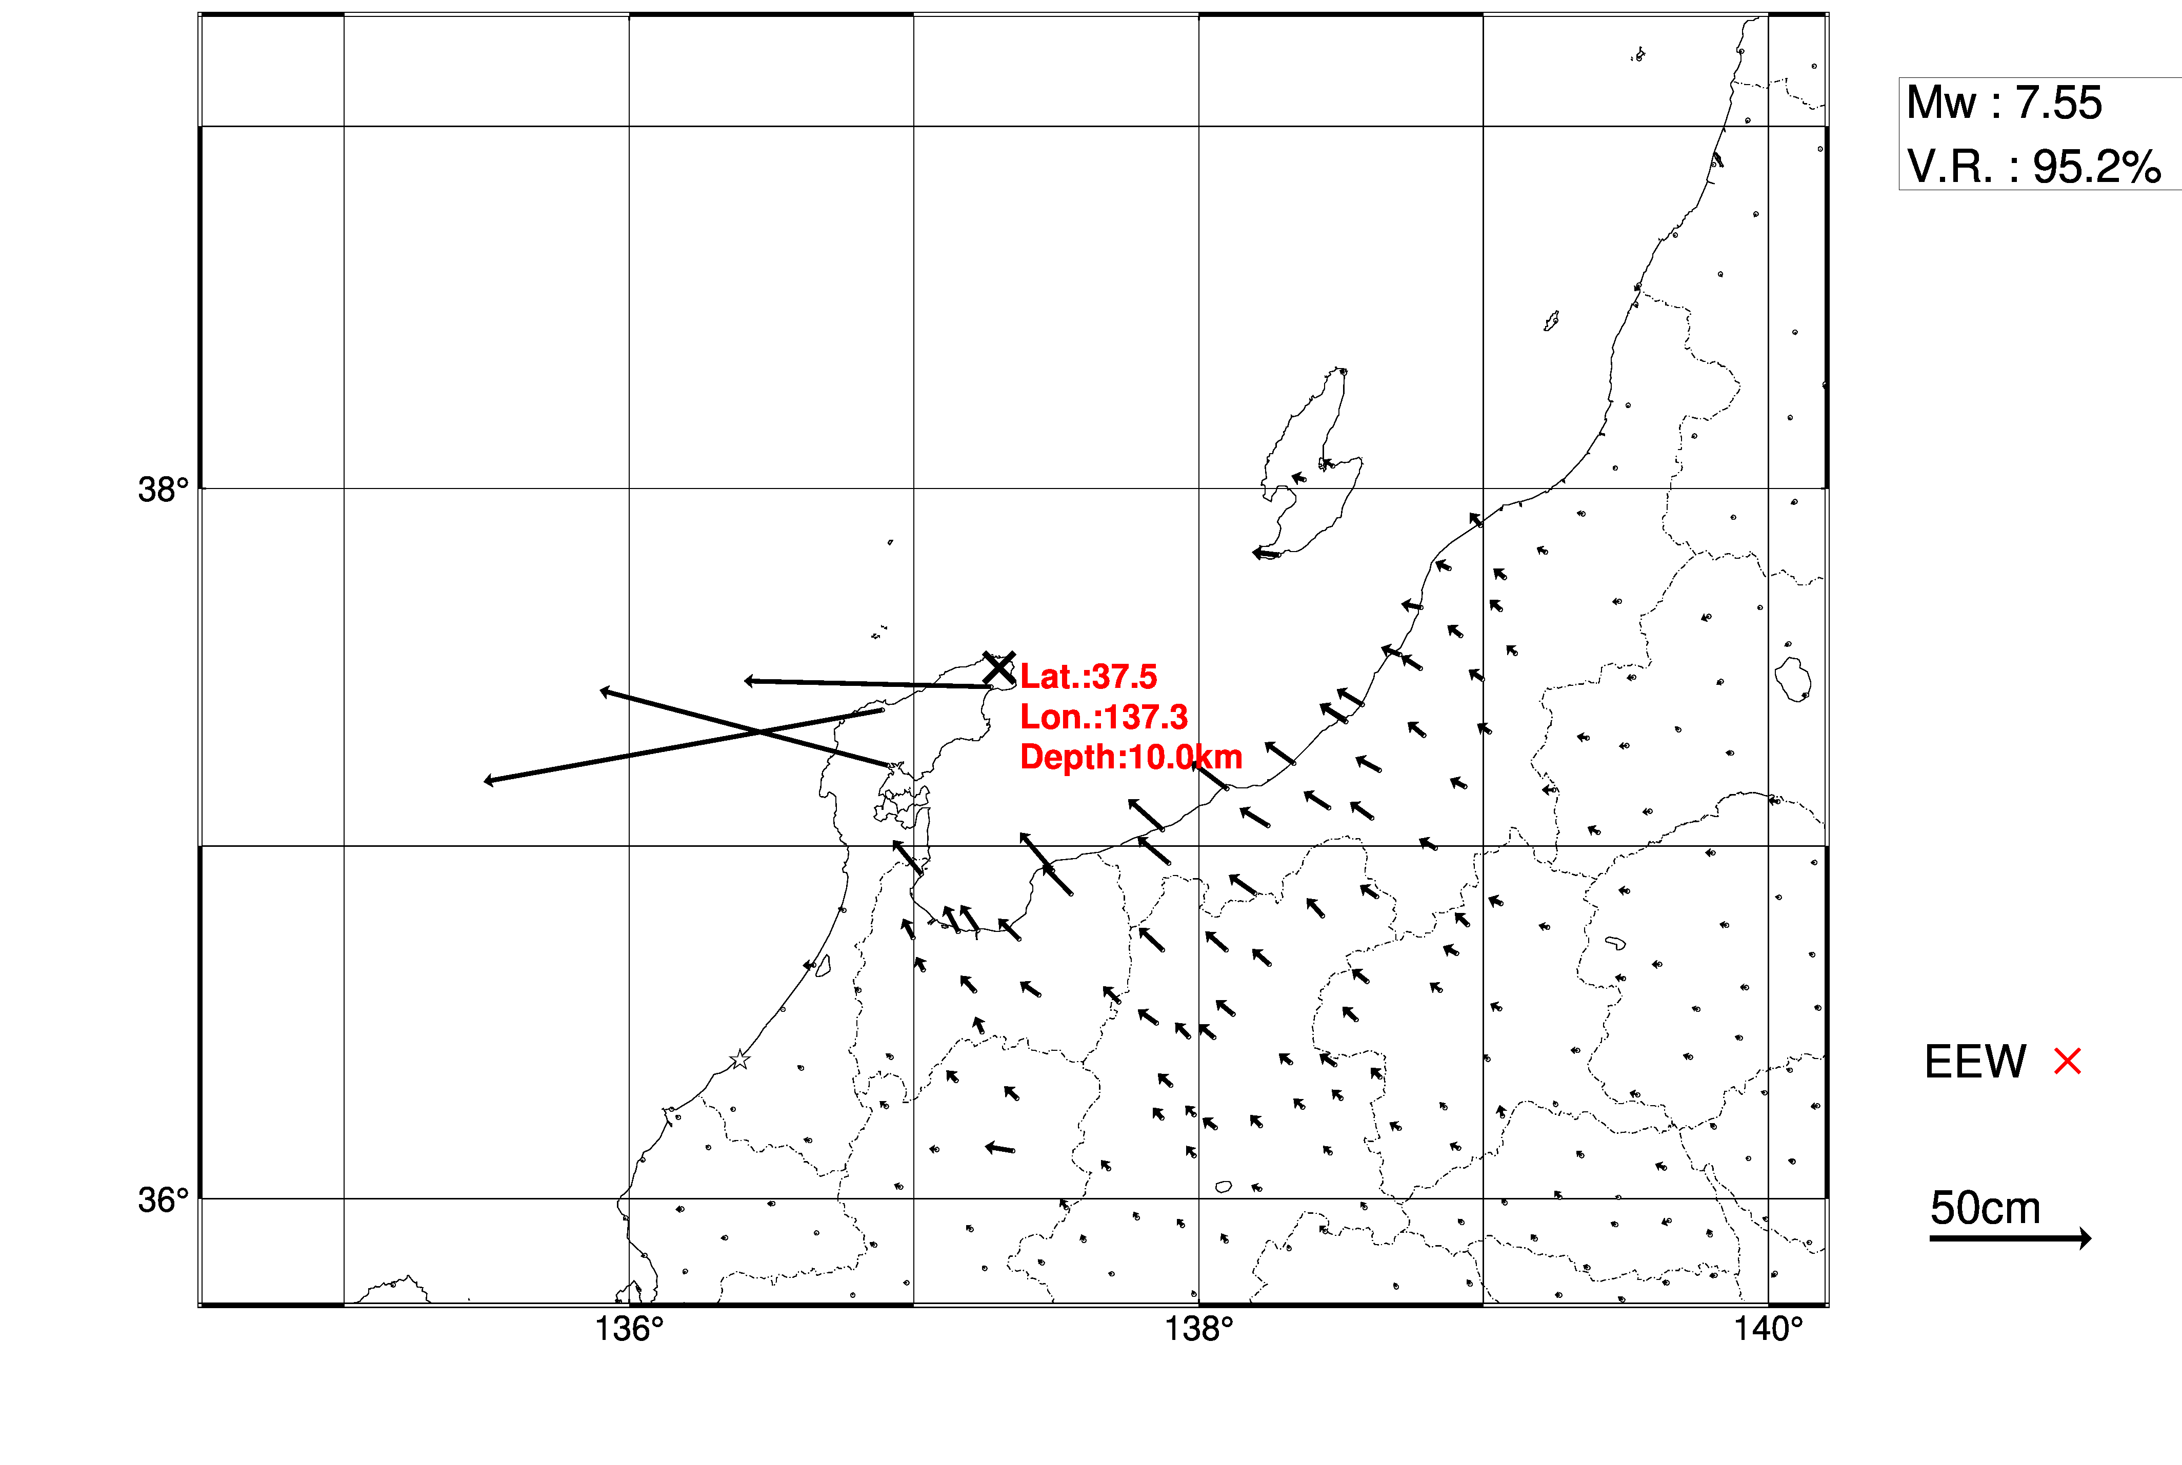
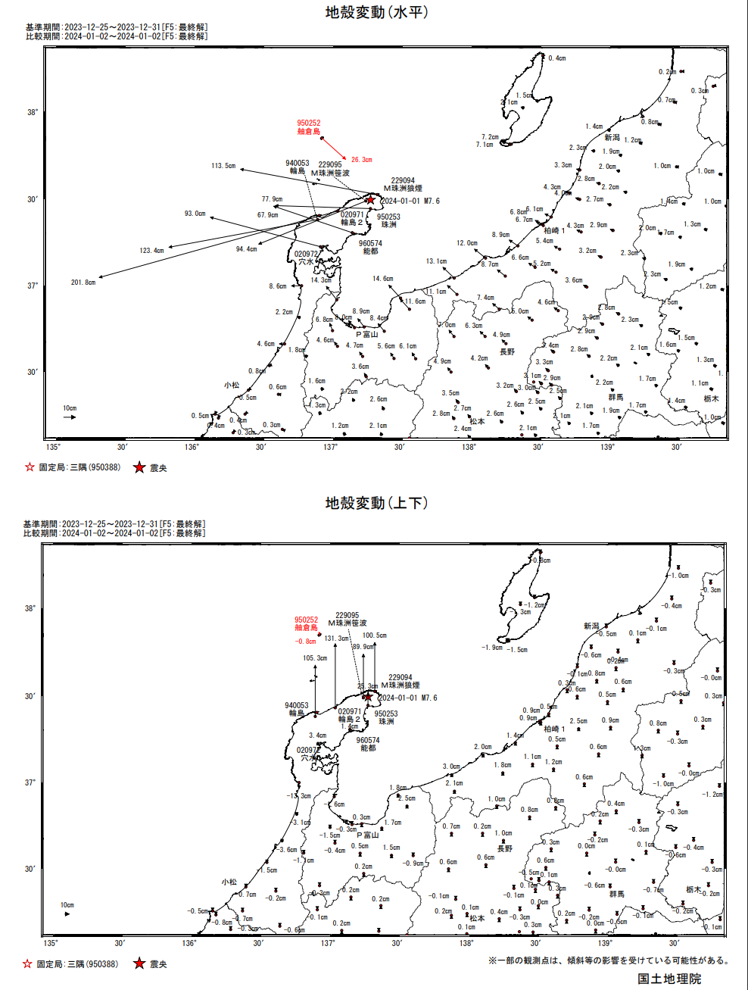
Crustal deformation field (Horizontal)
REGARD
Post-processed
50km
50km
50cm
50cm
★ Epicenter
×Epicenter
Crustal deformation of several meters to decimeters, even centimeters, was successfully captured.
Notes:
This is the horizontal crustal deformation field in comparison with the post-processed one, which was retrieved from daily coordinates by static positioning.
As you can see the right figure, the maximum amount of displacement reaches up to 2 meters.
This was not captured in real-time because the station is not capable of transmitting real-time data.
However, the overall deformation field is consistent with the post-processed one.
If we distance from the epicenter, the amount of deformation gradually decreases, but still consistent with the post-processed one even in a centimeter order.

Slide 14
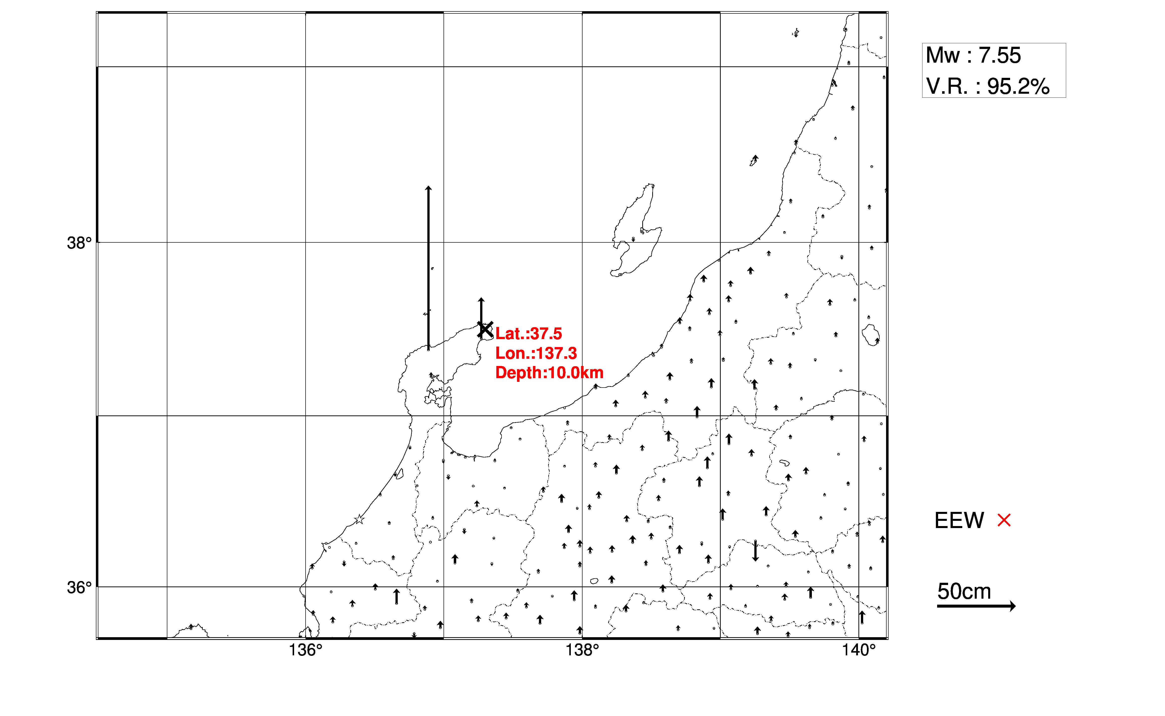
Crustal deformation field (Vertical)
REGARD
Post-processed
50km
50km
50cm
50cm
★ Epicenter
× Epicenter
Maximum displacement is consistent with post-processed result
Missing capability of real-time data transmission led sparse deformation field near the epicenter
Notes:
The vertical deformation field is also consistent with post-processed one.
However, as I said before, near field deformation field is sparse due to the missing capability in real-time data transmission.

Slide 15
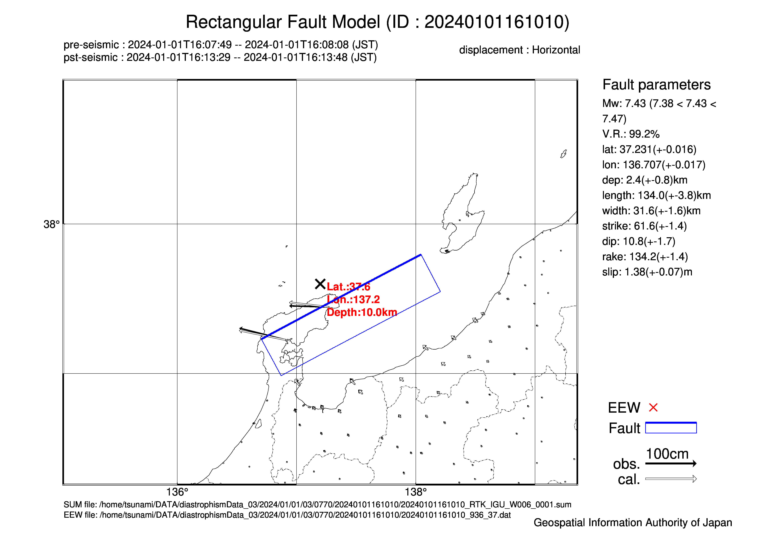
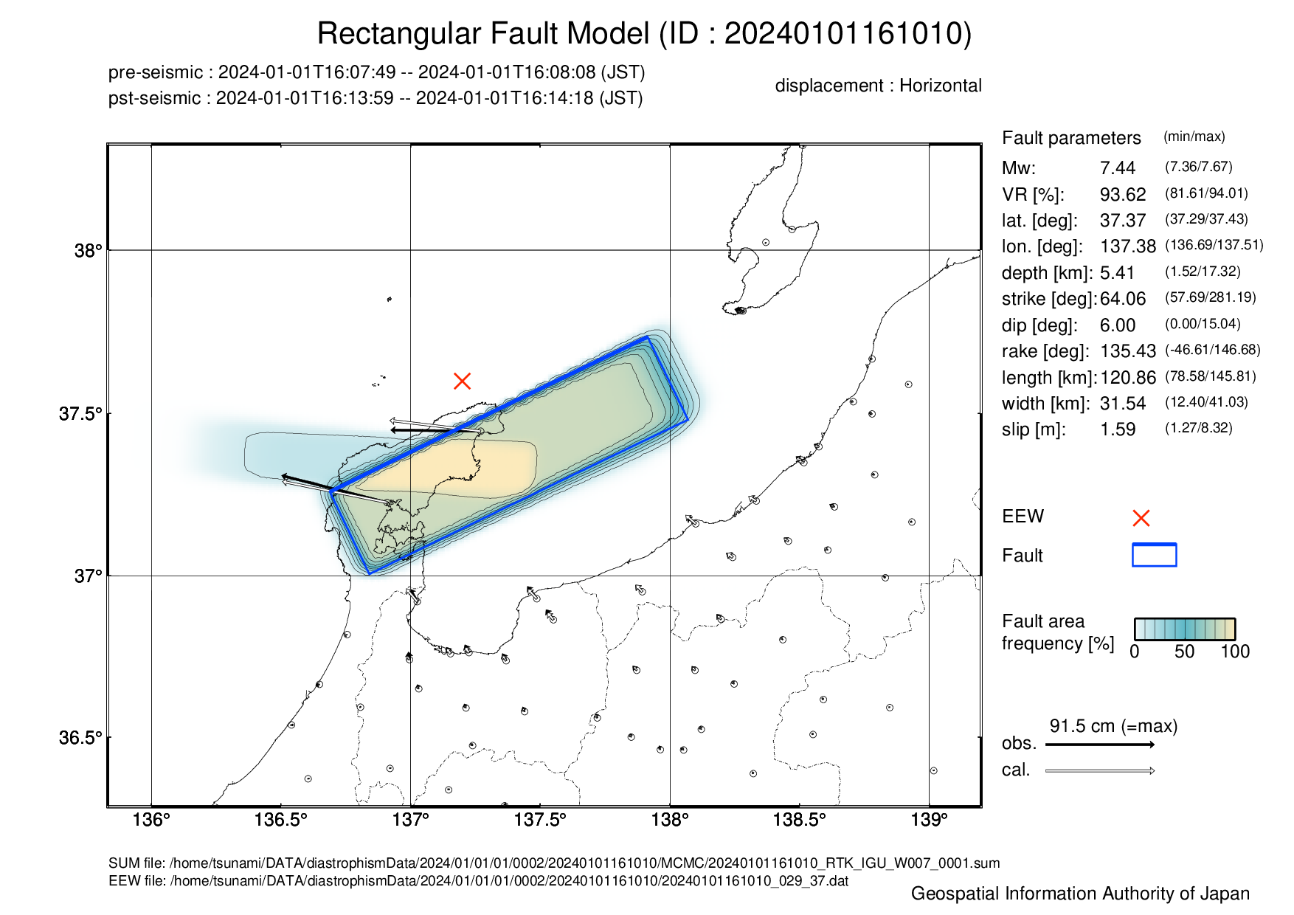
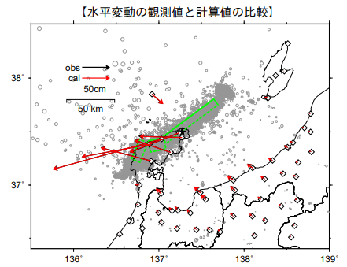
Fault model
REGARD (MLE)
REGARD (MCMC)
Post-processed
#3
#1
#2
Median model
aftershocks (~1/3 23:59LT)
Fault model
Fault are freq.[%]
The fault extent and location are well coincide with the post-processed model
Notes:
We compare the estimated fault model with post-processed one as well, which is comprised of 3 sub-faults denoted by #1 through 3.
Here, we show both maximum likelihood estimation and MCMC model.
In MCMC model, the blue rectangle represents the median model and the color shade indicates the probability of fault location.
While the fault model is supposed to be a single rectangle in REGARD, the overall extent and location are well coincide with the post-processed one.

Slide 16
Fault parameters
 | Lat. [deg] | Lon. [deg] | Dep. [km] | Len. [km] | Wid. [km] | Strike [deg] | Dip [deg] | Rake [deg] | Slip [m] | Mw
MLE | 37.23 | 136.71 | 2.4 | 134.0 | 31.6 | 61.6 | 10.8 | 134.2 | 1.38 | 7.43
MCMC (median) | 37.37 | 137.38 | 5.4 | 120.9 | 31.5 | 64.1 | 6.0 | 135.4 | 1.59 | 7.44
PP* (#1) | 37.246 | 136.680 | 0.1 | 22.0 | 12.2 | 22.7 | 40.6 | 84.4 | 6.79 | 7.09
(#2) | 37.414 | 136.876 | 0.0 | 16.2 | 20.4 | 78.3 | 54.9 | 140.2 | 2.83 | 6.90
(#3) | 37.445 | 137.037 | 0.1 | 66.8 | 11.5 | 53.3 | 49.7 | 114.6 | 4.42 | 7.27
* Mw=7.44 in total of 3 sub-faults
Mw well agrees with the post-processed model
The dip angle is underestimated because of the lack of near-field vertical displacement data
Notes:
This is a list of fault parameters by individual models.
The moment magnitude is very close to the sum of post-processed sub-faults; its magnitude is 7.44.
But the dip angles are clearly underestimated.
This is caused by lack of near-field data, especially for vertical displacement data.

Slide 17
Future development
Notes:
The final topic is our future development.

Slide 18
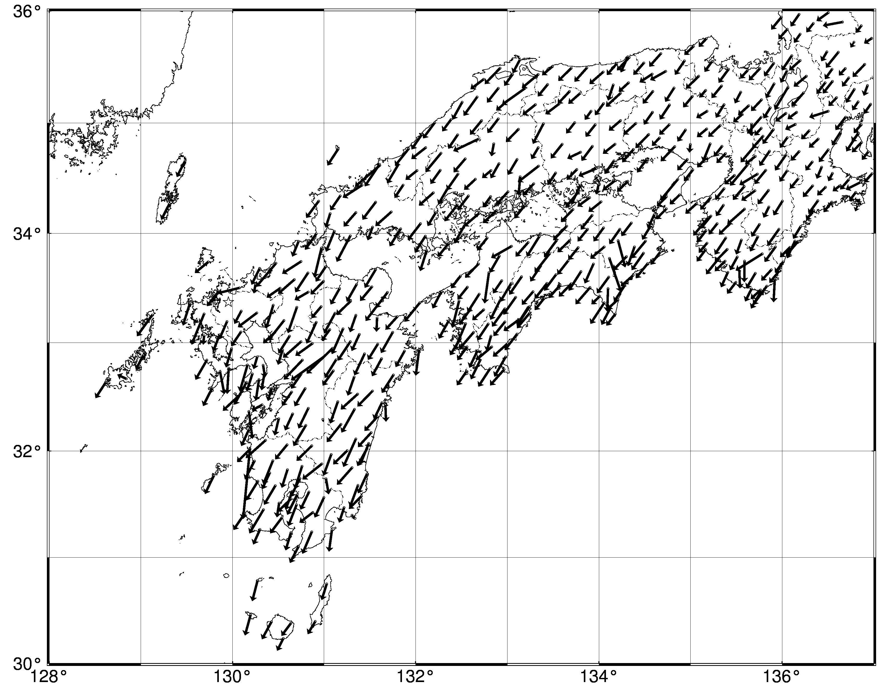
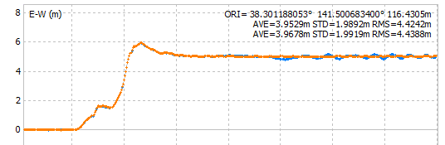
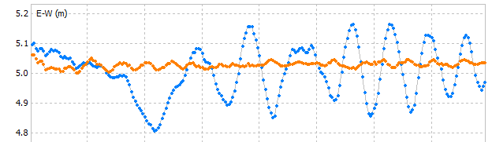
Precise point positioning (PPP)
RTK
RTK : network shift due to the fixing of
the single reference station.
PPP : directly calculate absolute coordinates
to avoid the network shift
70 cm
0050 (Ojika, 130km away from the Tohoku-Oki’s epicenter)
EW[m]
Earthquake occurance
40cm
－ PPP
－ RTK
14:46
14:50
14:54
LT
4 minutes
disturbed by surface wave at the reference station
Static offsets can be more readily retrieved.
Notes:
We are considering to implement PPP technique for more robust station coordinates retrieval.
In our current positioning technique, the entire network can shift due to the fixing of the single reference station.
This can lead the significant overestimation in the subsequent fault model inversion.
In contrast, PPP directly calculate absolute coordinates, so this problem can be avoided.
In Tohoku-Oki case, while the time series derived from RTK disturbed by the surface wave at the reference station, PPP successfully provides the undisturbed time series.
So, we think PPP could help us retrieve static offsets more easily than current method.

Slide 19
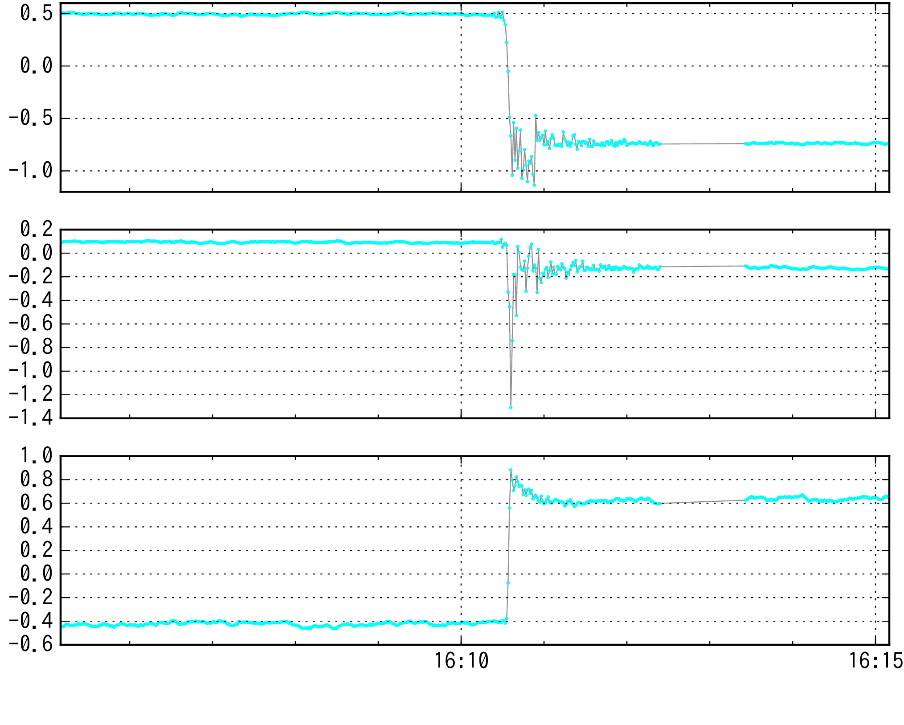
The 2024 Noto earthquake (0053: Wajima)
RTK
PPP
[m]
[m]
EW
NS
UD
data
lack
data
lack
Local time
Local time
Notes:
This is an example of station coordinates time series in Noto earthquake.
The amount of co-seismic displacement and successive strong shaking is very similar to each other.

Slide 20
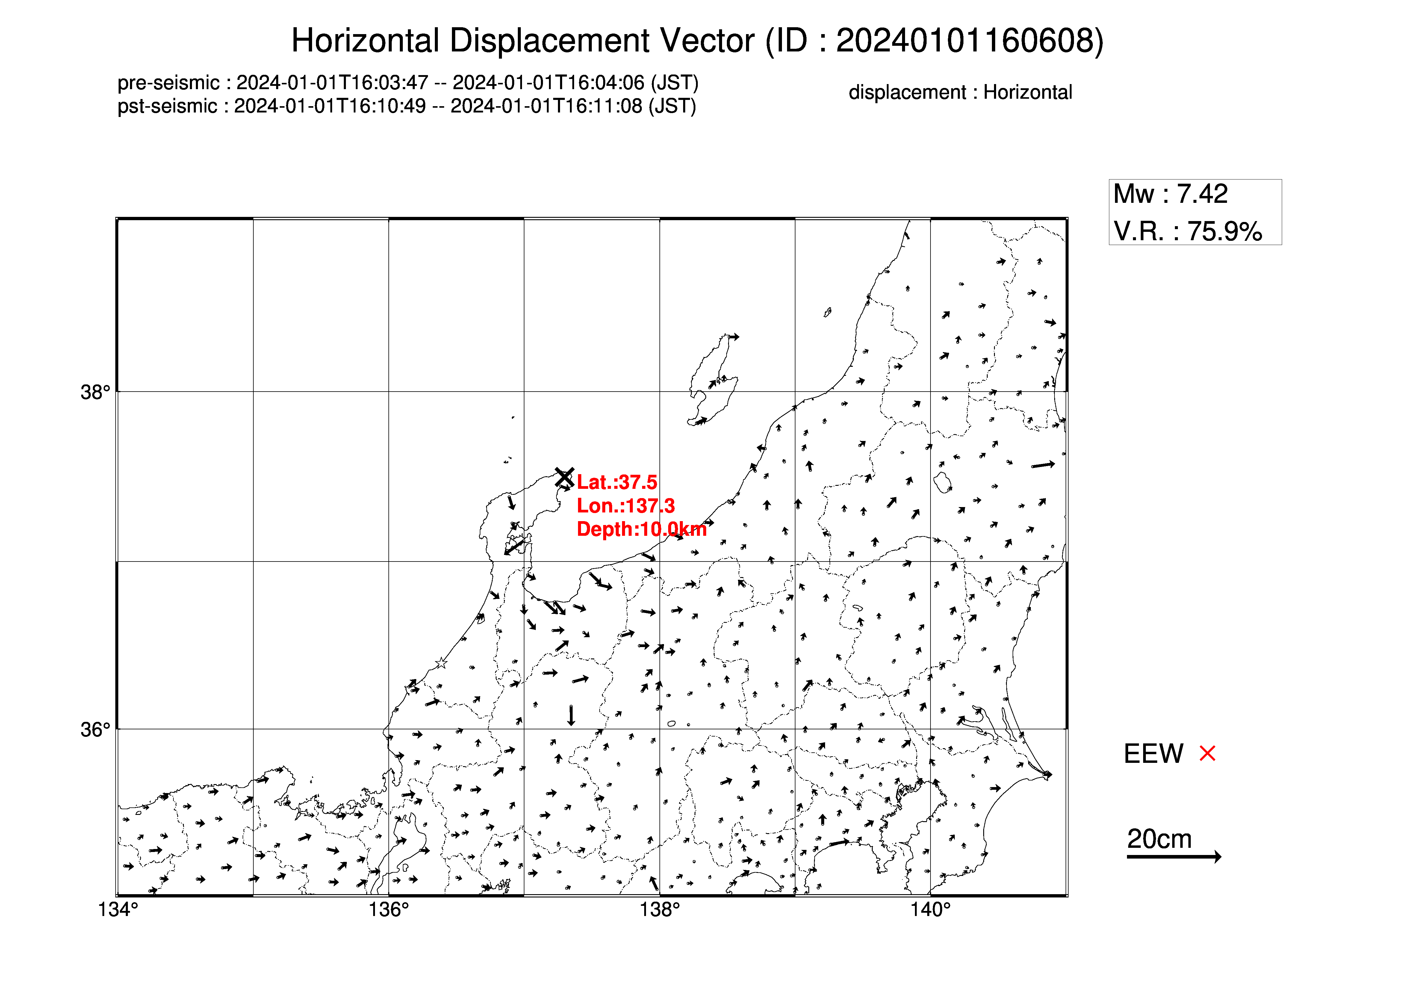
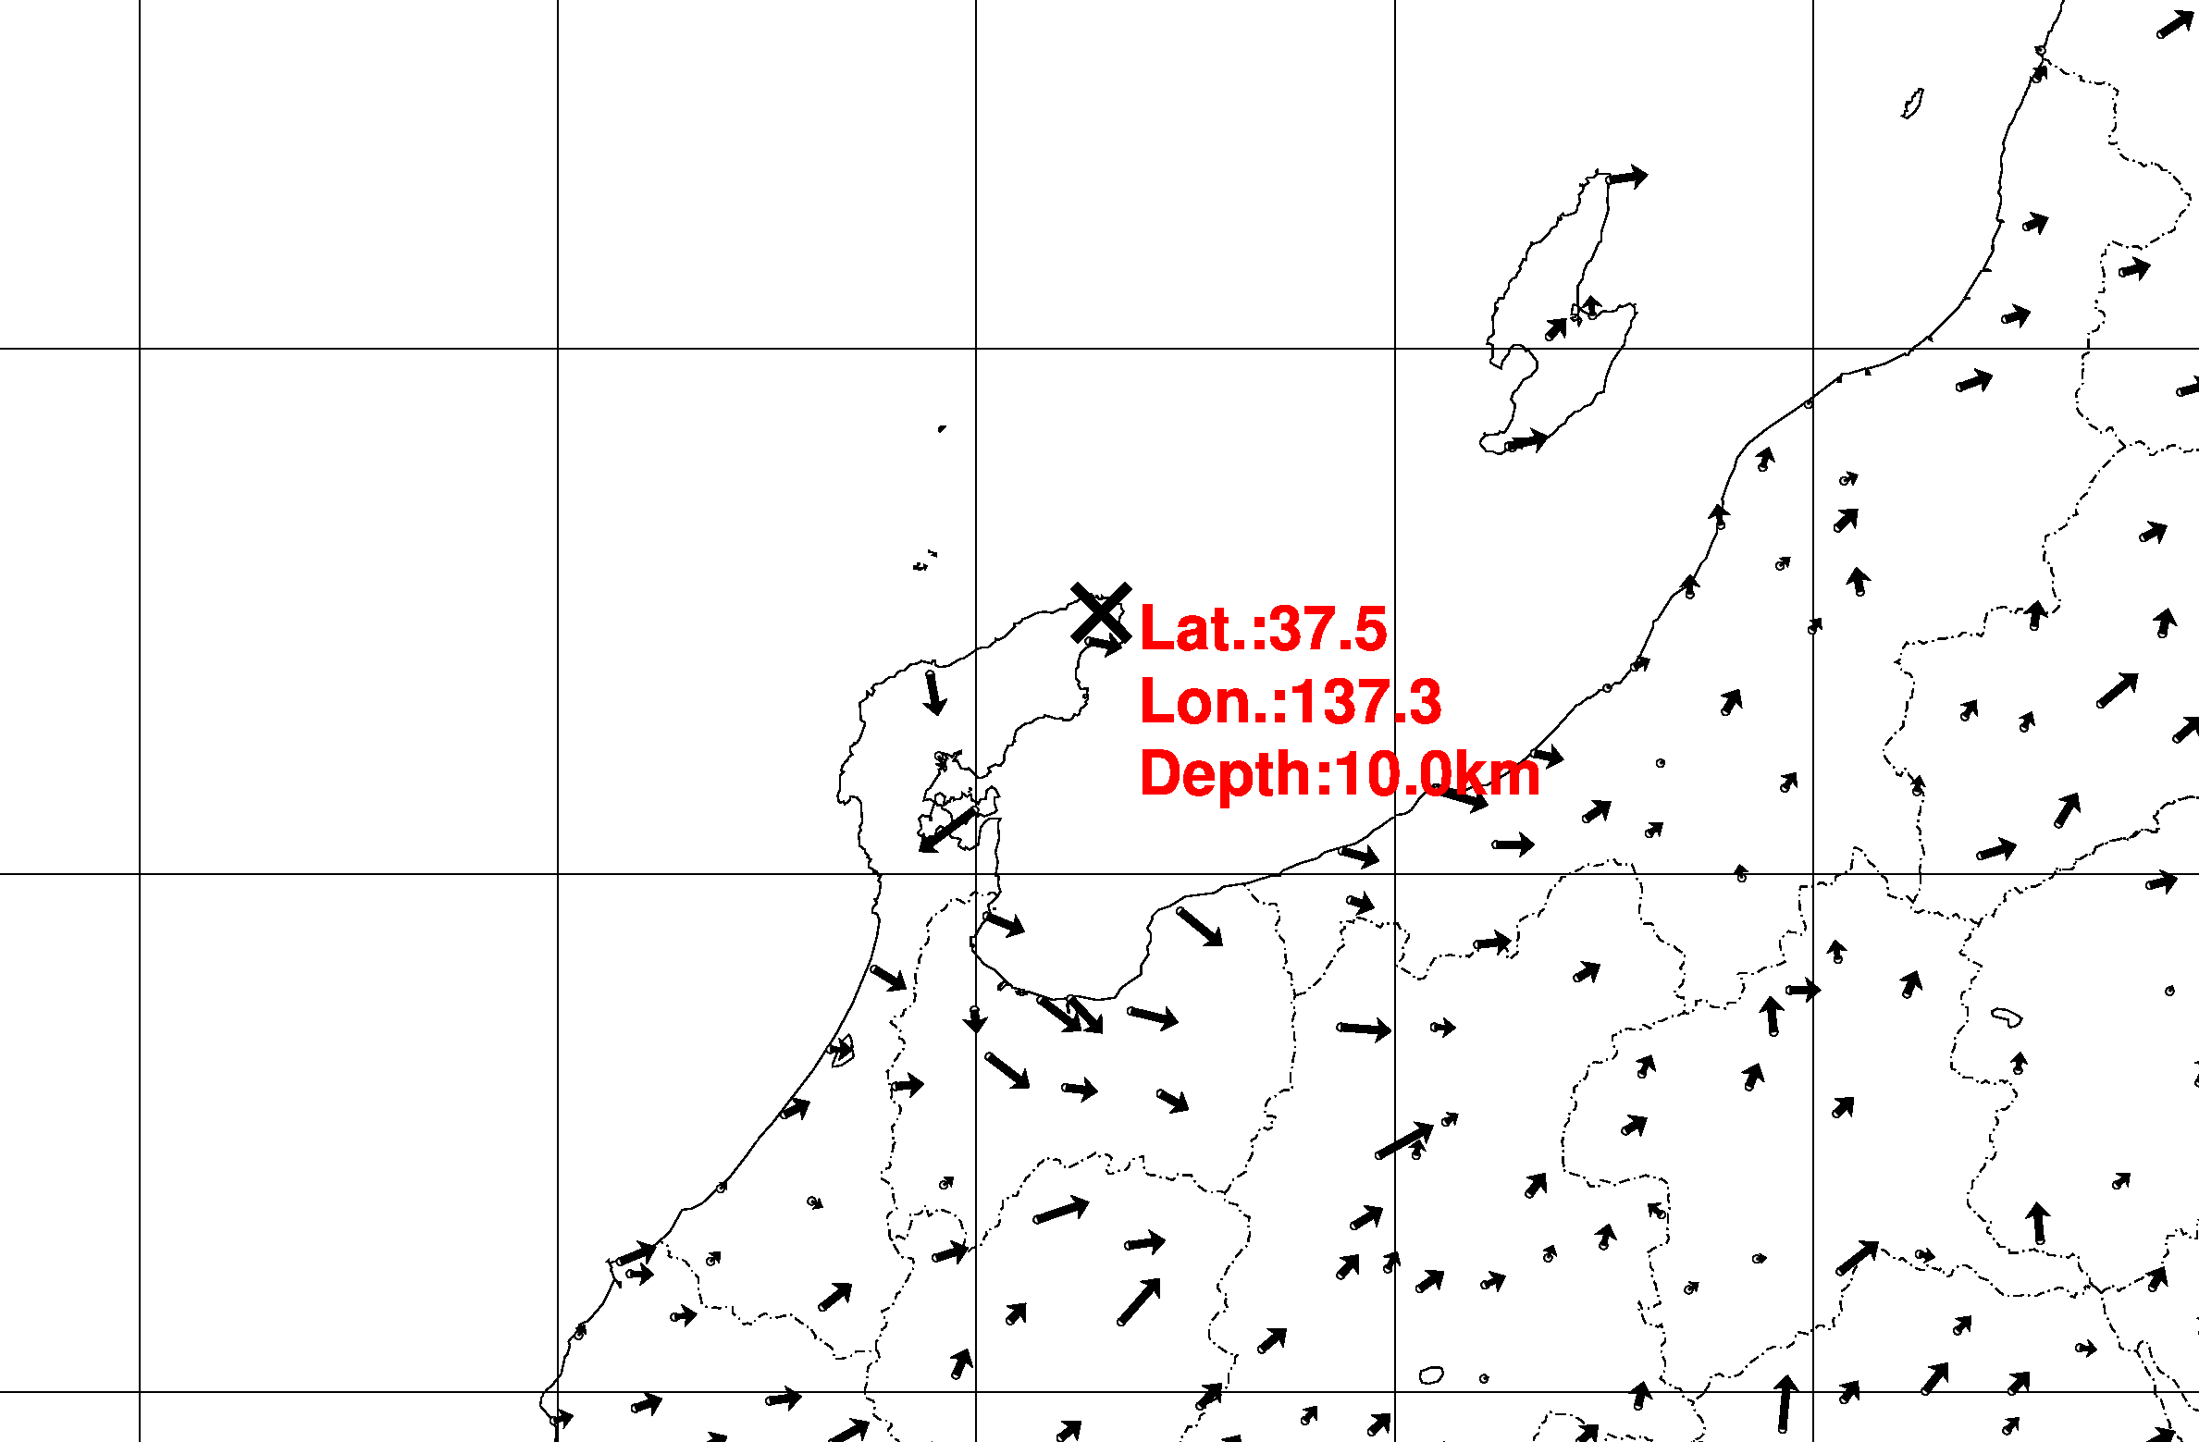
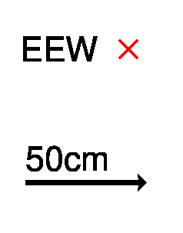
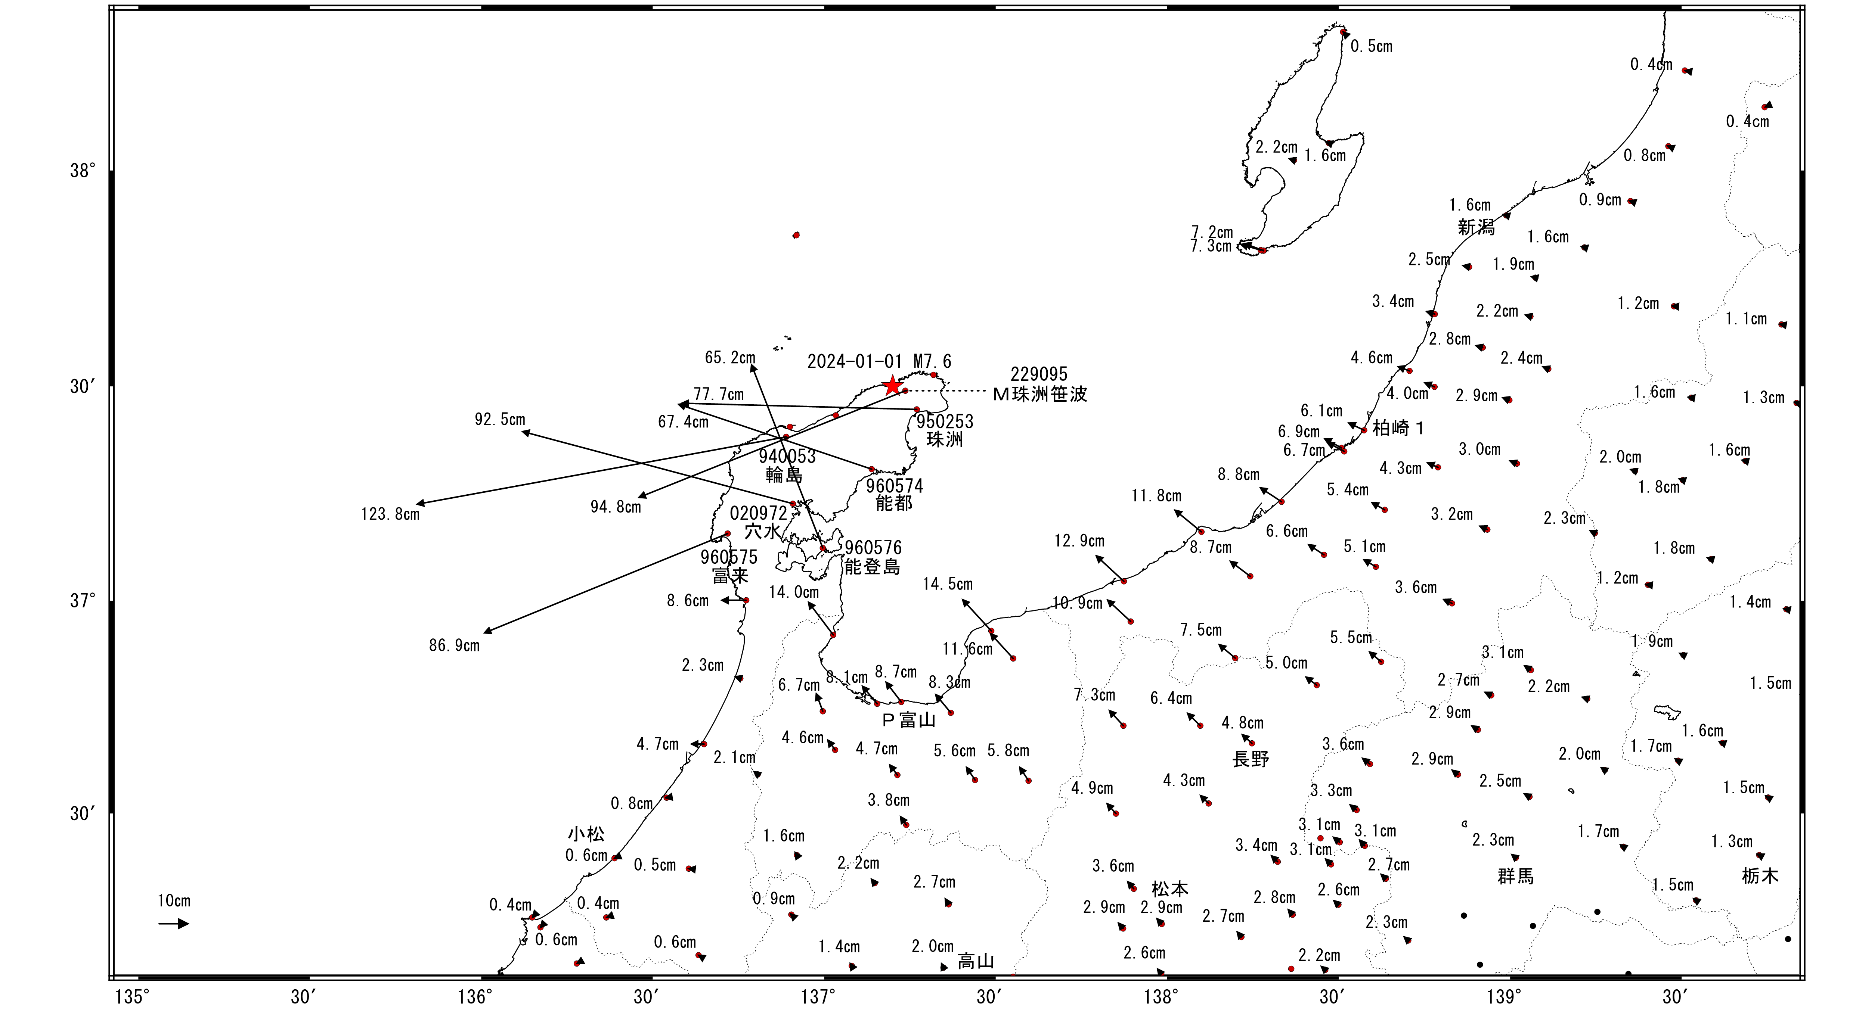
The 2024 Noto earthquake (deformation field)
RTK – Post-processed
PPP – Post-processed
Epicenter
Epicenter
×
×
Post-processed
PPP has comparable capability in detecting crustal deformation
50cm
★ Epicenter
Notes:
This slide is the comparison in deformation field with post-processed one.
The top 2 panels shows the residuals with respect to post-processed deformation field.
The both resemble each other, so we can say, PPP has comparable capability in detecting co-seismic deformation.
However, near epicenter, there are large residuals, which could be attributed to post-seismic deformation.
Post-processed data is based on the observation at half a day after the earthquake, so this can happen, but further efforts are needed to confirm this.

Slide 21
Summary
Notes:
This is summary of my presentation.

Slide 22
Summary
A GNSS-based real-time fault estimation system, REGARD, has been in operation since 2016 and has contributed to earthquake and tsunami risk reduction in Japan.
In 2024 Noto peninsula earthquake, REGARD successfully captured crustal deformation of several meters to decimeters, even centimeters and well constructed the fault model except for dip angle, which was underestimated due to the lack of near-field vertical displacement data.
For more robustness, an effort to implement PPP is ongoing. The result of Noto earthquake shows PPP has comparable capability in detecting co-seismic crustal deformation.
Notes:
REGARD has contributed to earthquake and tsunami risk reduction in Japan, including Noto earthquake in this year.
In Noto earthquake, REGARD successfully captured crustal deformation of even centimeters and well constructed the fault model.
But the dip angle was underestimated due to the lack of near-field vertical displacement data.
These results are based on RTK, but PPP prove to has comparable capability in detecting co-seismic deformation.
We’d like to make further validation and coordination to implement PPP and achieve greater robustness of REGARD.
That’s all my presentation.
Thank you for your attention.

