Slide 1
Regional Triple-frequency Integer Recovery Clock Estimation
for Augmented Real-time Positioning Services
Jun Tao*, Guo Chen, Gaojian Zhang🔈, Yihao Jiang
GNSS Research Center, Wuhan University, China
(*jtaowhu@whu.edu.cn)
IGS Workshop 2024, 4. July 2024
Notes:
Hello everyone. I’m Gaojian Zhang, a phd from Wuhan University, China, Dr. Tao was absent due to visa issues, so I’m pleasure to give you this presentation on his behalf.
Our topic is about regional augmentation for realtime positioning service

Slide 2
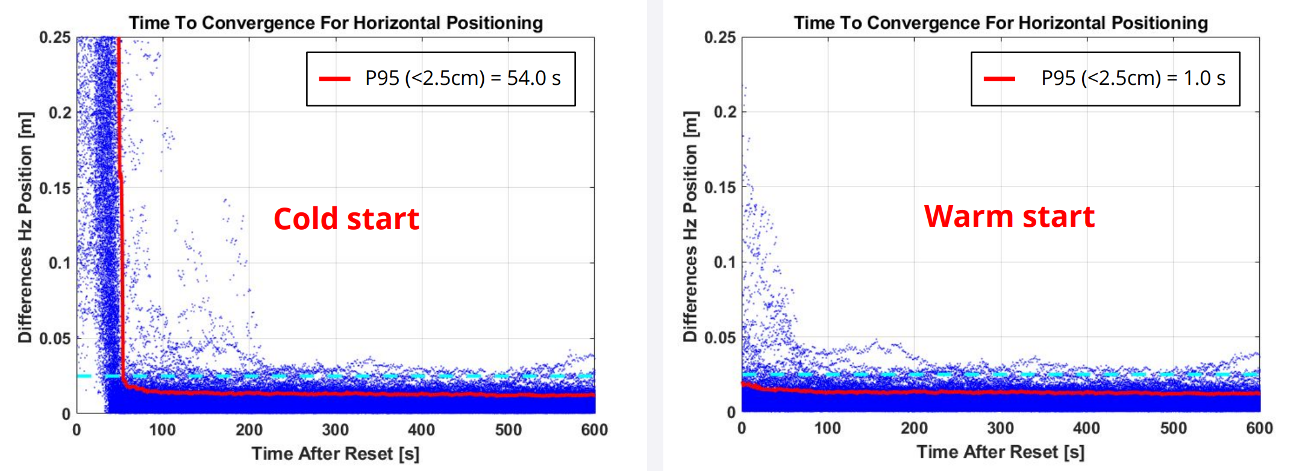
Background
Objective: High-accuracy PPP instantaneous service becomes increasingly mature
“RTK From the Sky delivers an industry-first PPP solution with the accuracy of RTK without the PPP convergence wait time.”
“CenterPoint RTX Fast is a regionally available service that significantly reduces the convergence time for Trimble RTX services, down to as little as 1 minute for 2 cm horizontal accuracy.”
“Starfix®.G4+ service is an ultra-precise Global Positioning Service, using Clock and Orbit Corrections enhanced with carrier-phase correction.”
……
Most instantaneous operations rely on commercial augmentation services
Notes:
We all know，high-accuracy, especially PPP services, have made significant progress nowadays.
Many operations， have already claimed to offer PPP services without convergence .
But obviously, most instantaneous services rely on commercial augmentation

Slide 3
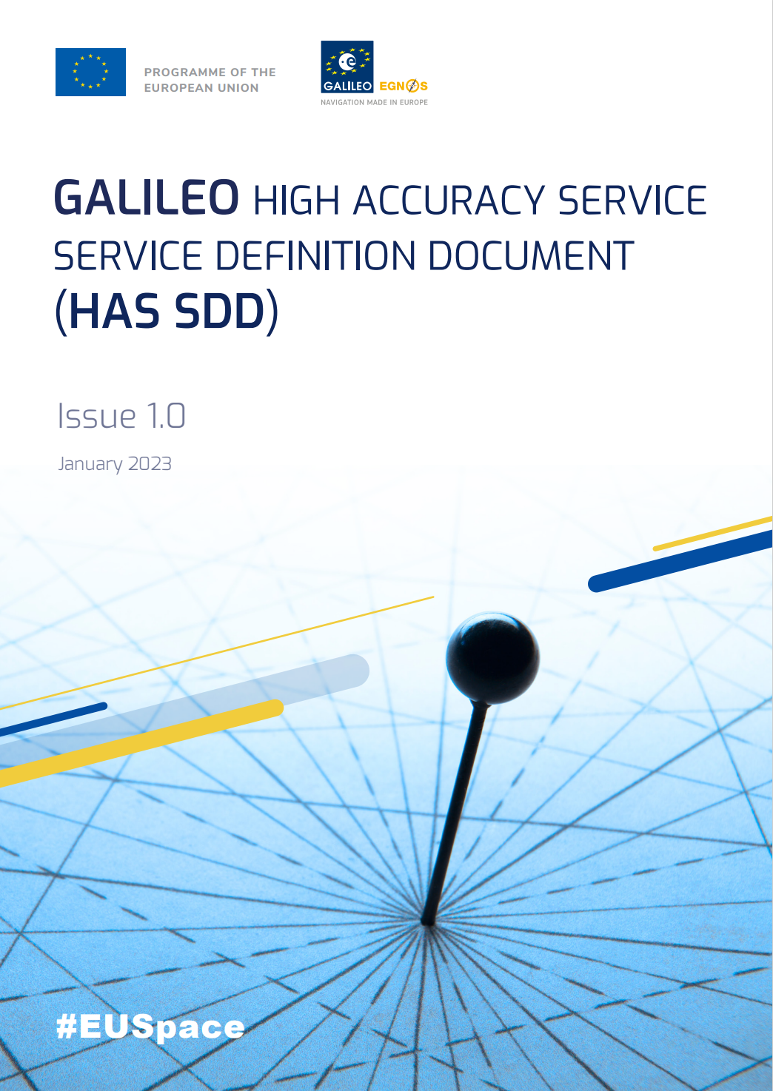
Background
Objective: National or regional public efforts to provide positioning services are also fully underway in parallel.
BDS-3 PPP-B2b (First Phase)
Special designed navigation message with orbit, clock, and code bias
Real-time corrections for BDS and GPS system in BDCS and BDT
Decimeter-level positioning around China and surrounding areas
Galileo HAS (Service Level 1)
Corrections composed by orbit, clock, code & phase biases (not provide phase yet)
Horizontal 20 cm / vertical 40 cm (95%) with a global coverage availability
QZSS MADOCA/CLAS
……
All of public services are free of charge for decimeter-level PPP at present
Notes:
In parallel, public efforts to provide positioning services are also fully underway
As ordinary users, we have PPP-B2b from BDS-3, HAS from Galileo，and QZSS etc.
All of them are Free of charge for decimeter level PPP at present

Slide 4
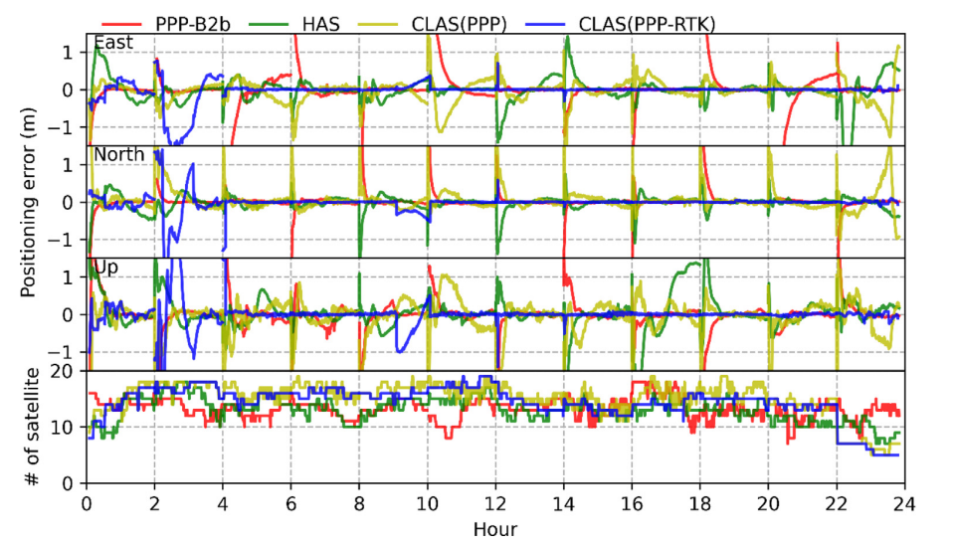
Background
Assessment of public positioning services (PPP-B2b & HAS & CLAS)
Horizontal < 20 cm & vertical < 30 cm anywhere
Initialization 20~30 minutes without phase bias correction
Requires full re-initialization after loss
Ionosphere constraints to CLAS can improve the PPP performance
Standalone PPP convergence is far from RTK-like performance, with long time lost to waiting for initialization
Notes:
Some assessment of public services are displayed here
When we leave ambiguity float, PPP convergence is far from RTK-like performance, with long time lost for initialization
Assuredly, adding precise ionosphere constraints to CLAS can improve the PPP performance, but it highly rely on dense network, also ionosphere sometime exhibits irregular variations (ˌverɪˈeʃən)

Slide 5
Motivation
Can we implement instantaneous centimeter-level PPP augmentation without dense network to provide the precise ionospheric corrections?
Basic demand
Low-cost infrastructure, as sparse network as possible
Wide-area coverage, as many available end-users as possible
Fast convergence, as seamless as possible
OSB-format correction, as convenient for transmitting as possible
Additional problem
Time-variable bias, e.g. GPS L5
Notes:
Given the current situation, we certainly wonder, can we implement instantaneous centimeter-level PPP with sparse network?
Basically, let’s check our demand,
We need lost-cost infrastructure（ɪnfrəstrʌktʃə(r), and serve as many end-users as possible,
Most importantly, wait time should be as seamless as possible
Besides, the convenience of correction transmission and additional bias should be treated specially

Slide 6
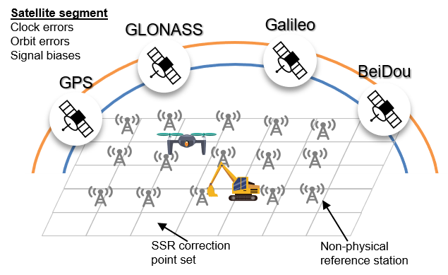
Motivation
Can we implement instantaneous centimeter-level PPP augmentation without dense network to provide the precise ionospheric corrections?
Practical solution
Demonstrate a regional real-time positioning service (China area for instance)
Ambiguity-fixed without atmospheric augmentation
Realize a unified multi-frequency OSB generator (including phase bias & L5 bias)
Public PPP augmentation service can be expected
Notes:
Regarding the issue above, We provide our proposed solution
We demonstrate(ˈdemənstreɪt) a real-time positioning service in China,
And only utilizing ambiguity fix without atmosphere, to realize a unified multi-frequency OSB generator
Next，we will describe in detail how to implement this service

Slide 7
Methodology
A novel manner to enhance wide-lane ambiguity resolution
Phase triple-frequency combination measurement
Satisfy 1) Maintain geometry; 2) Eliminate ionosphere; 3) Remove original ambiguity
Phase wide-lane (PWL) ambiguity only formed by float (Extra-)WL ambiguity, and hold relatively longer wavelength (e.g. 3.4 m for GPS)
$$L_{comb,r}^{s}=αL_{1,r}^{s}+βL_{2,r}^{s}+γL_{3,r}^{s}$$
$$L_{PWL,r}^{s}=ρ_{r}^{s}+{\tilde{δt}}_{IF,r}−{\tilde{δt}}_{IF}^{s}+m_{r}^{s}T_{r}+αλ_{1}{\check{N}}_{wl,r}^{s}−γλ_{3}{\check{N}}_{ewl,r}^{s}+γ{δb}_{3}^{s}$$
EWL UPD extracted from MW
$${L_{PWL,r}^{s}: λ}_{PWL}{\tilde{N}}_{PWL,r}^{sq}=αλ_{1}\left(N_{wl,r}^{sq}+\left(b_{1}^{sq}−b_{2}^{sq}\right)−\frac{D^{s}}{λ_{wl}}\right)−γλ_{3}\left(N_{ewl,r}^{sq}+\left(b_{2}^{sq}−b_{3}^{sq}\right)−\frac{D^{s}}{λ_{ewl}}\right)$$
Much lower noise than MW wide-lane
Easily resolution in advance
Notes:
It’s widely known that Multi-frequency can form precise geometry to optimize model strength
But if we use un-combined model like usually in PPP for clock estimation, it would take up large compute burden.
Here, we introduce the Phase triple-frequency combination (ˌkɒmbɪˈneɪʃn)
let coefficients(ˌkəʊɪˈfɪʃənts) satisfy these three conditions, then we can obtain Phase wide-lane measurement.
As we can see, phase widelane only consists of phase observations, it is not affected by range
So the phase widelane holds much lower noise than MW
If the extra widelane can be determined in advance, the widelane ambiguity extracted from the equation can be fixed easier

Slide 8
Methodology
Derive multi-frequency clock estimation model
Dual-frequency baseline IRC
Expand to multi-frequency
$$\begin{aligned}&{δP}_{IF,r}^{s}=\frac{γ_{2}}{γ_{2}−γ_{1}}P_{1,r}^{s}−\frac{γ_{2}}{γ_{2}−γ_{1}}P_{2,r}^{s}−ρ_{r}^{s}={\tilde{δt}}_{IF,r}−{\tilde{δt}}_{IF}^{s}+m_{r}^{s}T_{r}+ε_{IF,r}^{s} \\ &{δL}_{IF,r}^{s}=\frac{γ_{2}}{γ_{2}−γ_{1}}L_{1,r}^{s}−\frac{γ_{2}}{γ_{2}−γ_{1}}L_{2,r}^{s}−ρ_{r}^{s}={\tilde{δt}}_{IF,r}−{\tilde{δt}}_{IF}^{s}+m_{r}^{s}T_{r}+λ_{IF}{\tilde{N}}_{IF,r}^{s}+e_{IF,r}^{s}\end{aligned}$$
$$Z_{con,r}^{s}=λ_{wl}\frac{f_{2}}{f_{1}+f_{2}}N_{wl,r}^{s}+λ_{nl}N_{1,r}^{s}, σ_{Z_{con,r}^{s}}=0.001 mm$$
Constrain:
Add measurements:
Output:
$${\tilde{δt}}^{s,IRC}={\tilde{δt}}_{IF}^{s}+λ_{nl}b_{nl}^{s}$$
$$\begin{aligned}&{δP}_{IF\left(1,5\right),r}^{s}={\tilde{δt}}_{IF,r}−{\tilde{δt}}_{IF}^{s}+m_{r}^{s}T_{r}+D_{IF\left(1,5\right),r}^{s}+ε_{IF\left(1,5\right),r}^{s} \\ &{δL}_{PWL,r}^{s}={\tilde{δt}}_{IF,r}−{\tilde{δt}}_{IF}^{s}+m_{r}^{s}T_{r}+αλ_{1}{\check{N}}_{wl,r}^{s}−γλ_{3}{\check{N}}_{ewl,r}^{s}+γ{δb}_{3}^{s}\end{aligned}$$
Determined by PWL and MW, respectively
Notes:
Then, derive our clock estimation model
Basically, We have Dual-frequency baseline IRC like this，
Then, we incorporated the phase widelane measurement into the observation model.
As for code bias on non-datum frequency, which can not be assimilated into the receiver clock, so another parameter is added

Slide 9
Methodology
How to deal with the time-variable IFCB in real-time?
GFIF combination
discontinuity caused by changes in initial datum
Network PPP
Long time to converge owing to weak model
Prediction
difficulty to forecast due to certain random periodic items
Ambiguity-fixed and ionosphere-free (AFIF) combination
After multi-frequency IRC demonstration, variables in box are all known
Obtain continuous IFCB products whose datum provided by UPD
Callback PWL :
$${δL}_{PWL,r}^{s}={\tilde{δt}}_{IF,r}−{\tilde{δt}}_{IF}^{s}+m_{r}^{s}T_{r}+αλ_{1}{\check{N}}_{wl,r}^{s}−γλ_{3}{\check{N}}_{ewl,r}^{s}+γ{δb}_{3}^{s}$$
Notes:
After establishing the multi-frequency irc, another problem confronts us.
That’s How to deal with the IFCB in real-time?
Current studies use GFIF/Network PPP or Prediction methods， But they do have their own flaws.
Let’s recall the phase widelane we mentioned above, after multi-frequency IRC demonstration, the variables (ˈveərɪəblz) in the red box are all known,
So, the remaining IFCB in the equation can be naturally extracted, and in this way, IFCB will be continuous for the sake of datum provided by UPD

Slide 10
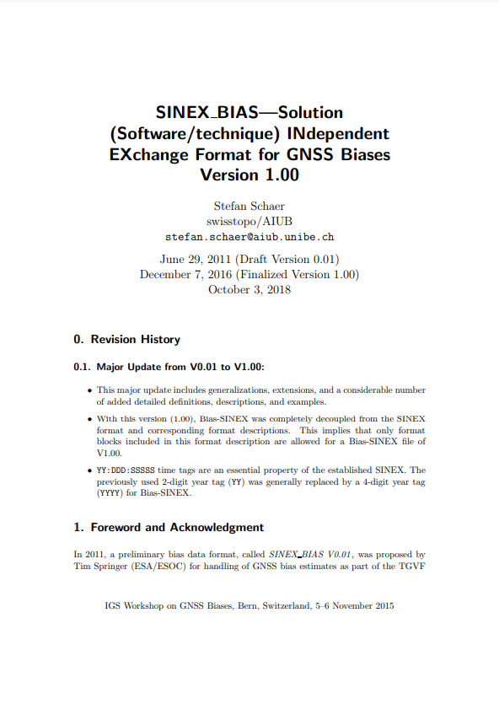
Methodology
Unified multi-frequency OSB generator
Abide by IGS SINEX convention
Correct on raw observation
Contain phase and L5 bias
$$\left[\begin{matrix}{\tilde{B}}_{1}^{s} \\ {\tilde{B}}_{2}^{s} \\ {\tilde{B}}_{2}^{s}\end{matrix}\right]={\left[\begin{matrix}0 & \frac{f_{2}}{f_{2}−f_{3}} & \frac{−f_{3}}{f_{2}−f_{3}} \\ \frac{f_{1}}{f_{1}−f_{2}} & \frac{−f_{2}}{f_{1}−f_{2}} & 0 \\ \frac{γ_{2}}{γ_{2}−γ_{1}} & \frac{−γ_{1}}{γ_{2}−γ_{1}} & 0\end{matrix}\right]}^{−1}\left[\begin{matrix}{\check{b}}_{ewl}^{s} λ_{ewl} \\ {\check{b}}_{wl}^{s} λ_{wl} \\ {\tilde{δt}}^{s,IRC}−{\tilde{δt}}_{IF}^{s}\end{matrix}\right]+\left[\begin{matrix}0 \\ 0 \\ {δb}_{3}^{s}\end{matrix}\right]$$
Convert IRC/UPD/IFCB to Observation-Specific Bias
Notes:
Under multi-frequency conditions, each ambiguity must be corrected with a specific UPD, which is inflexible. While Using OSB is more compatible.
Therefore, Abide by SINEX convention, we convert our products to OSB-format

Slide 11
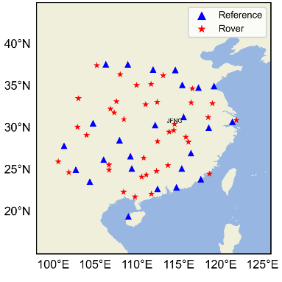
Results – Data collection
Station
Distribution in China
UB4B0 receiver and Dywell antenna
Frequency
GPS L1/L2/L5, Galileo E1/E5a/E5b
BDS-2 B1I/B3I/B2I, BDS-3 B1I/B3I/B2a
Notes:
To validate our real-time service, we hire a network in China for data processing.

Slide 12
Results - Third frequency contribution
EWL or PWL can both reach 95% fixed in 2 minutes, much better than MW wide-lane
Triple-frequency strategy increase narrow fixrate by 28% than dual-frequency
 | MW WL | EWL | PWL WL | NL
 |  |  |  | IF | EWL+WL constraint
2 min | 65.00% | 98.70% | 95.40% | 57.30% | 85.40%
5 min | 73.90% | 99.60% | 98.70% | \ | \
10 min | 82.90% | 99.90% | 99.50% | \ | \
30 min | 94.50% | 100.00% | 99.90% | 93.30% | 94.50%
60 min | 98.40% | 100.00% | 100.00% | \ | \
(Fixing rate for different types of ambiguities (below 30°) after different smoothing span)
Notes:
To begin with, we investigate the third frequency contribution to ambiguity resolution
This table summarizes the fixing rate for different ambiguities whose elevation below 30 degrees at different smoothing span
When satellite is just in view, Extra-widelane and phase wide-lane can both reach 95% fixed in 2 minutes, their smoothing time is much shorter than MW wide-lane
Meanwhile, the fast resolution of wide-lane ambiguity can improve the fixrate of narrow lane, we can see triple-frequency strategy increases narrow lane fixrate by 28% than dual-frequency

Slide 13
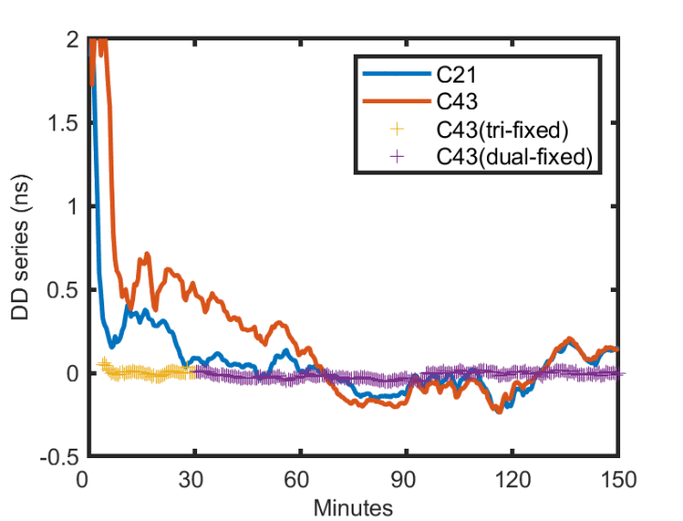
Results - Third frequency contribution
Satellite with lower elevations requires more time to converge
E.g. C21 56° (blue) vs C43 13° (orange)
Ambiguity resolution accelerates the convergence of satellite clock
E.g. C43 float (orange) vs C43 dual-fixed (purple) vs C43 triple-fixed (yellow)
Improve the availability of regional real-time clock when the elevation is low
Notes:
we take an example to further illustrate.
Like C21 in blue with higher elevation requires less time to converge
meanwhile, as we can see, triple-fixed in yellow line converge faster than dual-fixed in purple line, improving the availability of regional real-time clock when elevation is low

Slide 14
Results - Realtime Clock
Input ultra-rapid orbit prediction part
RMS of regional rt. Clock
Larger than that of rt. Global clock, with average of 1.14 ns vs. 0.36 ns
STD of regional rt. Clock
IRC solutions outperforms the float solutions, with average of 0.13 ns vs. 0.23 ns
RMS
 | GPS | Galileo | BDS2 |  | BDS3
 | MEO | MEO | IGSO | MEO | IGSO | MEO
R (m) | 0.025 | 0.029 | 0.127 | 0.052 | 0.18 | 0.063
C (m) | 0.035 | 0.059 | 0.189 | 0.092 | 0.212 | 0.12
A (m) | 0.095 | 0.047 | 0.201 | 0.118 | 0.199 | 0.08
STD
Notes:
In the terms of reatime clock precision, the std of float clock is large, after ambiguities fix to integer, the STD is comparable to the accuracy of rapid products.

Slide 15
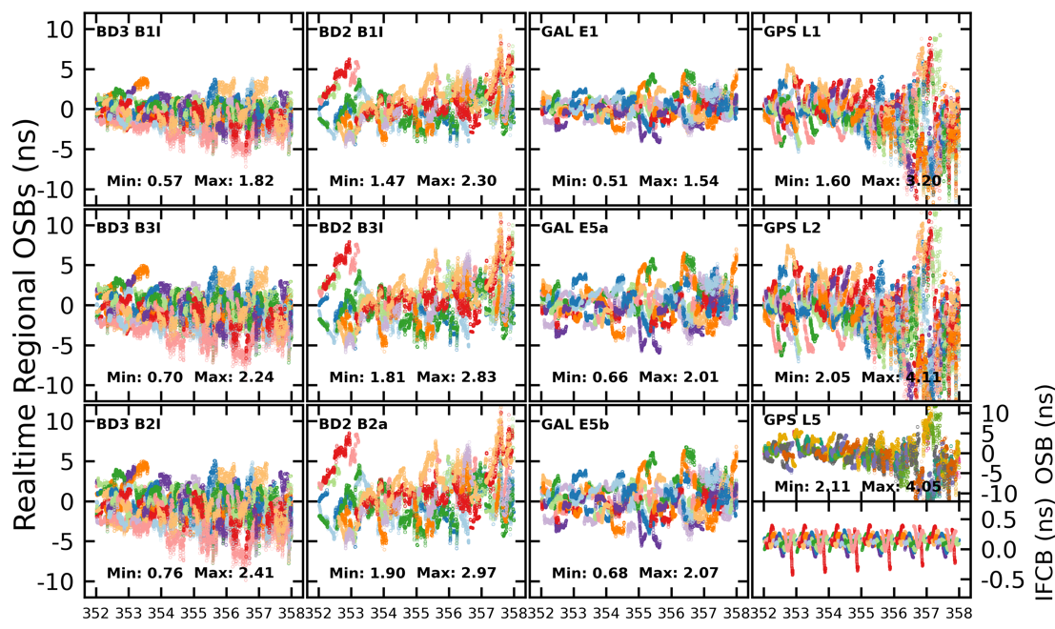
Results - Realtime phase OSB
Phase OSB estimated by the regional clock exhibits a time-variant trend
Phase OSB retrieved by our proposed method contains not only the phase hardware delay but also the float clock error
The fluctuations of the GPS appear to be pronounced
IFCB exhibits continuous and cyclic feaures
Notes:
What we concern most is phase OSB
first, the product estimated by the regional clock exhibits a time-variant trend, suggesting the phase OSB retrieved from the network contains not only the phase hardware delay but also the float clock error
Also, the fluctuations of the GPS appear to be pronounced than the others, This’s attributed that not all GPS satellites provide multi-frequency signals, so the number of phase widelane measurements is fewer
笔， Look IFCB at the right corner, the IFCB extracted from afif measurement show continuous and cyclic feature.

Slide 16
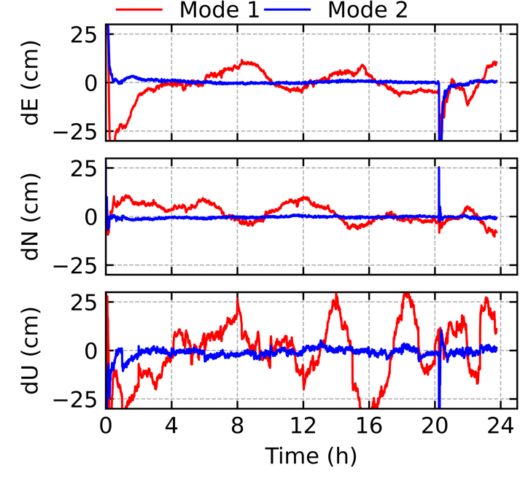
Results – Phase OSB compensation for float clock
Residuals of the float clock directly affect the PPP accuracy. Our phase OSB compensates for these parts, improving the clock stability and PPP performance
Mode1: PPP float solution with float clock and code OSB products
Mode2: PPP float solution with float clock and code/phase OSB products
Proposed phase OSB on refining the float clocks and correcting the phase hardware delays is confirmed.
Notes:
Given that stability of OSB in the series is not sufficient to judge its quality, we further validate the OSB’s compensation for float clock,
Mode 1 and 2 are PPP float solution without or with phase OSB
The PPP float accuracy in Mode 1 was at the decimeter level,
While after introducing the phase OSB product, Mode 2 greatly improves the positioning accuracy
Therefore, Our Phase OSB indeed refines the float clocks and corrects phase hardware delay.

Slide 17
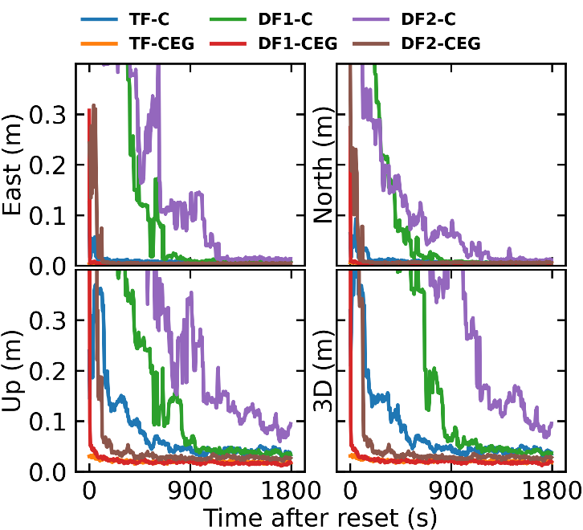
Results - Accuracy performance
During initialization, TF positioning obtains the highest accuracy
After converge, DF1 shares the compared final accuracy to TF, while DF2 is relatively lower
Solutions |  | Accuracy (cm)
 |  | East | North | Up | 3D
DF1 | C | 1.1 | 1.0 | 4.4 | 5.0
 | CEG | 0.4 | 0.5 | 2.1 | 2.2
DF2 | C | 1.7 | 2.0 | 8.5 | 8.5
 | CEG | 0.5 | 0.6 | 3.2 | 3.3
TF | C | 1.1 | 1.0 | 4.4 | 5.0
 | CEG | 0.4 | 0.5 | 2.1 | 2.2
(DF1: baseline dual-frequency; DF2: non-datum dual-frequency; TF: triple-frequency)
Notes:
Based on the products we generated above, we conducted a real-time PPP validation.
We found During initialization, TF positioning accuracy is the highest,
After converge, DF1 shares the compared final accuracy to TF, while DF2 is relatively lower

Slide 18
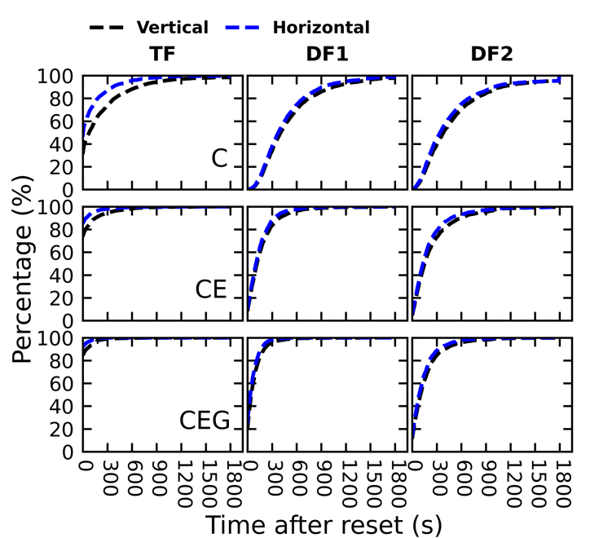
Results - Convergence performance
Setting the convergence criteria to maintain a horizontal accuracy of 5cm and a vertical accuracy of 10cm for 2 minutes, reset every half an hour
For BDS-only, TF-PPP reaches nearly 65 % horizontal convergence within one minute
In multiconstellation, TF-PPP achieves 91% in horizontal instantaneous convergence
Solutions |  | Instantaneous (%) |  |  | < 30 (%) |  |  | < 60 (%)
 |  | E | N | U | E | N | U | E | N | U
C | TF | 46.2 | 45.8 | 31.1 | 60.2 | 59.3 | 42.7 | 65.4 | 64.8 | 47.9
 | DF1 | 0.1 | 0.1 | 0.1 | 0.8 | 0.8 | 0.6 | 2 | 2 | 1.5
 | DF2 | 0.3 | 0.4 | 0.2 | 1.5 | 1.5 | 1 | 4.7 | 4.8 | 3.4
CE | TF | 84.8 | 83.7 | 73.5 | 89.6 | 88.6 | 80.3 | 91.7 | 90.8 | 83.1
 | DF1 | 9.7 | 9.7 | 8.2 | 24.3 | 25 | 21.8 | 36.1 | 37.2 | 33.1
 | DF2 | 5.7 | 5.7 | 4.6 | 18.1 | 18.1 | 15.7 | 29 | 29.5 | 26.1
CEG | TF | 91.9 | 91.8 | 84.5 | 94.8 | 94.7 | 89.4 | 96.2 | 96.1 | 91.1
 | DF1 | 24.5 | 24.1 | 18.2 | 50.4 | 50.2 | 43.6 | 65.7 | 65.5 | 59.3
 | DF2 | 13.4 | 13.7 | 18.9 | 29.6 | 30.1 | 26.3 | 42.6 | 43.1 | 37.8
Bear the PPP ability to perform RTK-like convergence
Notes:
As for the convergence performance related to user experience.
Setting the convergence criteria to maintain a horizontal accuracy of 5cm and a vertical accuracy of 10cm for 2 minutes
For BDS-only, TF-PPP reaches nearly 65 % horizontal convergence within one minute
In multiconstellation, TF-PPP achieves 91% in horizontal instantaneous convergence
In some sense, we bear the ability to perform RTK-like convergence

Slide 19
Conclusions
We develop a regional realtime instantaneous PPP service, based on a multi-constellation multi-frequency integer recovery clock estimator
Utilizing triple-frequency observations, multi-constellation PPP instantaneous convergence percentage can reach 91% in horizontal, and 84% in vertical
It can be used as a practical alternative public PPP service to RTK/PPP-RTK, meeting the accuracy, availability, continuity and low latency requirements for many realtime applications
Thank you for attention!
Notes:
To our conlusion ,.

