Slide 1
Advancing GNSS Variometry:
from Real-Time Scenarios to
Real-Time Implementation for Enhanced Tsunami Early Warning Systems
Michela Ravanelli¹
Elvira Astafyeva², Mattia Crespi¹
(1) Sapienza University of Rome, Rome, Italy
(2) Institut de Physique du Globe de Paris, Paris, France
IGS 2024 Symposium Session 5: GNSS-Enabled Applications
Bern, July, 4th , 2024

Slide 2
GNSS Variometry
What is the Variometric Approach?
It is based on single time differences of suitable linear combinations of GNSS carrier-phase observations
It employs a stand-alone GNSS receiver and standard GNSS broadcast products (orbits and clocks corrections)
It works in real-time
The Variometric Approach allows a GNSS receiver to provide valuable real-time
information in a standalone operative mode
Advantages
no infrastructure
no post-processing
no initialization needed
no need for ambiguity resolution

Slide 3
GNSS Variometry
The Variometric approach was applied to
GNSS Seismology
GNSS Ionospheric Seismolology
3D velocities & displacements
Ionospheric TEC estimates
VADASE
VARION

Slide 4
VADASE
Main feautures
Variometric
Approach for
Displacements
Analysis
Stand-Alone
Engine
Single time differences of ionospheric-free combinations of GNSS carrier-phase observations between two consecutive epochs
Real-time estimation of epoch by epoch 3D velocities and 3D displacements
Accuracy of few mm/s and 1-2 cm
Multi-constellation and multi-frequency compatibility
No ambiguity term is contained in the observation equation

Slide 5
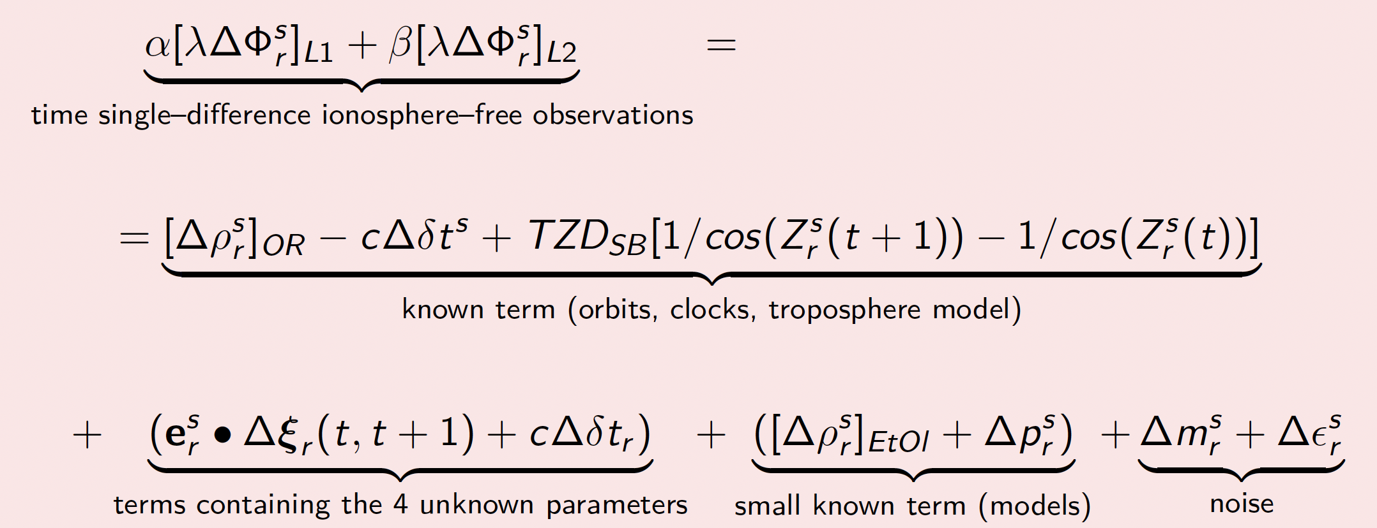
VADASE

Slide 6
VADASE
VADASE key results
Variometric
Approach for
Displacements
Analysis
Stand-Alone
Engine
First displacements computation for the waveforms recorded by the IGS stations at MIZU and USUD for Mw 9.0 Tohoku-Oki earthquake
Small displacements detection (down to a few cm) for the Emilia earthquake (Mw 6.0, 20 May 2013, 02:03:51 UTC) and single-frequency measurements, incorporating the Klobuchar ionospheric model
Tracking of a low-cost GNSS patch antenna fixed to a bike wheel setup horizontally was tracked at 1cm accuracy level using Galileo E1 observations
LEICA VADASE
Tested on GNSS raw measurements retrieved from Android smartphones
Leave-One-Out cross-validation (VADASE-LOO) for autonomous outlier detection in the receiver and augmentation approach (A-VADASE) to filter out common trends
Detection of displacements by anthropogenic earthquakes (mining tremors)

Slide 7
VARION
Main feautures
Variometric
Approach for
Real-time
Ionosphere
Observatio
N
Dual frequency phase observations
Single time differences of geometry-free combination (L4 - removal of geometry, clocks and all non-dispersive effects) of GNSS carrier-phase observations between two consecutive epochs
Each satellite common to the two epochs provides one epoch-to-epoch sTEC variation
Cycle slips identification and removal (no need of ambiguity fixing)

Slide 8
VARION

Slide 9
VARION
VARION key results
Variometric
Approach for
Real-time
Ionosphere
Observatio
N
Application to data coming from geostationary satellites
Tested on GNSS raw measurements retrieved from Android smartphones
Feasibility Demonstration of applying VARION from GNSS Onboard Ships
Analysis of the ionospheric response of the 2022 Tonga volcano eruption
Deep Learning Based Framework for Real-Time Detection of Earthquake and Tsunami Induced Ionospheric Perturbation
Machine learning-based detection of VARION TEC signatures related to earthquakes and tsunamis for the 2015 Illapel earthquake
Ionospheric analysis of the paroxysmal eruptive activity of Mt. Etna

Slide 10
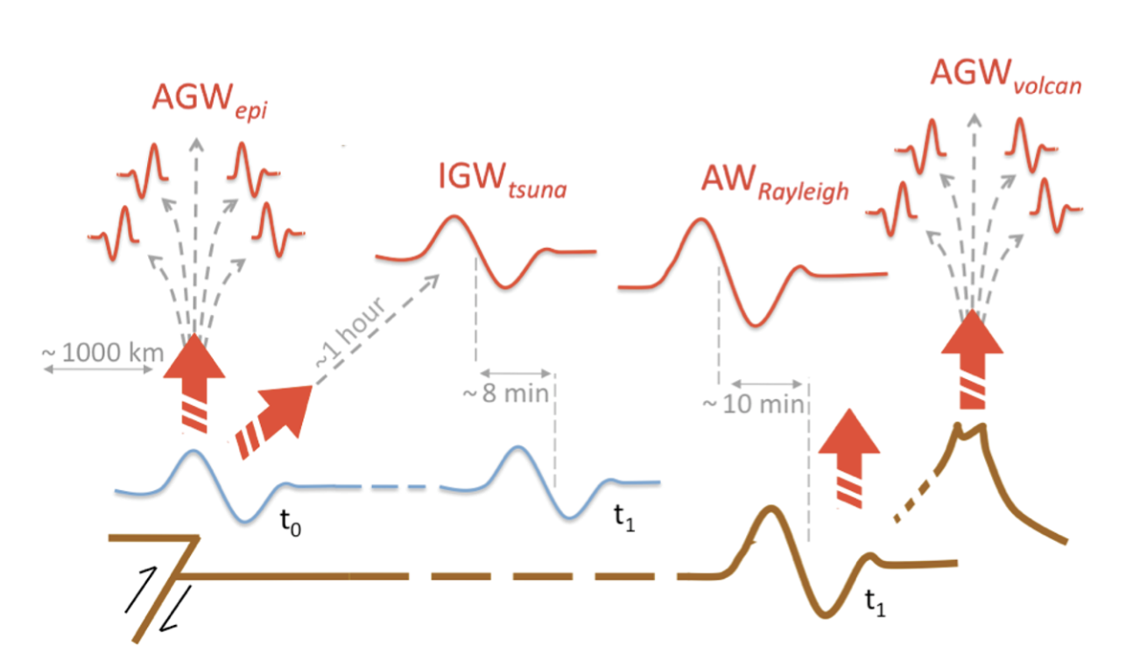
From Ground to Ionosphere
Figure adapted from Occhipinti, 2015

Slide 11
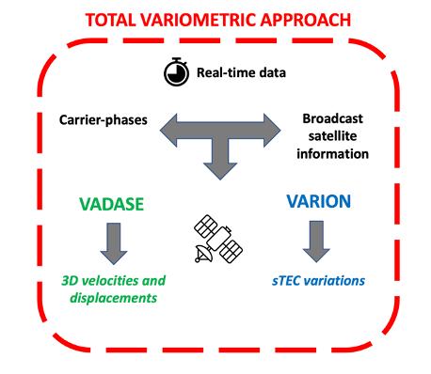
Total Variometric Approach
TVA allows for a complete characterization of the natural hazards or man-made event from ground to the ionosphere in real-time

Slide 12
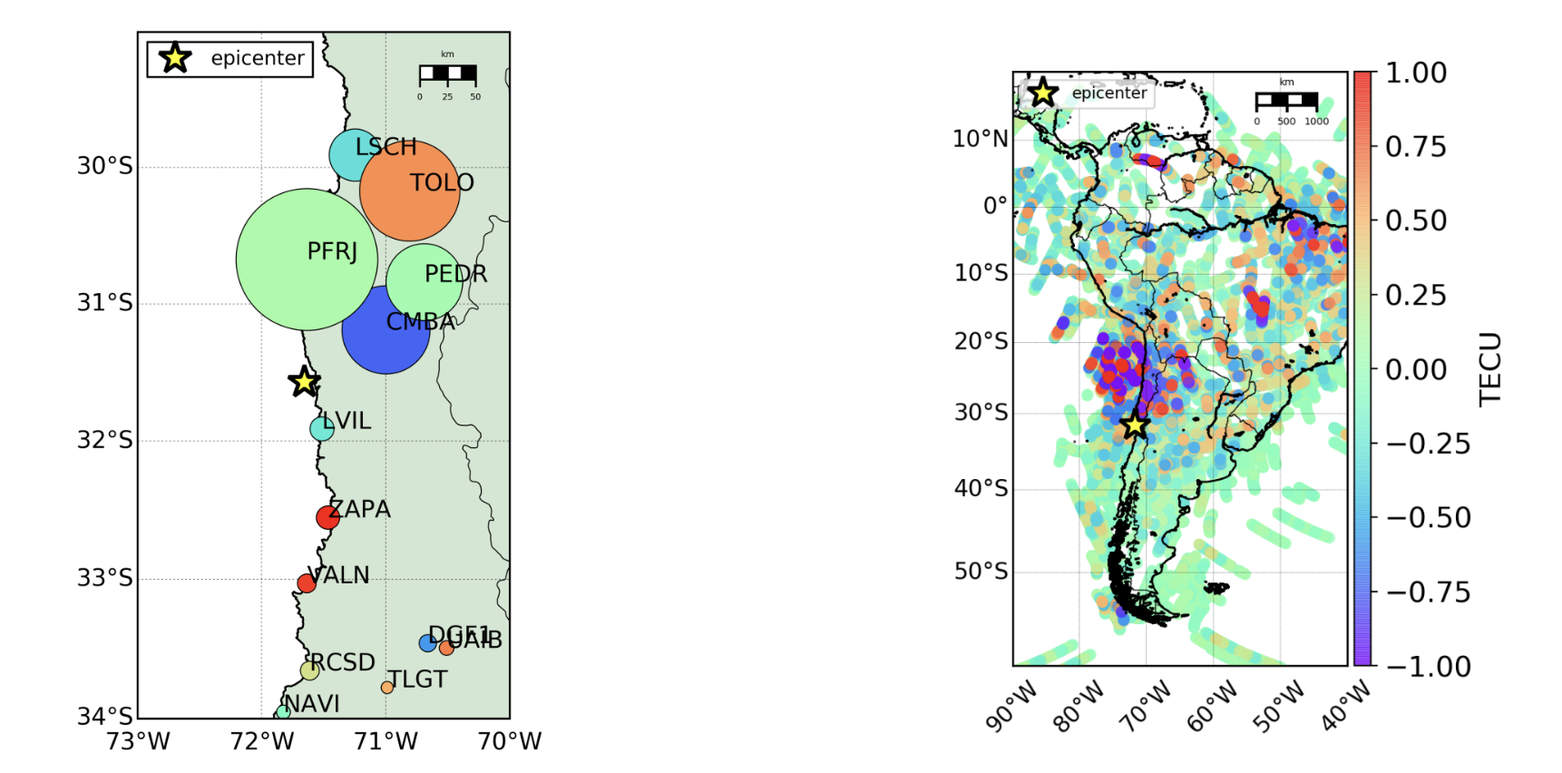
Total Variometric Approach
Mirroring between vertical ground shaking and ionospheric disturbances
Ravanelli et al., Scientific Reports, 2021

Slide 13
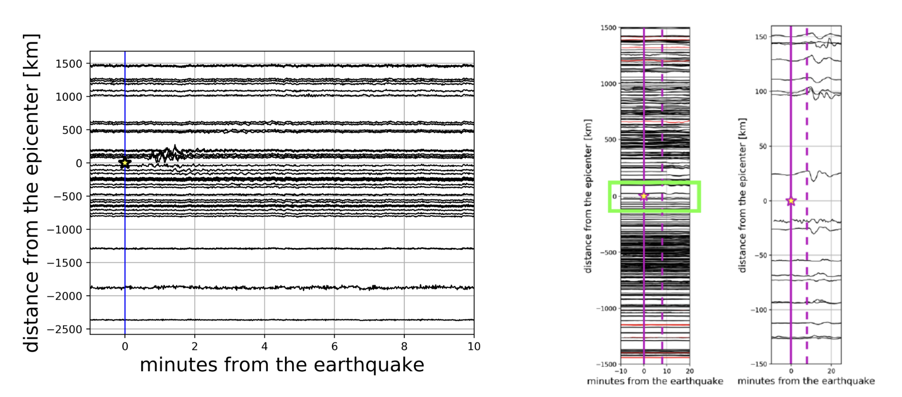
Total Variometric Approach
Much bigger information richness in the ionosphere compared to the ground

Slide 14
Total Variometric Approach
TVA main features
Same GNSS stream in real-time
Simultaneous and independent estimates
Timely information
Ground –> significant shaking 30 seconds after the EQ
Ionosphere –> AGWepi 8-10 minutes after the EQ
Ground and ionosphere information reinforce each other
Velocities and displacements can provide both magnitude and direction of the ground motion which is critical information for estimating displacement of the seafloor and its tsunamigenic potential
VARION-related TEC anomalies can provide an estimate of the distribution of vertical displacement of the sea surface, thereby validating the tsunami potential within the first 10 min of the seismic rupture
TVA allows for real-time estimation of a tsunami genesis, being suitable to support the classic method for tsunami early warning system

Slide 15
The ALTRUIST project
ALTRUIST is one of the eight projects selected worldwide for the Joint Call
by the AXA Research Fund &
IOC-UNESCO on Coastal Livelihood
within the framework of the United Nations Ocean Decade
Goals
Real-time implementation of TVA methodology
Implementation in the of IPGP Observatoire Sismologique et Vulcanologique de Guadeloupe
Improvement of the reliability and accuracy of real-time tsunami warning system in the area

Slide 16
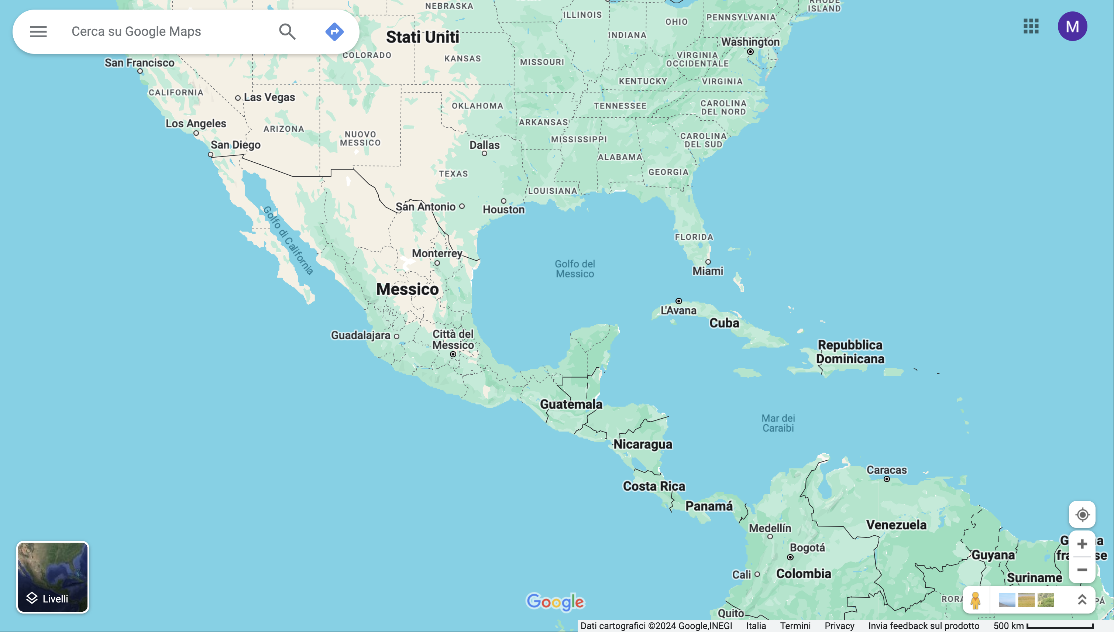
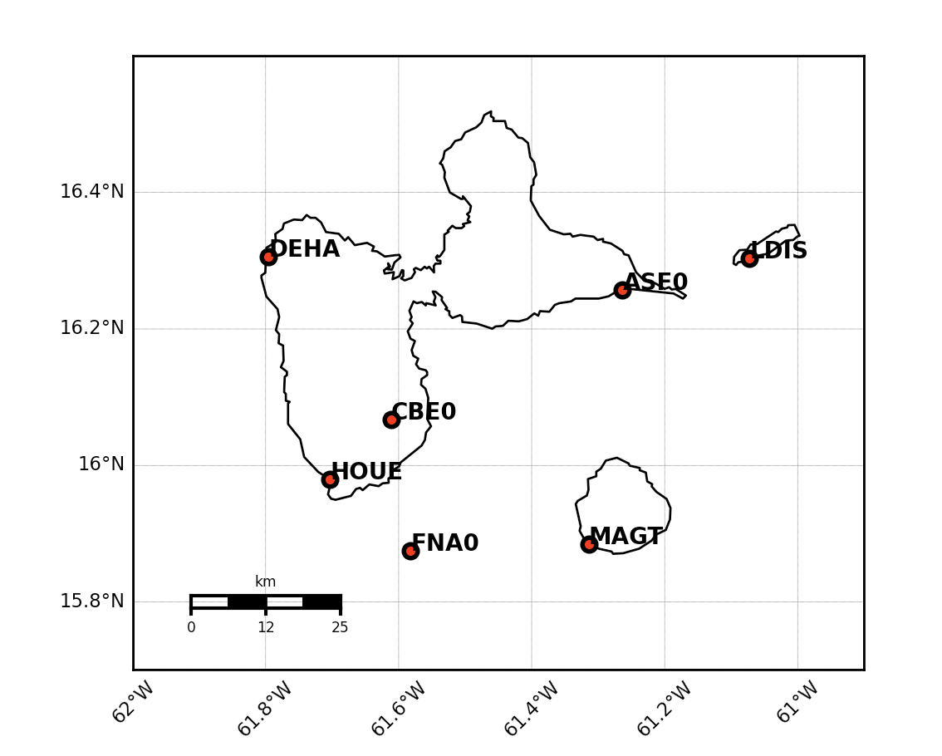
The ALTRUIST project
Input data
GNSS real-time stream from TERIA stations placed all over the Guadeloupe archipelago
RTCM MSM 7 (Observations and Ephemeris ) for GPS, Galileo, GLONASS and Beidou
The Caribbeans are a tsunamigenic zone where no other tsunami warning systems based on ionospheric data is nowadays present

Slide 17
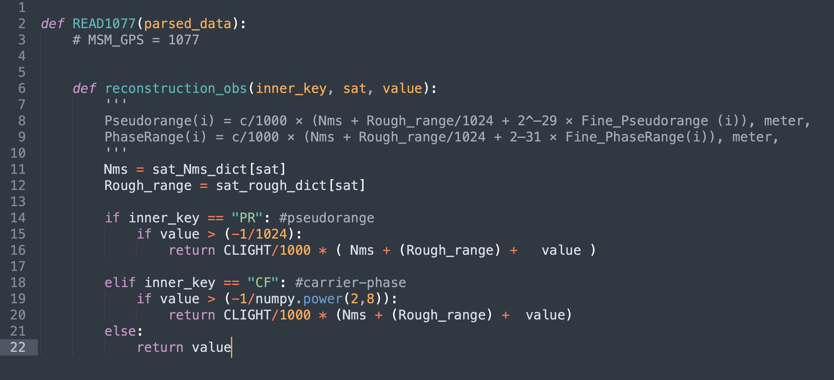
The ALTRUIST engine
The ALTRUIST project is also based on GNSS Variopy
Support the streaming of RTCM-3 data (MSM 7) through a socket connection to a NTRIP caster, allowing for real-time data collection and processing for permanent station networks and any additional receiver available
GNSS Variopy

Slide 18
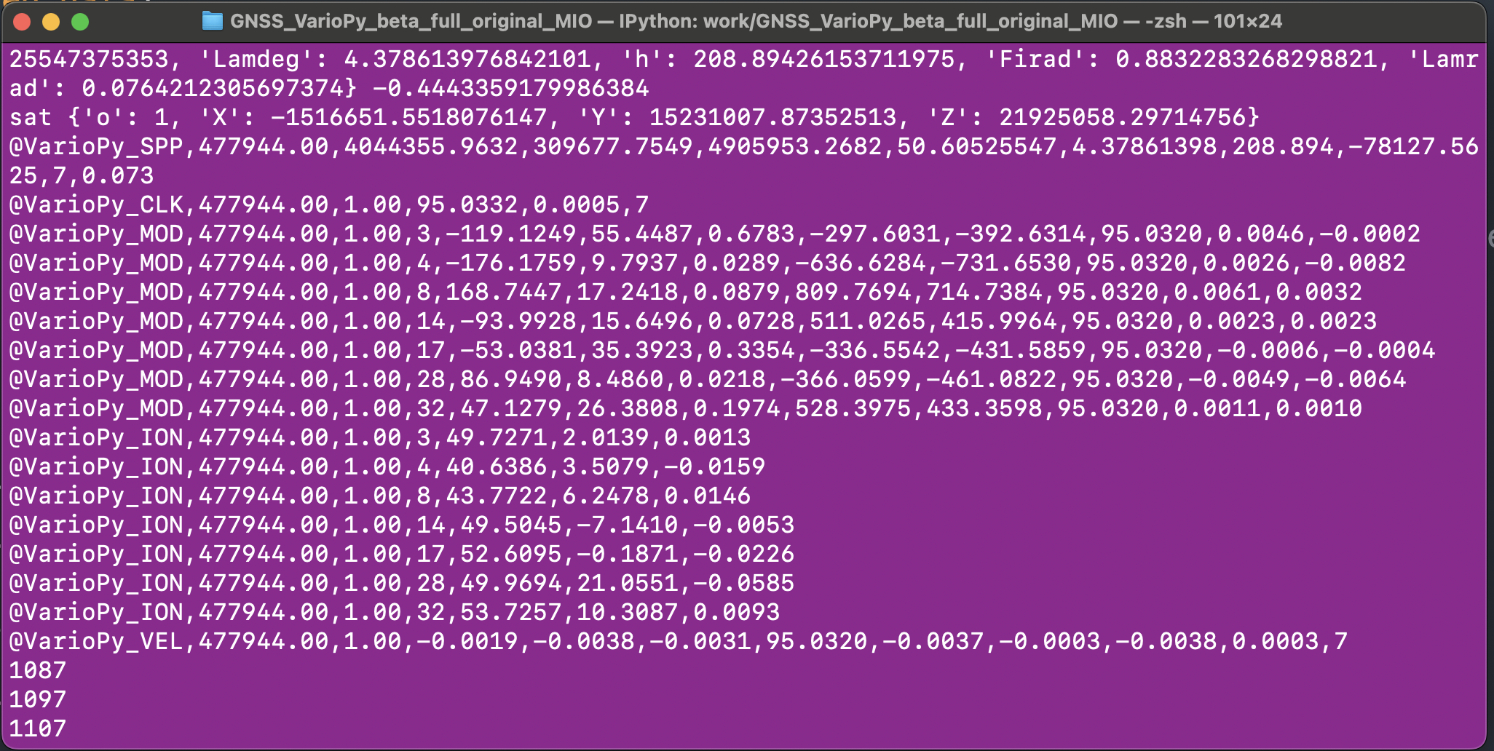
The ALTRUIST engine
The ALTRUIST project is also based on GNSS Variopy
GNSS Variopy
Python-based package designed to implement the real-time GNSS Variometric Approach for static and quasi-static applications
Real-Time Implementation of Total Variometric Approach

Slide 19
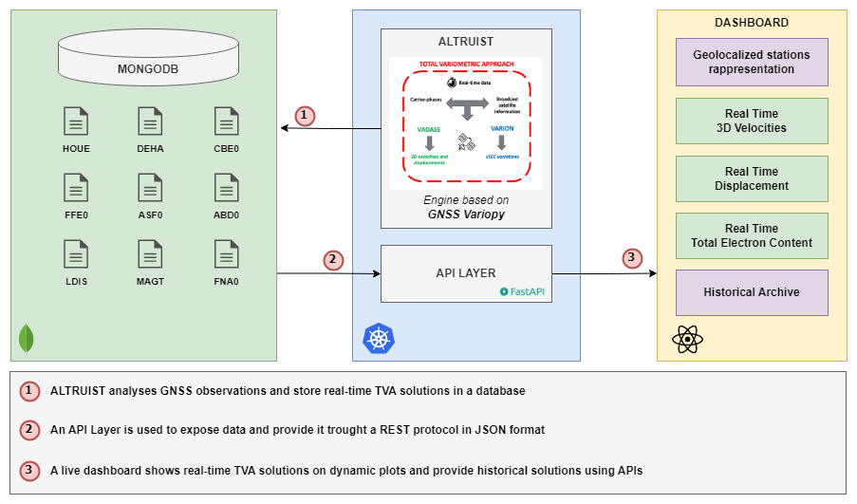
The ALTRUIST architecture

Slide 20
The ALTRUIST project

Slide 21
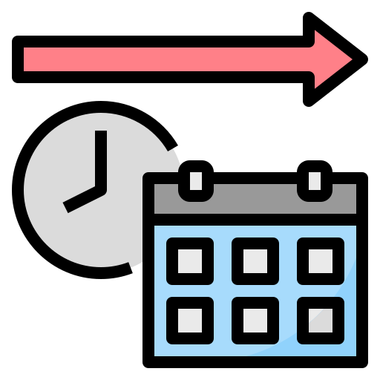
Conclusions & Outlook
Take-home messages
Feasibility demonstration of real-time operational capabilities of TVA
High adaptability and versatility of the dashboard
Deploy of the dashboard in the next few months
Outlook
Include more stations from other Caribbeans (Martinique) and other tsunamigenic zones (South Pacific?) and IGS data → High Exportability
Simulated real-time data will involve the utilization of randomly generated datasets representing ground motion, coseismic displacements, ionospheric TEC
Easily applied to the monitoring of any kind of natural hazards impacting ground and ionosphere geosphere

Slide 22
Thanks for your kind attention

Slide 23
References
[1] Benedetti, E., Branzanti, M., Biagi, L., Colosimo, G., Mazzoni, A., & Crespi, M. (2014). Global Navigation Satellite Systems seismology for the 2012 M w 6.1 Emilia earthquake: Exploiting the VADASE algorithm. Seismological Research Letters, 85(3), 649-656.
[2] Benedetti, E., Branzanti, M., Colosimo, G., Mazzoni, A., & Crespi, M. (2016). VADASE: state of the art and new developments of a third way to GNSS seismology. In VIII Hotine-Marussi Symposium on Mathematical Geodesy: Proceedings of the Symposium in Rome, 17-21 June, 2013 (pp. 59-66). Springer International Publishing.
[3] Branzanti, M., Colosimo, G., & Mazzoni, A. (2017). Variometric approach for real-time GNSS navigation: First demonstration of Kin-VADASE capabilities. Advances in Space Research, 59(11), 2750-2763.
[4] Colosimo, G., Crespi, M., & Mazzoni, A. (2011). Real‐time GPS seismology with a stand‐alone receiver: A preliminary feasibility demonstration. Journal of Geophysical Research: Solid Earth, 116(B11)
[5] Kudłacik, I., Kapłon, J., Kazmierski, K., Fortunato, M., & Crespi, M. (2023). First feasibility demonstration of GNSS-seismology for anthropogenic earthquakes detection. Scientific Reports, 13(1), 20905.
[6] Fortunato, M., Ravanelli, M., & Mazzoni, A. (2019). Real-time geophysical applications with Android GNSS raw measurements. Remote Sensing, 11(18), 2113.
[7] Fratarcangeli, F., Ravanelli, M., Mazzoni, A., Colosimo, G., Benedetti, E., Branzanti, M., ... & Crespi, M. (2018a). The variometric approach to real-time high-frequency geodesy. Rendiconti Lincei. Scienze Fisiche e Naturali, 29, 95-108.
[8] Fratarcangeli, F., Savastano, G., D’Achille, M. C., Mazzoni, A., Crespi, M., Riguzzi, F., ... & Pietrantonio, G. (2018b). VADASE reliability and accuracy of real-time displacement estimation: Application to the Central Italy 2016 earthquakes. Remote Sensing, 10(8), 1201.
[9] Fratini, R., De Pace, A. M., Fortunato, M., Ravanelli, M., Crespi, M., & Mazzoni, A. (2024, April). GNSS VarioPy: A Comprehensive Tool for Enhancing Early-Warning Systems for Geophysical and Atmospheric Events Through GNSS Permanent Stations Networks. In Proceedings of the ION 2024 Pacific PNT Meeting (pp. 46-53).
[10] IGSMAIL-6358 (2011) Magnitude 8.8 earthquake offshore of Japan-preliminary computation of GPS displacement waveforms at MIZU and USUD. https://lists.igs.org/pipermail/igsmail/2011/000192.html

Slide 24
References
[11] Pirazzi, G., Mazzoni, A., Biagi, L., & Crespi, M. (2017, September). Preliminary performance analysis with a GPS+ Galileo enabled chipset embedded in a smartphone. In Proceedings of the 30th International technical meeting of the satellite Division of the Institute of Navigation (ION GNSS+ 2017) (pp. 101-115).
[12] Constantinou, V., Ravanelli, M., Liu, H., & Bortnik, J. (2023a). A deep learning approach for detection of internal gravity waves in earth’s ionosphere. In Igarss 2023-2023 ieee international geoscience and remote sensing symposium (pp. 1178–1181).
[13] Constantinou, V., Ravanelli, M., Liu, H., & Bortnik, J. (2023b). Deep learning drivendetection of tsunami related internal gravitywaves: a path towards open-ocean natural hazards detection. In Proceedings of the ieee/cvf international conference on computer vision (iccv) workshops (pp. 3748–3753).
[14] Ravanelli, M., Astafyeva, E., Munaibari, E., Rolland, L., & Mikesell, T. (2023). Ocean -ionosphere disturbances due to the 15 january 2022 hunga-tonga hunga-ha’apai eruption. Geophysical Research Letters, 50 (10), e2022GL101465.
[15] Ravanelli, M., Crespi, M., & Foster, J. (2020). Tids detection from ship-based gnss receiver: First test on 2010 maule tsunami. In Igarss 2020-2020 ieee international geoscience and remote sensing symposium (pp. 6846–6849).
[16] Ravanelli, M., Occhipinti, G., Savastano, G., Komjathy, A., Shume, E. B., & Crespi, M. (2021). GNSS total variometric approach: first demonstration of a tool for real-time tsunami genesis estimation. Scientific reports, 11 (1), 1–12.
[17] Savastano, G., Komjathy, A., Shume, E., Vergados, P., Ravanelli, M., Verkhoglyadova, O.,.. Crespi, M. (2019). Advantages of geostationary satellites for ionospheric anomaly studies: Ionospheric plasma depletion following a rocket launch. Remote Sensing, 11 (14), 1734.
[18] Savastano, G., Komjathy, A., Verkhoglyadova, O., Mazzoni, A., Crespi, M., Wei, Y., & Mannucci, A. J. (2017). Real-time detection of tsunami ionospheric disturbances with a stand-alone gnss receiver: A preliminary feasibility demonstration. Scientific reports, 7 (1), 46607.

Slide 25
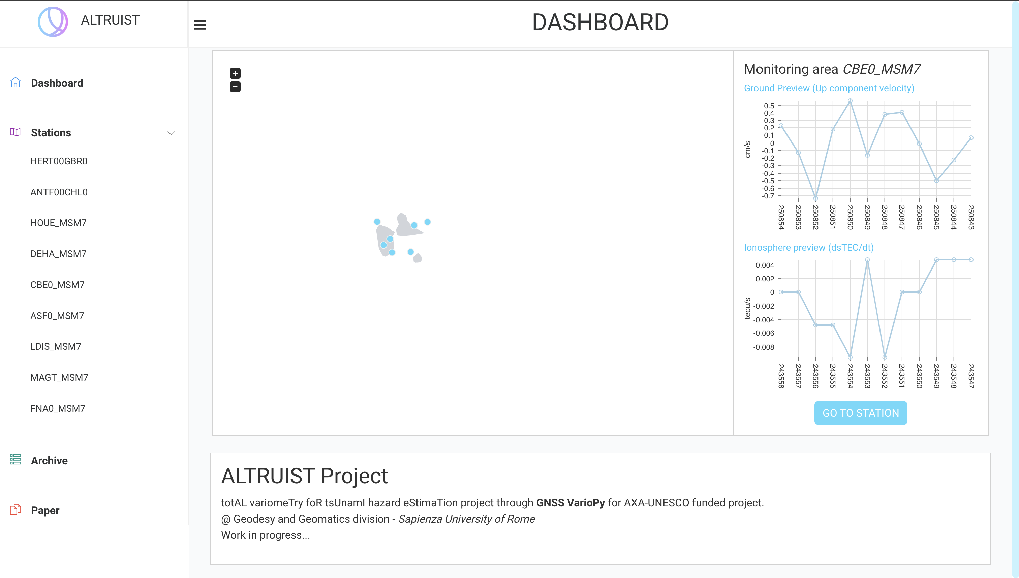
The ALTRUIST project
The frontend solution encompasses a homepage featuring an interactive map showcasing all stations, enabling users to click on individual stations for quick access to ground and ionospheric in real time
Archive section to query historical data on a database and conduct searches across past datasets with ease
APIs are accessible for integration with the dashboard frontend and can be made available to the public through IP authorization mechanisms

Slide 26
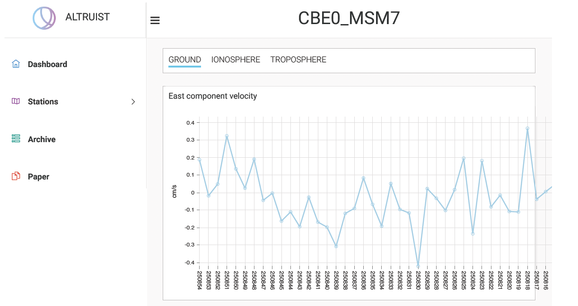
The ALTRUIST project
3D velocities & displacements are showed for the chosen station

Slide 27
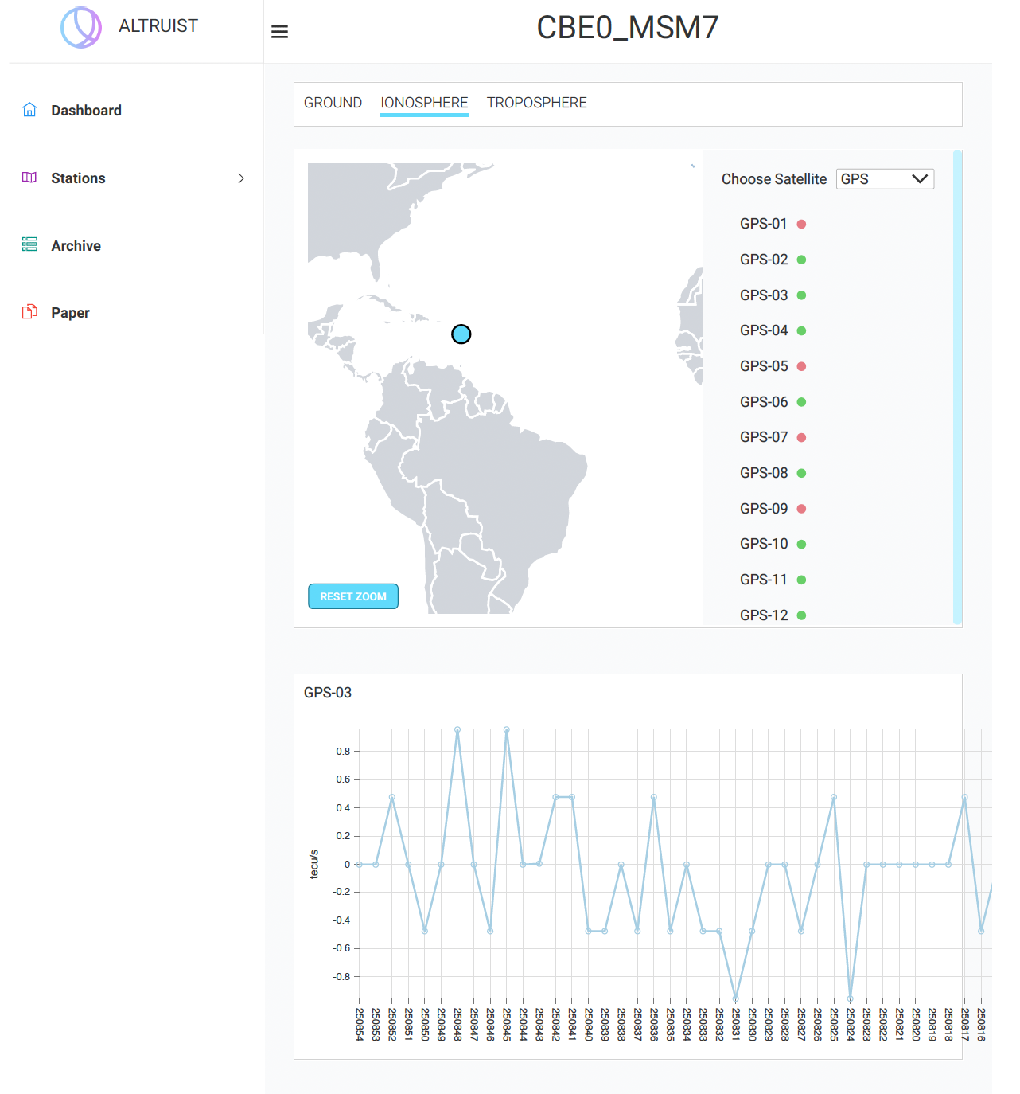
The ALTRUIST project
Ionospheric TEC: Upon delving into specific stations, users can explore the list of all associated satellites, with real-time data presented through time-series for each satellite

