Slide 1




GENESIS – PROAD
Data PROcessing, Archiving and Delivery
W. Enderle¹, F. Dilssner², T. Springer², M. Otten², S. Bruni², M. van Kints³, F. Gini¹, E. Schoenemann¹
¹ESA/ESOC - Navigation Support Office; ²PosiTim@ESA/ESOC - Navigation Support Office; ³VisionSpace@ESA/ESOC - Navigation Support Office
V. Navarro: ESA ESAC
ESA UNCLASSIFIED – For ESA Official Use Only

Slide 2

GENESIS – PROAD General Interface Overview
GENESIS Satellite
On-Board Measurements
- GNSS (GAL/GPS)
- DORIS
Industry
- GENESIS Satellite
- Design and Development
- Operations
International Community
- Geodetic Community
- Science Community
ESA
- Project
- PROAD
Precise Orbit Determination
Data Archive and I/F for Data Dissemination
CNES DORIS
International Geodetic Community
- IERS and four geodetic Services
- International Geodetic Oerganisations
Ground Support Infrastructure
- SLR Network
- VLBI Network
- IGS Network
PROAD

Slide 3
GENESIS – PROAD Data Flow
GNSS
Galileo & GPS
Industry
GNSS Measurements + Additional Data
GNSS+Doris Measurements
DORIS
CNES
Doris Measurements
Navigation Support Office
ESAC GNSS Science Support Center
GENESIS Data and Products Dissemination
International Geodetic Services
SLR (ILRS)
VLBI (IVS)
GNSS (IGS)
GENESIS POD Products and other Data
PROAD

Slide 4
GENESIS – PROAD
Precise Orbit Determination Data Products
Products generated by PROAD
Precise Orbit Determination for Galileo and GPS satellites
Precise Orbit Determination for GENESIS satellite
In-Orbit validation of the pre-launch calibrated space ties between the different geodetic payloads on board the GENESIS satellite
Additional Products are possible, based on agreements with International Organizations

Slide 5
GENESIS – PROAD
Precise Orbit Determination Data Products
Potential New PROAD Products
Combined solutions
  Solution A: coherent processing of all four geodetic techniques in a single least squares process
  Solution B: Solution A including MEO satellites
  Solution C: Solution B including LEO satellites (e.g. Sentinel satellites, Lageos satellites, etc. )
    Important: so far, no GNSS LEO contribution towards the ITRF

Slide 6
GENESIS – Contributions from ESA’s
Navigation Support Office
In addition to the PROAD activities, ESA’s Navigation Office will also contribute to the generation of the ITRF by provision of individual solutions for all four geodetic techniques as official Analysis Center (AC) to IERS.

Slide 7







GENESIS – PROAD Collaborating across ESA
Measurements and Ancillary Data
Data and Products
Data Processing
&
Precise Orbit Determination
Data Storage
&
Distribution
ESOC
ESAC
Navigation Support Office
GNSS Science Support Centre
GNSS
VLBI
POD Products and Additional Data
SLR
PROcessing, Archiving and Distribution (PROAD)

Slide 8

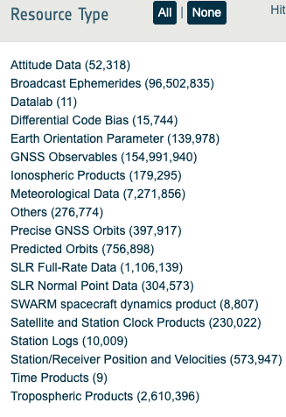



GENESIS – PROAD Advanced Ingestion Services
Pull
DOWNLOAD
METADATA
UPLOAD
Push
Contributors
GSSC
ESAC
REPOSITORY
…

Slide 9
GENESIS – PROAD
The success of GENESIS depend on international cooperation.
Thank you for your support!

