Slide 1




GENESIS: A Multi-Technique Geodetic Observatory in Space
P.Waller, S.Gidlund, G.Fusco, E.Honoré-Livermore, E.Sakalauskaite: ESA ESTEC
E.Schoenemann, W.Enderle: ESA ESOC
V.Navarro: ESA ESAC
ESA UNCLASSIFIED – For ESA Official Use Only

Slide 2
GENESIS Mission Objectives
01
02
GENESIS Science
Overview of
…The Mission
…The System
…The Satellite and Payloads
Index
03
04
Scientific Setup
05
Conclusions

Slide 3


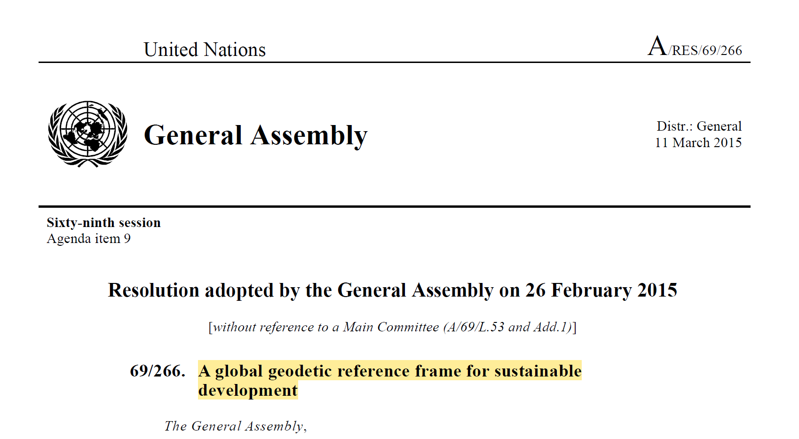
GENESIS Primary Objectives
GEODESY and REFERENCE FRAMES
Contribute to improve ITRF accuracy and stability by providing in-orbit colocation and necessary combined processing for the four space-based geodetic techniques that contribute to its realization. The goal is to contribute to the achievement of the Geodetic Global Observing System (GGOS) objectives for the ITRF realisation, aiming for a parameter accuracy of 1 mm and a stability of 0.1 mm/year, in order to provide significant scientific benefits in Earth modelling, and to support a wide range of societal applications (as endorsed by the United Nation resolution A/RES/69/266).
Contribute to improve the link between the ITRF and the ICRF, thanks to the increased consistency of the Earth Orientation Parameters (EOP). In particular, this mission shall allow for the first time a link between the orbit reference frame, ITRF and ICRF.
Targets:
Accuracy: 1 mm
Stability: 0.1 mm per year

Slide 4


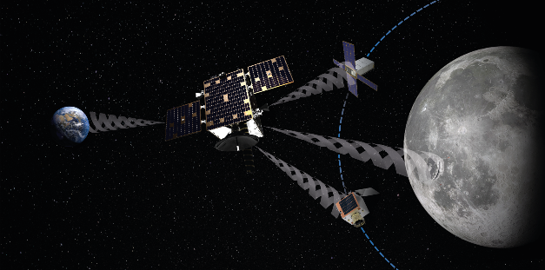
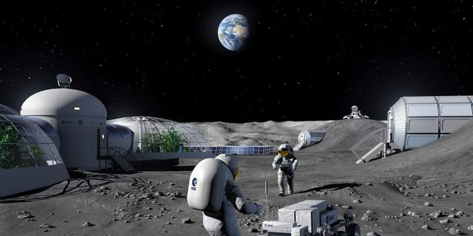
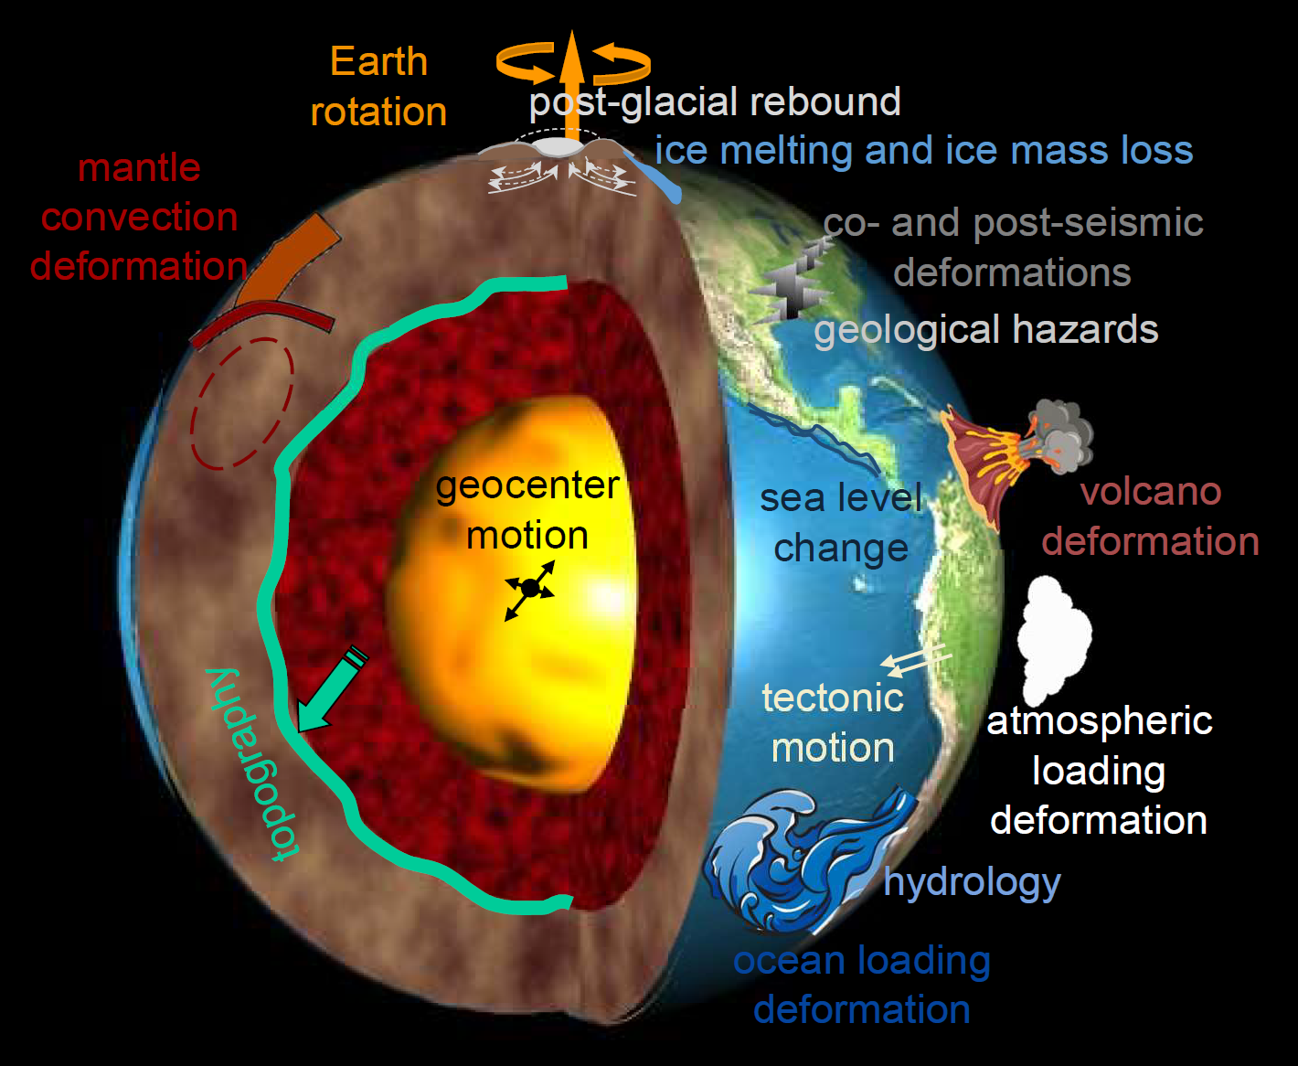
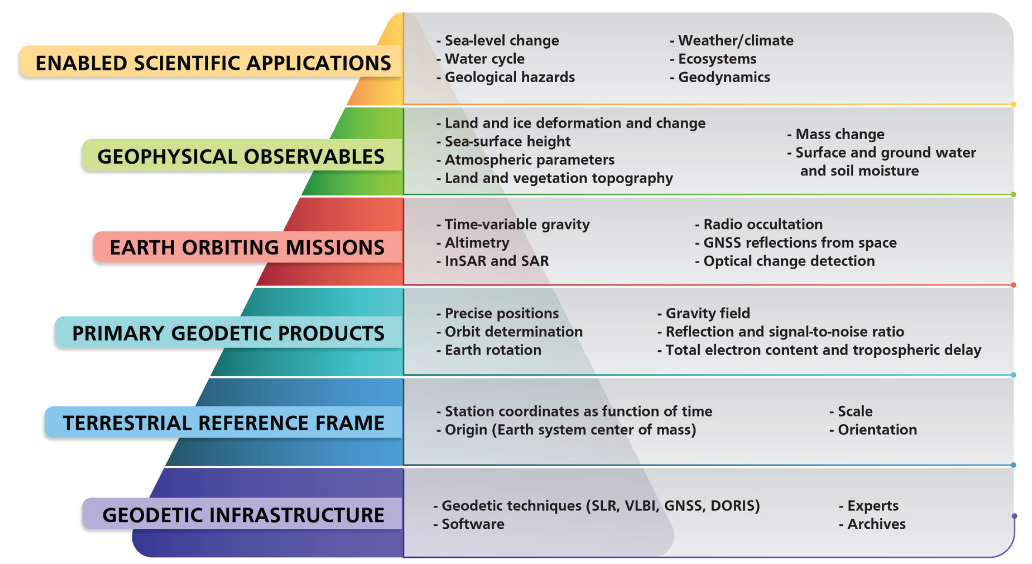
GENESIS-enabled Science and Applications
Geodesy, Reference Frames
Improved ITRF, EOPs,
Unified Reference Frames
GNSS, Navigation
Navigation to the Moon, and beyond…
Improved GNSS POD (LEO, MEO, GEO), calibrations…
Earth Sciences
Geophysics: Deep Interior
Geo-centre motion
Core flows
Magnetic field…
Geophysics: Mantle, Oceans
Tectonic motions
Post-glacial rebound
Ice melting, Ice mass loss
Sea level change…
Atmospheric Physics
Iono, Plasmaspheric density
Radiation budgets, Earth Energy imbalance…
“Evolving the Geodetic Infrastructure to Meet New Scientific Needs”,
National Academies of Sciences, Engineering and Medicine (2020)

Slide 5







Overview of the GENESIS Mission
Management
  GENESIS is an ESA Mission, managed by the ESA Navigation Directorate and part of its Optional FutureNAV Programme.
    Italy
    Belgium
    France
    Switzerland
    United Kingdom
    Hungary

Slide 6
Overview of the GENESIS Mission
Mission Scope
  Industrial Activities
  Single contract for Phases A/B/C/D/E
  Development and Qualification of Satellite and Ground Segment
  Launch and Early Operations (including calibrations)
  2 years of Operation (Option for extension)
  Data exploitation (making use of ESA facilities)
  4 on-board instruments:
    GNSS receiver
    VLBI transmitter
    SLR reflector
    DORIS receiver
  + Strong involvement of the Scientific Community and International Geodetic Services

Slide 7
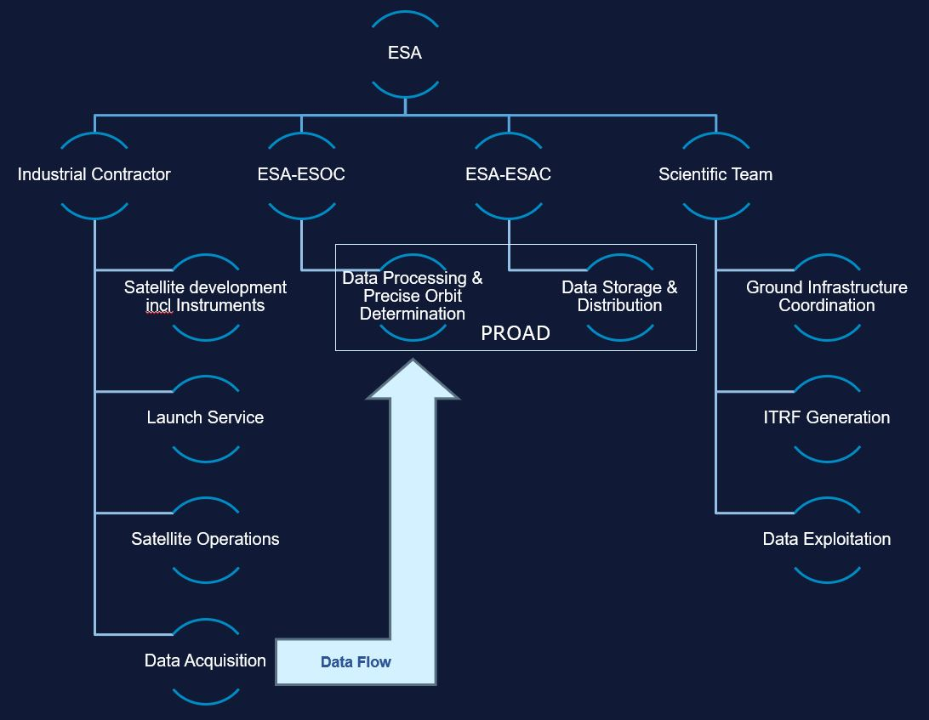
Overview of the GENESIS Mission
ESA
Industry
Scientific
Community

Slide 8
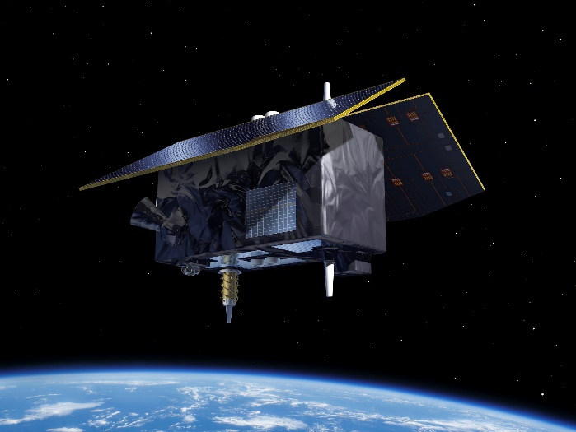


Overview of the GENESIS Mission
Kick Off of activities
22 April 2024
Preliminary Design Review (PDR)
Critical Design Review (CDR)
Qualification and Acceptance Review (QAR)
System Requirements Review (SRR)
LAUNCH 2028
2 years of Operations
Option for extension

Slide 9
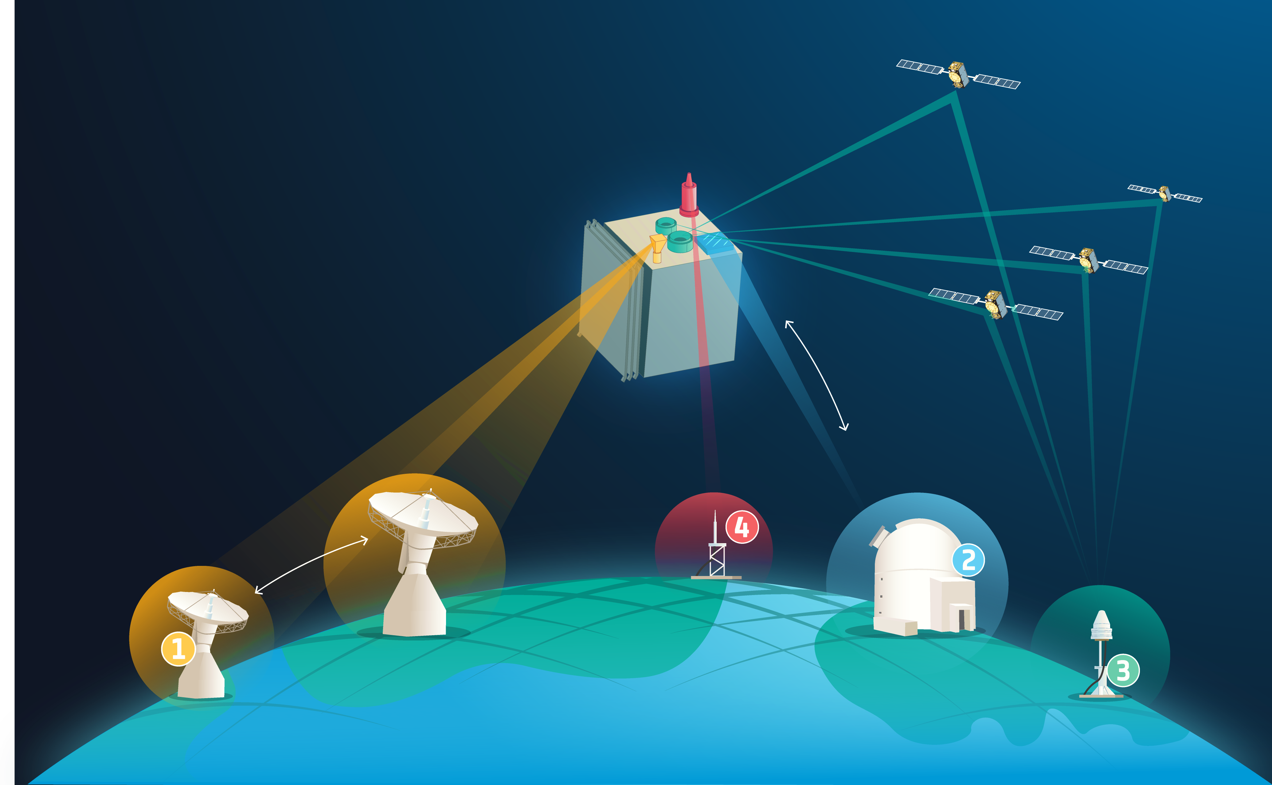
GENESIS System Overview
System:
Satellite
GCS (Ground Control Segment)
ESA PROAD (PROcessing, Archiving & Distribution)
Existing infrastructure (GNSS, SLR, VLBI, DORIS)
Four on-board geodetic Instruments:
SLR: passive reflector
DORIS, GNSS: on-board receivers
VLBI: on-board transmitter in existing VLBI frequency bands
Mission Phases:
Launch and commissioning
In-orbit test and calibration
Operations
End of mission
Four geodetic payloads:
VERY-LONG-BASELINE INTERFEROMETRY (VLBI) Transmitter
SATELLITE LASER RANGING (SLR) Retroreflector
GLOBAL SATELLITE NAVIGATION SYSTEMS (GNSS) Receiver (Nadir
and Zenith antennas)
DORIS Receiver

Slide 10
GENESIS Satellite and Payload Overview
Description
Satellite ~250-300kg, ~6000km alt. (MEO), ~95º inclination
Platform: maximum reuse of qualified equipment
Payload: 4 co-located geodetic instruments (GNSS, DORIS, SLR, VLBI) and an ultra-stable oscillator for synchronisation
Key drivers:
Radiation environment: total dose and single events effects
Radiofrequency and electromagnetic compatibility
Non-gravitational forces: mechanisms, geometry, materials...
Spacecraft centre-of-mass and attitude law
Synchronisation of active instruments to the on-board oscillator
On-board instruments systematic biases and their calibrations: phase centres + group delays
GNSS
GNSS
SLR
GNSS
DORIS
VLBI
GCS
PROAD
users

Slide 11
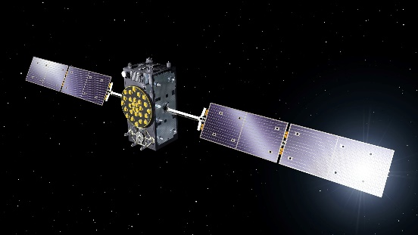
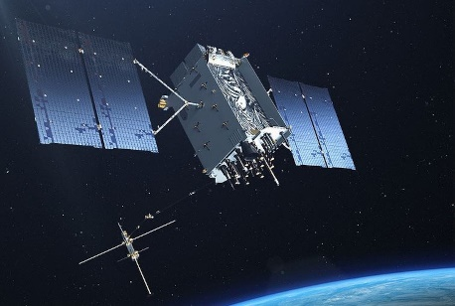
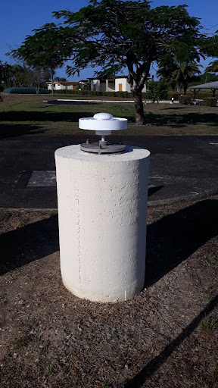
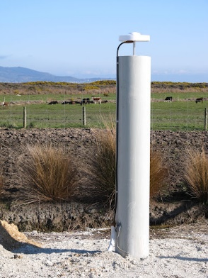
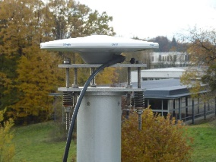
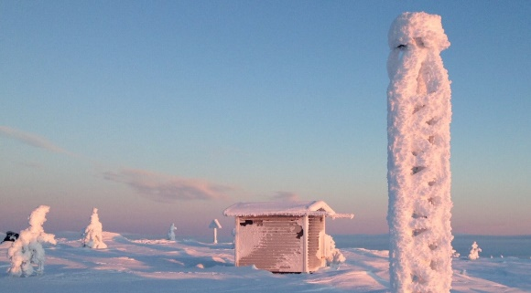
GENESIS Payload: GNSS Receiver
Description:
Multi-channel/multi-GNSS receiver
Nadir and Zenith antennas
Externally synchronised to on-board reference frequency
Key drivers:
Quality of observables (signal-to-noise ratio, Cycle Ambiguity Resolution, ...)
GNSS visibility at 6000km
Antenna Phase Center Offsets calibration (vs. azimuth/elevation, vs. temperature)
Antenna location on platform
Instrument and antenna group-delay stability
On-board time tagging of observables

Slide 12
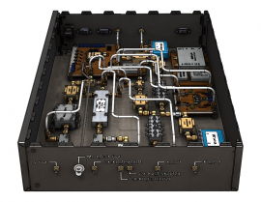
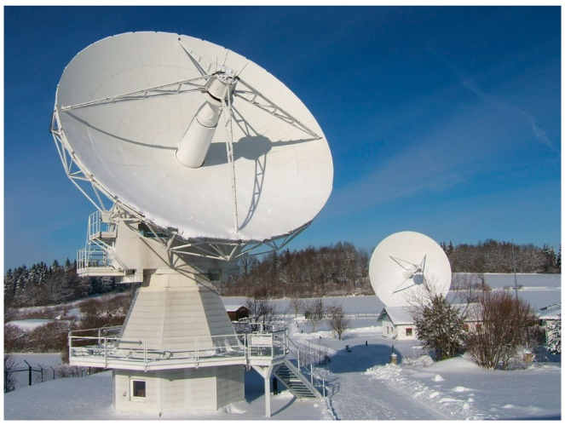
GENESIS Payload: VLBI Transmitter
Description:
4 frequency bands within [2GHz, 14GHz]
PSFD: [0.5Jy, 10Jy]
Single nadir antenna with full Earth Field of View
Externally synchronised to on-board reference frequency
Key drivers:
ITU regulations, RF Interferences and EMC
Multi-band antenna over wide bandwidth
Compatibility with both legacy and VGOS stations
Antenna PCOs calibration (vs. azimuth/elevation, vs. temperature)
Instrument group-delay calibration
VLBI Transmitter breadboard for G2G
(https://h2020nav.esa.int/project/h2020-038-01)
VLBI Radio Telescope in Wettzell, Germany
(https://shorturl.at/ctwGP)

Slide 13
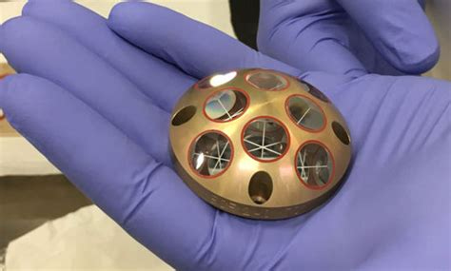
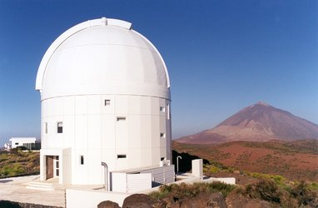
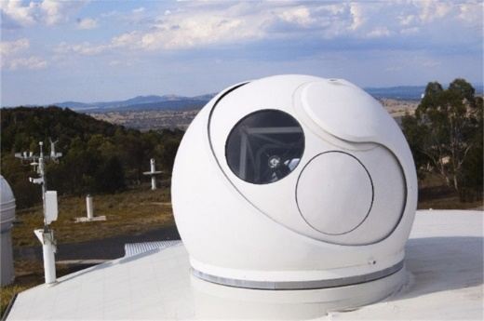
GENESIS Payload: Laser Retro-reflector
Description:
Passive LRR on the nadir-side of the satellite
Array of corner cube reflectors
Key drivers:
Field of view and optical cross-section at 6000km
Thermo-elastic effects, materials...
Accommodation
Compatibility with SLR stations
PCO calibration

Slide 14
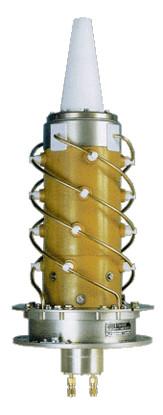
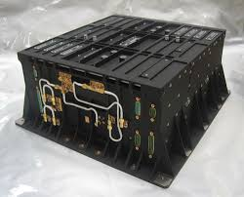
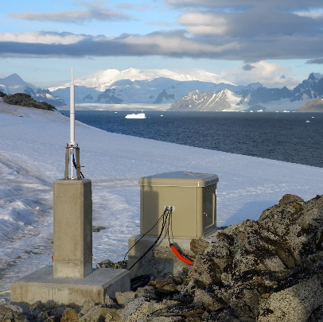
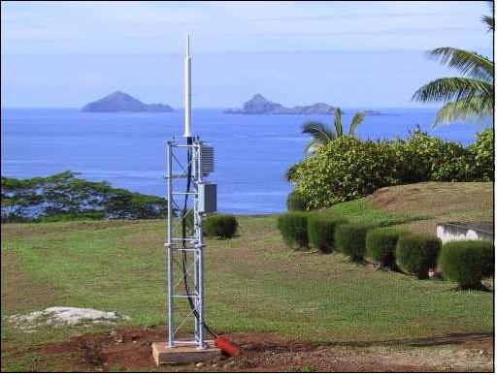
GENESIS Payload: DORIS receiver
Description:
Doppler tracking of UHF and S-band ground beacons
Dual-frequency nadir antenna
Externally synchronised to on-board reference frequency
Key drivers:
Ground Beacon visibility at 6000km
Quality of observables and on-board processing
Antenna PCOs calibration (vs. azimuth/elevation, vs. temperature)
Instrument group-delay calibration
MEO radiation environment

Slide 15
GENESIS Data PROcessing, Archiving and Delivery
GNSS
Galileo & GPS
Industry
GNSS Measurements + Additional Data
GNSS+Doris Measurements
DORIS
CNES
Doris Measurements
Navigation Support Office
ESAC GNSS Science Support Center
GENESIS Data and Products Dissemination
International Geodetic Services
SLR (ILRS)
VLBI (IVS)
GNSS (IGS)
GENESIS POD Products and other Data
PROAD

Slide 16
GENESIS Science Team
GENESIS Science Team
GENESIS Science Management Board
GENESIS Science Exploitation Team (GSET)
ESA GENESIS Scientific Representative
GENESIS Mission Lead Scientific Coordinator
GENESIS Mission Lead Scientific Co-Coordinator
Working Groups Chairs
GENESIS Mission Lead Scientific Coordinator and Co-Coordinator
GENESIS Working Groups (WGs)
  WG1: ITRF and Combination of Techniques
  WG2: GNSS
  WG3: VLBI
  WG4: DORIS
  WG5: Laser Ranging

Slide 17
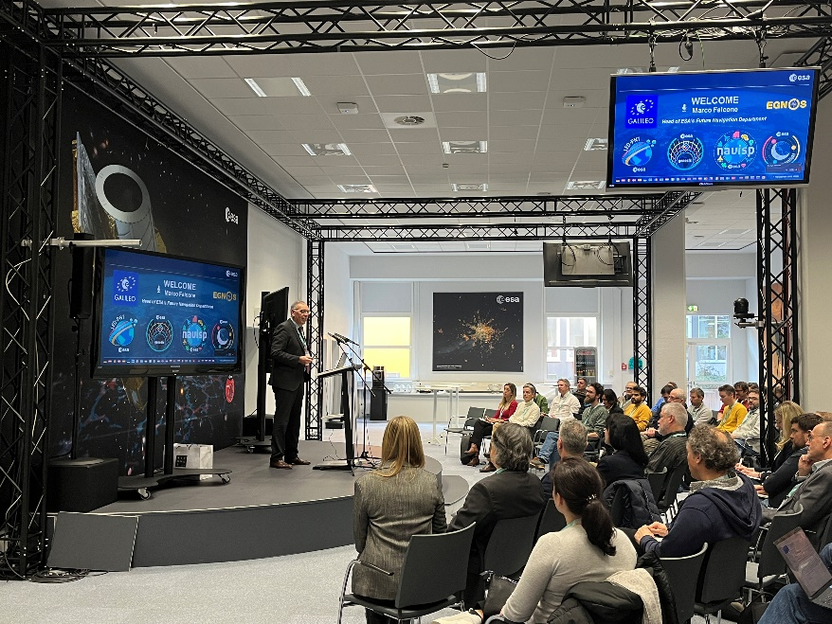
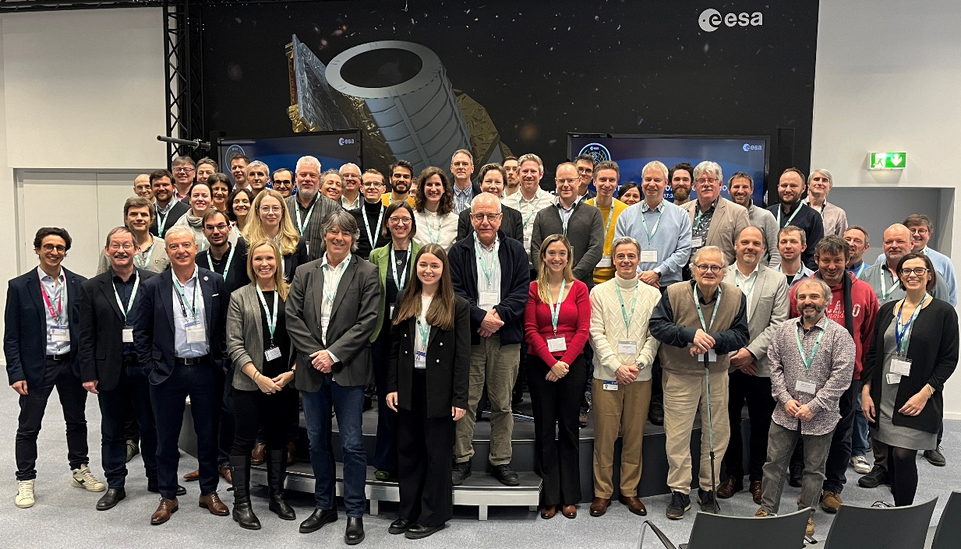
GENESIS Science Workshop
29th February @ ESOC
Agenda
Morning
Over 100 people onsite and online
Attendance from all relevant International Geodetical Services (Chairs or deputies):
Presentations from the ESA GENESIS project team
Interactive working group discussions
Wrap up and Conclusions
IAG, IERS, IGS, IVS, ILRS, IDS
Strong commitment and engagement from the community
Afternoon
“GENESIS – A Mission for the World”

Slide 18

GENESIS Science Exploitation Team - Nominations
Coordinator
Co-Coordinator
WG1: ITRF & Combination of Techniques
WG3: VLBI
WG4: DORIS
Zuheir Altamimi
Institut national de l'information géographique et forestière – IGN
Florian Seitz
Deutsches Geodätisches Forschungsinstitut-Technischen Universität München – DGFI
WG2: GNSS
Rolf Dach
Universität Bern
Benjamin Männel
Deutsches GeoForschungsZentrum – GFZ
Rüdiger Haas
Chalmers Tekniska Högskola
Guilhem Moreaux
CLS-Collecte Localisation Satellites
WG5: Laser Ranging
Clément Courde
Centre national de la recherche scientifique-Géoazur
Francesco Vespe
ASI Space Geodesy Centre at Matera
Özgur Karatekin
Royal Observatory of Belgium – RoB

Slide 19
To conclude…
Thanks to combined efforts from Scientific Community, ESA Member States, Industry and ESA, the GENESIS Mission has become a reality!
This challenging mission will be a stepping stone towards improved GNSS and navigation, together with addressing major scientific and societal goals
Despite a challenging schedule, ESA, Industry and the Scientific community are fully committed to the success of the Mission, starting with a System Requirement Review in fall 2024
We are looking forward to updating the community on the progress of the mission
GENESIS – AT THE FOUNDATION OF NAVIGATION
ESA UNCLASSIFIED – For ESA Official Use Only

Slide 20

Thank you for your attention
ESA UNCLASSIFIED – For ESA Official Use Only

