Slide 1
（Geodetic SpatioTemporal data Analysis and Research）
GSTAR software: a new framework for processing space geodetic data at the observation level
Lei Fan, Chuang Shi, Shiwei Guo, Xinqi Fang,
Linghao Zhou, Tao Zhang
Beihang University
Key Laboratory of Navigation and Communication Fusion Technology,
Ministry of Industry and Information Technology, China
Notes:
Good morning. My name is Fan Lei. It’s a pleasure for me to represent the team to give a presentation. The topic is, the GSTAR software: a new framework for processing space geodetic data at the observation level.

Slide 2
Contents
Background and Motivation
Introduction to the GSTAR software
GNSS-based products from the GSTAR software
Multiple techniques: geocenter motion estimation
Notes:
First is the background and motivation.

Slide 3
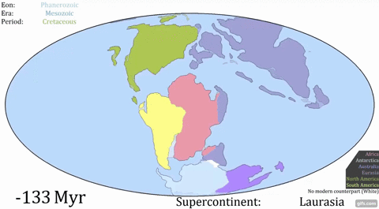
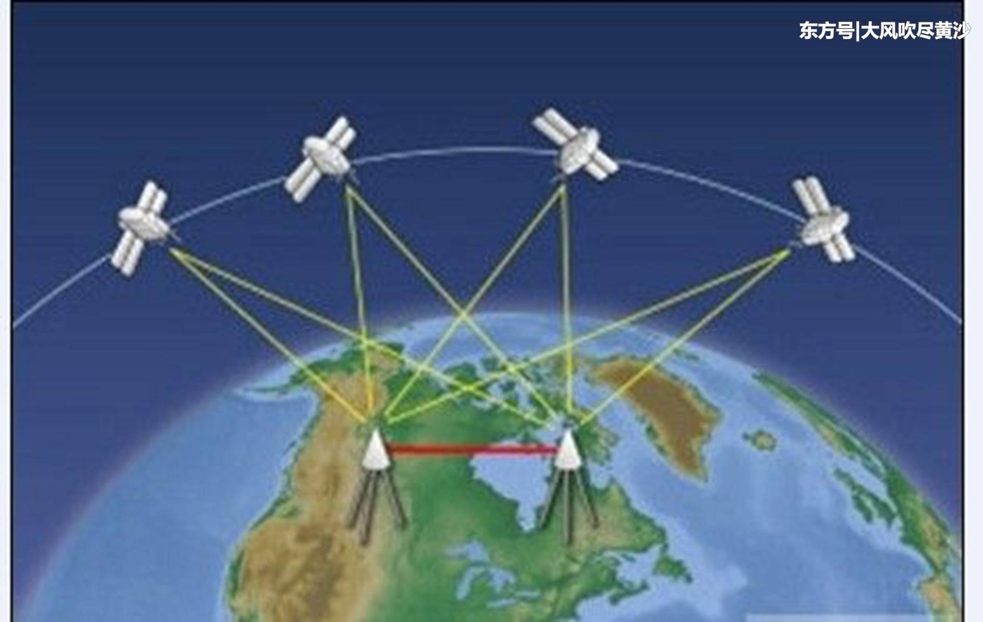
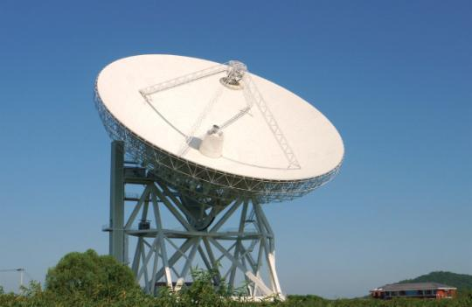
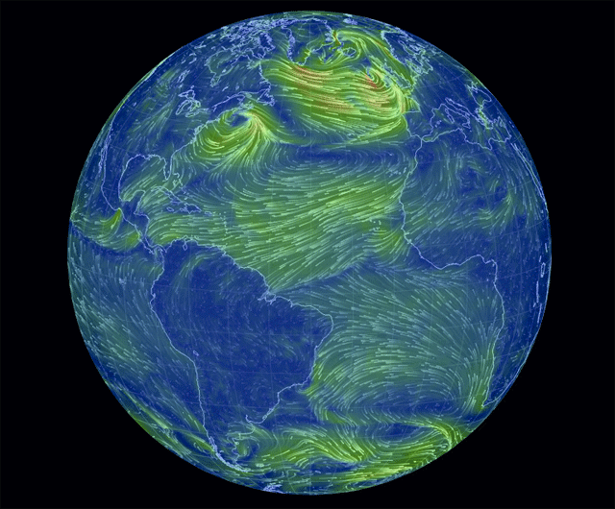
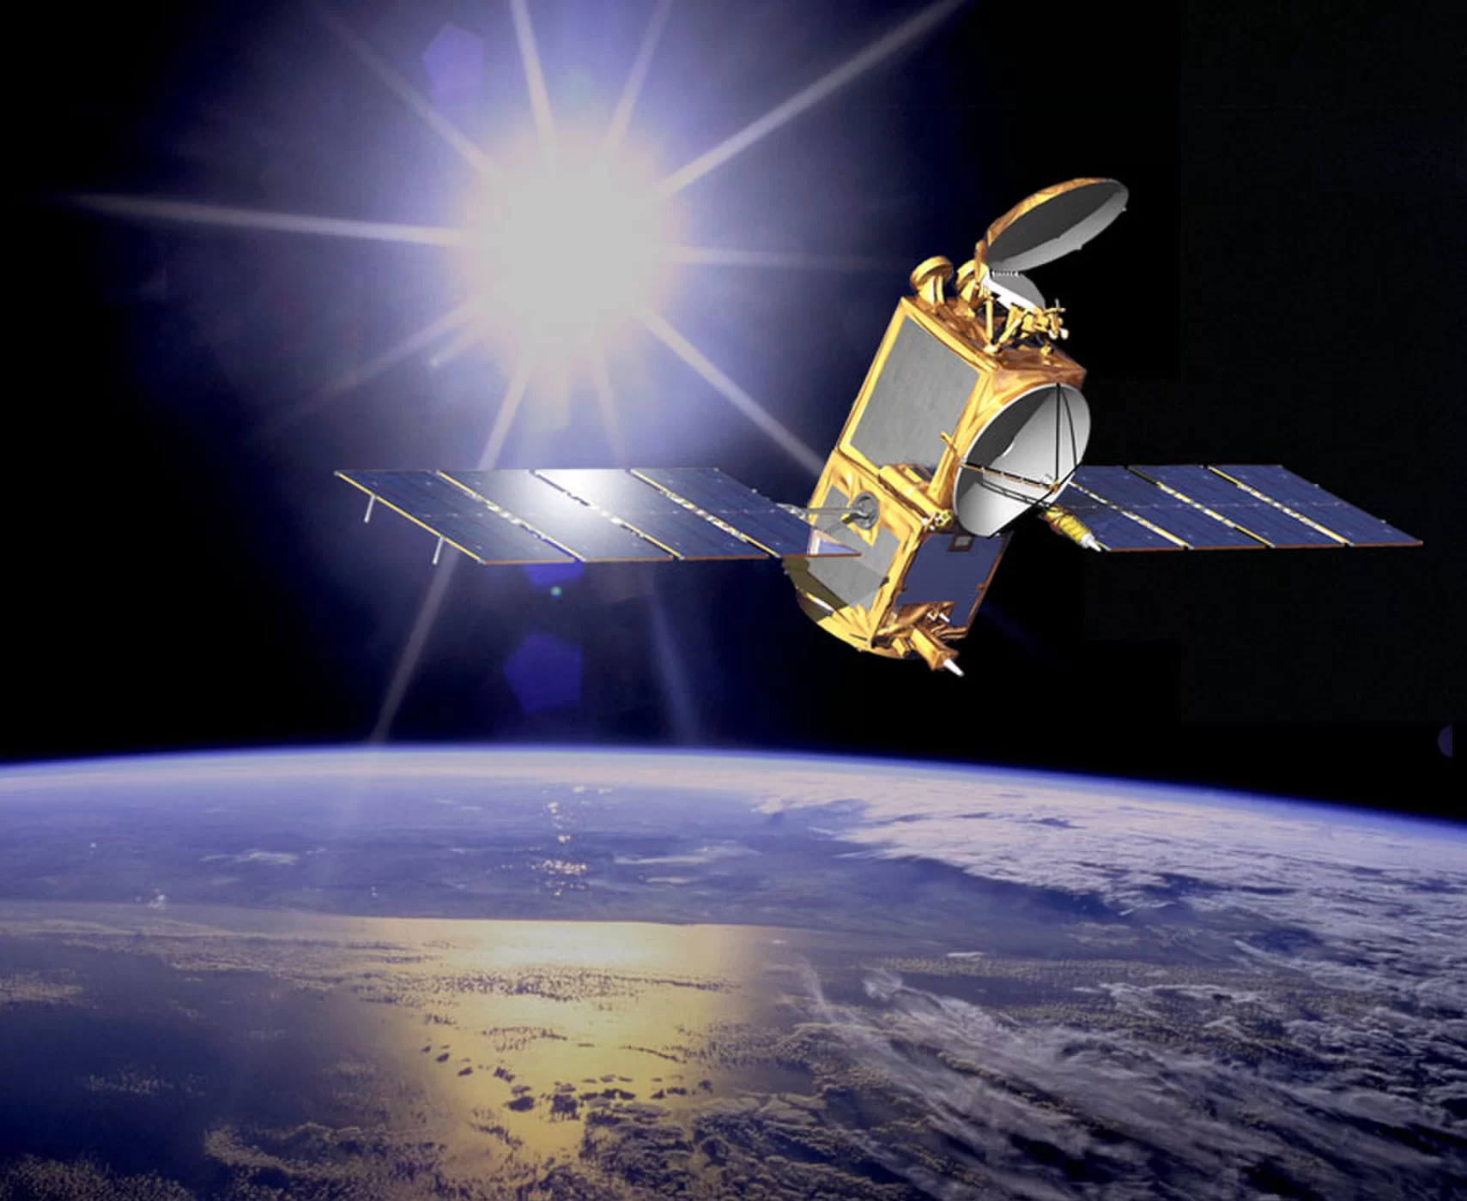
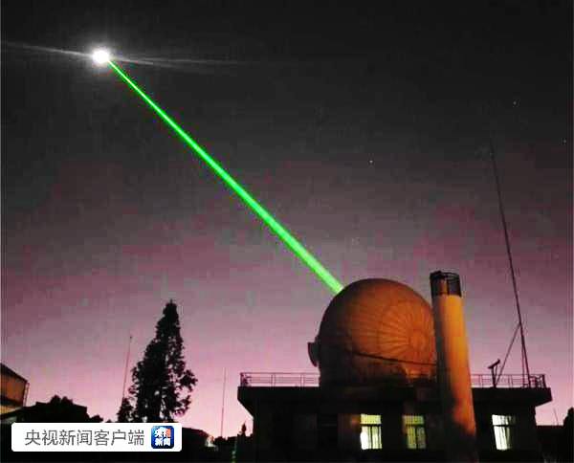

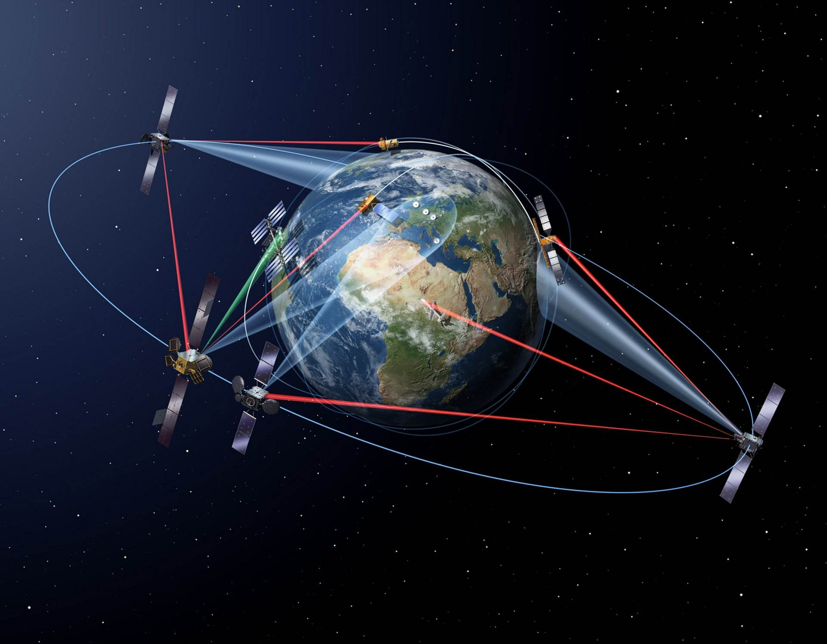
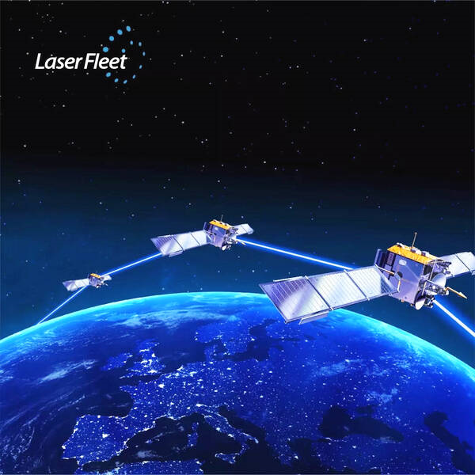
Fusion of Global Space Geodetic Observations
3
Crustal Movements
Geodetic parameter for earth system variation
Geometric parameter
geocenter, coordinate/velocity, sea surface height, etc.
Earth orientation parameter
polar motion, UT1, LOD, precession, nutation, etc.
Earth gravity parameter
Time-varying gravity field, etc.
GNSS
VLBI
Mass Movements
DORIS
SLR
Glacier Change
Inter-Satellite Link (ISL)
LEOs
Earth System Change
Parameter Characterization
Space Geodetic Observation
Data fusion: normal equation level observation level
Notes:
An integration of multiple space geodetic techniques, such as GNSS, VLBI, DORIS, SLR, and the addition of Inter-satellite link (ISL), helps to improve the accuracy of geodetic parameters. These parameters include geometric, earth orientation and gravity. They are essential for studying earth system variation. At the moment, multiple geodetic data fusion is mostly done on the normal equation level. A more rigorous approach is to combine the geodetic data on the observation level. Although this approach has already been performed, it still has not been fully exploited.

Slide 4
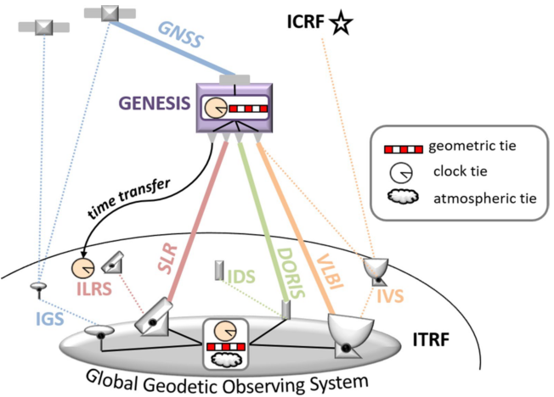
Combination of Global Space Geodetic Techniques
4
Geodetic Global Observing System (GGOS) Objectives
  ITRF: a parameter accuracy of 1mm and a stability of 0.1mm/year
  Link between the ITRF and the ICRF: improve consistency of the EOP
ESA’s GENESIS Mission
  Scheduled for launch in 2028, ~6000km
  All four space-based geodetic techniques
    on-board
  Allow for the first time a link between
  the ITRF and the ICRF
  Non-gravitational accelerations measuring
  by an accelerometer
  Improve the operational time and frequency
  transfer and synchronization globally
Delva et al. (2023)
Techniques combination: co-location on ground in space
Notes:
A stable and accurate reference frame is the precondition for earth system study. A major objective of the GGOS is to realize an accuracy of 1mm and a stability of 0.1mm/yr for ITRF. It needs co-location of different techniques. At the moment, the four techniques are combined and linked together according to co-location sites located on the ground. However, it’s hard to accurately measure the local ties between the reference points and systematic effects from each technique. An obvious trend is to realize co-location of different techniques in space. A typical example is the ESA’s GENESIS mission, it plans to carry all the four geodetic instruments, therefore, it allows for the first time a link between the ITRF and the ICRF.

Slide 5
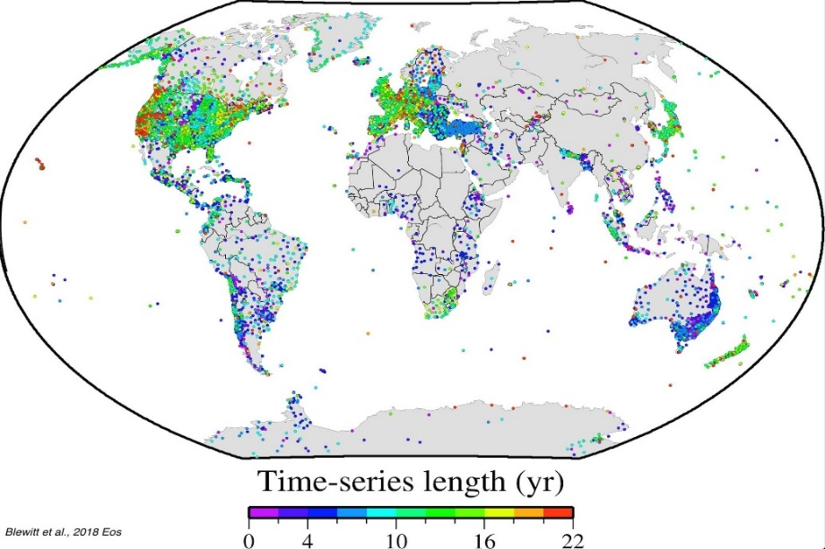
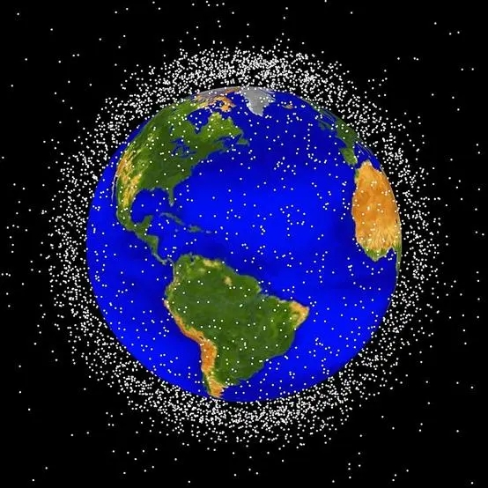
Sensors in Space and on Ground：From Sparse to Dense
5
Tens of Thousands of Ground Stations
  GNSS, VLBI, DORIS, SLR, (ISL)
Thousands of Observation Satellites
  GEO, IGSO, MEO, LEO
Tens of Millions of Parameter Estimates
  Geometrical, Physical, Models, Errors, etc.
Geodetic parameters | Space geodesy technology
 | GNSS | VLBI | DORIS | SLR | ISL | LEO
Site coordinates & velocity | √ | √ | √ | √ |  | √
Radio source coordinates |  | √
Nutation |  | √
Polar motion | √ | √ | √ | √ |  | √
UT |  | √
LOD | √ |  | √ | √ |  | √
Geocenter motion | √ |  | √ | √ | √ | √
Troposphere | √ | √ | √ | √ |  | √
Ionosphere | √ | √ | √ | √ | √ | √
Processing efficiency: low-speed high-performance
Notes:
Another challenge of future geodetic data processing is the number increasement of instruments and sensors. For example, ground stations with all geodetic techniques may reach tens of thousands, while thousands of satellites may work in the space. This creates tens of millions of parameters to be estimated if data from all these instruments is processed together. It’s a big challenge for current geodetic software in terms of computation efficiency. This is because the parameters are highly related, computation efficiency cannot be significantly improved by simply using more computers. Therefore, a new powerful software needs to be developed for data processing with high-performance computation.

Slide 6
Contents
Background and Motivation
Introduction to the GSTAR software
GNSS-based products from the GSTAR software
Multiple techniques: geocenter motion estimation
Notes:
To meet the above challenges, we developed the GSTAR software. So let me introduce it.

Slide 7
GSTAR：Architecture Design
7
Layered modular architecture
Object-oriented programming (C++) with more than 100,000 lines
Layered modular design with high cohesion and low coupling
Strong expandability and better usability for secondary development
Multi-thread processing architecture using CPU and GPU
Good cross-platform-ability on Windows, Linux and Mac OS
Notes:
The layered modular architecture is adopted to develop the GSTAR software. All modules are implemented using the object-oriented method which obeys the rule of high cohesion and low coupling. At present, there are more than 100,000 lines of C++ code. The advantage of this architecture is to realize the software in a modular form. Developers will find it convenient for secondary development by using a few interfaces. It supports multi-thread processing using CPU and GPU. It has good cross-platform-ability on Windows, Linux and Mac OS.

Slide 8
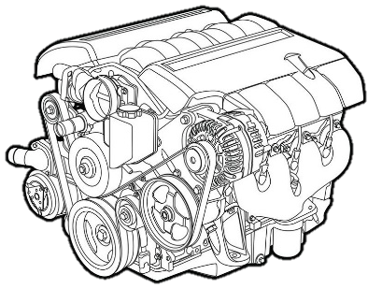
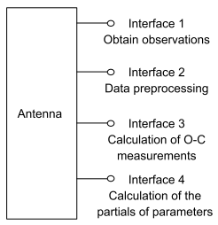
GSTAR：Data Structure
8
Antenna is the core unit for independent storage and processing（platform -> antenna -> processing）
LSQ estimator
（for post analysis）
SRIF estimator
（for real-time process）
Notes:
When we design the data structure, we consider that future satellite is assumed to have a number of sensors of the four geodetic techniques. In this way, a satellite is like an observation platform. To accommodate this trend, an antenna is taken as a core unit for data storage and processing. The antenna is designed as a base class with four interfaces. Developers can implement the four interfaces in terms of different geodetic techniques. The antennas are independent with each other, so data in each antenna can be processed in parallel. After that, the data are organized in two groups, namely parameters and Observation minus Calculation measurements, and they will be automatically pushed to the estimator to form normal equations. Two types of estimators are designed, the one is sequential least square used for post process, the other one is SRIF for real-time process.

Slide 9
GSTAR：Parameter Estimation
9
= Pointer
= Parameter
Automatic parameter organization algorithm for reducing memory and disk operations
Sequential LSQ method based on CPU+GPU parallel algorithm
  High-performance linear algebra libraries, e.g., BLAS and cuBLAS
  Parallel algorithms for different steps in sequential LSQ procedure
  Parallel I/O operations on disk and memory
Parameter List
STATIC
Normal Matrix
KINEMATIC
IONO & AMBIGUITY
Notes:
For the estimator, rapid parameter estimating algorithms are designed. First, since time-dependent parameters need to be pre-eliminated, it is very time consuming to move tens of millions of floats at the same time. Therefore, parameters are organized automatically to reduce memory and disk operations. Second, CPU and GPU parallel algorithm is proposed, which includes high-performance linear algebra libraries, e.g., BLAS for CPU and cuBLAS for GPU. Also, different steps in LSQ procedure, IO operations on disk and memory are conducted in parallel.

Slide 10
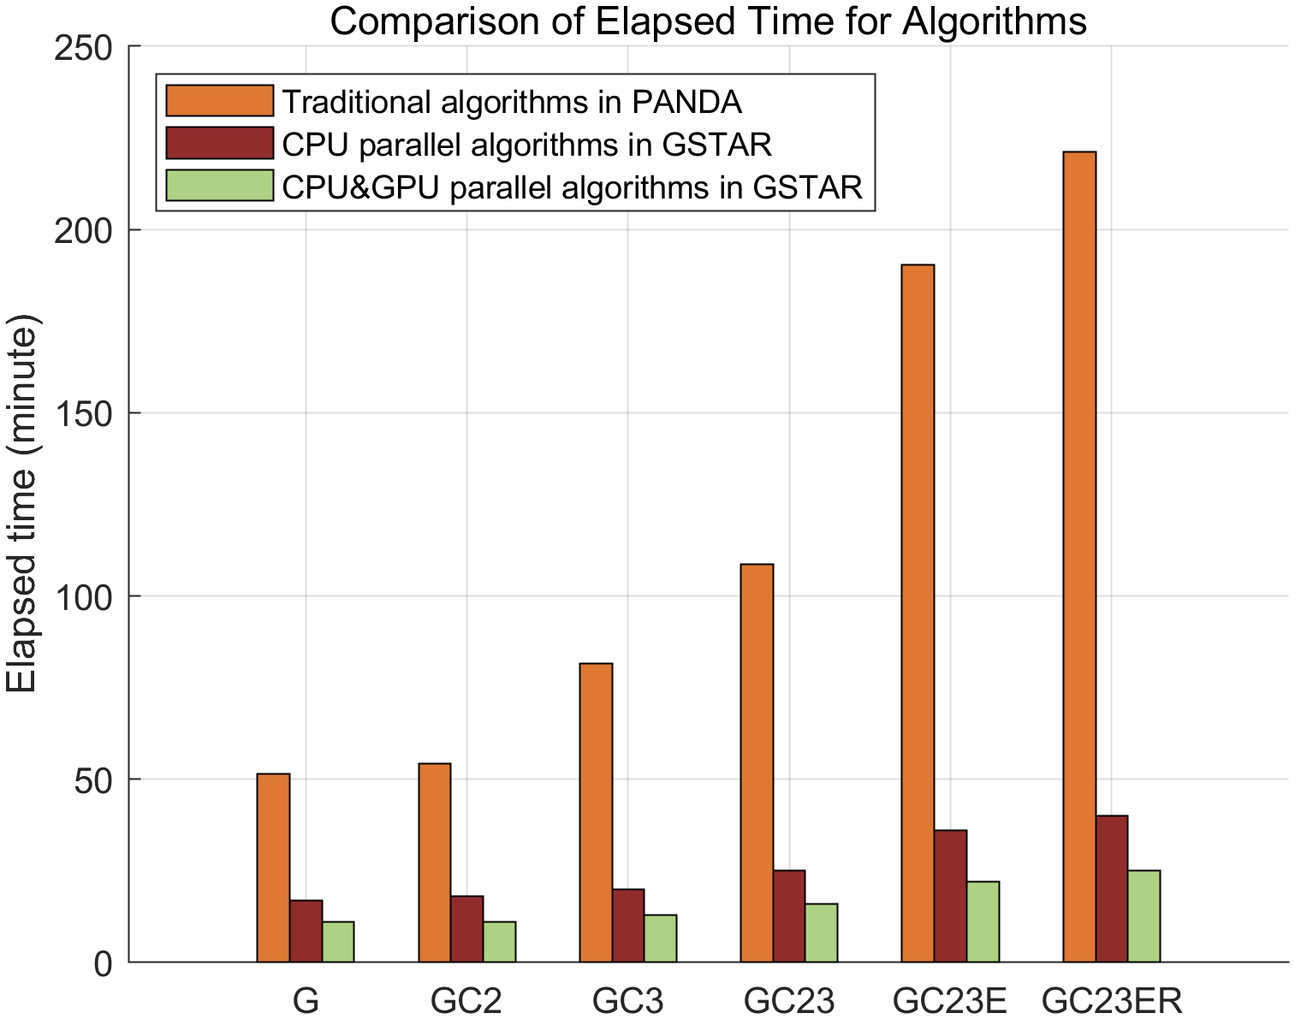
GSTAR：Processing Efficiency Test
10
CPU: Intel Xeon Gold 5220R 1GHz
GPU: Tesla P100-PCIE-16GB
Precise orbit determination: 160 stations, 300s processing interval
Compared with efficient algorithm proposed by Ge et al. (2006) used in PANDA
Improved by 6 times when using CPU-based parallel algorithm
Improved by 9 times when using CPU&GPU-based parallel algorithm
Communication consumption between CPU and GPU is a major problem which prevents further improvement
3h40min
40min
25min
G =GPS
GC2=GPS+BDS-2
GC3=GPS+BDS-3
GC23 =GPS+BDS-2+BDS-3
GC23E =GPS+BDS-2+BDS-3+Galileo
GC23ER=GPS+BDS-2+BDS-3+Galileo+GLONASS
Notes:
This is a test for processing efficiency of the GSTAR. The example is the POD with 160 stations and processing interval of 5 min. The horizontal axis refers to different combination of satellite systems, while the vertical axis refers to elapsed time in minute. The traditional efficient algorithm used in PANDA is used to be compared. We can see that, when all four systems are processed together, the CPU-based parallel algorithm in GSTAR costs 40 minutes, about 6 times that used in traditional one. When both CPU and GPU are used, GSTAR spends only 25 minutes, about 9 times that used in traditional one. It has a lot of improvement. But it is not an ideal result because communication consumption between CPU and GPU is a big problem to prevent further improvement. It still needs lots of effort to display biggest effect of GPU.

Slide 11
GSTAR：Function Status
11
Geodetic parameters | Space geodesy technology
 | GNSS | ISL | LEO | SLR | VLBI | DORIS
Site coordinates and velocity | √ |  | √ | √ | ▲ | O
Time/Frequency | √ | √ | √ |  | O
Satellite orbit and dynamic parameters | √ | √ | √ | √ | O | O
Radio source coordinates |  |  |  |  | O
Nutation |  |  |  |  | ▲
Polar motion | √ |  | √ | √ | ▲ | O
UT |  |  |  |  | ▲
LOD | √ |  | √ | √ |  | O
Geocenter motion | √ | √ | √ | √ |  | O
Troposphere | √ |  | √ |  | O | O
Ionosphere | √ |  | √ |  | O | O
Gravity field | O |  | O | O |  | O
√ Be capable of ▲ Under test O Under development
Notes:
This page summarizes the function status of the GSTAR at present. It supports satellite precise orbit and clock determination; precise positioning for both network and PPP solution in either of static or kinematic mode; precise estimation of ERP, geocenter, atmosphere delay; combination of GNSS, ISL and SLR at the observation level, while VLBI, DORIS and gravity field are still under development and test.

Slide 12
Contents
Background and Motivation
Introduction to the GSTAR software
GNSS-based products from the GSTAR software
Multiple techniques: geocenter motion estimation
Notes:
Next, let me introduce performance of GNSS-based products from the GSTAR.

Slide 13
GSTAR：GNSS-based Products Processing
13
~165
~100
~150
~150
Strategies | Descriptions
Num. of stations | GPS/GLONASS/Galileo/BDS ~ 315 stations
Time span & Reference frame | 2020.01.01-2022.06.30 align to IGS14 2022.07.01-2024.03.01 align to IGS20
Antenna correction | IGS14_”week”.atx, IGS20_”week”.atx
Solar radiation pressure | ECOM-2 model with 7 parameters
Earth radiation pressure | Considered
Antenna thrust | Consider the different thrust values
ERP | Estimate polar motion and LOD, while fix UT1-UTC to IERS C04
Geocenter motion | NNT+NNR constraint
Yaw attitude | Kouba (2017)
Ionosphere | IF combination without higher order
Troposphere | GPT2+VMF1
Other error corrections | IERS Conversions 2010
Notes:
This table gives the strategy. More than four years multi-GNSS data, from 2020 to 2024, collected from totally 315 stations are used for data processing. Before July 2022, the reference frame is IGS14, and after, IGS20. The satellite orbit is first estimated using 165 stations with interval of 5 minutes. Then, satellite clock is estimated using 100 stations with interval of 30 seconds. After that, precise positioning procedure is conducted to calculate station coordinates using 150 stations. In addition, geocenter motion is determined independently with no-net-translation and no-net-rotation constraint using 100 stations.

Slide 14
GSTAR: GNSS Satellite Orbit
14
Take ESA products as reference
GPS
GLONASS
Galileo
BDS-MEO
BDS-IGSO
3D RMS of the orbit differences are 2.7, 6.6, 3.6, 7.2 and 21.7 cm for GPS, GLONASS, Galileo, BDS MEO, and BDS IGSO satellites
Notes:
This is the GNSS satellite orbit result. ESA’s products are taken as reference and all results are compared to it. Results from GSTAR is denoted as BUAA, abbreviation of Beihang University. For comparison, products from seven IGS ACs are also given. The left figure shows the RMS of each component for four years. The right figure shows the time series of 3D RMS of each day. The red bar and dot represent our results while other colors refer to IGS ACs. In conclusion, the 3D RMS of the orbit differences are 2.7, 6.6, 3.6, 7.2 and 21.7 cm for GPS, GLONASS, Galileo, BDS MEO, and BDS IGSO satellites, which are comparable with IGS ACs.

Slide 15
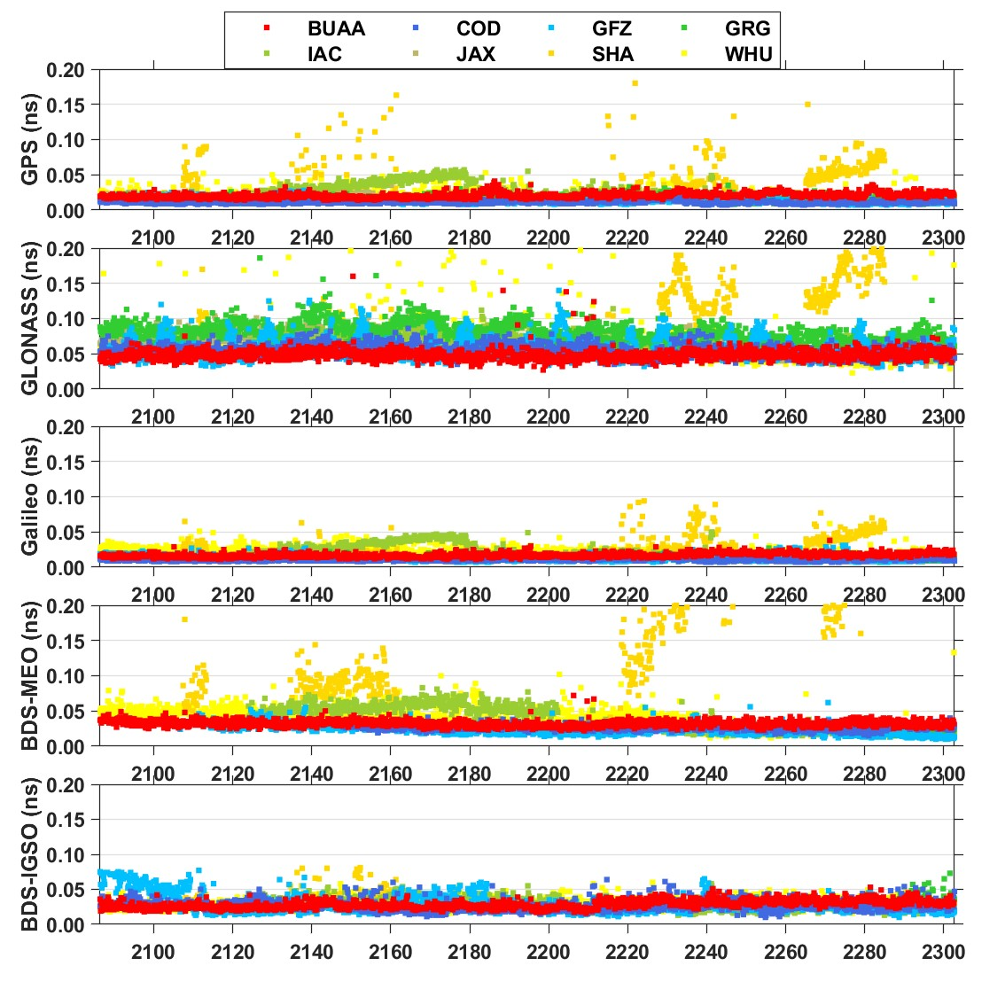
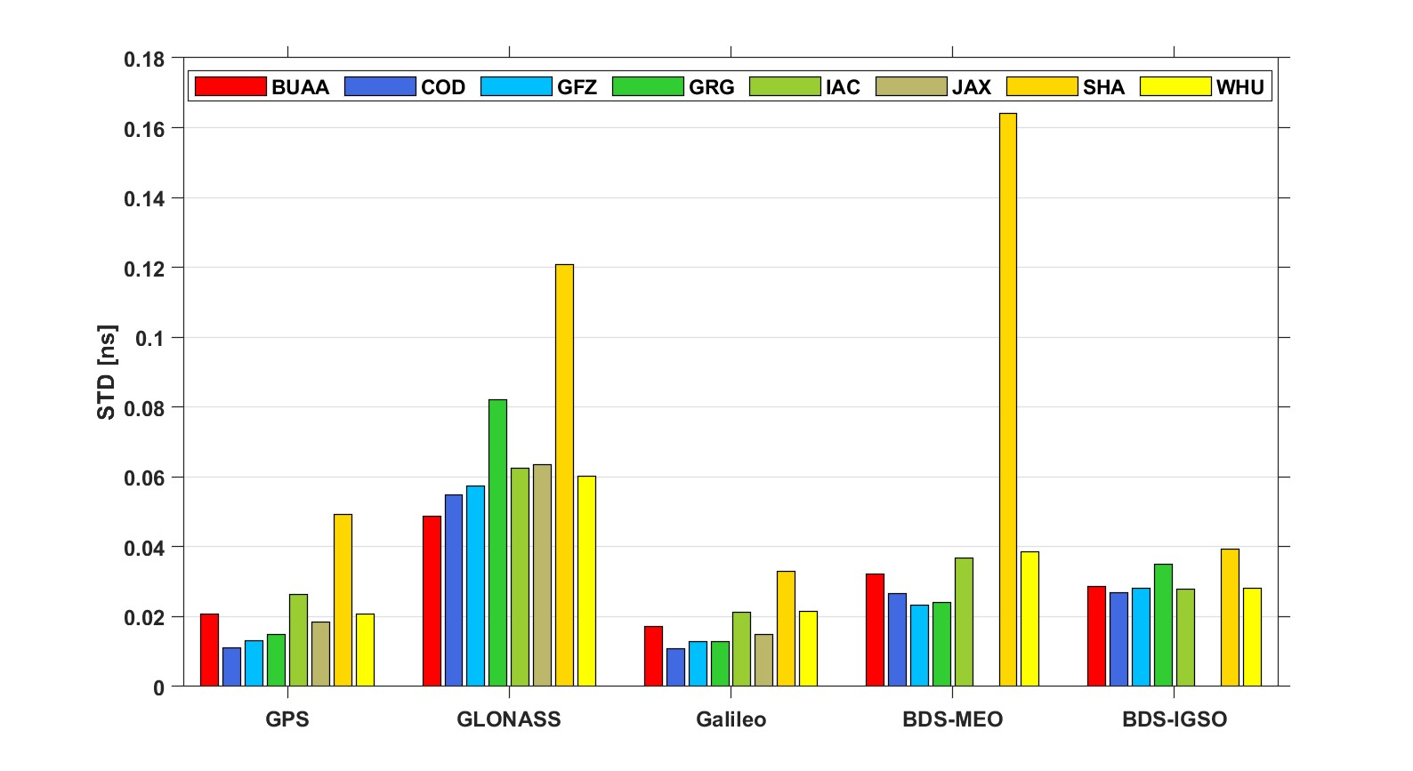
GSTAR: GNSS Satellite Clock
15
Take ESA products as reference
GPS
GLONASS
Galileo
BDS-MEO
STD of the clock differences are 21, 49, 17, 32 and 28 ps for GPS, GLONASS, Galileo, BDS MEO, and BDS IGSO satellites
BDS-IGSO
Notes:
Similarly, this is the GNSS satellite clock result. It is evaluated by standard deviation with respect to the ESA’s products. The STD of the clock differences are 21, 49, 17, 32 and 28 picoseconds for GPS, GLONASS, Galileo, BDS MEO, and BDS IGSO satellites.

Slide 16
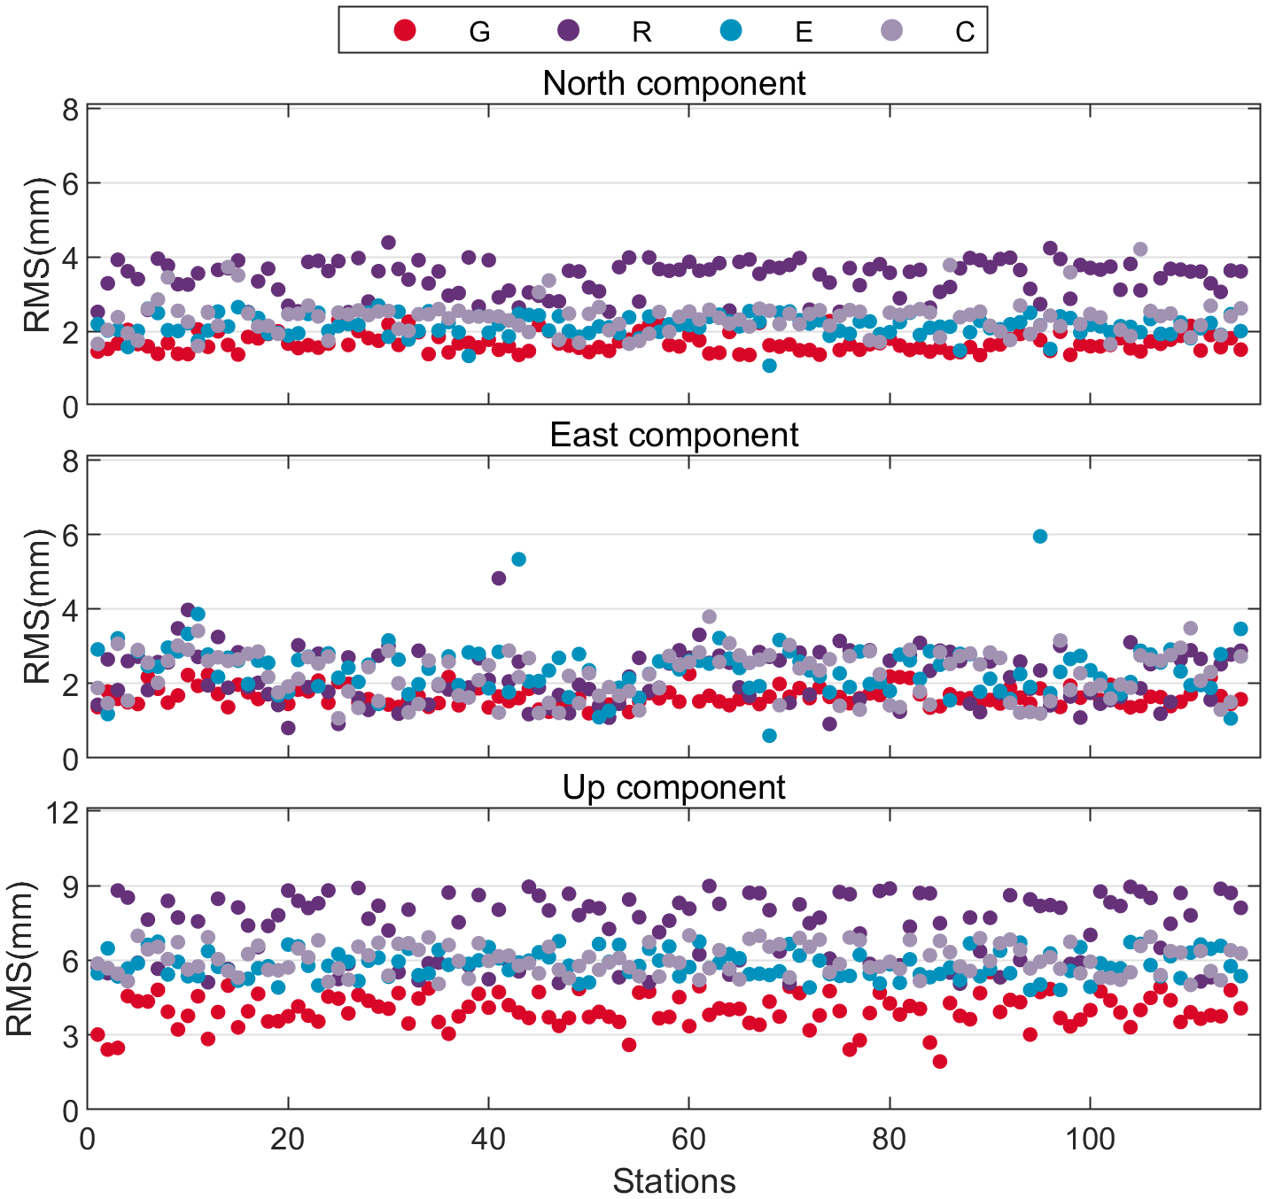
GSTAR: Station Coordinates
16
  Time span：2023.01.01 – 2023.12.31
  Helmert transformation is conducted
  BUAA：compared with IGS daily solution
  Other ACs: compared with IGS daily solution
RMSs of the position differences for each station with respect to the IGS daily solution
Unit (mm) | N | E | U
GPS-only | 1.6 | 1.6 | 3.8
GLONASS-only | 3.5 | 2.3 | 7.3
Galileo-only | 2.2 | 2.3 | 5.8
BDS-only | 2.4 | 2.3 | 6.0
Combined G/R/E/C | 3.3 | 2.2 | 4.2
Unit (mm) | N | E | U
ESA | 1.5 | 1.6 | 3.9
JPL | 2.2 | 2.3 | 4.8
MIT | 1.3 | 1.6 | 3.7
GRG | 1.3 | 1.5 | 3.6
JAX | 1.9 | 1.7 | 5.1
Notes:
This is the station coordinate result. All results are compared to the IGS daily solution. Helmert transformation is conducted to eliminate the frame differences of different solutions. We can see that the horizontal direction of less than 2 mm and up direction of less than 4 mm can be achieved in GPS-only solution by the GSTAR. This is at the same level with other ACs solution. For Galileo-only and BDS-only solution, the horizontal direction of less than 3 mm and up direction of less than 6 mm are obtained.

Slide 17
GSTAR: Geocenter Motion
17
Time series of GCC
Amplitude spectra of GCC series
The X and Y directions from different systems are consistent with IGS products
Draconitic harmonics of BDS-3 in Z directions are significant with amplitude of 19 mm
7-day periodical signal are observed for BDS-3 in X and Y directions
Notes:
This is the geocenter result. Time series of GPS, Galileo, BDS and IGS products are given here. Also, amplitude spectra of each series are given in the right picture. We can see that the X and Y directions from different systems are consistent with IGS products. But for BDS, some different phenomenon can be found, the draconitic harmonics of BDS-3 in Z directions are significant, and 7-day periodical signal are observed in X and Y directions. This might relate to the constellation geometry.

Slide 18
Contents
Background and Motivation
Introduction to the GSTAR software
GNSS-based products from the GSTAR software
Multiple techniques: geocenter motion estimation
Notes:
Next, let me briefly introduce the evaluation of multiple geodetic data processing at the observation level for geocenter.

Slide 19
GSTAR：Galileo+SLR Geocenter Motion
19
Amplitude spectra of GCC time series. The vertical gray lines denote the harmonics of a draconitic year
Adding SLR data
  Formal errors are reduced by 32%, 32% and 29% in X, Y and Z components
  3rd draconitic signals in the Z component: reduced by 74%
Formal errors of GCC parameters as a function of the absolute value of the Sun elevation angle above the orbital plane (|β|)
Notes:
The combination of Galileo and SLR is conducted. Compared to Galileo-only solution, with a small amount of SLR data from Galileo satellite, the formal error in the three directions is reduced by an average of 31%, and the 3rd draconitic signals in the Z component is reduced by 74%.

Slide 20
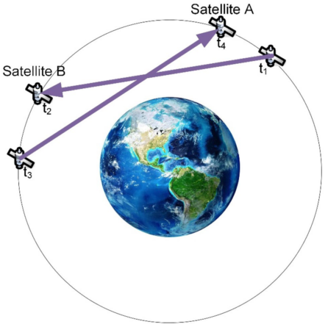
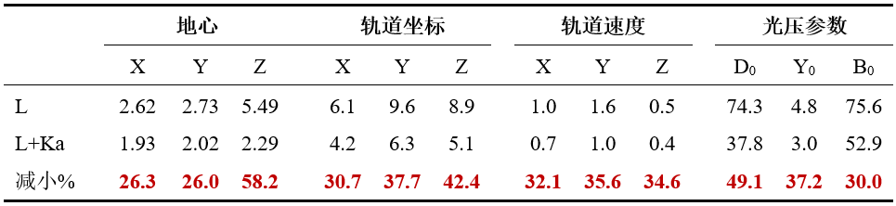
GSTAR：BDS-3+ISL Geocenter Motion
20
0.7 to 0.3
Reduction of Formal errors
  GCC-X/Y: 26%, GCC-Z: 58%
  Orbit position : 31~42%
  SRP parameters: 30~49%
  The additional ISL measurements can decorrelate the GCC-Z and SRP parameters
Geocenter coordinates
Orbit position
Orbit velocity
SRP parameters
Reduction %
Notes:
The ISL also contribute to the improvement of geocenter estimates. When both BDS-3 and ISL data are used, the formal error of the geocenter is reduced by 26% in X and Y directions and 58% in Z direction. The correlation between the geocenter Z direction and SPR parameters is significantly reduced from 0.7 to 0.3.

Slide 21
Summary
Geodetic SpatioTemporal data Analysis and Research (GSTAR) software was developed in Beihang University; layered modular architecture and antenna-based data structure were proposed to make secondary development more convenient.
The GSTAR realizes CPU+GPU parallel processing algorithm, which improved the data processing efficiency by 9 times than traditional serial algorithm for multi-GNSS POD.
The GSTAR is initially tested by estimating GNSS satellite orbit, clock, station coordinate and geocenter motion. The accuracies of these GNSS-based products are comparable with those from IGS Analysis Centers.
The formal errors and draconitic signals of geocenter motion estimates with multiple geodetic techniques is significantly improved compared to the only GNSS solution.
The GSTAR is still under development and it needs more test (e.g., VLBI, DORIS, Gravity field). A website to provide open service for geodesy communities and the user manual is expected to be finished soon.

Slide 22


Thanks for participation!

