Slide 1
IGS Real-Time ACC at BKG: First Experiences
Andrea Stürze, Peter Neumaier, Erwin Wiesensarter
Federal Agency for Cartography and Geodesy, BKG
IGS Symposium & Workshop 1 to 5 July in 2024, Bern

Slide 2
Contents
IGS Real-Time ACC-Tasks
RTS Clock Combination in Real-Time
RTS Product Validation
RTS Performance Monitoring
Aspects of Satellite Clock Estimation and Comparison
Kalman Filter Clock Combination Approach
SP3-File Comparison Approach
Results
Multi-GNSS RTS Clock Combination Products
RTS Product Validation based on CODE’s Rapid Multi GNSS Product
RTS Performance Monitoring
Conclusion
Status and Future Work

Slide 3
Aspects of Satellite Clock Estimation
Satellite clocks can be estimated e.g. using:
Pseudo-range (code) observations
A reference clock has to be chosen:
a selected receiver or satellite clock or
a linear combination of clocks: e.g. constraining the sum of all satellite clock corrections towards zero
Hence, the resulting clock estimates refer to the respective reference
A combination of code and phase observations
Computing a phase aligned clock solution to have a noise as low as possible (for PPP) and
Additional estimation of a drift between code and phase clocks to follow the code (for IGS)
.. unknown, a lot of possibilities
In all cases the satellite clocks can be estimated in a relative sense only
Removing the AC-dependent biases is a major issue with clock combinations
Usually a ionosphere-free linear combination is used in order to eliminate the effect of the ionosphere

Slide 4
Kalman Filter Clock Combination Approach
Clocks:
Kalman filter approach
$c_{A}^{S}=c^{S}$ $\text{+}$ $o_{A} \text{+ } o_{A}^{S}$
with pseudo-observations
$c_{A}^{S}$ .. the clock corrections for satellite S estimated by Analysis Center A referring to a common broadcast clock
and unknowns, which differ in their stochastic properties
$c^{S}$ .. the resulting combined clock correction for satellite S
$o_{A}^{S}$ .. the satellite and analysis center specific offset; both are defined to be epoch-specific, whereas
$o_{A}$ .. the analysis center specific offset is assumed to be a static parameter and is common for all satellites
System-wise combination for defined reference signals: G: C1W/C2W, R: C1P/C2P, E: C1C/C5Q, C: C2I/C6I

Slide 5
Kalman Filter Clock Combination Approach
Code Biases:
Consideration of satellite code biases supplied by individual ACs
Assuming the ACs generate ionosphere-free clocks using their individual chosen signals, the ionosphere-free biases for the reference signals are determined from the supplied code biases and subtracted from the clocks before the combination
The combined clocks are code-bias-free and ionosphere-free satellite clocks
Computation of satellite code biases for the combination result using bias product from CAS (G,R,E,C)
If the ionosphere-free linear combination of two Observable-specific Signal Biases (OSBs) that means, those of the reference signals, is set to zero all other OSBs can be calculated.
Orbits:
The orbit information is extracted from one of the incoming AC solutions

Slide 6
Results: Multi-GNSS RTS Clock Combination Product
Results:
SSRA02IGS1, SSRC02IGS1 supporting G + R + E
SSRA03IGS1, SSRA03IGS1 supporting G + R + E + C
.. in IGS-SSR (1) format
.. SSRC stands for CoM (IGS) and SSRA stands for APC (BRDC)
Product files are extracted and uploaded to CDDIS and BKG GNSS Data Center
IGS2OPSRTS_YYYYDOY0000_01D_01M_OSB.BIA.gz
IGS2OPSRTS_YYYYDOY0000_01D_10S_CLK.CLK.gz
IGS2OPSRTS_YYYYDOY0000_01D_30S_ORB.SP3.gz
IGS3OPSRTS_YYYYDOY0000_01D_01M_OSB.BIA.gz
IGS3OPSRTS_YYYYDOY0000_01D_10S_CLK.CLK.gz
IGS3OPSRTS_YYYYDOY0000_01D_30S_ORB.SP3.gz

Slide 7
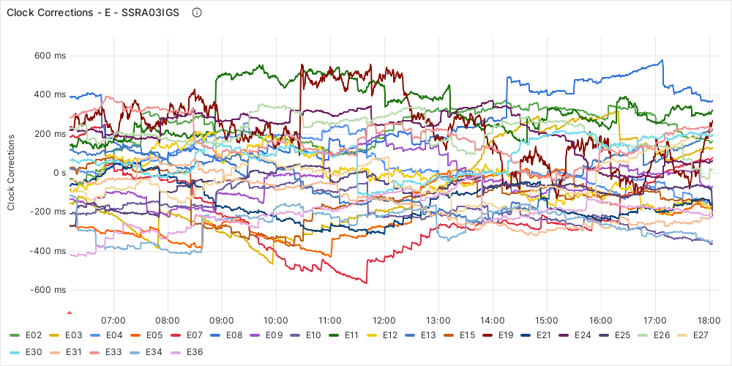
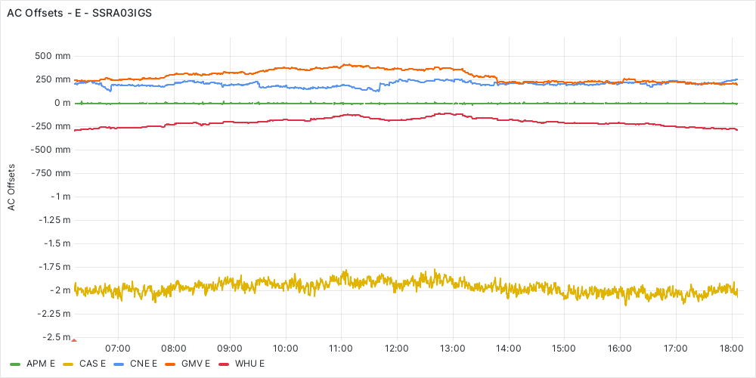
Results: Multi-GNSS RTS Clock Combination Product
Combined clock corrections for Galileo satellites $c^{S}$ AC specific offsets common for all Galileo satellites $o_{A}$
07-01-2024 - SSRA03IGS

Slide 8
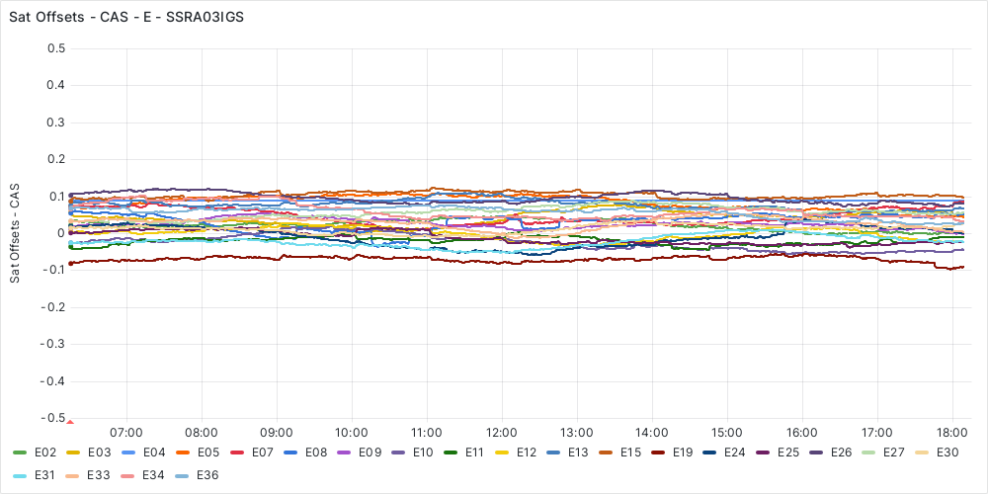
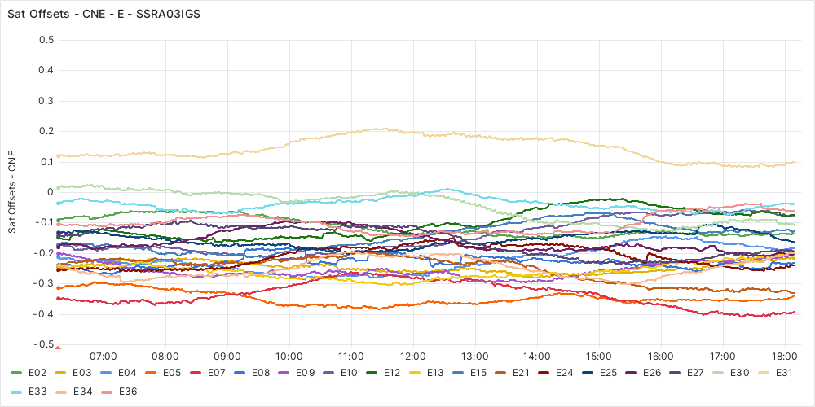
Results: Multi-GNSS RTS Clock Combination Product
Satellite and AC specific offset $o_{A}^{S}$: CAS - E Satellite and AC specific offset $o_{A}^{S}$: CNES – E
07-01-2024 - SSRA03IGS

Slide 9
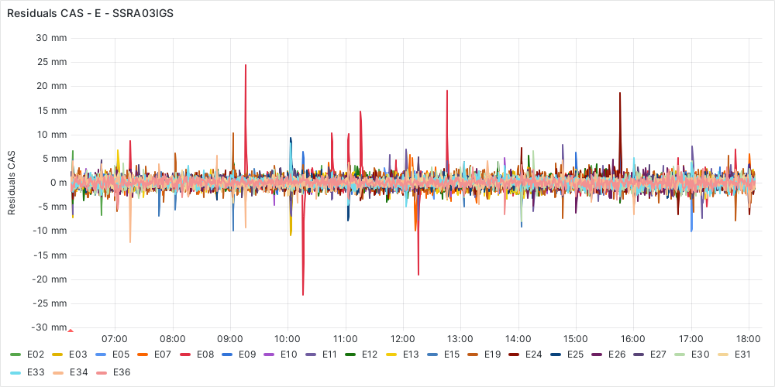
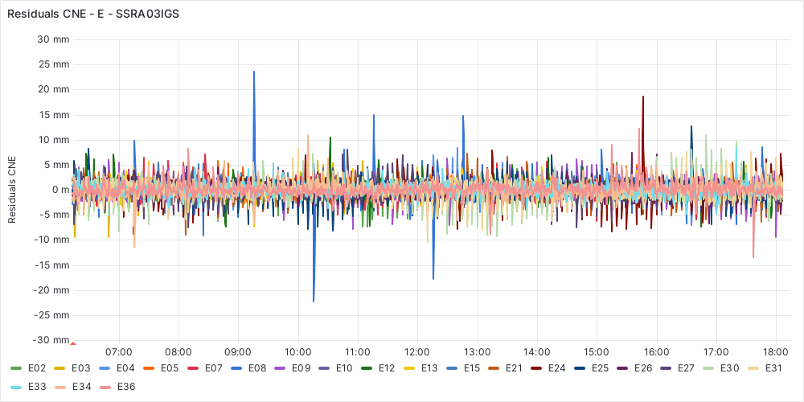
Results: Multi-GNSS RTS Clock Combination Product
Clock Residuals for RTS AC CAS - E Clock Residuals for RTS AC CNES - E
07-01-2024 - SSRA03IGS
Satellite and AC specific biases are removed

Slide 10
Aspects of Satellite Clock Comparison
The major issue within a clock comparison is to be aware of the variety in the relative sense that satellite clock parameters estimated by different AC’s can have. In other words:
We have to take care of removing the AC dependent biases!
Hence, we started with an implementation of a post-processing capability to compare satellite orbits and clocks considering that issue.

Slide 11
SP3-File Comparison Approach
In a first step the comparison is based on SP3 files:
Input:
a SP3 reference file, for example the rapid solution of an IGS AC, and
a SP3 file generated using a IGS RTS AC or product stream
Therefore the corrections stream can be ‘combined’ with the Broadcast Ephemeris stream to save final orbit and clock results in SP3 and/or Clock RINEX format.
Orbits:
Computation of orbit differences $dX, dY, dZ$using common epochs from both files and its expression in radial, along-track and cross-track components
This allows a quality check of the ultra rapid solution that was introduced during clock estimation process

Slide 12
SP3-File Comparison Approach
Clocks:
Computation of the clock differences ${∆c}_{A}^{S}$ from common epochs of both files
Correct them for the radial component of coordinate differences and
using them in a least square adjustment
${∆c}_{A}^{S}=$ $o_{A} \text{+ } o_{A}^{S}$
of $p$ independent groups of observations based the so called addition theorem of normal equations:
$$\left(\sum_{i=1}^{p}{α_{i}A_{i}^{´}P_{i}A_{i} }\right)\hat{x}= \sum_{i=1}^{p}{α_{i}A_{i}^{´}P_{i}l }$$
with the following unknowns
$o_{A}$ .. the analysis center specific offset common for all satellites
$o_{A}^{S}$ .. the satellite and analysis center specific offset

Slide 13
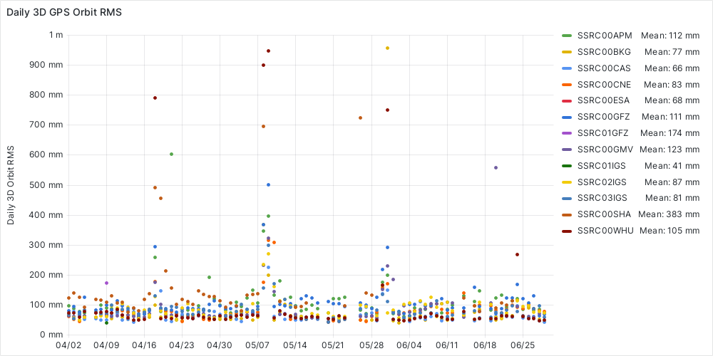
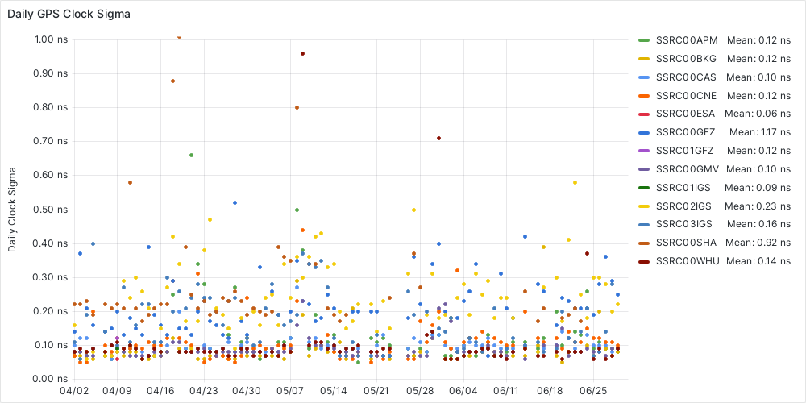
Results: RTS Product Validation
Reference:
CODE’s Rapid GNSS orbits and clocks (G + R + E) with an update rate of 30 seconds acting as reference allow for the validation of the IGS RTS AC solutions and the IGS RTS Products (CoM + APC streams)
Results:
GPS satellite orbit and clock performance for IGS RTS AC solutions and IGS RTS Products (last 90 d, CoM)

Slide 14
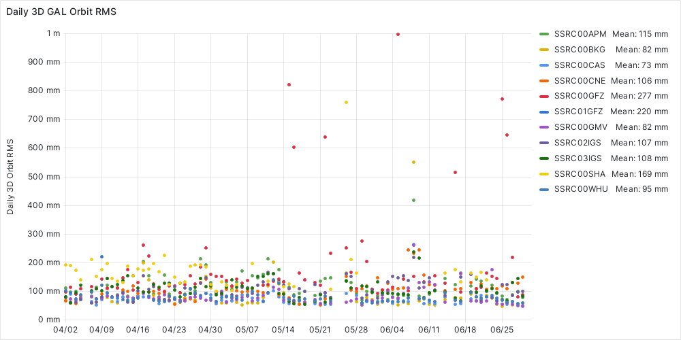
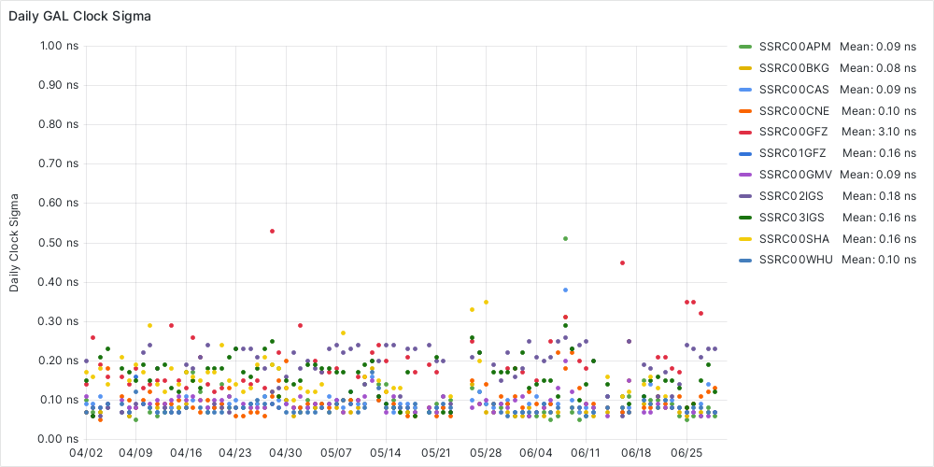
Results: RTS Performance Monitoring
Galileo Satellite Orbits & Clock Performance for IGS RTS AC solutions and IGS RTS Products (last 90 d, CoM)

Slide 15
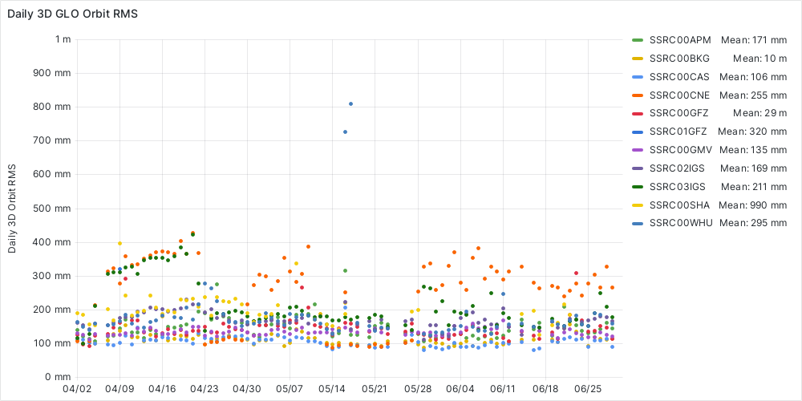
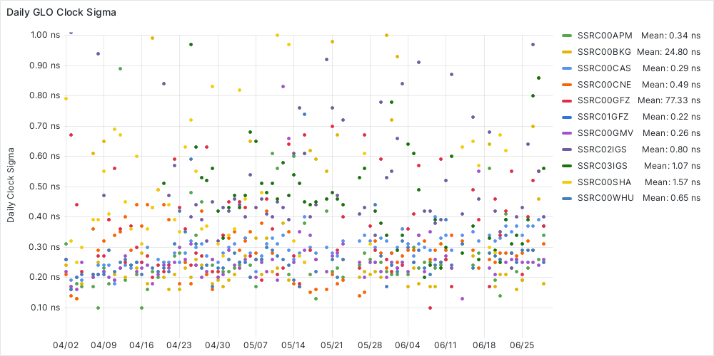
Results: RTS Performance Monitoring
GLONASS Satellite Orbits & Clock Performance for IGS RTS AC solutions and IGS RTS Products (last 90 d, CoM)

Slide 16
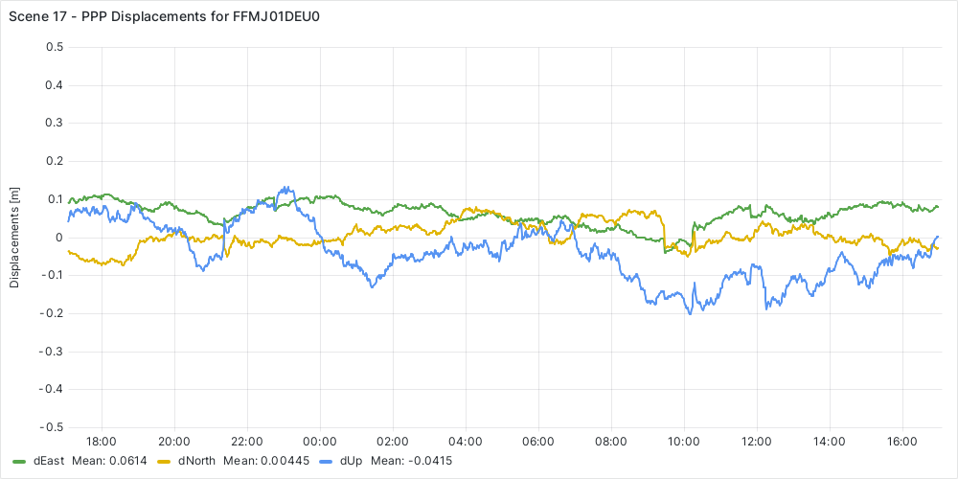
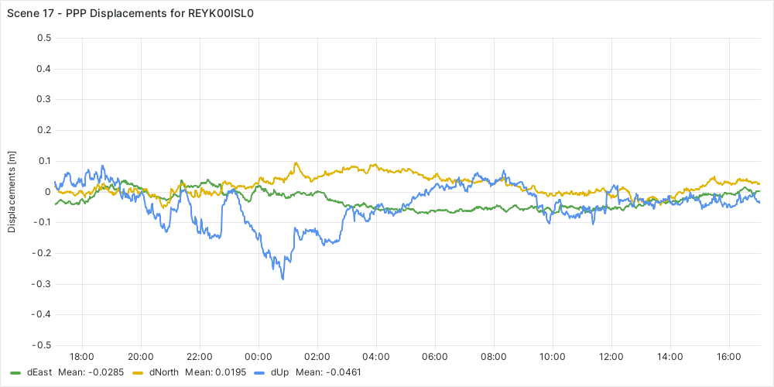
Results: RTS Performance Monitoring
PPP using IGS RTS Products 06-30-2024/07-01-2024
FFMJ01DEU0 with SSRA02IGS1 REYK00ISL0 with SSRA02IGS1

Slide 17
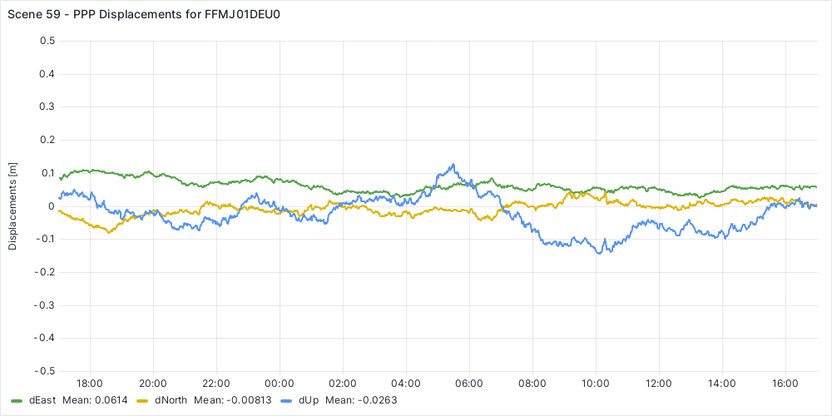
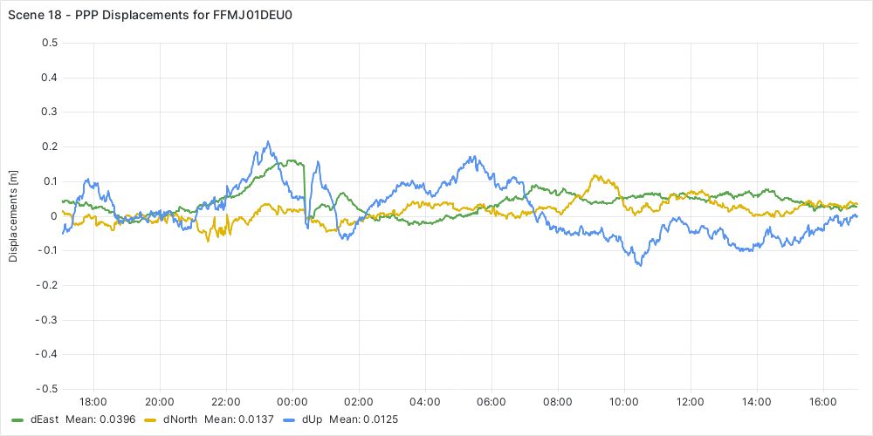
Results: RTS Performance Monitoring
PPP using IGS RTS AC solutions 06-30-2024/07-01-2024
FFMJ01DEU0 with SSRA00CAS1 FFMJ01DEU0 with SSRA00CNE01

Slide 18
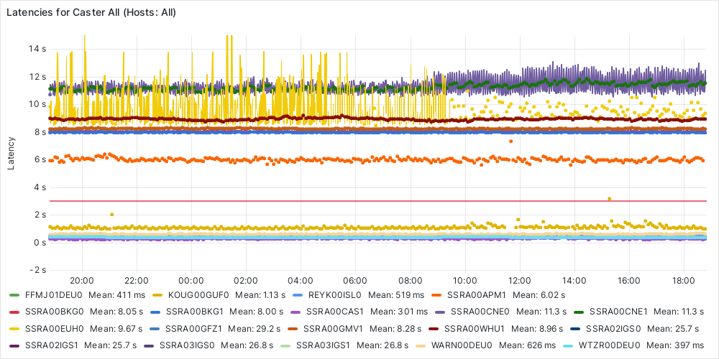
Results: RTS Performance Monitoring
Latencies of GNSS observations, IGS RTS AC solutions and IGS RTS Products 06-30-2024/07-01-2024

Slide 19
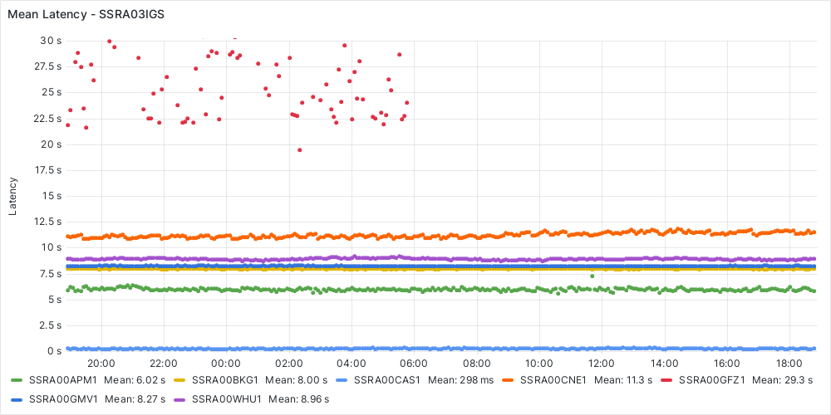
Results: RTS Performance Monitoring
Latencies of IGS RTS AC solutions 06-30-2024/07-01-2024

Slide 20
Conclusion
Initial Setup Completed
Multi-GNSS RTS clock combination products: G+R+E and G+R+E+C
Upload of product files (ORB, CLK, BIA) using long filenames to CDDIS and GDC
RTS product validation for G+R+E based on CODE’s rapid multi-GNSS product
RTS performance monitoring
Realized within our Open Source Tool BKG Ntrip Client that can be adapted according our needs
Future Work
Detailed analysis of performance issues related to
Individual satellites or satellite systems (R)
Individual AC solutions and their latencies etc.
Adjustments and further developments regarding the combination and validation approach

Slide 21
Thank you for your kind attention!
Federal Agency for Cartography and Geodesy (BKG) G2 Satellite Navigation Richard-Strauss-Allee 11 60598 Frankfurt am Main
Andrea Stürze andrea.stuerze@bkg.bund.de

