Slide 1
From Genesis to GNSS: What are the opportunities with VLBI transmitters on satellites?
Johannes Böhm, Helene Wolf, Lisa Kern, Urs Hugentobler
July 2, 2024
Notes:
on behalf of co-authors

Slide 2
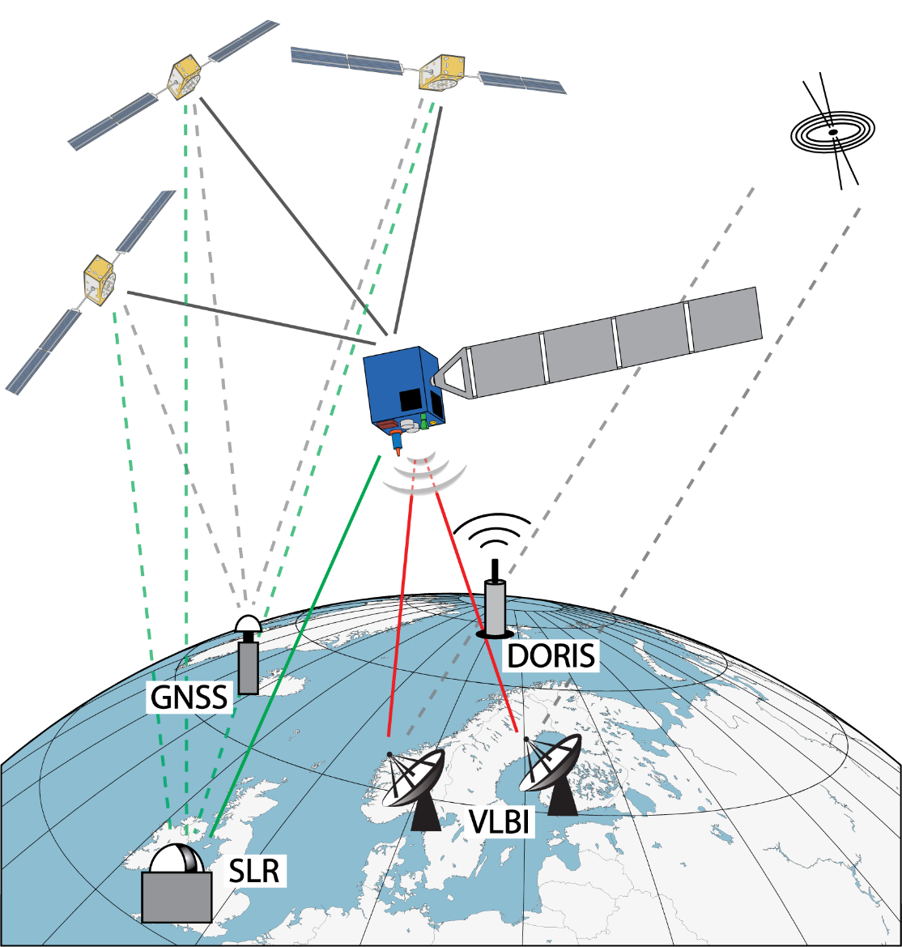
Genesis
Mission of European Space Agency (ESA)
Launch in 2028
two years of operation
Polar orbit in 6000 km altitude
GNSS, SLR, VLBI, and DORIS

Slide 3
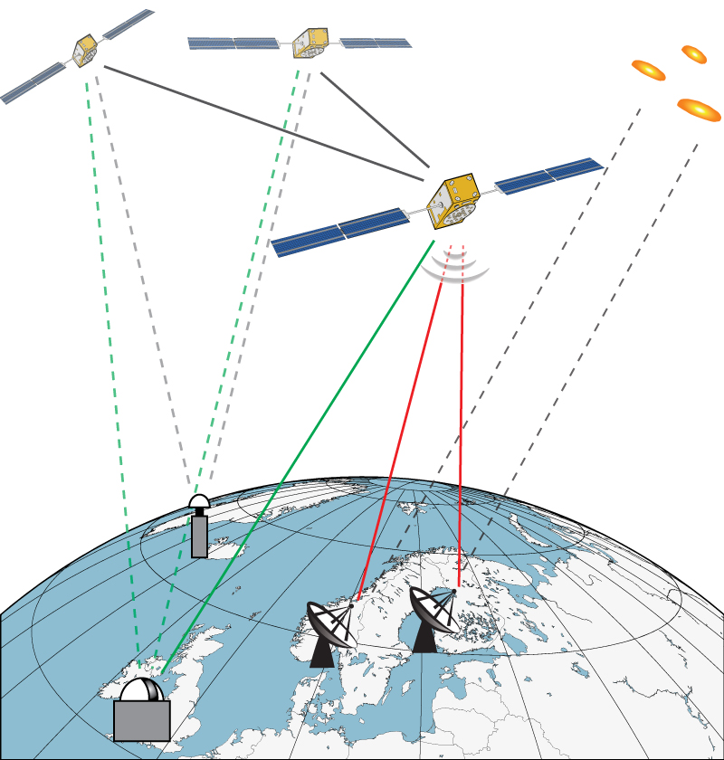
Galileo
Next generation Galileo satellites G2G
23222 km altitude at 56° inclination
GNSS, SLR, and VLBI

Slide 4
Opportunities with VLBI transmitters on satellites
Orbit determination in the celestial reference frame
VLBI station coordinate determination in the frame of the satellite orbit

Slide 5
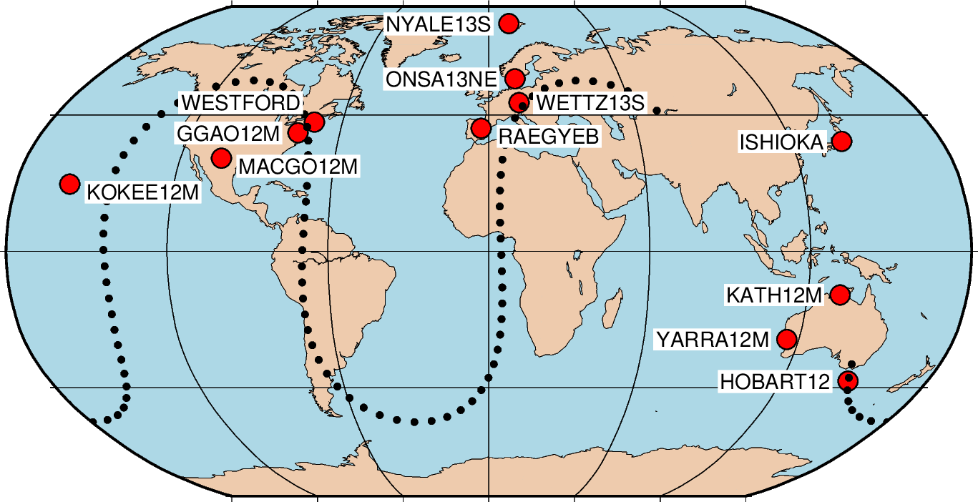
Estimation of orbital elements - Galileo
Example: Jan. 1, 2021 00:00 – 24:00
12 station network
GSAT0101 (E11)
Schedule with 10% satellite observations
10 seconds on-source time
Estimation of orbital elements
one value for 24 hours
quasars and stations fixed
EOP from quasar observations
Monte Carlo simulation
tropospheric turbulence, clock variation, 10 ps white noise per observations
Notes:
Tropospheric turbulence main contribution

Slide 6
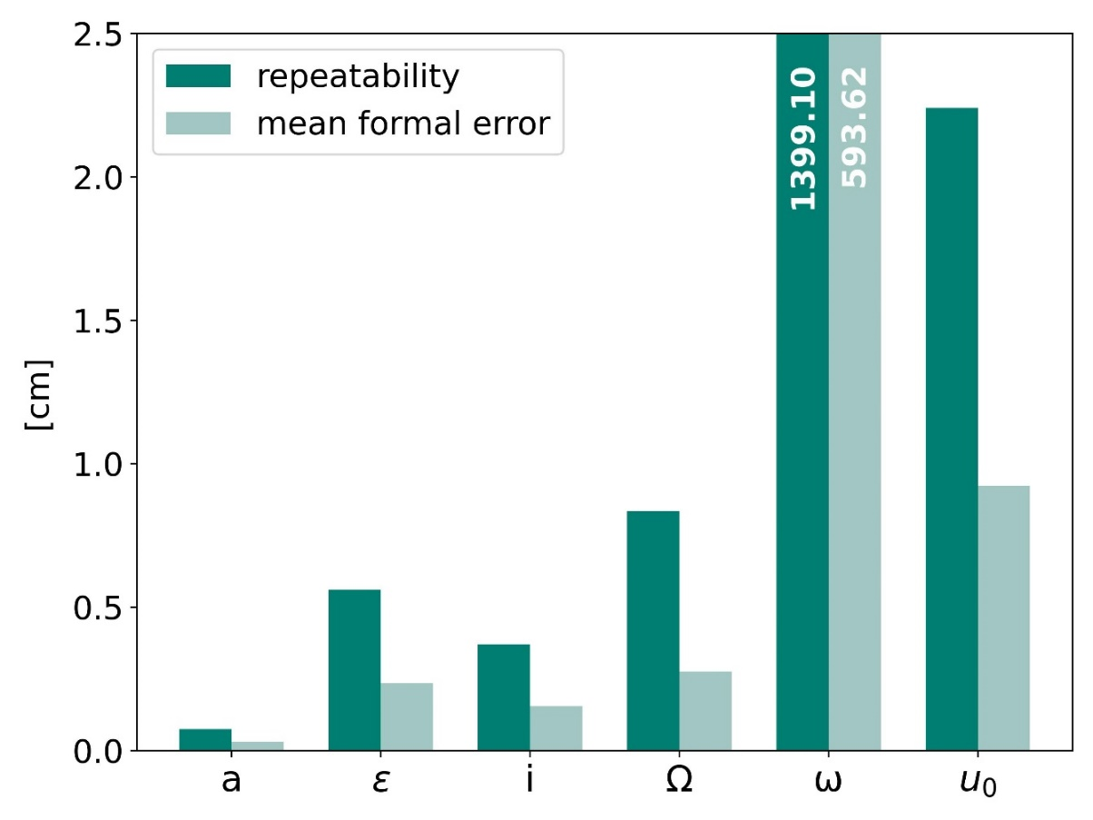
Estimation of orbital elements - Galileo
Formal errors and repeatability of orbital elements
partials from the Bernese GNSS Software
Semi-major axis a well determinable
Argument of perigee ω difficult to determine
Right ascension Ω directly accessible
Notes:
although radial component not well determinable

Slide 7
Estimation of orbital elements - Genesis
Under development
We expect better results for Genesis (better geometry)

Slide 8
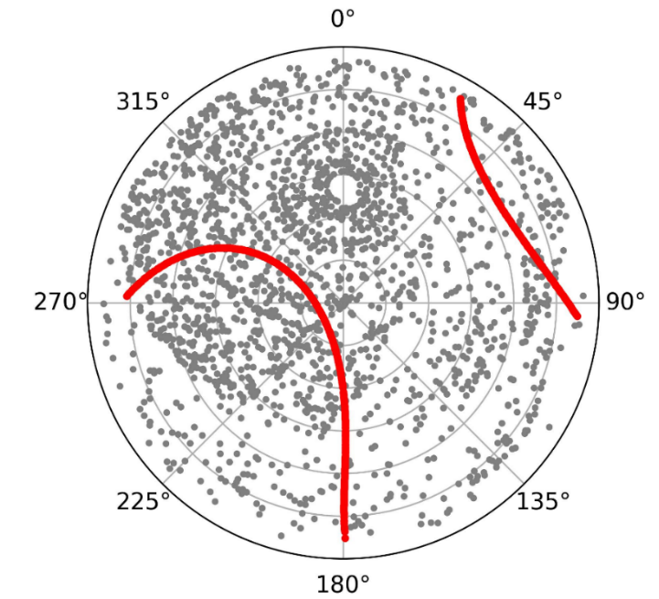
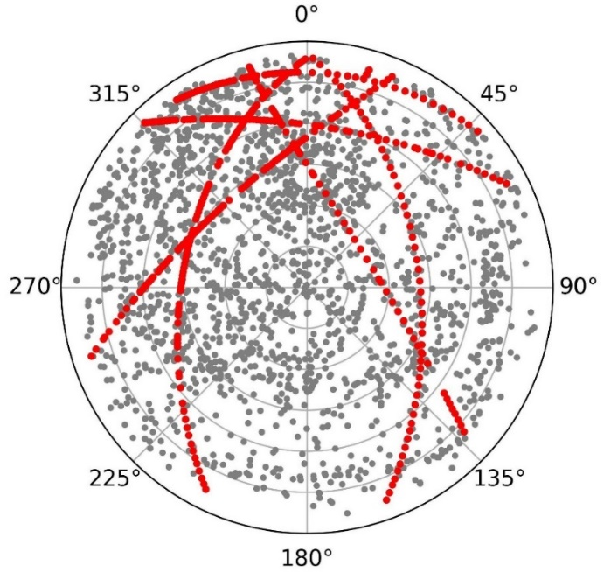
Estimation of VLBI station coordinates
Estimation in the frame of the satellite observed
assessment of frame ties w.r.t. quasar frame
additional information on local ties
Additional observations to quasars critical for troposphere parameters
Skyplot at Wettzell in 24 hours with one transmitter on Galileo and Genesis
Galileo
Genesis

Slide 9
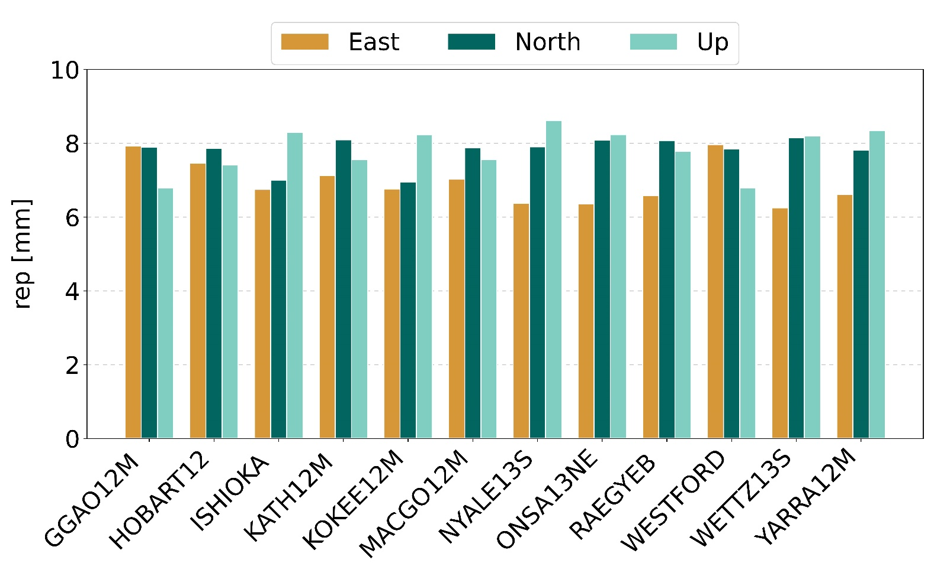
Estimation of VLBI station coordinates - Galileo
Station coordinate scatter from 24h sessions
Station coordinates from satellite observations only (NNR)
3 VLBI transmitters (VT) in plane A
30% satellite observations
Hardly improvement with 4th VT
Scatter with one VT >3cm

Slide 10
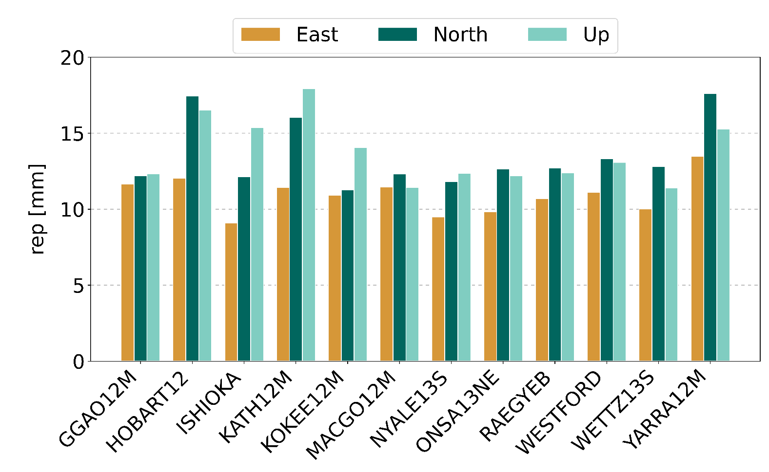
Estimation of VLBI station coordinates - Genesis
Station coordinate scatter from 24h sessions
Station coordinates from Genesis observations only (NNR)
VLBI transmitter on Genesis
10% Genesis observations

Slide 11
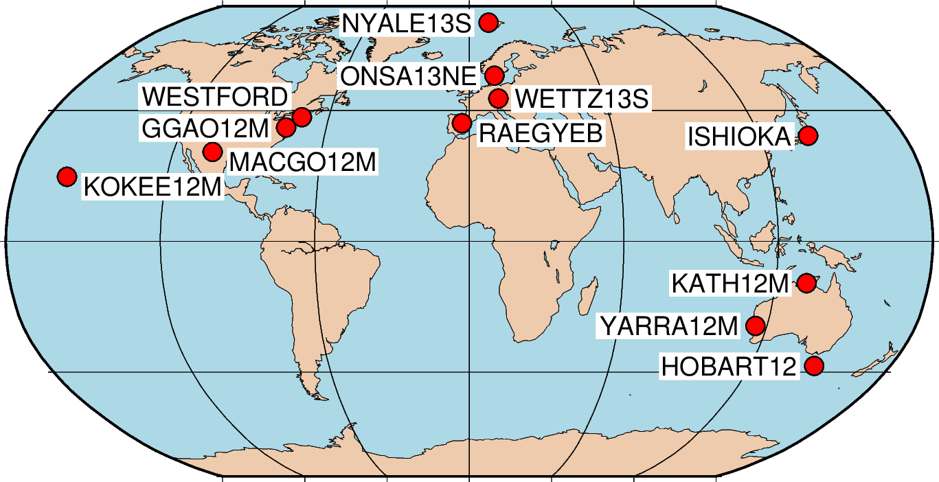
Estimation of VLBI station coordinates - Genesis
How many weeks do we need for millimeter precision?
One 24h session per week with 12 station network
Stacking of normal equations

Slide 12
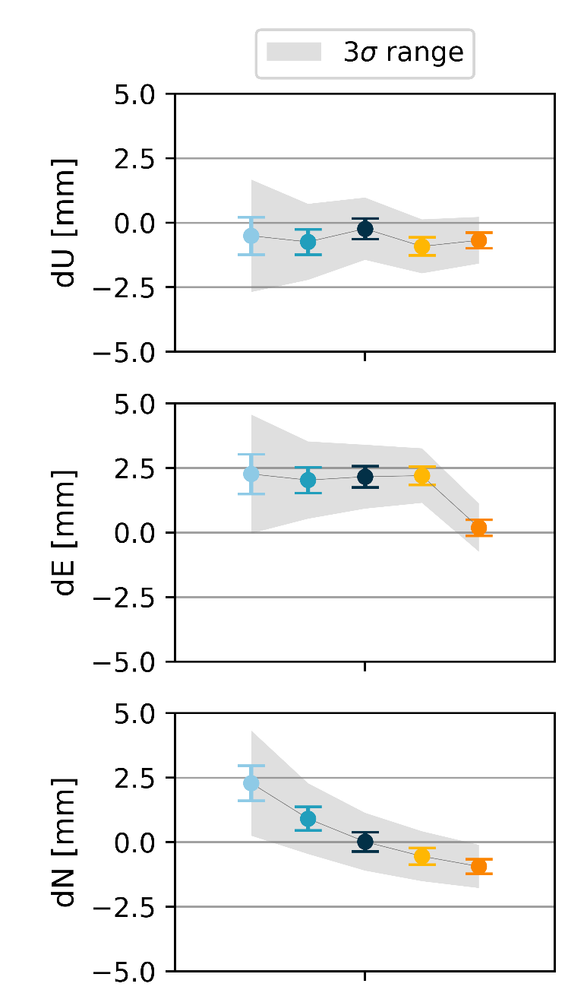
Estimation of VLBI station coordinates - Genesis
WETTZ13S
Setup
One year

Slide 13
Estimation of VLBI station coordinates - Genesis

Slide 14
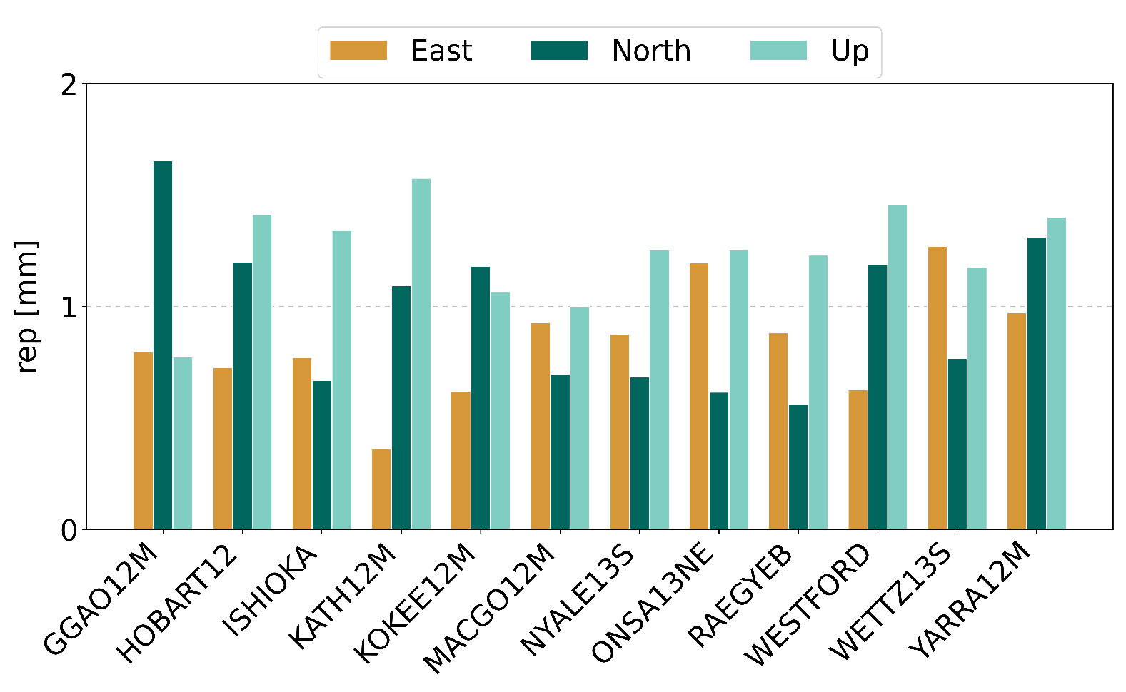
Estimation of VLBI station coordinates - Genesis
Station coordinate scatter of yearly solutions
1 to 2 mm level
no orbit errors simulated
observation errors 10 psec
Notes:
The troposphere is in the simulation, the rest is depending on us

Slide 15
Summary and conclusions
VLBI useful tool for orbit determination
combination with other techniques pending
Simulations with Genesis promising
however more realistic error scenarios required including orbit errors

