Slide 1
ITRF2020 Updates and the IGS Contribution
Zuheir Altamimi
Paul Rebischung, Xavier Collilieux, Laurent Métivier, Kristel Chanard, Julien Barnéoud
IGN-IPGP, France

Slide 2
Key Points
IGS Contribution to the ITRF is fundamental
Regular (yearly) updates of ITRF2020
Motivation
ITRF2020 Update Specifications
Some Early/Preliminary Results
Conclusion

Slide 3
The IGS specific contribution to the ITRF
Ensures the Inter-Technique link :
Connecting the three other techniques within the ITRF combination
==> Reinforcing the ITRF definition (origin, scale & orientation)
Provides the most precise Polar Motion estimates
Determination of Post-Seismic Deformation Models
Significant contribution to the ITRFyy Plate Motion Models
ITRF Access & densification through the IGS Products

Slide 4
Regular (yearly) updates of ITRF2020
ITRF2020 strategy: stacking of all technique time series all together
==> Adding extended time series is easy to handle
Motivation:
Errors in ITRF station coordinates are more and more amplified as they are extrapolated after the end of the ITRF input data;
ITRF stations subject to equipment changes or earthquakes posterior to the end of the ITRF input data cannot be used anymore as reference frame stations;
Most of the TCs regularly update their own realizations of the ITRF;
==> Increase ITRF2020 lifetime and may postpone the need for the next version of the ITRF;
The scale agreement between SLR and VLBI is now at the level of 1 mm
ITRF origin and scale are now stabilized (see next slide)
==> This will simplify the life of a number of users, with no “datum” change in their applications

Slide 5
Transformation Parameters: From ITRF2020 to past ITRFs
Transformation parameters from ITRF2020 to past ITRFs at Epoch 2015.0
-------------------------------------------------------------------------------
SOLUTION Tx Ty Tz D Rx Ry Rz
UNITS----------> mm mm mm ppb .001" .001" .001"
. . . . . . .
RATES Tx Ty Tz D Rx Ry Rz
UNITS----------> mm/y mm/y mm/y ppb/y .001"/y .001"/y .001"/y
--------------------------------------------------------------------------------
ITRF2014 -1.4 -0.9 1.4 -0.42 0.00 0.00 0.00
rates 0.0 -0.1 0.2 0.00 0.00 0.00 0.00
ITRF2008 0.2 1.0 3.3 -0.29 0.00 0.00 0.00
rates 0.0 -0.1 0.1 0.03 0.00 0.00 0.00
ITRF2005 2.7 0.1 -1.4 0.65 0.00 0.00 0.00
rates 0.3 -0.1 0.1 0.03 0.00 0.00 0.00
ITRF2000 -0.2 0.8 -34.2 2.25 0.00 0.00 0.00
rates 0.1 0.0 -1.7 0.11 0.00 0.00 0.00

Slide 6
ITRF2020 Update Specifications
Same analysis strategy as for ITRF2020: Accumulate the full 4 technique time series all together, adding local ties and co-motion constraints
Plan to preserve the frame and seasonal signal defining parameters in origin, scale, and orientation
ITRF2020 updates will be delivered using the same file format as ITRF2020
IAG TCs used the same models and strategy as for their contribution to the ITRF2020
Analysis is still ongoing

Slide 7
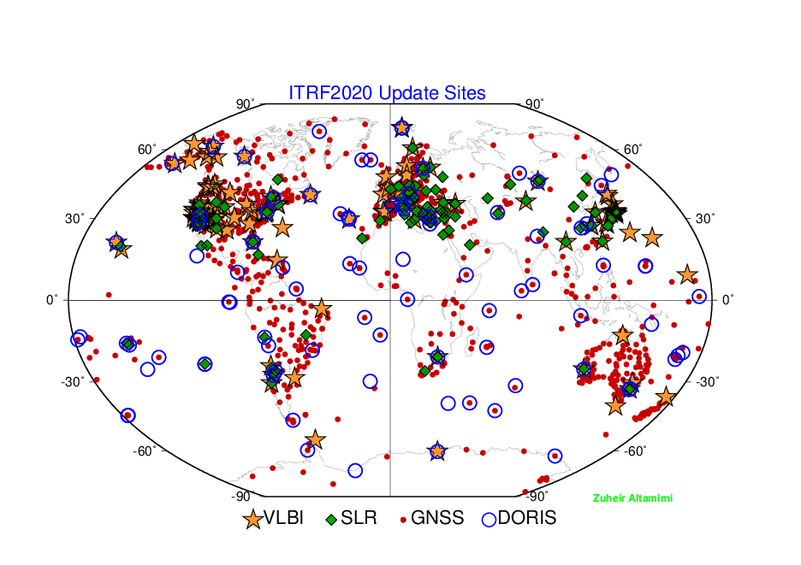
Sites ITRF2020 Update 1

Slide 8
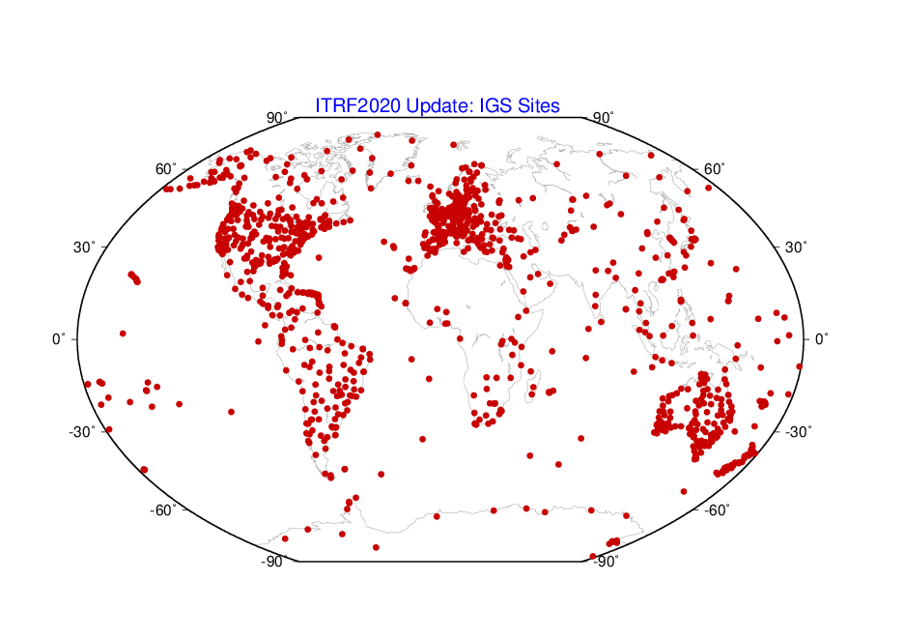
ITRF2020 Update 1: GNSS Sites
1159 sites
1350 stations
3221 discontinuities

Slide 9
Some preliminary results using the extended data

Slide 10
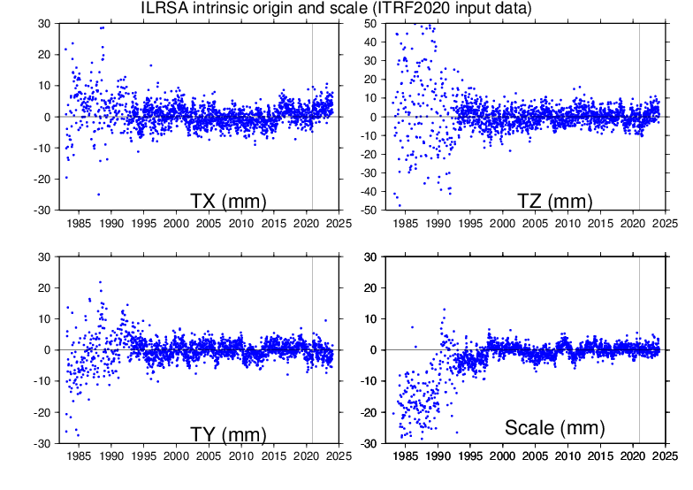
ILRS/SLR intrinsic (ITRF2020 input data) origin & scale

Slide 11
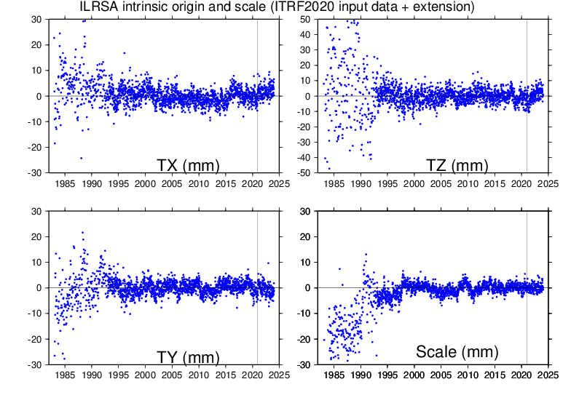
ILRS/SLR intrinsic origin & scale with extension
SLR Origin & scale accuracy at 2015.0 below 1 mm and scale stability at the level of 0.1 mm/yr

Slide 12
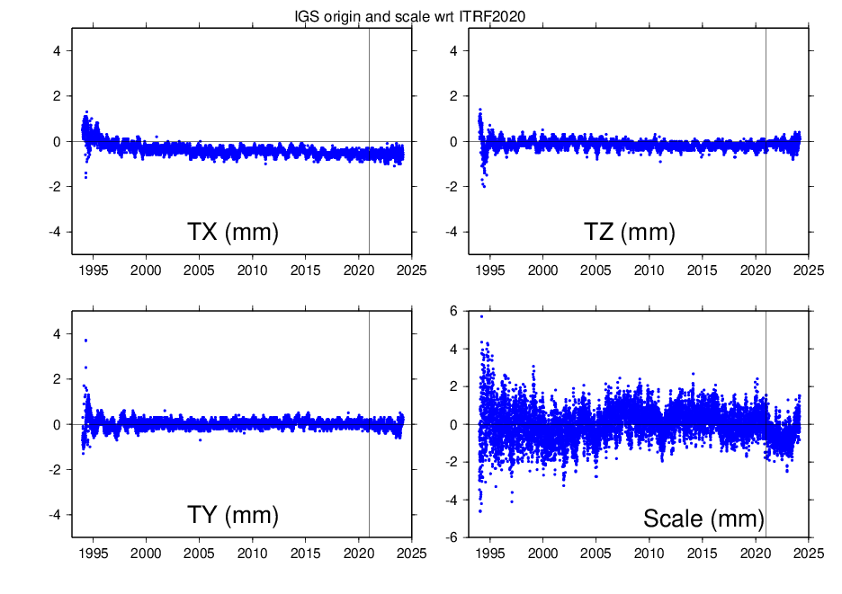
IGS/GNSS origin & scale wrt ITRF2020

Slide 13
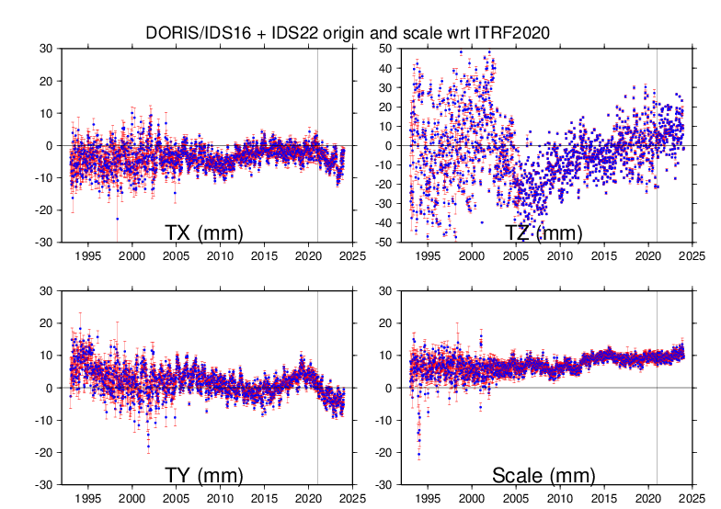
IDS/DORIS origin & scale wrt ITRF2020 with extension

Slide 14
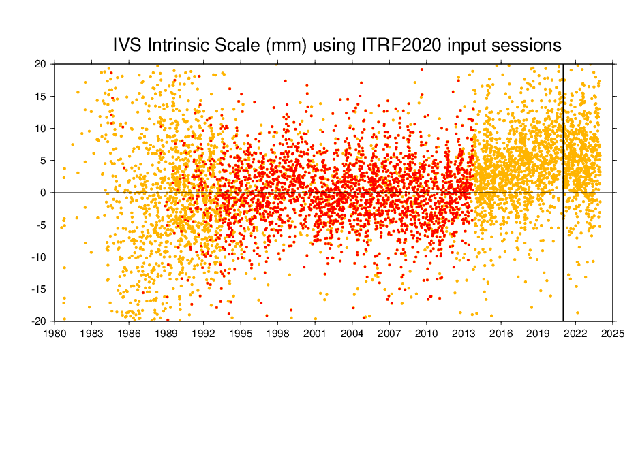
IVS/VLBI Intrinsic Scale (ITRF2020 Sessions)
Extension
Red: Selected VLBI Sessions (convex hull volume ≥ 10¹⁹ m³ )

Slide 15
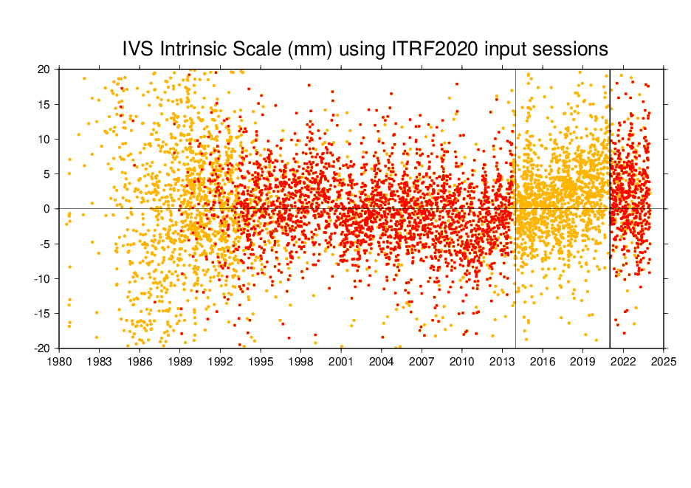
IVS/VLBI Intrinsic Scale (ITRF2020 Sessions + Extension)
Extension
==> δD = + 0.35 ppb at epoch 2015.0, 0.025 ppb/yr

Slide 16
Conclusion
No major issue so far with technique extended data
Stability of SLR/ILRS origin and scale, with the extension, is at the level of or better than 0.1 mm/yr
The IVS/VLBI scale comes back to “normal”, after the extension, starting at 2021.0
Expected release date : summer 2024!
There will be no changes to the defining parameters of the frame and seasonal signals (origin, scale, orientation) between ITRF2020 and its 1st update
Proposed name: ITRF2020-u2023

