Slide 1
Characterization of the GLONASS-K1+ spacecraft
Peter Steigenberger, Steffen Thoelert, André Hauschild, Oliver Montenbruck

Slide 2
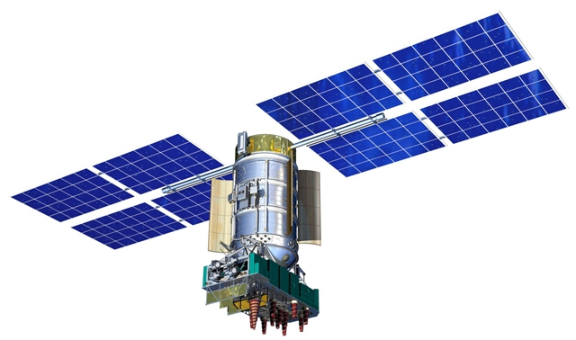
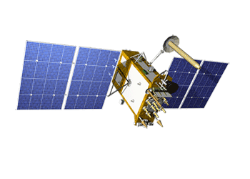
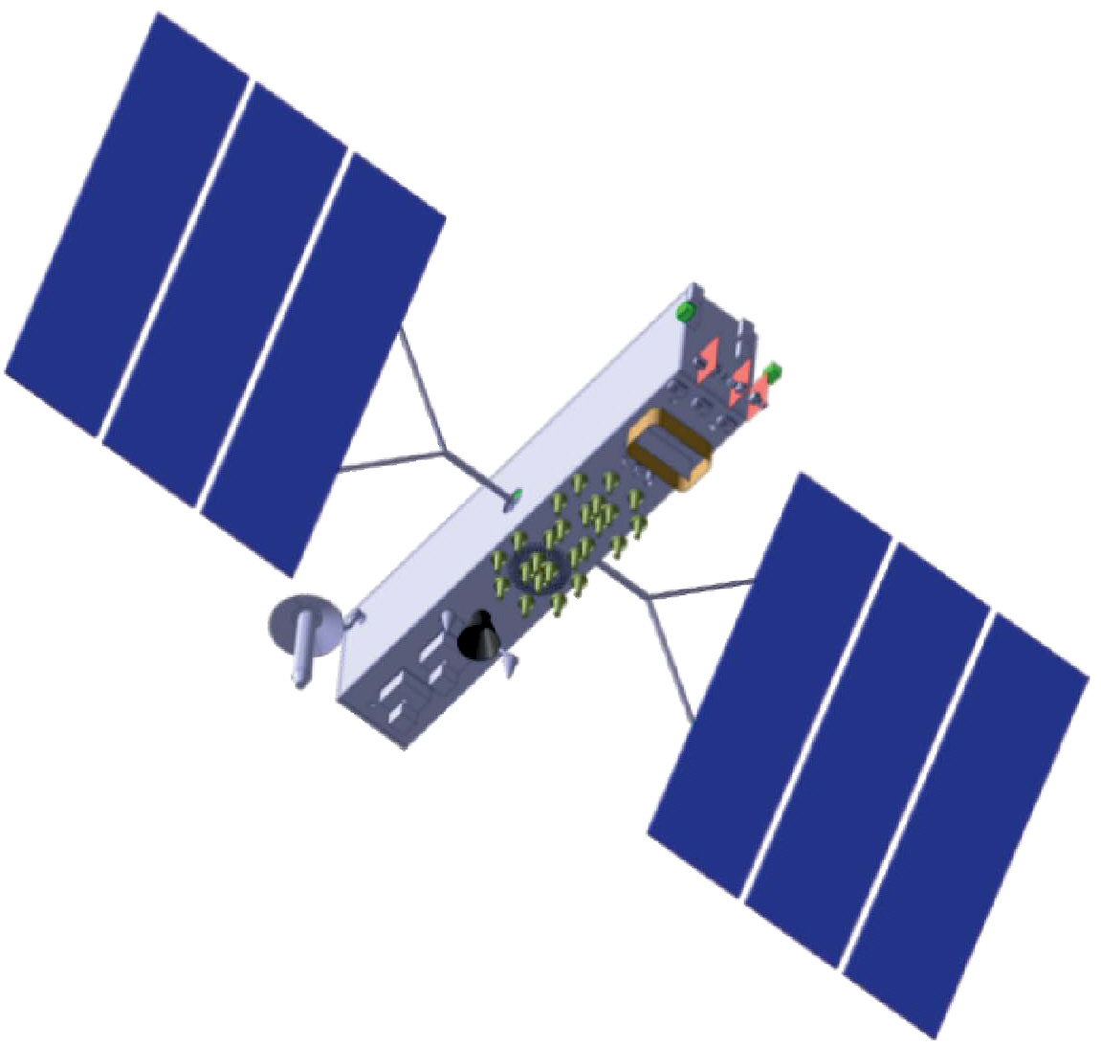
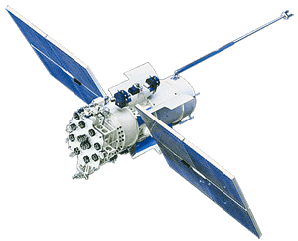
GLONASS Spacecraft
 | IIv | M | M+ | K1A | K1B | K1+ | K2
L1/L2 FDMA | x | x | x | x | x | x | x
L3 CDMA |  |  | x | x | x | x | x
L2 CDMA |  |  |  |  |  | x | x
L1 CDMA |  |  |  |  |  |  | x
Nav. Antennas | 1 | 1 | 2 | 2 | 1 | 2 | 2
FDMA:
Frequency Division Multiple Access
Code Division Multiple Access
CDMA:
Notes:
OM => GNSS Handbook

Slide 3
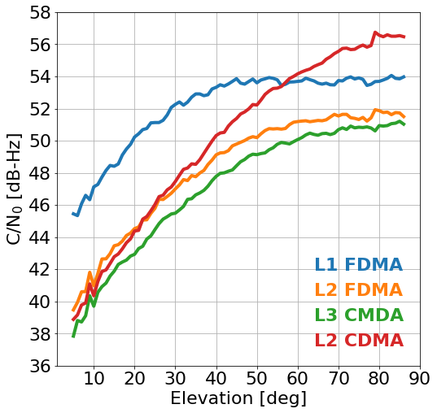
GLONASS K1+
SVN R807 launched in October 2022
Slot number 25
Frequency channel number -5
Start of signal transmission on November 3, 2022
L2 CDMA signal
Suspected use of new clock (H-maser?)
Carrier-to-noise density ratio (C/N₀)
Javad TRE_3S receiver with CDMA-capable prototype firmware at Oberpfaffenhofen, Germany
Averages of 8-day data arc
Notes:
evalCN0.ipynb

Slide 4
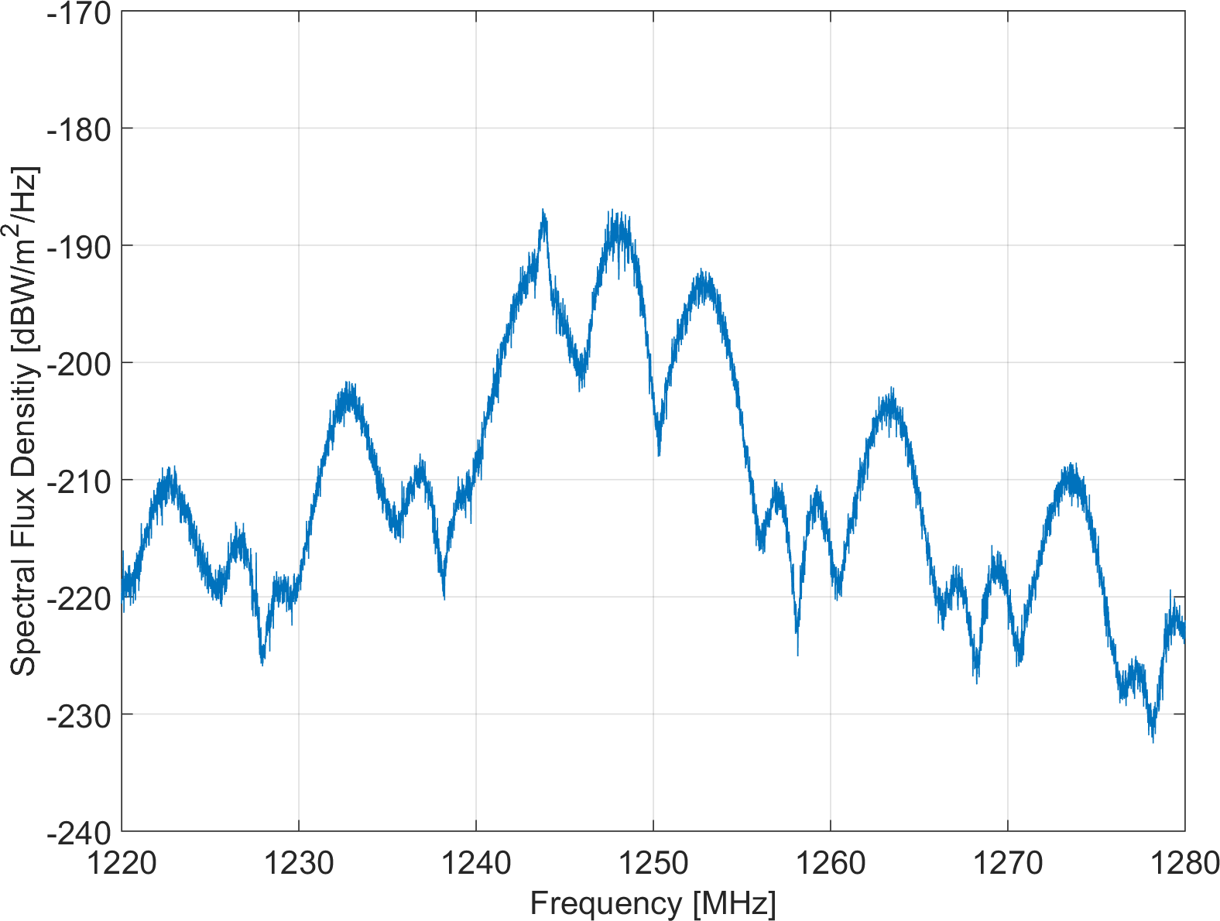
L2 Frequency Spectrum
L2 FDMA, k=-5
L2 CDMA
Measured with 30 m high-gain antenna in Weilheim, Germany
L2SC sidelobes
L2SC sidelobes
L2 CSI
Channel for Service Information
BPSK(1)
L2OC
L2 Open Service CDMA
BOC(1,1)
L2SC
L2xC
L2SC
L2SC
L2 Secure Service CDMA
BOC(5,2.5)
BPSK: binary phase-shift keying
BOC: binary offset carrier
Notes:
FDMA, FCN = -5: 1243.8125 MHz
CDMA: 1248.06 MHz
Peak at 1244 MHz

Slide 5
Triple Carrier Combination (1)
Geometry- and ionosphere-free linear combination: L1, L2 FDMA, L3 CDMA

Slide 6
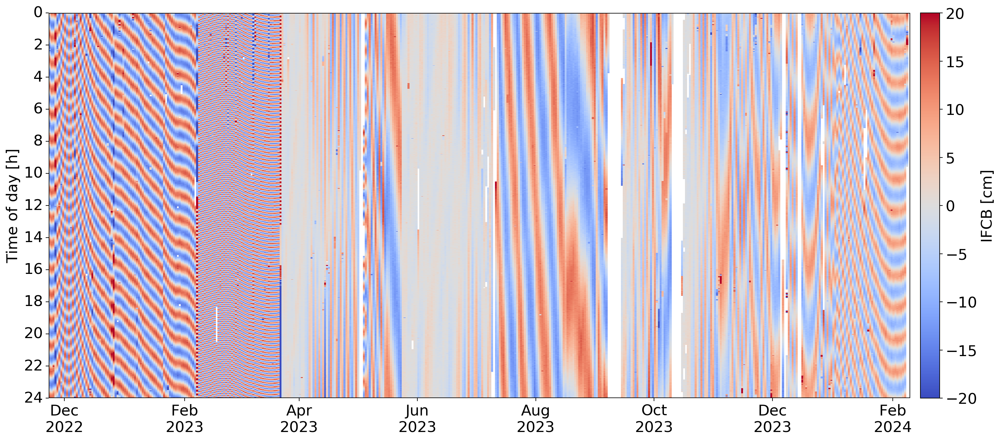
Triple Carrier Combination (2)
TCC [cm]

Slide 7
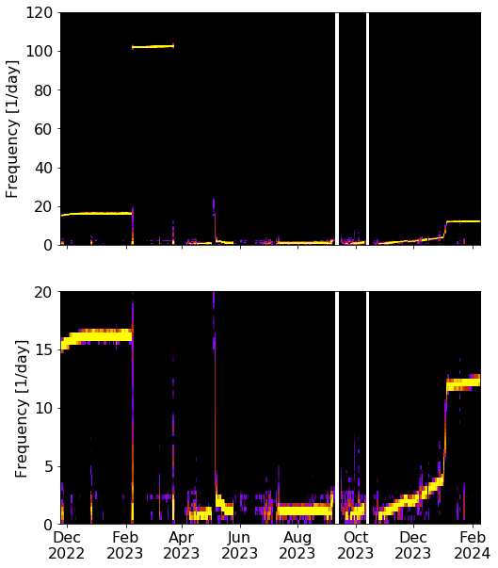
Triple Carrier Combination (3)
Possible explanations:
Clock hardware failure
Cross-talk of oscillators with slightly different frequencies and
Cross-coupling factor
Notes:
100 cpd = 15 min
For the maximum observed amplitude of about 20 cm, a cross-coupling factor of $\alpha\approx 0.02$ is obtained.

Slide 8
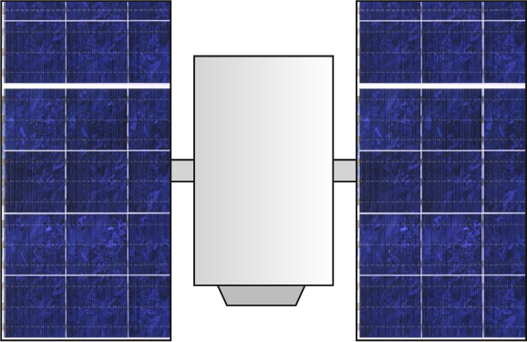
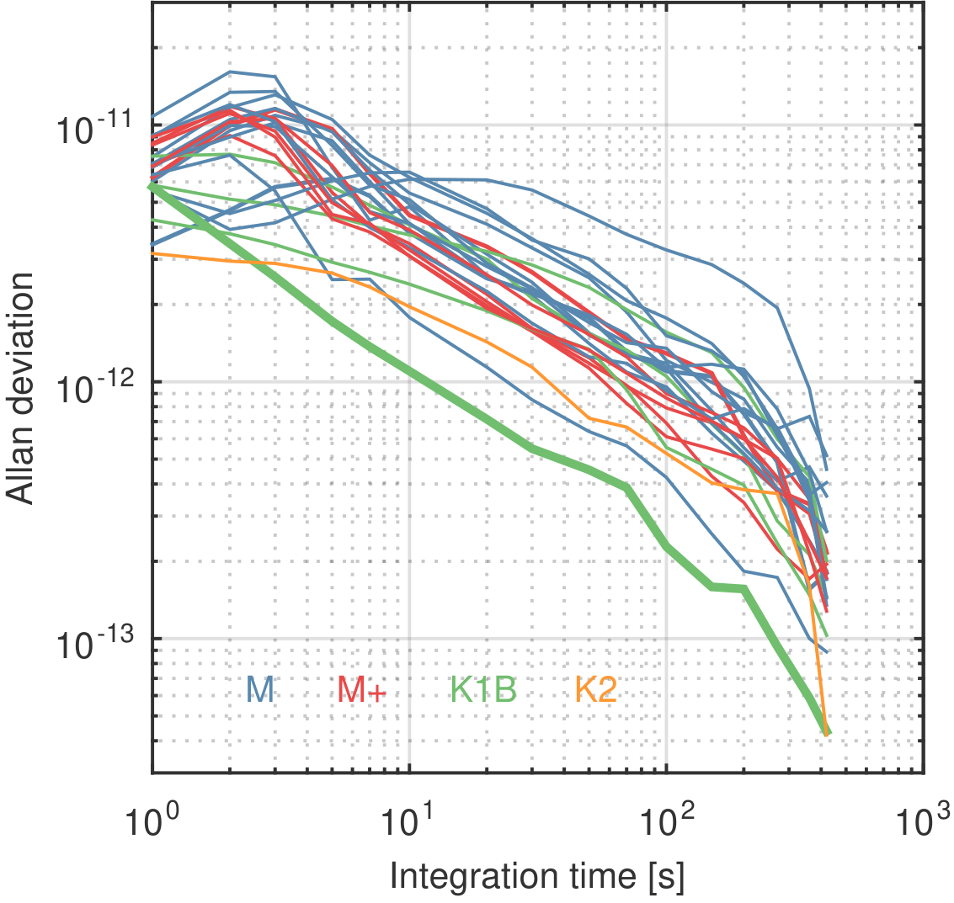
One-way Carrier Phase Analysis (1)
H Maser
GNSS
receiver

Slide 9
One-way Carrier Phase Analysis (2)
Consistency of L1 and L2 FDMA signals
Slight phase shift and increased amplitude of L3 CDMA
Notes:
FDMA and CDMA navigation signal generation units driven by two distinct effective signals or
themselves responsible for clock interference

Slide 10
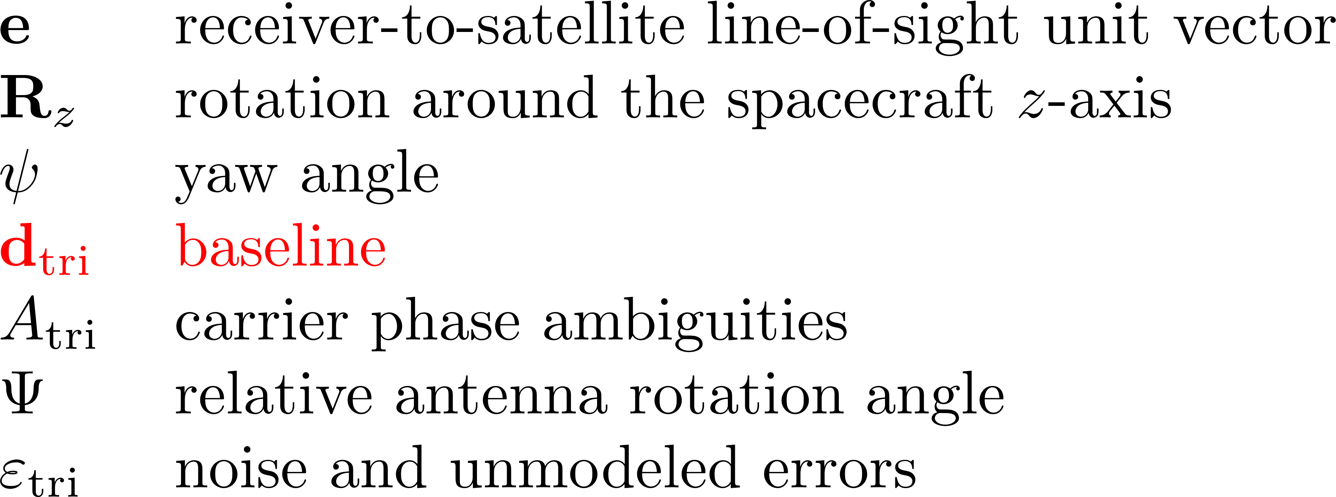
Baseline Estimation (1)
Estimation of “baseline” between two antennas from triple carrier phase observations
Baseline: triple-frequency combination of the antenna- and frequency-specific PCOs
Main antenna array
L2 CDMA
antenna

Slide 11
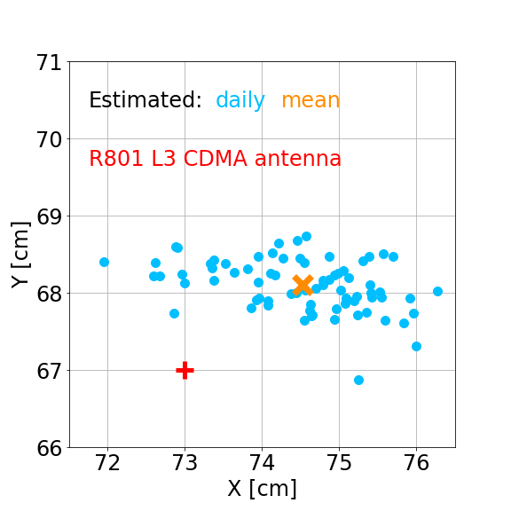
Baseline Estimation (2)
Javad TRE_3S receivers with CDMA-capable prototype firmware
Oberpfaffenhofen, Germany
Sydney, Australia
L1 FDMA, L2 and L3 CDMA
21 March – 3 June 2024
Notes:
dX [m] dY [m] dZ [m]
Median: 0.7463 0.6812 -0.5781
Mean : 0.7453 0.6811 -0.5793
STD : 0.0099 0.0034 0.0528

Slide 12
Summary and Conclusions
Enhanced GLONASS K1+ satellite design:
First GLONASS satellite with L2 CDMA signal
Dedicated L2 CDMA antenna
New type of clock?
Pronounced periodic clock variations
Pattern changes with time, periods between 15 min and a few days
Reason unknown: clock hardware failure or cross-talk of two oscillators?
Single satellite of this type or further launches?
Notes:
dX [m] dY [m] dZ [m]
Median: 0.7463 0.6812 -0.5781
Mean : 0.7453 0.6811 -0.5793
STD : 0.0099 0.0034 0.0528

