Slide 1
SLR Validation of BeiDou-3 MEO Orbits Insights from the First Year of Tracking
Radosław Zajdel^{1,2}, Adrian Nowak², Krzysztof Sośnica²
1 Geodetic Observatory Pecny, Research Institute of Geodesy, Topography and Cartography; Zdiby, Czechia 2 Institute of Geodesy and Geoinformatics, UPWr, Wrocław, Poland

Slide 2
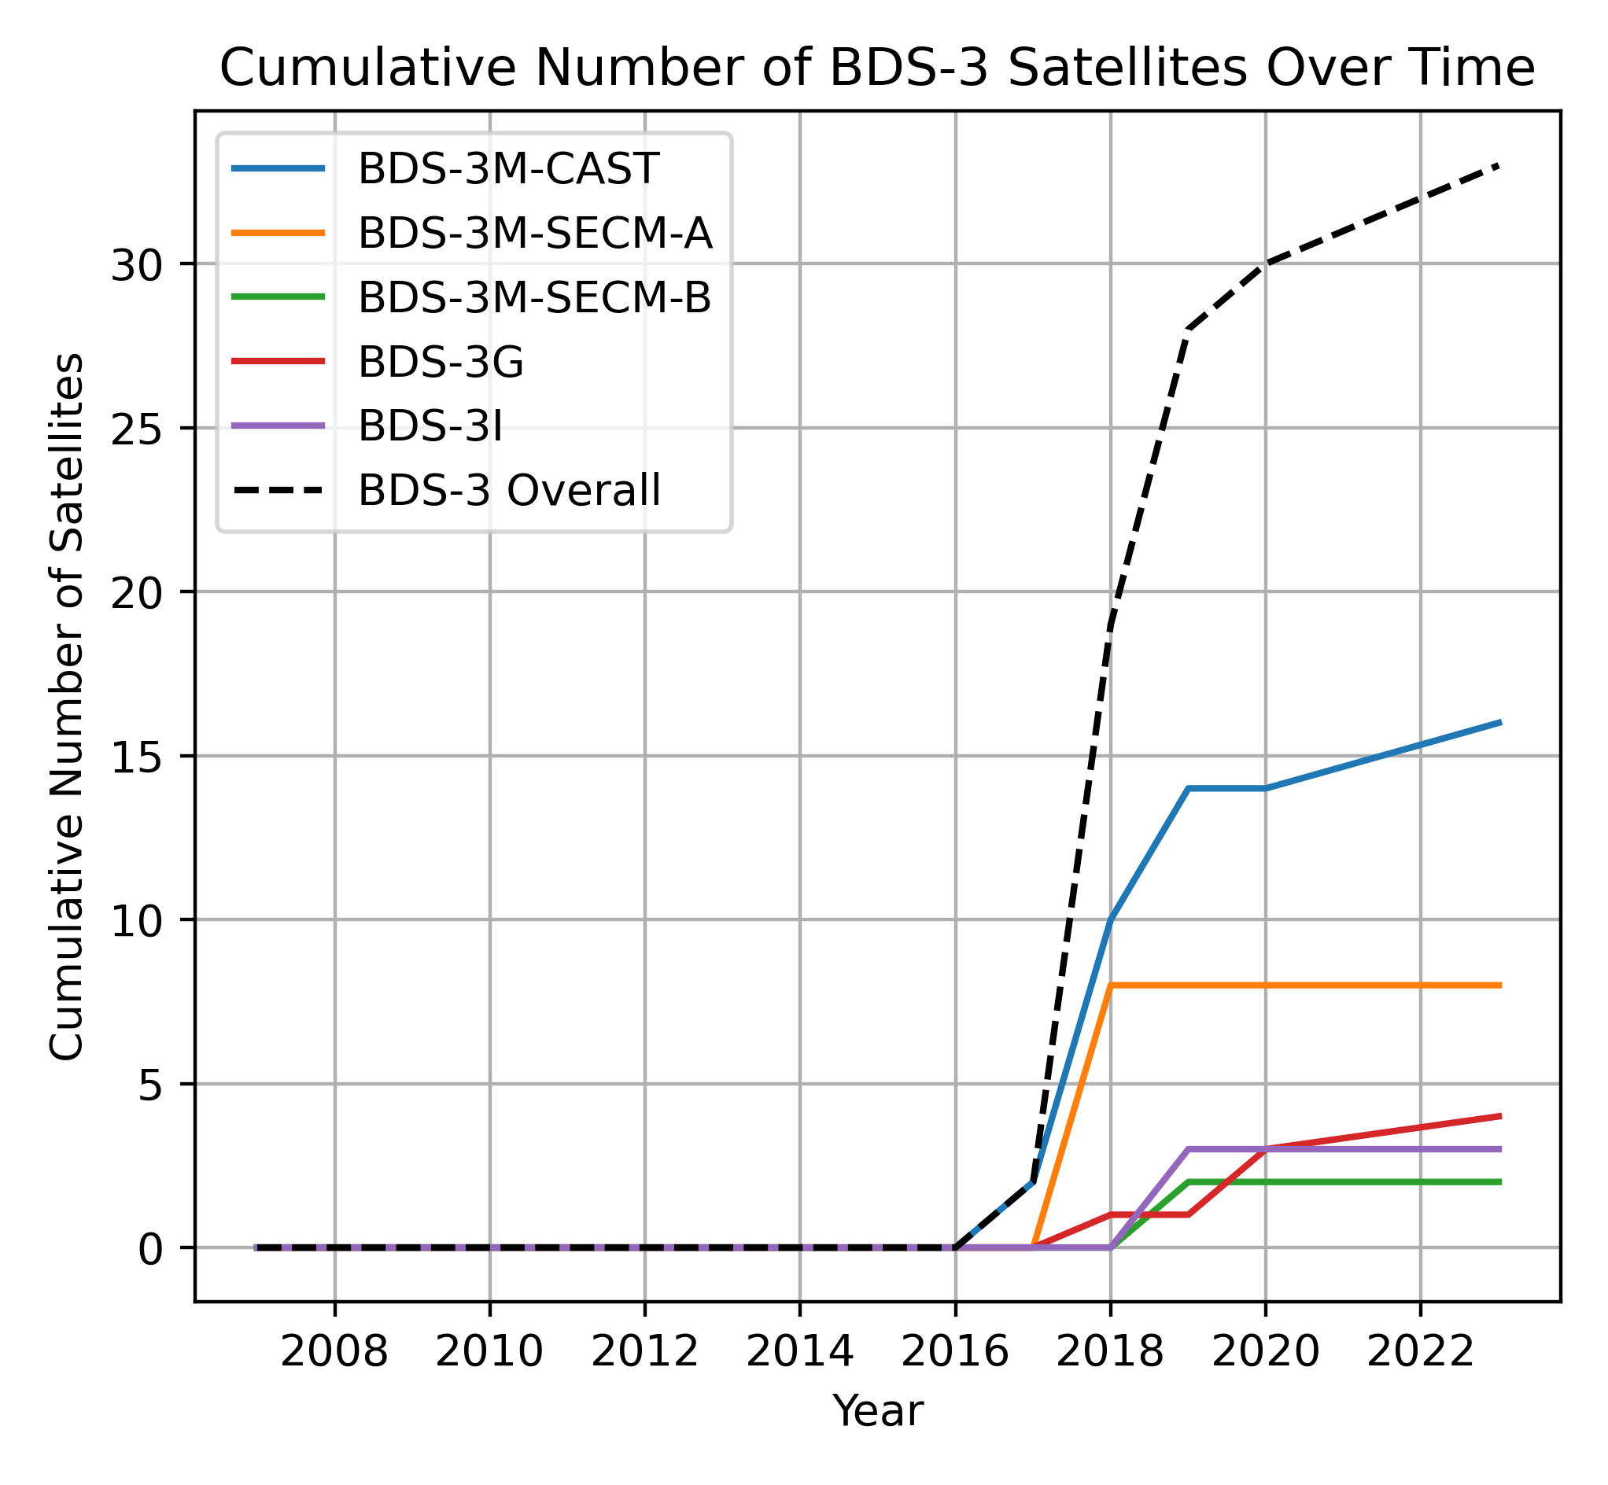
BDS-3 Overview
BDS-3-MEO SECM
BDS-3-MEO CAST
3 GEO, 3 IGSO, and 26 MEO
10 satellites manufactured by Shanghai Engineering Center for Microsatellites (SECM) and 16 by China Academy of Space Technology (CAST).
Within the SECM group of satellites, metadata differentiate between SECM-A and -B satellites, which have different dimensions.
Official metadata file specifies that there is only one type of the CAST satellites; Four CAST satellites are equipped with SAR antennas, i.e., C32/C33, C45/C46.
All the BDS-3 satellites are equipped with Laser Retroreflector Array, but till 2023 only 4 were tracked.
In January 2023, the International Laser Ranging Service approved tracking 20 additional BDS-3 MEO satellites.
Notes:
BeiDou-3 constellation constits of 26 MEO, 3 IGSO and 3 GEO satellites.
Thanks to the tremendous efforts and collaboration of IGS and ILRS communities and BeiDou authorities.

Slide 3
BDS-3 Tracking - Background
The IGS community wishes to incorporate BDS into future releases of global terrestrial reference frames, just as we did with Galileo for ITRF2020.
The previous studies of the individual BDS-3 MEO satellites show that:
Orbit modelling is challanging, especially Solar radiation pressure (SRP) Steigenberger, P. et al. BeiDou Orbits and Clocks (2022) Tour de l’IGS 4th Stop: BDS Constellation Spotlight. 27 September 2022. https://files.igs.org/pub/resource/pubs/workshop/2022/TourdelIGS4_04_Steigenberger.pdf
We may distinguish more groups of satellites than reported in metadata, eg., based on the patterns in the SRP model parameters (eg., Zajdel et al. 2022) or estimated phase center patterns (eg., Huang et al. 2023)
Zajdel, R., Steigenberger, P. & Montenbruck, O. On the potential contribution of BeiDou-3 to the realization of the terrestrial reference frame scale. GPS Solut 26, 109 (2022). https://doi.org/10.1007/s10291-022-01298-0
Huang, C., Song, S., He, L. et al. Estimation of antenna phase center offsets for BDS-3 satellites with the metadata and receiver antenna calibrations. J Geod 97, 57 (2023). https://doi.org/10.1007/s00190-023-01757-7
Satellite Laser Ranging (SLR) data was crucially required for performing SLR orbit validation and enhance our understanding of the system, particularly regarding orbit modeling issues.
Notes:
We are well aware that the road to this is winding and bumpy.

Slide 4
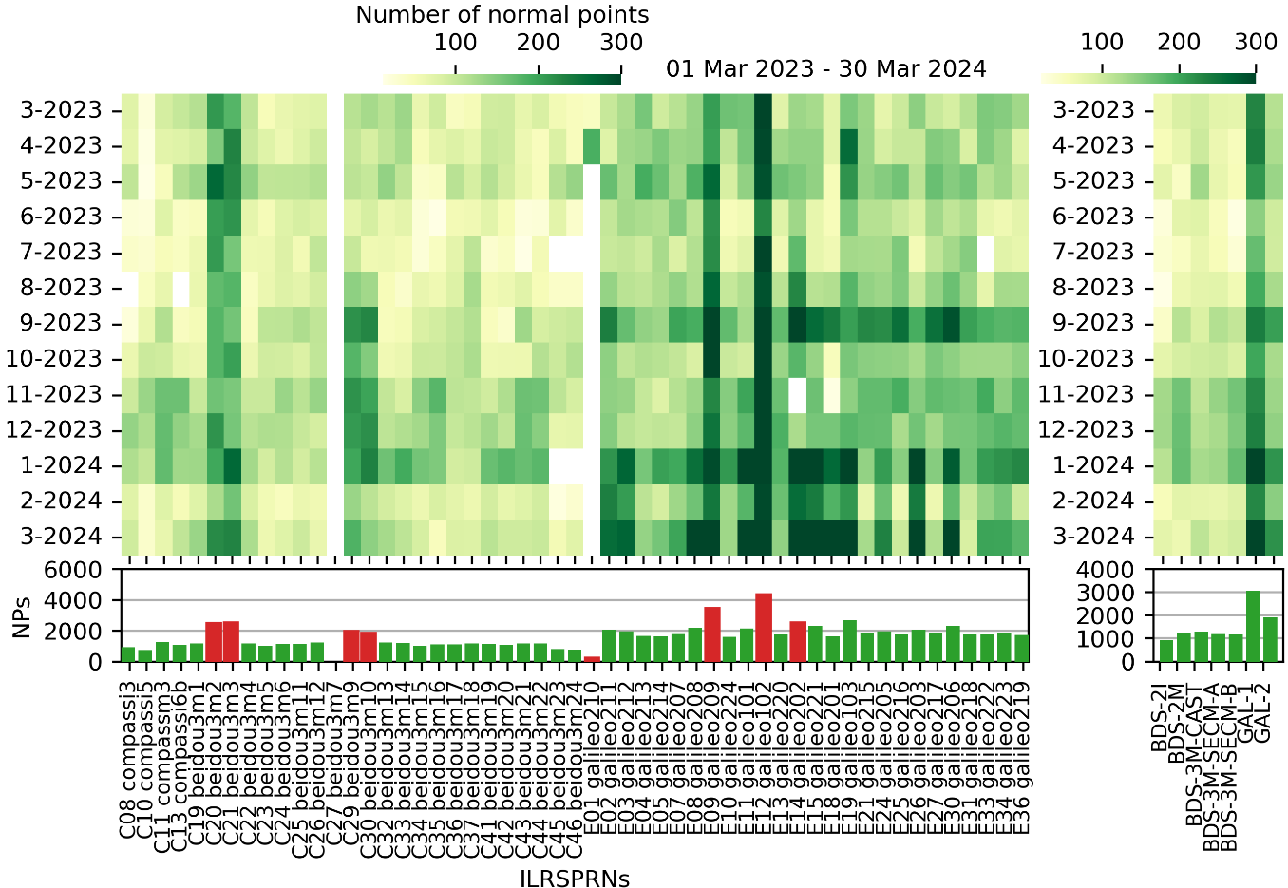
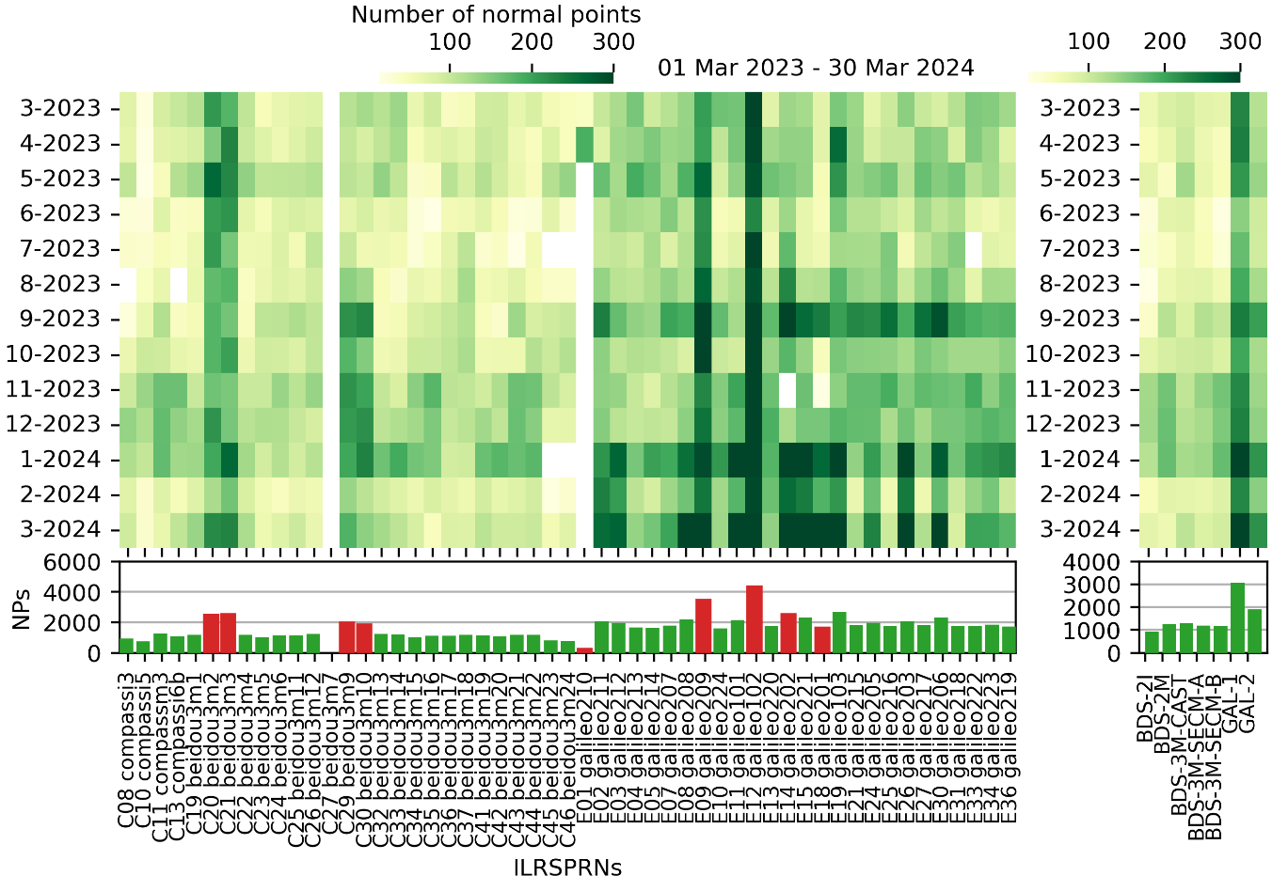
SLR Tracking Performance
The priority satellites C20/C21/C29/C30 have two times more observations compared to the other BDS.
The stations provide almost two times more observations for Galileo than for the BDS-3 satellites for the non-ILRS priority satellites.
The increased number of Galileo observations at the beginning of 2024 arises from the ILRS support to Galileo for Science Project (G4S_2.0)
NPs/sat
BDS-2
BDS-3
Galileo

Slide 5
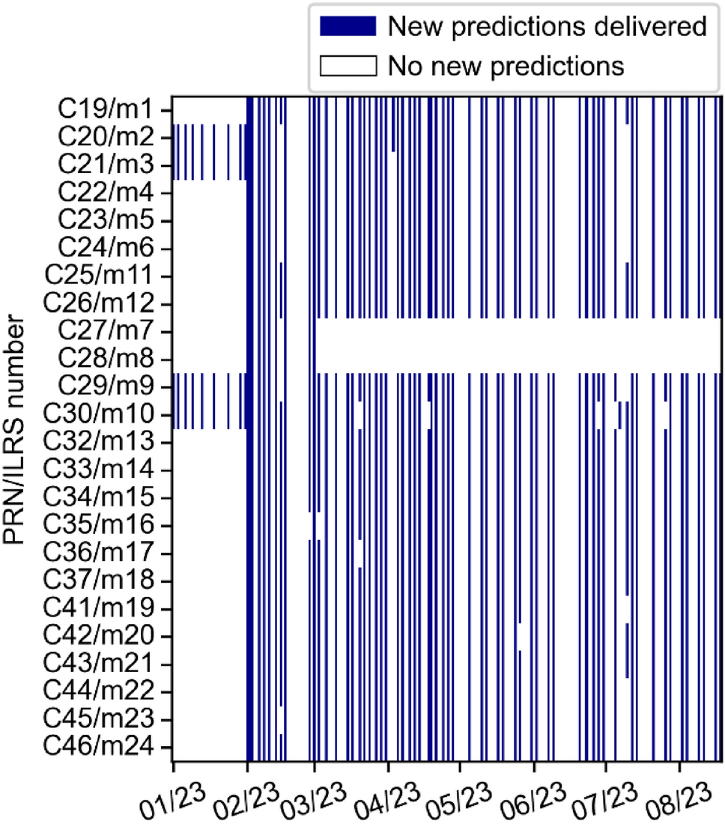
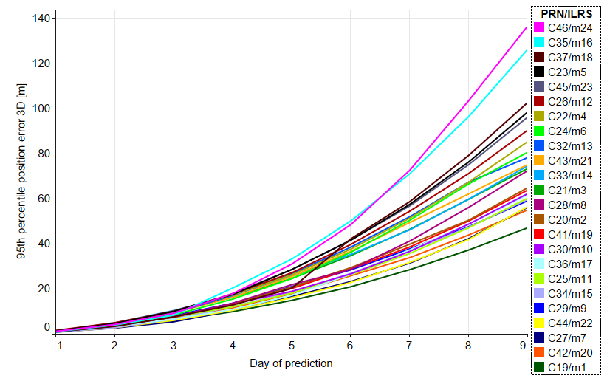
Orbit Predictions
Orbit predictions for ILRS provided by Shanghai Observatory Compared to COD0MGXFIN orbits
The average time between successive releases of these new satellite prediction files is approximately 3 days, with occasional intervals of 5 to 10 days.
No predictions for BeiDou-3M7 (C27) and BeiDou-3M8 (C28) from the beginning of March 2023. Stations failed to get returns from either satellite despite good predictions.
Prediction quality reaches 10 m and 100 m after 3 and 9 days, respectively. No correlation found between the prediction quality and the number of observations.

Slide 6
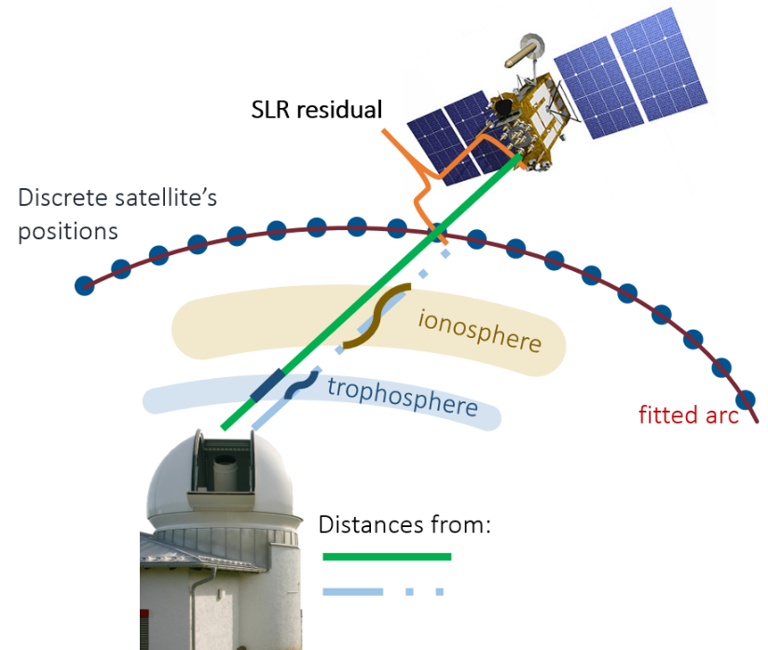
SLR Validation
Precise orbits delivered by: Center for Orbit Determination in Europe (COD) European Space Agency (ESA) GFZ German Research Centre for Geosciences Wuhan University (WUM) Information and Analysis Center (IAC) Shanghai Observatory (SHA)
Stations: SLRF2020
Satellites: most of the background models consistent with the validated orbits mm level orbit reconstruction
Software: Bernese GNSS Software 5.4
The SLR residuals have been corrected for detector-specific biases aiming to increase the internal consistency of the SLR dataset. Consistently with Zajdel et al. (2023)
Zajdel, R., Masoumi, S., Sośnica, K. et al. Combination and SLR validation of IGS Repro3 orbits for ITRF2020. J Geod 97, 87 (2023). https://doi.org/10.1007/s00190-023-01777-3

Slide 7
Selected BDS-3 Orbit Modeling Options
Abb. | Arc length | A priori SRP | SRP parameters | Albedo/IR
COD | 72 h | None | ECOM-2 D0,Y0,B0,BC,BS, D2C, D2S | --
ESA | 24 h | Box-wing | ECOM D0,Y0,B0,BC,BS; 1/rev in along-track A0, AC, AS | YES
GFZ | 24 h | None | ECOM D0,Y0,B0,BC,BS | --
IAC | 48 h | Box-wing | ECOM Sc, Y0, BC, BS |β| < 5° D0, B0 |β| > 5° D1C, D1S | YES
SHA | 24 h | Box-wing | ECOM D0,Y0,B0,BC,BS | --
WUM | 24 h | Box-wing | ECOM D0,Y0,B0,BC,BS | YES
Processing options as used by different ACs differ in terms of the way that they handle SRP:
Different set of empirical parameters
Different arc lengths
Usage a priori box-wing models; source of coefficients
Steigenberger, P. et al. BeiDou Orbits and Clocks (2022) Tour de l’IGS 4th Stop: BDS Constellation Spotlight. 27 September 2022. https://files.igs.org/pub/resource/pubs/workshop/2022/TourdelIGS4_04_Steigenberger.pdf

Slide 8
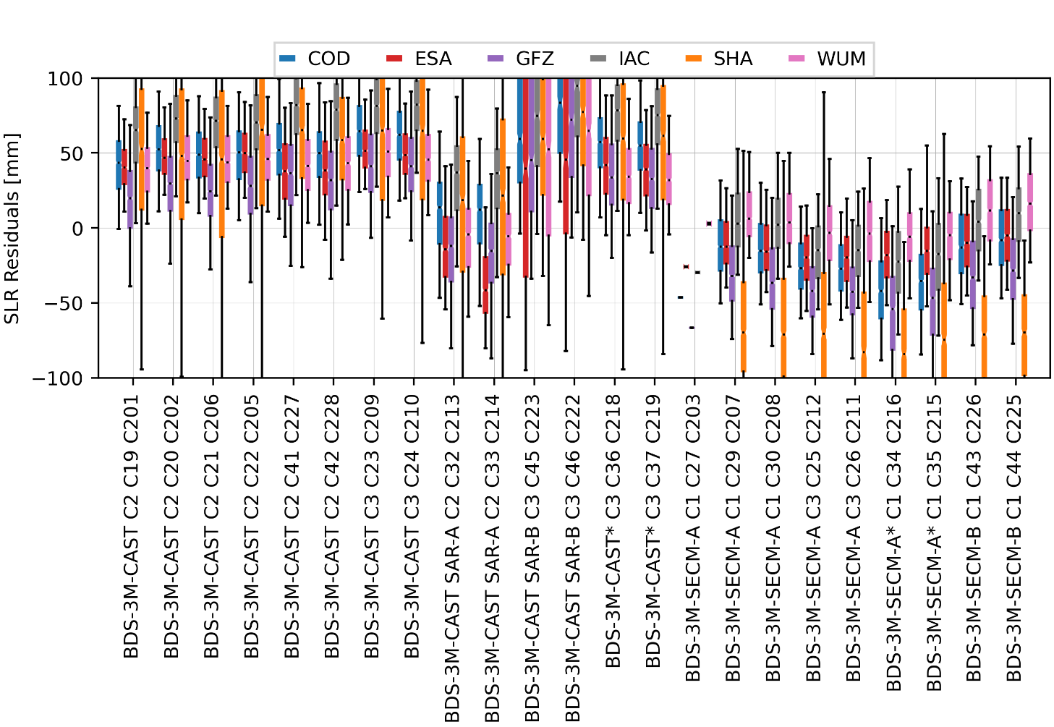
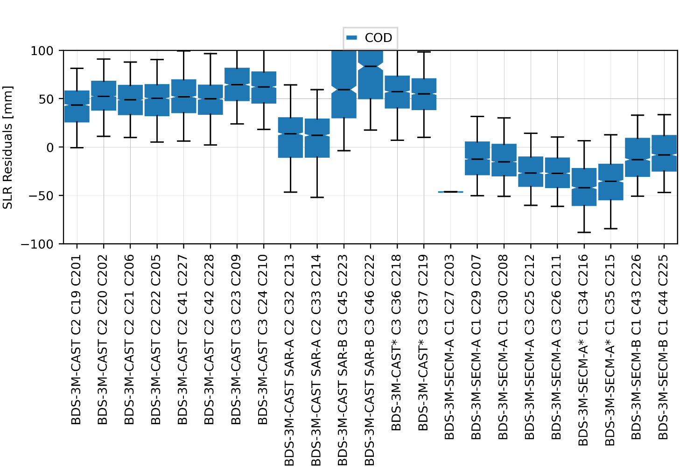
SLR Validation
Mean SLR residuals at the level of +50 and -20 mm, for CAST and SECM
The launch duos have similar residual characteristics, showing that these are the most consistent, especially for SECM, satellites.
We see more groups than the metadata indicates.
SVN
PRN
ORB. PLANE
BDS-3 CAST
BDS-3 SECM-A
BDS-3 SECM-B

Slide 9
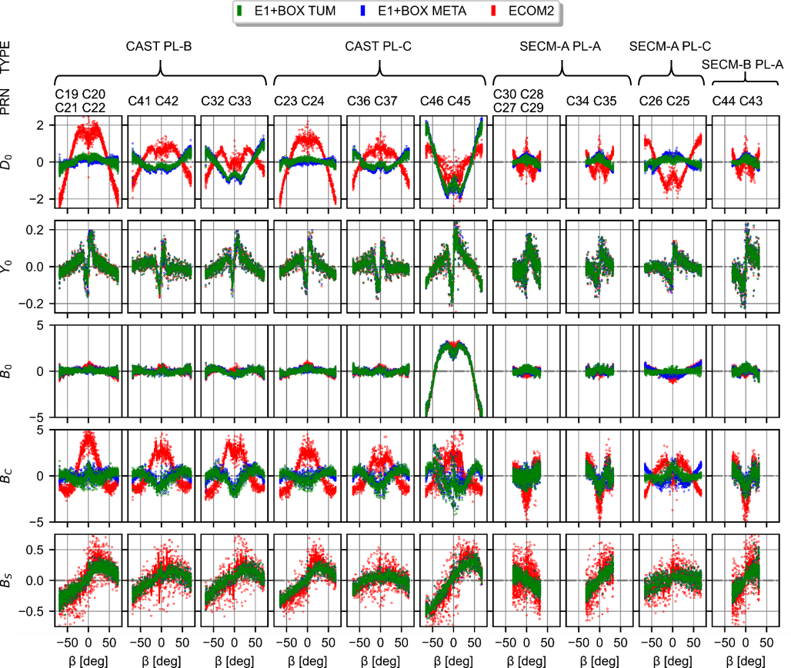
Empirical CODE Orbit Model Parameters
[nm/s²]
More different groups of satellites, which are placed on a given orbital plane and are characterized by similar patterns in the estimated ECOM parameters.
Zajdel, R., Steigenberger, P. & Montenbruck, O. On the potential contribution of BeiDou-3 to the realization of the terrestrial reference frame scale. GPS Solut 26, 109 (2022). https://doi.org/10.1007/s10291-022-01298-0
Duan B, Hugentobler U, Selmke I, Marz S, Killian M, Rott M (2022) BeiDou satellite radiation force models for precise orbit determination and geodetic applications. IEEE Trans Aerosp Electron Syst. https://doi.org/10.1109/TAES.2021.3140018

Slide 10
SLR Validation
The groups detailed from the analysis of empirical parameter are reflected in a different distribution of SLR residuals.
four BDS-3 CAST (C32, C33, C45, C46) satellites and two SECM-B satellites (C43, C44), are equipped with additional SAR equipment.

Slide 11
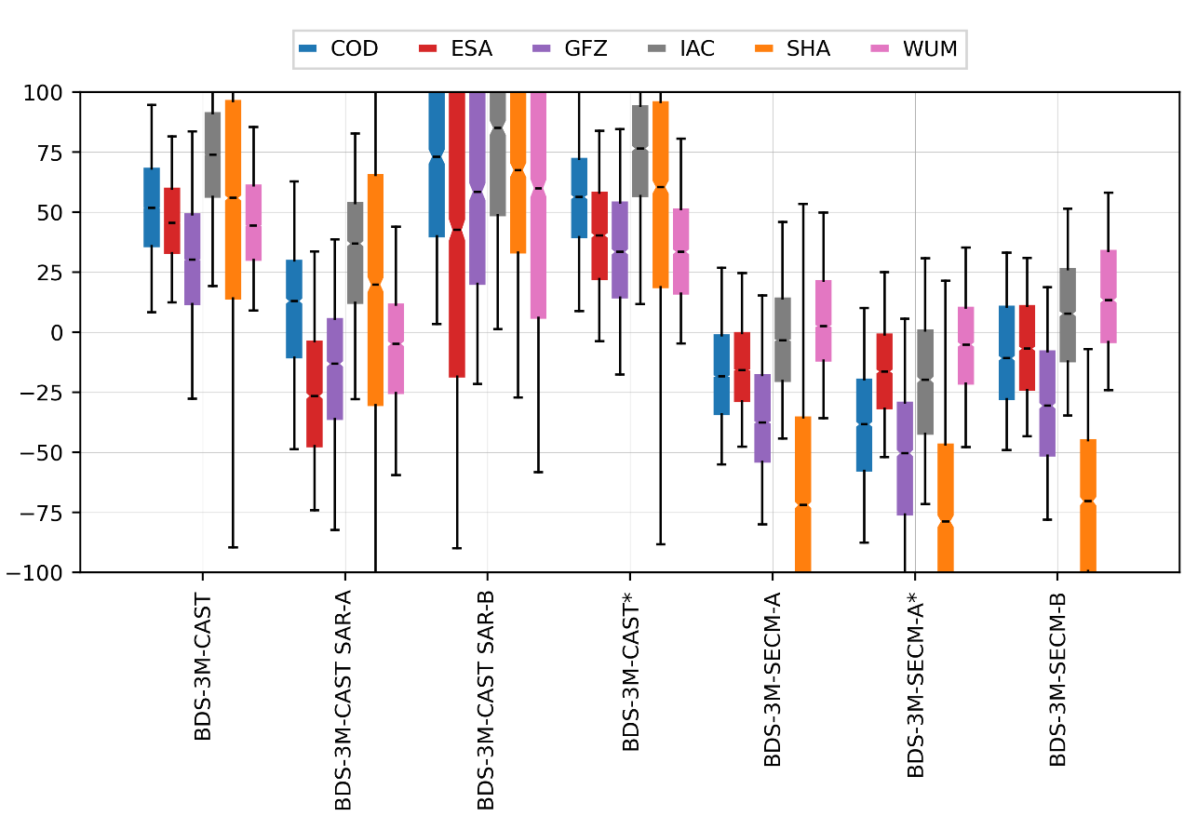
SLR Validation
STANDARD DEVIATION OF SLR RESIDUALS [mm]
 | BDS-3M-CAST | BDS-3M-CAST SAR-A | BDS-3M-CAST SAR-B | BDS-3M-CAST* | BDS-3M-SECM-A | BDS-3M-SECM-A* | BDS-3M-SECM-B | GAL-2
COD | 26.4 | 32.9 | 56.3 | 27.6 | 25.4 | 30.9 | 25.9 | 21.5
ESA | 21.7 | 32.4 | 84.6 | 26.9 | 22.2 | 35.1 | 23.6 | 20.2
GFZ | 34.9 | 37.4 | 65.9 | 31.9 | 29.4 | 37.7 | 29.8 | 26.4
IAC | 29.8 | 33.6 | 58.0 | 33.0 | 27.5 | 34.2 | 27.1 | 23.7
SHA | 71.3 | 80.1 | 60.0 | 69.9 | 64.1 | 62.6 | 40.6 | 26.9
WUM | 23.5 | 31.2 | 75.2 | 26.3 | 27.2 | 25.2 | 26.0 | 22.1
SLR Residuals [mm]
The different modelling of the BDS-3 orbits implemented by the different ACs results in large differences in the outcome of SLR validation.

Slide 12
SLR Validation
BDS-3M-CAST
The 3 ACs with the best results were selected.
The orbit modeling deficiencies are visible for most ACs and subgroups of satellites.
ESA orbit modelling works great with BDS-3 CAST satellites (comparable to their Galileo FOC results)
The SLR residual analysis confirms the validity of grouping satellites, revealing differences in orbit quality and systematic errors.
A
B

Slide 13
SLR Validation
BDS-3M-SECM
The 3 ACs with the best results were selected.
The orbit modeling deficiencies are visible for most ACs and subgroups of satellites.
ESA orbit modelling works great with BDS-3 SECM-A. The larger scatter of residuals applies only to high beta angles, i.e. satellites on plane C (C25/26).
The SLR residual analysis confirms the validity of grouping satellites, revealing differences in orbit quality and systematic errors.

Slide 14
Improvement of Metadata – C43/C44
The official LRA X- and Y-offset (m) from the BeiDou metadata:
SVN225/C44 0.6339 0.4250
SVN226/C43 0.6347 0.4248
The updated values by CSNO:
SVN225/C44 -1.062 -0.287
SVN226/C43 -1.061 -0.287
The estimated values by ESA and DLR:
SVN225/C44 -1.085 -0.315 | -1.048 -0.264
SVN226/C43 -1.068 -0.332 | -1.060 -0.300
OLD LRA
NEW LRA
Zajdel, R., Nowak, A. & Sośnica, K. Satellite laser ranging to BeiDou-3 satellites: initial performance and contribution to orbit model improvement. GPS Solut 28, 100 (2024). https://doi.org/10.1007/s10291-024-01638-2
The RMS of SLR residulals has been
reduced from 150 to 20 mm!

Slide 15
Conclusions
The ILRS network successfully tracks almost entire BDS-3 constellation.
As of March 2023, the ILRS network observes 22 BDS-3 satellites instead of the full 24 due to the suspension of orbit prediction provision for C27 and C28 satellites.
SLR validation revealed more satellite groups in the BDS-3 MEO constellation than documented in official metadata.
Current orbit modeling works well for 16 out of 22 BDS-3 MEO satellites (CAST, SECM-A, SECM-B); improving modeling for the remaining satellites is a challenge to be faced.
Problematic satellites: C32/C33 (BDS-3M-CAST SAR-A), C45/C45 (BDS-3M-CAST SAR-B), C34/C35 (BDS-3M-SECM-A*)
Continued ILRS network support and increased observations for specific satellites are recommended to improve orbit modeling.
Current ILRS recommendation: C20/C21 (CAST), C29/C30 (SECM-A) → C20 (CAST) C29 (SECM-A) C32 (CAST SAR-A) C34 (CAST*) C45 (CAST SAR-B) C36 (CAST*) C43 (SECM-B)
Something to be discussed with ILRS Networks and Engineering Standing Committee

Slide 16
Thank you
Radosław Zajdel
radoslaw.zajdel@pecny.cz
Zajdel, R., Nowak, A. & Sośnica, K. Satellite laser ranging to BeiDou-3 satellites: initial performance and contribution to orbit model improvement. GPS Solut 28, 100 (2024). https://doi.org/10.1007/s10291-024-01638-2
http://orcid.org/0000-0002-1634-388X
The research conducted under the "BENEFITS OF INTEGRATED GNSS 4 GEODESY, GEOPHYSICS, AND GEODYNAMICS" project, was facilitated through the MERIT Postdoctoral Fellowship. This project received funding from the European Commission, specifically from the MSCA-COFUND Horizon Europe call, along with additional financial support from the Central Bohemian Region's budget.
https://www.researchgate.net/profile/Radoslaw-Zajdel-2

Slide 17
SLR Validation Details
SATELLITE ID |  |  | SLR RESIDUALS [mm]
SAT TYPE | PLANE | SVN | MEDIAN | MEAN | STD | IQR | RMS | OBS.
BDS-3M-CAST | C2 | 601 | 43.5 | 42.0 | 25.9 | 32.1 | 49.3 | 1249
 |  | 602 | 52.5 | 52.6 | 24.8 | 29.9 | 58.2 | 2934
 |  | 605 | 50.3 | 49.3 | 26.6 | 32.1 | 56.0 | 1230
 |  | 606 | 48.7 | 48.6 | 24.3 | 30.3 | 54.4 | 3088
 |  | 627 | 51.8 | 51.9 | 28.2 | 34.0 | 59.1 | 1222
 |  | 628 | 49.8 | 49.0 | 28.0 | 30.1 | 56.4 | 1143
 | C3 | 609 | 64.5 | 64.3 | 25.6 | 33.4 | 69.2 | 1068
 |  | 610 | 62.2 | 61.3 | 26.0 | 32.1 | 66.6 | 1207
BDS-3M-CAST SAR-A | C2 | 613 | 13.6 | 10.8 | 32.7 | 41.0 | 34.4 | 1281
 |  | 614 | 12.2 | 9.3 | 33.1 | 39.4 | 34.3 | 1282
BDS-3M-CAST SAR-B | C3 | 622 | 83.4 | 92.9 | 53.5 | 88.3 | 107.2 | 1006
 |  | 623 | 59.4 | 74.2 | 57.5 | 85.6 | 93.9 | 1019
BDS-3M-CAST* | C3 | 618 | 57.2 | 57.1 | 28.3 | 33.1 | 63.7 | 1143
 |  | 619 | 55.1 | 54.6 | 26.9 | 32.0 | 60.8 | 1216
BDS-3M-SECM-A | C1 | 603 | -46.4 | -46.4 | 0.4 | 0.3 | 46.4 | 2
 |  | 607 | -12.4 | -11.0 | 24.9 | 33.8 | 27.3 | 2221
 |  | 608 | -15.2 | -12.9 | 25.2 | 32.7 | 28.3 | 2127
 | C3 | 611 | -27.1 | -26.2 | 22.4 | 30.7 | 34.4 | 1277
 |  | 612 | -26.9 | -25.5 | 24.6 | 30.4 | 35.4 | 1176
BDS-3M-SECM-A* | C1 | 615 | -35.3 | -34.7 | 33.2 | 36.9 | 48.0 | 1202
 |  | 616 | -42.0 | -41.4 | 27.9 | 38.2 | 49.9 | 1127
BDS-3M-SECM-B | C1 | 625 | -8.1 | -7.1 | 25.4 | 36.8 | 26.4 | 1251
 |  | 626 | -12.9 | -10.6 | 26.3 | 39.3 | 28.3 | 1234

Slide 18
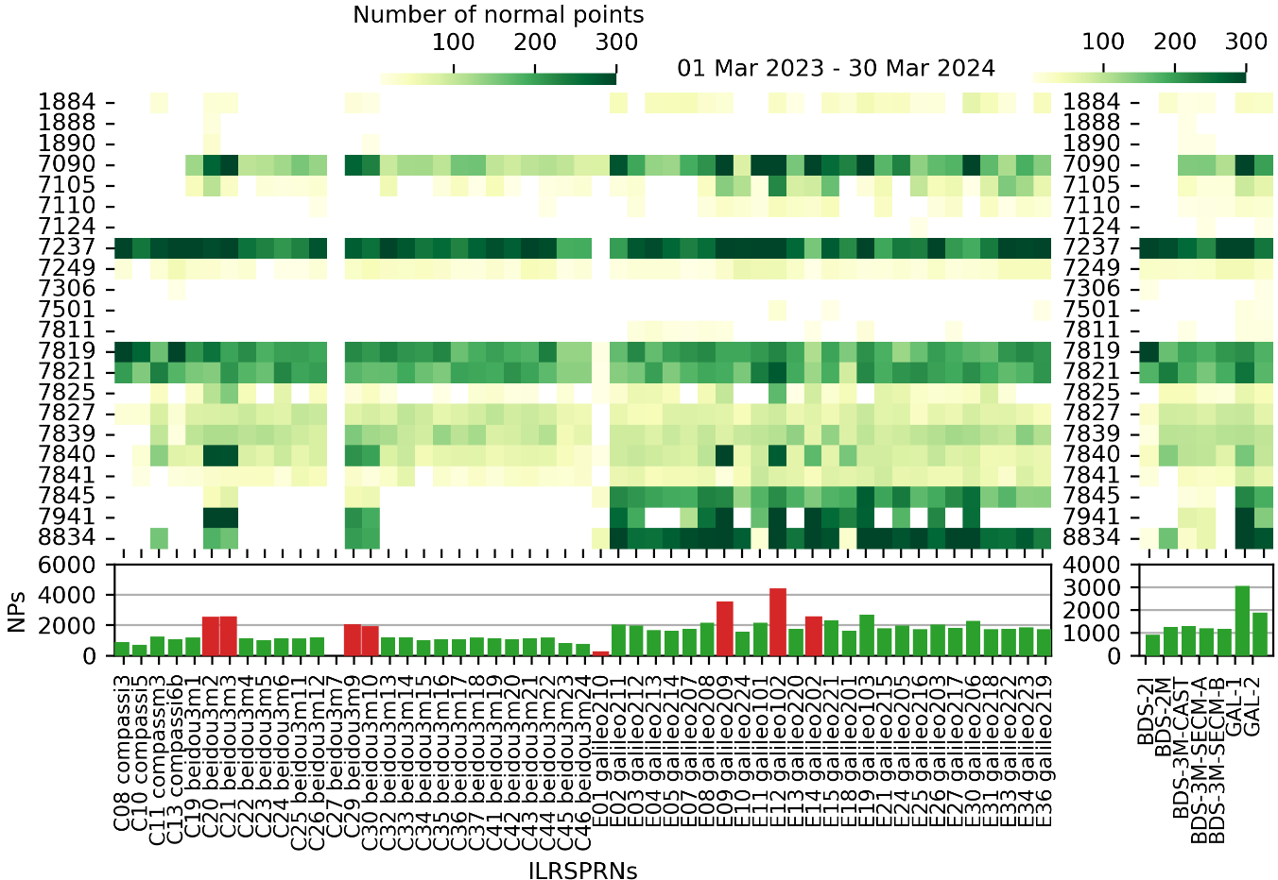
SLR Tracking Performance
Over half of the normal points to BDS-3 MEO satellites were collected by 5 out of the 24 active laser stations.
In the ILRS network, we can distinguish different groups of stations:
Stations that track all the targets almost equally.
Stations that strictly follow the ILRS priority list.
Stations that follow the ILRS priority list but also provide observations to non-priority satellites, albeit with less intensity.
`
NPs/sat
BDS-2
BDS-3
Galileo

