Slide 1
GFZRNX-QC: Advanced GNSS Data Processing and Quality Control for Multi-System Observations
Xinghan Chen¹, Thomas Nischan¹, Zhiguo Deng¹, Benjamin Männel¹, and Jens Wickert^{1,2}
1. GFZ German Research Centre for Geosciences, Potsdam, Germany; 2. Technische Universität Berlin, 10623 Berlin, Germany
IGS Symposium & Workshop 2024, Bern Switzerland, 1-5 July, 2024

Slide 2
1 Software Platform
GFZRNX-QC (quality control) is designed to provide data cleaning and quality control.
Source code
(Fortran/src)
Compile & Link
From “Earth Parameter and Orbit System” Software EPOS.P8
GNSS RINEX data
Binary exes
(GFZRNX/bin)
Python scripts
(GFZRNX/script)
Auxiliary files
(GFZRNX/wrkdir)
Results

Slide 3
2 Software Functions
RINEX Navigation File Check
check the consistency of broadcast ephemerides and convert it into sp3 format.
Quality Control of RNIEX Observations
1) check via single point positioning (SPP),
2) monitoring changes in elevation/azimuth angles and multipath effects,
3) detection of cycle slip,
4) provide the internal results summary file to users for any conversion, etc.
Flexibly Extended, ….

Slide 4
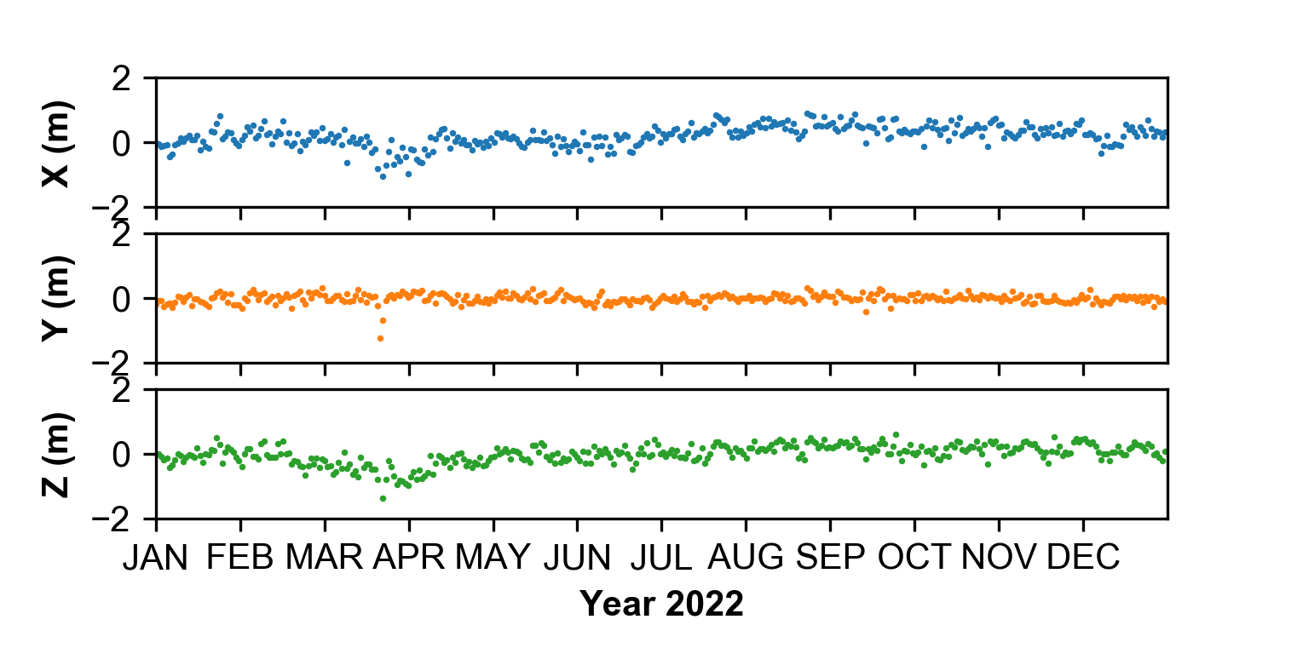
3 Results
3.1 Monitoring coordinates
SPP Positioning Results at IGS station POTS
Reference Coordinates:
XYZ: 3800694.729 m
882079.3358 m
5028797.996 m

Slide 5
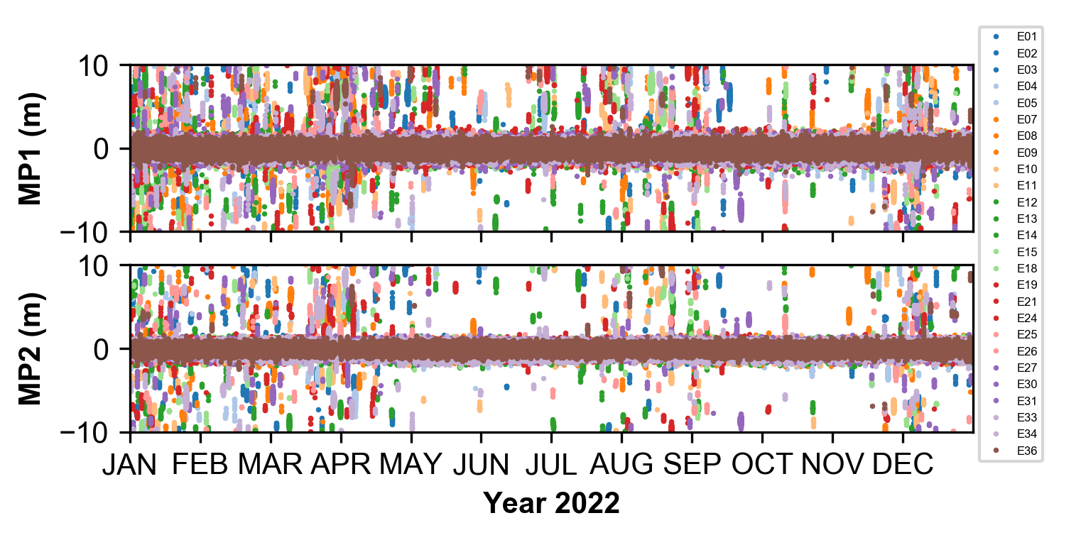
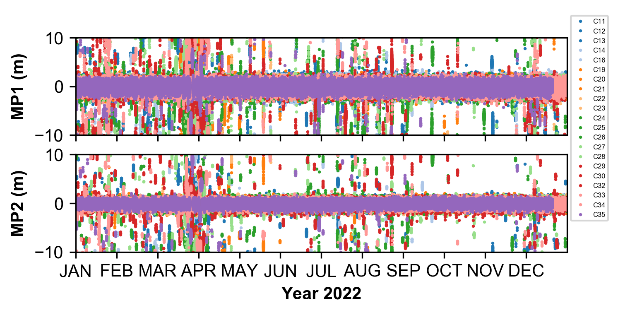
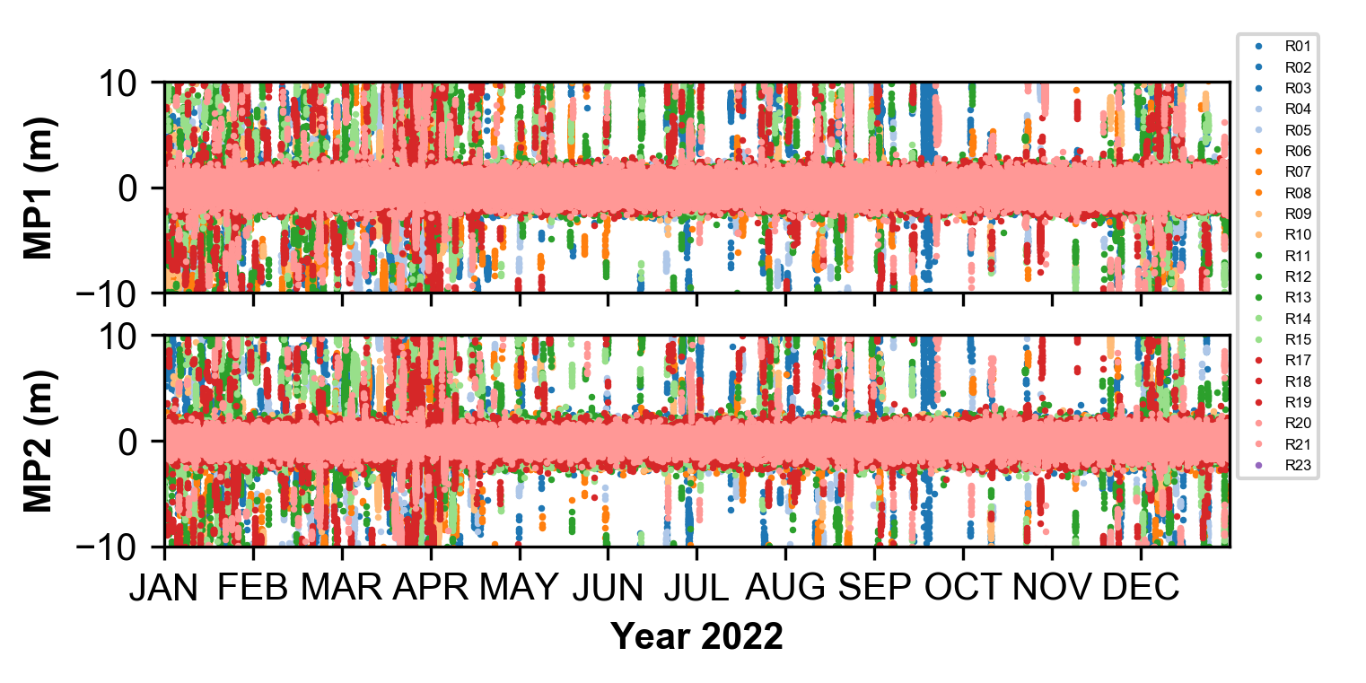
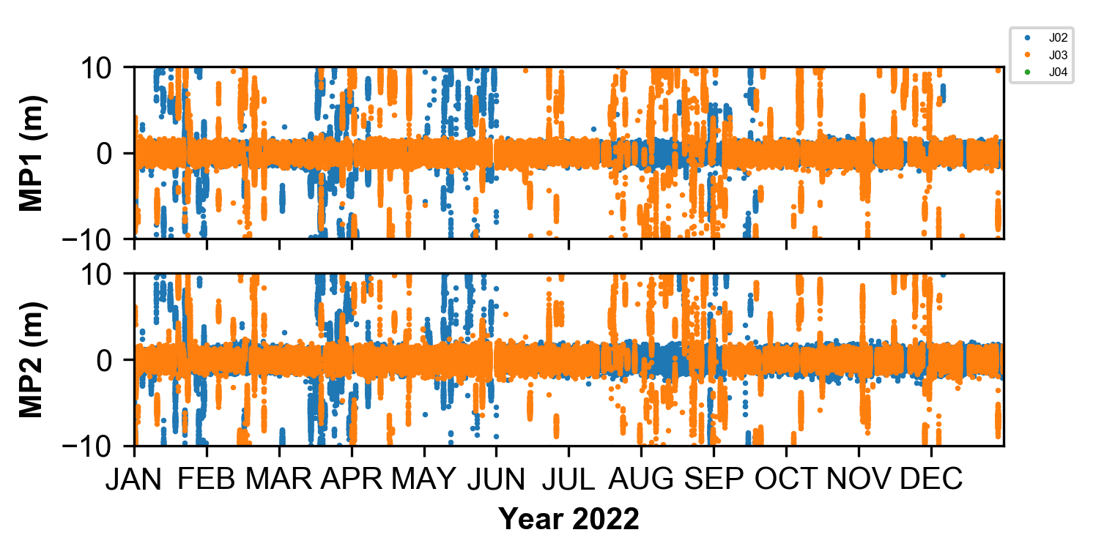
3 Results
3.2 Multipath Effects
POTS Station
Galileo
BeiDou
GLONASS
QZSS

Slide 6
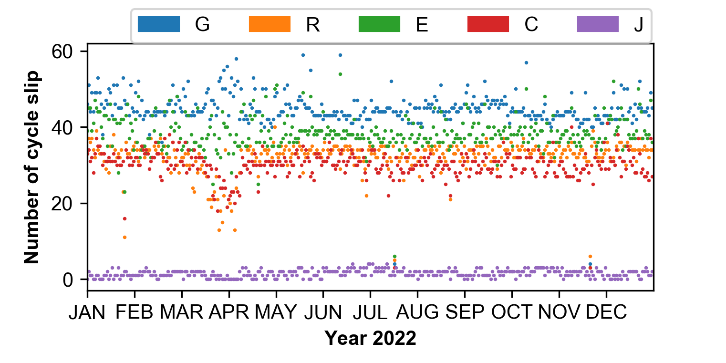
3 Results
3.3 Cycle Slip
POTS Station

Slide 7
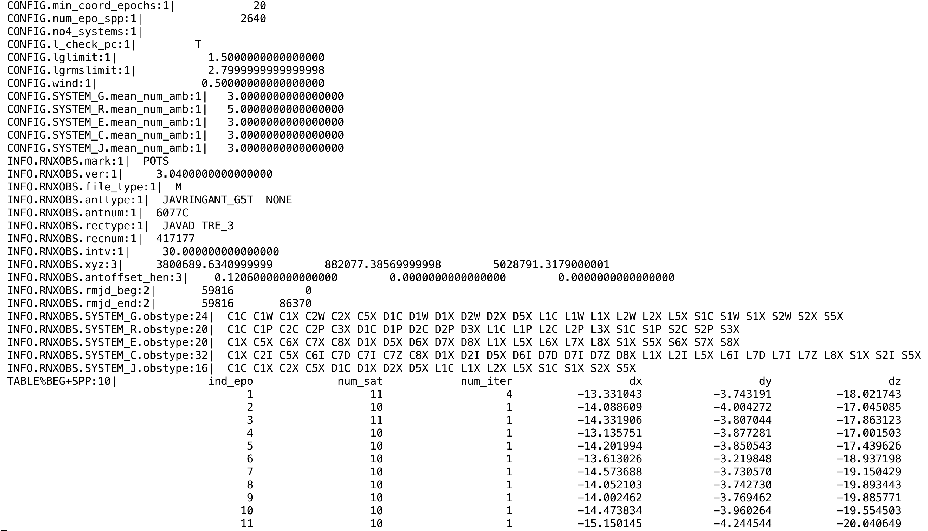
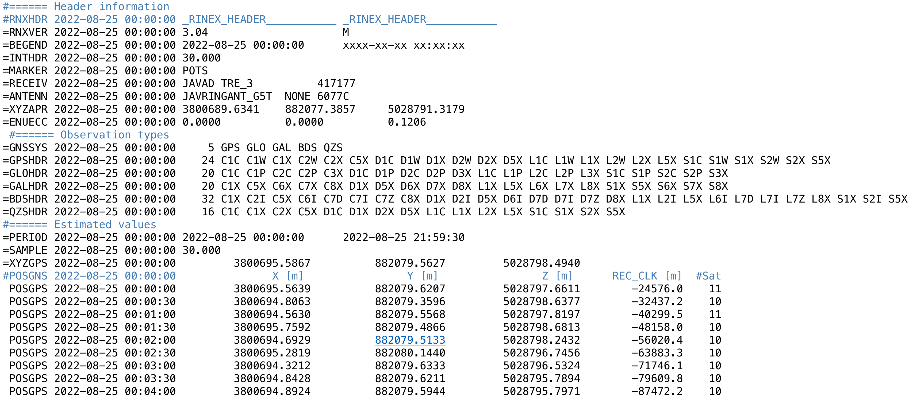
3 Results
3.4 Summary Output
Internal Results File
Converted Anubis Results File

Slide 8
Thanks for your attention!
Q & A

