Slide 1
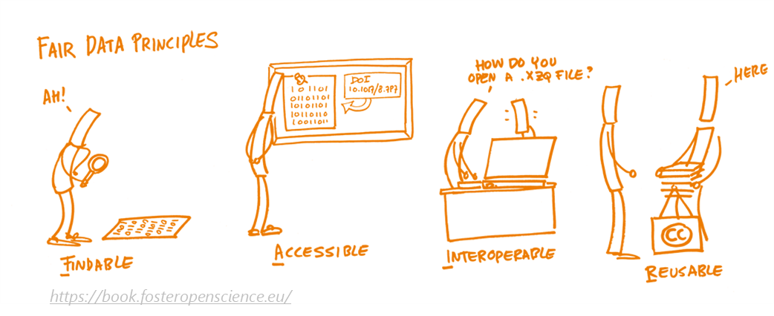
Enabling FAIR GNSS data repositories: the case of the EPN Historical Data Center
A. Miglio, C. Bruyninx, A. Fabian, J. Legrand
Royal Observatory of Belgium

Slide 2
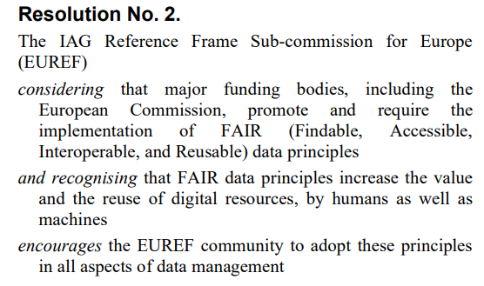
Introduction
Royal Observatory of Belgium has been looking into ways to apply the FAIR data principles on GNSS data since a couple of years
In collaboration with the data stewards of the University of Ghent
to enable and enhance the reuse of data by both humans and machines.
Experiences shared during splinter meetings:
EUREF 2021 symposium, May 27, 2021
EUREF 2022 symposium, June 2, 2022
This presentation: show results of the implementation of FAIR data principles applied on the EPN Historical Data Center
EUREF 2021

Slide 3
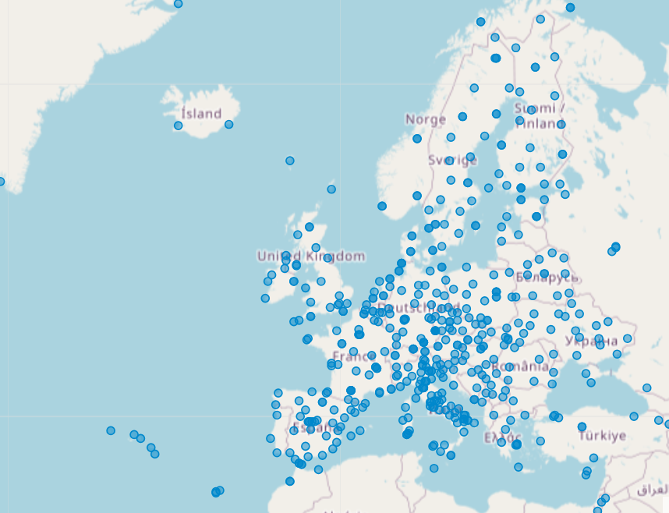
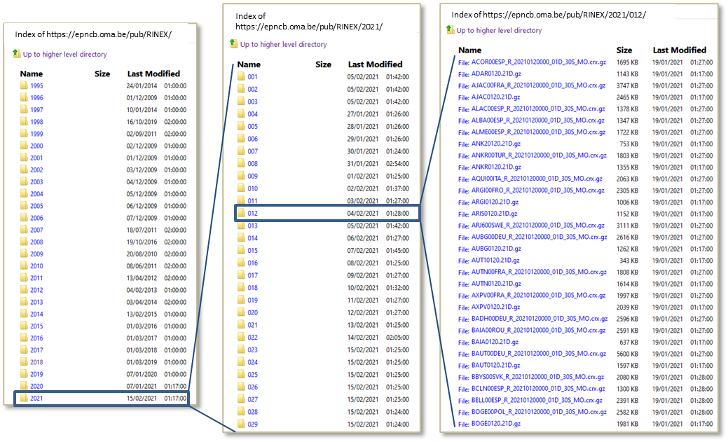
EPN Historical Data Center (HDC)
Archive of daily RINEX data from EPN stations – to be as complete as possible
Actively looking for data of EPN stations
from before station was included in EPN
not available from regional EPN data centers
500+ GNSS stations
3,1+ million RINEX files
https://epncb.oma.be/pub/RINEX
Standard IGS/EPN data center

Slide 4
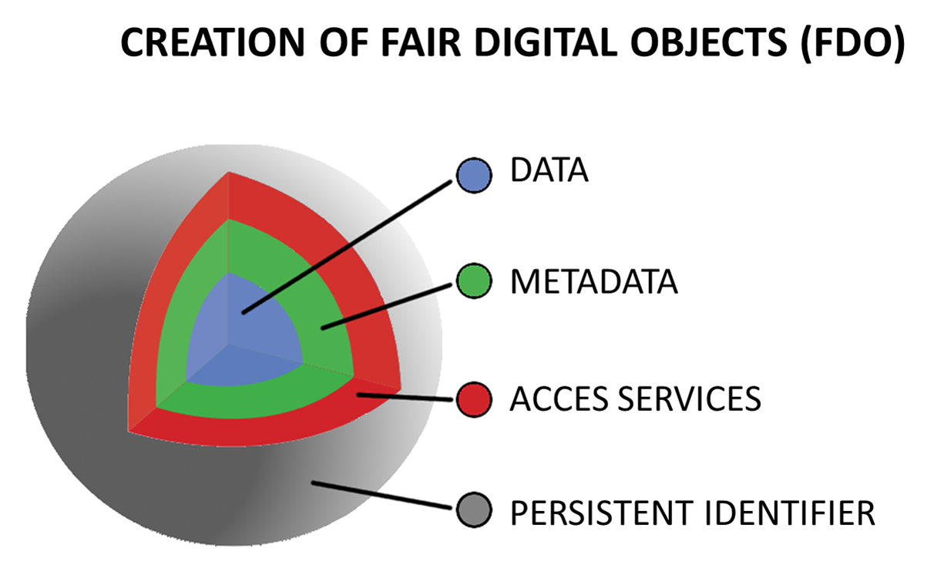
Implementation of FAIR data principles
→ RINEX data
→ Standardized & rich metadata
→ For humans and machines
→ Long-term reference to the (meta)data
Created by modifying Fig. 8 in "Turning FAIR into reality: final report and action plan from the European Commission expert group on FAIR data“ (2018) https://data.europa.eu/doi/10.2777/1524 - (licensed under CC-BY)

Slide 5
Implementation of FAIR data principles
→ RINEX data
→ Standardized & rich metadata
→ For humans and machines
→ Long-term reference to the (meta)data

Slide 6
New data portal providing access to GNSS data in historical EPN data center
https://gnss.be/opendataportal/
Beta version!

Slide 7
New data portal providing access to GNSS data in historical EPN data center
https://gnss.be/opendataportal/
Beta version!

Slide 8
Web Services to access rich GNSS metadata all the information a user needs to know about the data
RINEX FILE
URL of the RINEX file
Format: RINEX, Hatanaka compression
File size
Last modified date
Link to metadata of station dataset
To access the GNSS metadata directly via a RESTful API without need to go through the web portal
STATION DATASET (all daily RINEX data of a station)
GeodesyML, IGS site log
DOI, data license, station location, etc.
Overview of available RINEX data
Link to metadata of repository
DATA REPOSITORY
Publisher
Network coverage
Type of data
list of GNSS stations with datasets

Slide 9
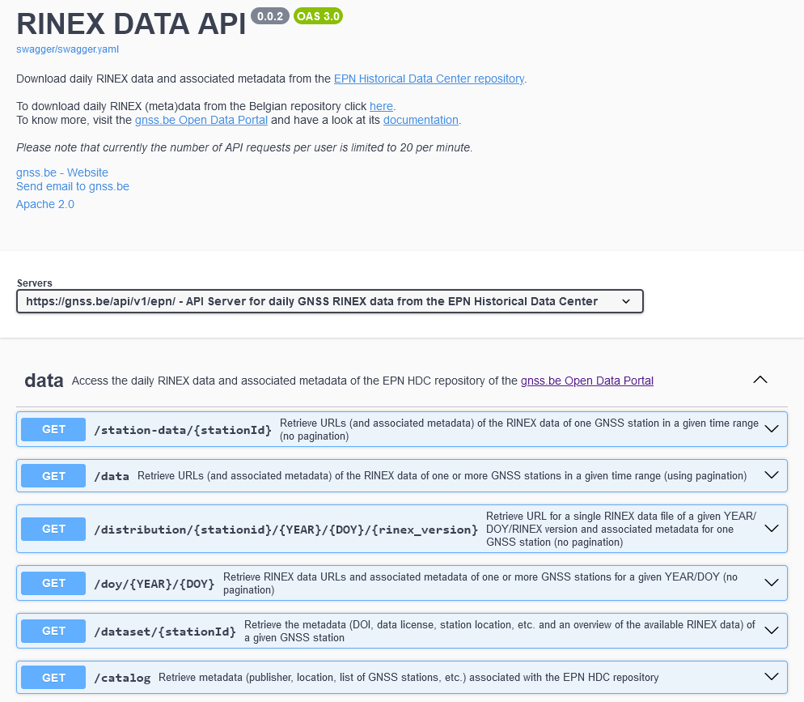
Data and Metadata Web Services - Documentation
https://gnss.be/api/v1/epn/doc

Slide 10
Example
RINEX files of ACOR00ESP observed between 1996-01-01 and 2022-12-31 that have been changed after 2023-07-01 ?
Command line
curl -X 'GET' 'https://gnss.be/api/v1/epn/station-data/ACOR00ESP ?rinexVersion=all&startDate=1996-01-01&endDate=2022-12-31&changeDate=2023-07-01' -H 'accept: text/plain'
Output
https://epncb.oma.be/pub/RINEX/2021/319/ACOR00ESP_R_20213190000_01D_30S_MO.crx.gz https://epncb.oma.be/pub/RINEX/2021/320/ACOR00ESP_R_20213200000_01D_30S_MO.crx.gz https://epncb.oma.be/pub/RINEX/2021/321/ACOR00ESP_R_20213210000_01D_30S_MO.crx.gz

Slide 11
Example
RINEX files of ACOR00ESP observed between 1996-01-01 and 2022-12-31 that have been changed after 2023-07-01 ?
Command line
curl -X 'GET' 'https://gnss.be/api/v1/epn/station-data/ACOR00ESP ?rinexVersion=all&startDate=1996-01-01&endDate=2022-12-31&changeDate=2023-07-01' –H 'accept: application/ld+json'
Output ?

Slide 12
Example
"@graph": [
{
"@id": "https://epncb.oma.be/PID/2021/319/ACOR00ESP_2021319_01D_30S_R3",
"@type": "Distribution",
"accessURL": {
"@type": "xsd:anyURI",
"@value": "https://epncb.oma.be/pub/RINEX/2021/319/ACOR00ESP_R_20213190000_01D_30S_MO.crx.gz"
},
"adms:status": {
"@id": "https://publications.europa.eu/resource/authority/distribution-status/COMPLETED"
},
"compressFormat": "application/x-gzip",
"dataset": {
"@id": "https://epncb.oma.be/PID/ACOR00ESP"
},
"dct:checksum": {
"@id": "https://epncb.oma.be/PID/2021/319/ACOR00ESP_2021319_01D_30S_R3#checksum"
},
"dct:conformsTo": {
"@id": "https://gnss.be/PID/standard#hatanaka"
},
"dct:description": "Daily RINEX data of the GNSS station ACOR00ESP for DOY 319 of 2021",
"dct:issued": {
"@type": "xsd:dateTime",
"@value": "2021-11-15T00:00:00"
},
"dct:license": {
"@id": "https://epncb.oma.be/PID/ACOR00ESP#license"
},
"dct:modified": {
"@type": "xsd:dateTime",
"@value": "2023-11-17T18:34:21"
},
"dct:title": "ACOR00ESP_R_20213190000_01D_30S_MO.crx.gz",
"downloadURL": {
"@type": "xsd:anyURI",
"@value": "https://epncb.oma.be/pub/RINEX/2021/319/ACOR00ESP_R_20213190000_01D_30S_MO.crx.gz"
},
"gnss:obsData": {
"@id": "https://epncb.oma.be/PID/2021/319/ACOR00ESP_2021319_01D_30S_R3#obsdata"
},
"mediaType": "application/octet-stream",
"temporal": {
"@id": "https://epncb.oma.be/PID/2021/319/ACOR00ESP_2021319_01D_30S_R3#temporal"
}
},
{
"@id": "https://epncb.oma.be/PID/2021/319/ACOR00ESP_2021319_01D_30S_R3#obsdata",
"@type": "gnss:OBSData",
"gnss:compressFormat": {
"@id": "https://gnss.be/PID/standard/hatanaka"
},
"gnss:format": {
"@id": "https://gnss.be/PID/standard/RINEX"
},
"gnss:frequency": {
"@id": "http://purl.org/cld/freq/daily"
},
"gnss:obsHeader": {
"@id": "https://epncb.oma.be/PID/2021/319/ACOR00ESP_2021319_01D_30S_R3#obsheader"
},
"gnss:station": {
"@id": "https://epncb.oma.be/PID/ACOR00ESP#station"
}
},
JSON-LD
RINEX files of ACOR00ESP observed between 1996-01-01 and 2022-12-31 that have been changed after 2023-07-01 ?
Rich & Standardized metadata
Command line
curl -X 'GET' 'https://gnss.be/api/v1/epn/station-data/ACOR00ESP ?rinexVersion=all&startDate=1996-01-01&endDate=2022-12-31&changeDate=2023-07-01' -H'accept: application/ld+json’
Output ?

Slide 13
Implementation of FAIR data principles
→ RINEX data
→ Standardized & rich metadata
→ For humans and machines
→ Long-term reference to the (meta)data

Slide 14
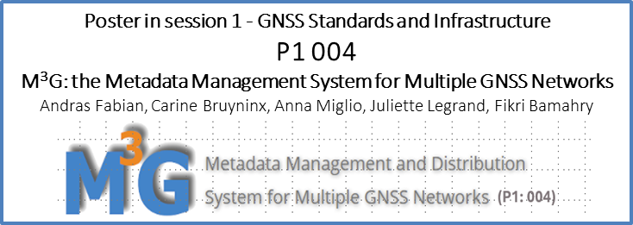
Standardized & rich metadata for RINEX data
Rich metadata
Standardized metadata
What?
Everything the user needs to know about the data
Information required by FAIR data principles
Why?
Facilitate search and provide any useful information related to the (RINEX) data
How?
RINEX Data curation, new database
Exploit GNSS station metadata system (M3G)
What?
Reusable & machine-readable by construction
Easy to be converted into other metadata standards
Why?
Required by FAIR data principles to enable interoperability and reuse by both humans and machines
How?
Buiding a standardized metadata schema GNSS-DCAT-AP

Slide 15
New DCAT Application Profile (DCAT-AP): GNSS-DCAT-AP
"@graph": [
{
"@id": "https://epncb.oma.be/PID/2021/319/ACOR00ESP_2021319_01D_30S_R3#temporal",
"@type": "PeriodOfTime",
"endDate": {
"@type": "xsd:dateTime",
"@value": "2021-11-15T23:59:30"
},
"startDate": {
"@type": "xsd:dateTime",
"@value": "2021-11-15T00:00:00"
}
},
{
"@id": "https://epncb.oma.be/PID/2021/319/ACOR00ESP_2021319_01D_30S_R3",
"@type": "Distribution",
"accessURL": {
"@type": "xsd:anyURI",
"@value": "https://epncb.oma.be/pub/RINEX/2021/319/ACOR00ESP_R_20213190000_01D_30S_MO.crx.gz"
},
"adms:status": {
"@id": "https://publications.europa.eu/resource/authority/distribution-status/COMPLETED"
},
"compressFormat": "application/x-gzip",
"dataset": {
"@id": "https://epncb.oma.be/PID/ACOR00ESP"
},
"dct:checksum": {
"@id": "https://epncb.oma.be/PID/2021/319/ACOR00ESP_2021319_01D_30S_R3#checksum"
},
"dct:conformsTo": {
"@id": "https://gnss.be/PID/standard#hatanaka"
},
"dct:description": "Daily RINEX data of the GNSS station ACOR00ESP for DOY 319 of 2021",
"dct:issued": {
"@type": "xsd:dateTime",
"@value": "2021-11-15T00:00:00"
},
"dct:license": {
"@id": "https://epncb.oma.be/PID/ACOR00ESP#license"
},
"dct:modified": {
"@type": "xsd:dateTime",
"@value": "2023-11-17T18:34:21"
},
"dct:title": "ACOR00ESP_R_20213190000_01D_30S_MO.crx.gz",
"downloadURL": {
"@type": "xsd:anyURI",
"@value": "https://epncb.oma.be/pub/RINEX/2021/319/ACOR00ESP_R_20213190000_01D_30S_MO.crx.gz"
},
"gnss:obsData": {
"@id": "https://epncb.oma.be/PID/2021/319/ACOR00ESP_2021319_01D_30S_R3#obsdata"
},
"mediaType": "application/octet-stream",
"temporal": {
"@id": "https://epncb.oma.be/PID/2021/319/ACOR00ESP_2021319_01D_30S_R3#temporal"
}
},
{
"@id": "https://epncb.oma.be/PID/2021/319/ACOR00ESP_2021319_01D_30S_R3#antenna",
"gnss:igsModelCode": "LEIAT504 LEIS",
"gnss:marker-arpEastEcc": {
"@type": "xsd:float",
"@value": "0.0"
},
"gnss:marker-arpNorthEcc": {
"@type": "xsd:float",
"@value": "0.0"
},
"gnss:marker-arpUpEcc": {
"@type": "xsd:float",
"@value": "3.046"
}
},
{
"@id": "https://epncb.oma.be/PID/2021/319/ACOR00ESP_2021319_01D_30S_R3#obsdata",
"@type": "gnss:OBSData",
"gnss:compressFormat": {
"@id": "https://gnss.be/PID/standard/hatanaka"
},
"gnss:format": {
"@id": "https://gnss.be/PID/standard/RINEX"
},
"gnss:frequency": {
"@id": "http://purl.org/cld/freq/daily"
},
"gnss:obsHeader": {
"@id": "https://epncb.oma.be/PID/2021/319/ACOR00ESP_2021319_01D_30S_R3#obsheader"
},
"gnss:station": {
}
DCAT Application Profile =
Cookbook (set of metadata elements, policies and guidelines) used to create a standard metadata schema for a particular application
e.g., GeoDCAT-AP (geospatial datasets, dataset series and services), StatDCAT-AP (statistical data sets), EPOS-DCAT-AP (Research Infrastructures in the solid-Earth domain)
DCAT:
W3C vocabulary designed to facilitate interoperability between data repositories
GNSS-DCAT-AP https://doi.org/10.5281/zenodo.7777568
(current version is 0.3)
Standardized metadata
schema
https://joinup.ec.europa.eu/collection/semantic-interoperability-community-semic/solution/dcat-application-profile-data-portals-europe/release/211

Slide 16
GNSS-DCAT-AP
{
"@context": {
"@vocab": "https://www.w3.org/ns/dcat#",
"adms": "http://www.w3.org/ns/adms#",
"dcat": "https://www.w3.org/ns/dcat#",
"dcatap": "http://data.europa.eu/r5r/",
"dct": "http://purl.org/dc/terms/",
"dctype": "http://purl.org/dc/dcmitype/",
"foaf": "http://xmlns.com/foaf/0.1/",
"gnss": "https://gnss.be/vocab/2023/gnss#",
. . .
"xsd": "http://www.w3.org/2001/XMLSchema#"
},
"@graph": [
{
. . .
"adms:status": {
"@id": "https://publications.europa.eu/resource/authority/distribution-status/COMPLETED"
},
"compressFormat": "application/x-gzip",
"dct:conformsTo": {
"@id": "https://gnss.be/PID/standard#hatanaka"
},
...
"dct:modified": {
"@type": "xsd:dateTime",
"@value": "2023-11-17T18:34:21"
},
"dct:title": "ACOR00ESP_R_20213190000_01D_30S_MO.crx.gz",
"downloadURL": {
"@type": "xsd:anyURI",
"@value": "https://epncb.oma.be/pub/RINEX/2021/319/ACOR00ESP_R_20213190000_01D_30S_MO.crx.gz"
},
},
{
"@id": "https://epncb.oma.be/PID/2021/319/ACOR00ESP_2021319_01D_30S_R3#obsdata",
"@type": "gnss:OBSData",
"gnss:frequency": {
"@id": "http://purl.org/cld/freq/daily"
},
},
"dataset": {
"@id": "https://epncb.oma.be/PID/ACOR00ESP"
},
{
"@id": "https://epncb.oma.be/PID/2021/319/ACOR00ESP_2021319_01D_30S_R3#checksum",
"@type": "dct:Checksum",
"dct:checksumAlgorithm": "MD5",
"dct:checksumValue": "d04b0c6c8b7f75335e5cb3dbc09b1cdc"
},
{
"@id": "https://epncb.oma.be/PID/2021/319/ACOR00ESP_2021319_01D_30S_R3#receiver",
"gnss:firmware_version": "4.50/7.710",
"gnss:igsModelCode": "LEICA GR50"
},
{
"@id": "https://epncb.oma.be/PID/2021/319/ACOR00ESP_2021319_01D_30S_R3#obsheader",
"gnss:antenna": {
"@id": "https://epncb.oma.be/PID/2021/319/ACOR00ESP_2021319_01D_30S_R3#antenna"
},
"gnss:interval": {
"@type": "xsd:nonNegativeInteger",
"@value": "30"
},
"gnss:issued": {
"@type": "xsd:dateTime",
"@value": "2021-11-15T00:00:00"
},
"gnss:markerName": "ACOR00ESP",
"gnss:receiver": {
"@id": "https://epncb.oma.be/PID/2021/319/ACOR00ESP_2021319_01D_30S_R3#receiver"
},
"gnss:rinexVersion": "3.04",
"gnss:temporal": {
"@id": "https://epncb.oma.be/PID/2021/319/ACOR00ESP_2021319_01D_30S_R3#temporal"
}
}
]
}
https://doi.org/10.5281/zenodo.7777568
(current version is 0.3)
FAIR
Advantages of DCAT-AP:
Combine metadata elements from multiple vocabularies (like DCAT, ISO)
Extend existing vocabularies or application profiles with domain-specific metadata elements (IGS antenna/receiver types)
Descriptive RINEX file information/metadata:
File has “completed” status
Info on compression
Last modified time
Link to RINEX file
Daily RINEX file
Link to station dataset (which contains the station metadata)
JSON-LD
GNSS-DCAT-AP

Slide 17
Implementation of FAIR data principles
→ RINEX data
→ Standardized & rich metadata
→ For humans and machines
→ Digital Object Identifiers
→ Long-term reference to the (meta)data

Slide 18
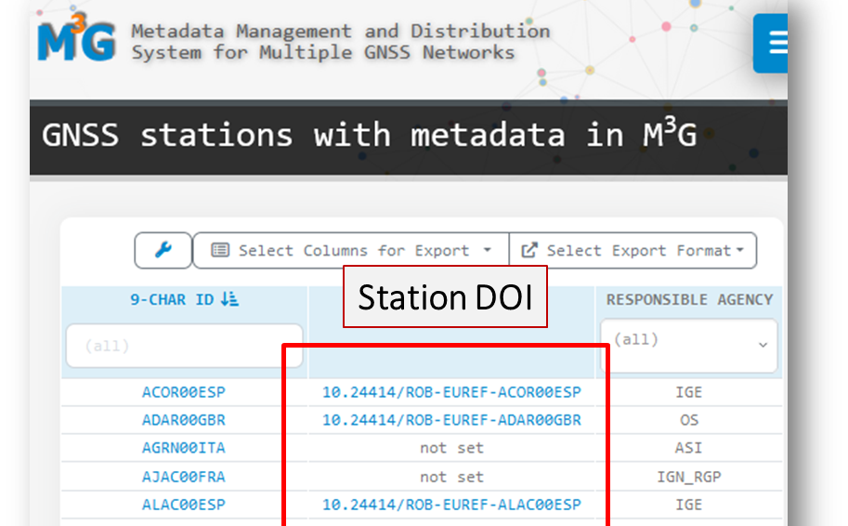
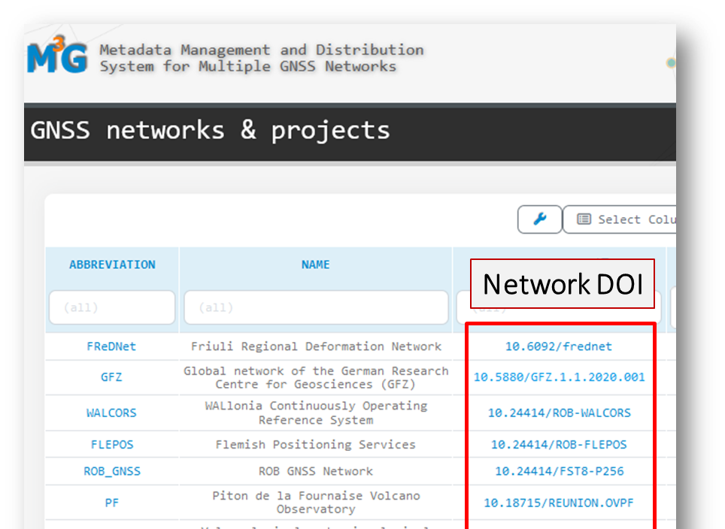
Persistent Identifiers for GNSS Data: Digital Object Identifiers (DOI)
Tools to collect existing DOI in M³G have been developed
Upgrade of M³G software to allow station/network managers to insert GNSS network and/or GNSS station DOI in M³G
Agreement:
DOI for dataset of a GNSS station is necessary
DOI for datasets of GNSS networks should also be allowed!
Both can be linked with each other

Slide 19
New service to provide DOI for EPN stations
Very few DOI inserted in M³G: station managers ask help to get DOI
→ Development of new (on demand) service provided to EUREF
to export harmonized/standardized DOI datacite metadata and landing page (GGOS draft recommendations) based on EPN station metadata in M³G
DOI minted by EPN Central Bureau
DOI minted by station manager
→ Station DOIs already available for 118 EPN stations
EUREF 2024
Resolution No. 1
The IAG Reference Frame Sub-commission for Europe (EUREF)
recognising the increasing adoption of Persistent Identifiers such as Digital Object Identifiers (DOIs) for a wide range of data, including geo related data
and noting that unique identifiers increase the accessibility and discoverability of data
encourages EPN station owners to, if possible, derive DOIs for their GNSS station’s dataset and to insert the DOI into the M3G database
and asks EPN station owners without DOIs to accept the offer of the EPN Central Bureau to mint the identifiers and add them into M3G

Slide 20
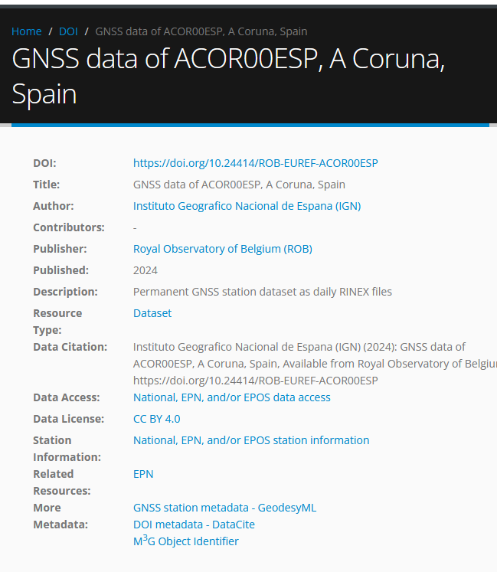
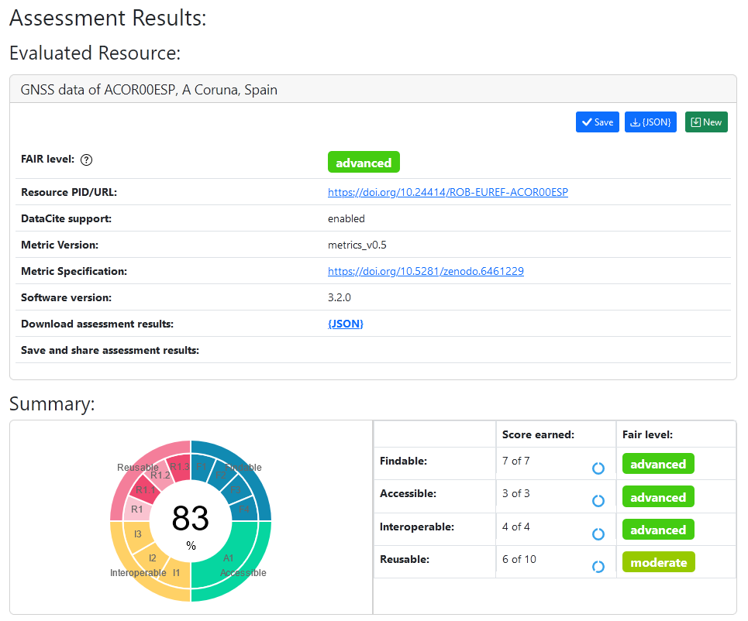
Example of DOI landing page
https://doi.org/10.24414/ROB-EUREF-ACOR00ESP
F-UJI is a web service to programmatically assess FAIRness of research data objects (aka data sets) based on metrics developed by the FAIRsFAIR project.

Slide 21
FAIR data principles have been implemented on a GNSS RINEX data repository (IGS-style data center)
→ RINEX data
Standardized metadata schema
GNSS-DCAT-AP (including e.g. links to site log and data)
JSON-LD
Humans and machines → web portal and web services
Search functionality
New service to provide DOI for EPN data (standardization in progress with GGOS/IGS)
Service to generate PIDs for all metadata (not detailed in this presentation)

Slide 22
Work to be continued !
Populate additional optional metadata fields in GNSS-DCAT-AP
GNSS data quality indicator
File provenance
Web services: first version
Extend search possibilities - add them slowly to ensure service speed is not deteriorated
Web portal : beta version
User friendliness + documentation (more examples)
User authentication for usage of web services
GNSS-DCAT-AP is modular: new classes and properties can added e.g. for GNSS products
https://github.com/ROB-GNSS/gnss.be-data-API-examples

Slide 23
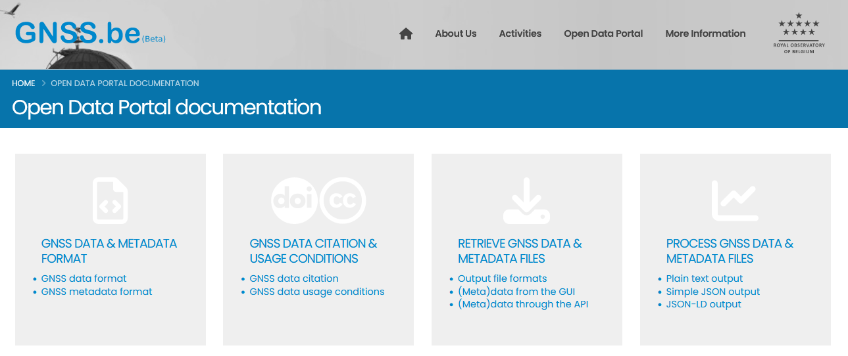
Data Portal – https://gnss.be/opendataportal Documentation

Slide 24
Contact
Royal Observatory of Belgium
EPN Central Bureau
epncb@oma.be
https://epncb.oma.be/
Brussels
BELGIUM
Thank you for your attention
Cite this presentation as:
A. Miglio, C. Bruyninx, A. Fabian, J. Legrand (2024), Enabling FAIR GNSS data repositories: the case of the EPN Historical Data Center, Presented at IGS Symposium & Workshop, July 1-5, 2024, Bern, Switzerland

