Slide 1
GNSS Interference - Impact, Detection, and Mitigation
July 2024
Youssef Tawk Leica Geosystems
Notes:
Good morning, everyone. It’s a pleasure to open this session and share insights on GNSS Interference, its Impact, Detection, and Mitigation, a topic that I believe is becoming increasingly significant for the GNSS community.

Slide 2
Outline
GNSS Interference
SmartTrack+ Interference Toolbox
Spectrum Analysis
Interference Mitigation
Implications of Interference on GNSS Receiver Performance
Summary
Automatic Detection & Alerting
Notes:
Here's the outline of my presentation. I'll begin with a brief description of GNSS interference. Next, I'll introduce the SmartTrack+ Interference Toolbox, a solution from Leica Geosystems designed to mitigate RF interference. Then, I'll discuss the implications of interference on GNSS receiver performance. Finally, I'll wrap up with a summary.

Slide 3
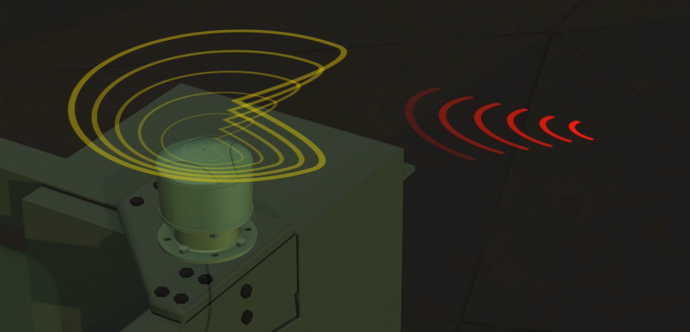
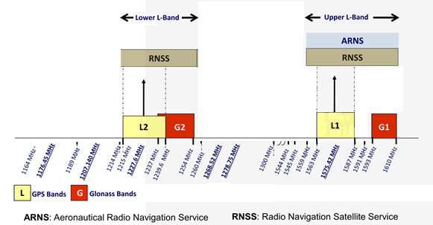
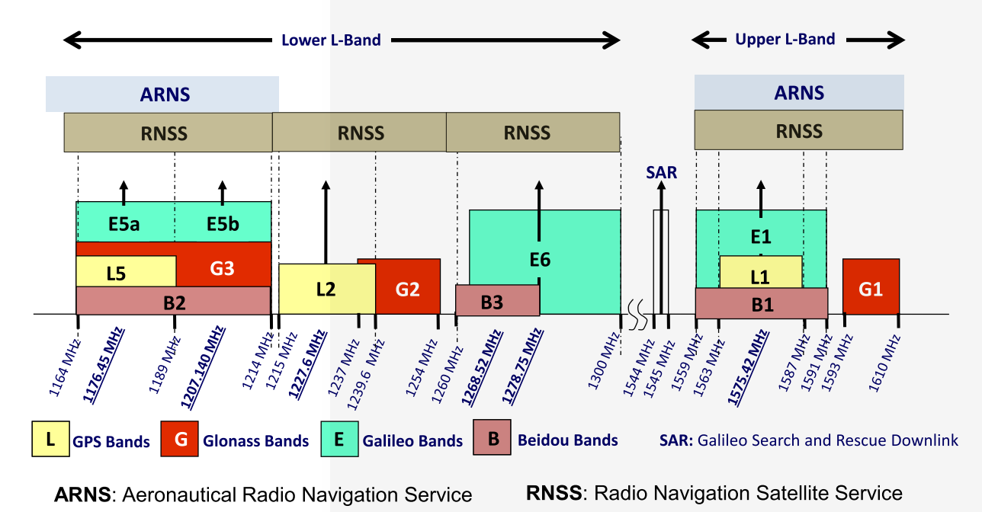
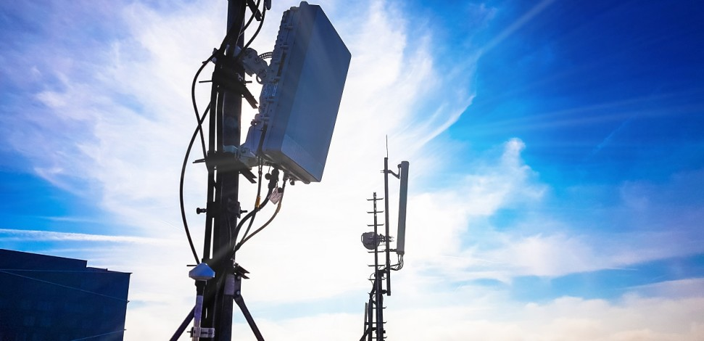
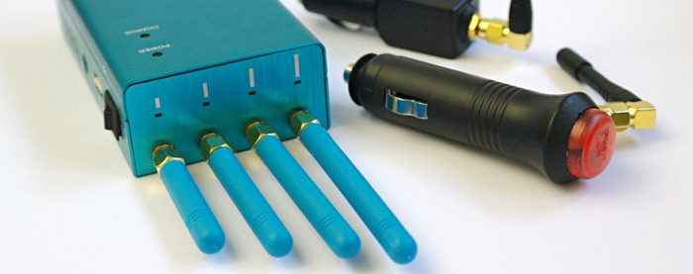
What is Interference for a GNSS receiver?
Interference is a phenomenon where undesired signals enter the GNSS receiver and mix with the satellite signals to disrupt the operation of the receiver
Legacy GPS/GLO Dual-Frequency Receiver Spectrum
Full Band GNSS Receiver Spectrum
http://www.gage.upc.edu/gnss_book
Notes:
To define RF interference for a GNSS receiver, I'd describe it as a phenomenon where unwanted signals enter the receiver, disrupting its operation. This issue is becoming increasingly significant due to the growing number and variety of RF interference sources, such as satellite transmissions, sensor-to-sensor communications, intentional jamming, and military activities. Additionally, modern GNSS receivers and antennas are designed with larger bandwidths to track all visible satellites and signals. For instance, while legacy GPS/GLO dual-frequency receivers needed tens of MHz to track GPS and GLO L1 and L2 frequencies as can be seen from the graph on the left, today's full-band GNSS receivers require hundreds of MHz to track all signals across all bands which makes them more susceptible for receiving these unwanted signals.

Slide 4
How Interference Impacts GNSS receiver?
Partial or total loss of lock
Reduced and/or noisy Carrier to Noise ratio (C/No, signal strength)
Reduced ability of the receiver to properly operate to provide reliable raw observation data, RTK corrections, and compute a precise position.
Availability
Accuracy
Reliability
Notes:
The key question here is how interference impacts a GNSS receiver. Often, we observe that in the presence of interference, the receiver may experience partial or total loss of lock, a reduced and/or noisy C/No, and a reduced ability to operate properly, which affects its capacity to provide reliable raw observation data, RTK corrections, or compute a precise position. In summary, interference affects three critical performance criteria of a GNSS receiver: its availability to provide data, and the accuracy and reliability of that data.

Slide 5
SmartTrack+ Interference Toolbox
Mitigating RF Interference for GNSS CORS Operations
Consideration:
RF Interference and its various forms must be addressed when operating a GNSS Continuously Operating Reference Station (CORS) receiver right from the establishment of the station.
Solution:
To monitor, detect, and mitigate interference, ensuring high availability, reliability, and accuracy in RF challenging environments, Leica Geosystems introduced the SmartTrack+ Interference Toolbox solution in 2018.
This solution is available on all Leica Geosystems GNSS CORS receivers.
Notes:
Given that RF interference in its various forms must be addressed when operating a GNSS CORS receiver right from the establishment of the station, Leica Geosystems introduced the SmartTrack+ Interference Toolbox solution in 2018. This technology is designed to monitor, detect, and mitigate interference, ensuring high availability, reliability, and accuracy for GNSS CORS receivers, even in RF challenging environments.

Slide 6
SmartTrack+ Interference Toolbox
Mitigating RF Interference for GNSS CORS Operations
Frequency Power Spectrum Analysis: Measures and outputs the radio frequency power spectrum on all GNSS bands
Automatically detects, and instantly notifies operators about presence of interference signals
Adaptive interference rejection technologies for strong interference situations using three methods:
HDR mode - High dynamic range mode performing a wideband mitigation
Band pass filter
Adaptive notch filter
Monitor
Detect & Alert
Mitigate & Protect
Notes:
The SmartTrack+ solution has three key functionalities: frequency power spectrum analysis, automatic detection, and mitigation.
To give you a better understanding of the potential of this technology and to demonstrate the impact of interference on GNSS receiver performance, we conducted an experiment at our headquarters in Switzerland. → Move to next slide

Slide 7
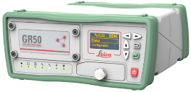
Interference Scenario Experimentation
1232 MHz
1579 MHz
Notes:
In a controlled environment, we generated two signals to interfere with GPS L1, GAL E1, and GPS L2 signals. We then analysed the receiver's performance both in the presence of these interference signals and after they were mitigated. In the next slides, I will present the comparison results. But first, I want to demonstrate the functionalities and behaviour of the Interference Toolbox on this receiver.

Slide 8
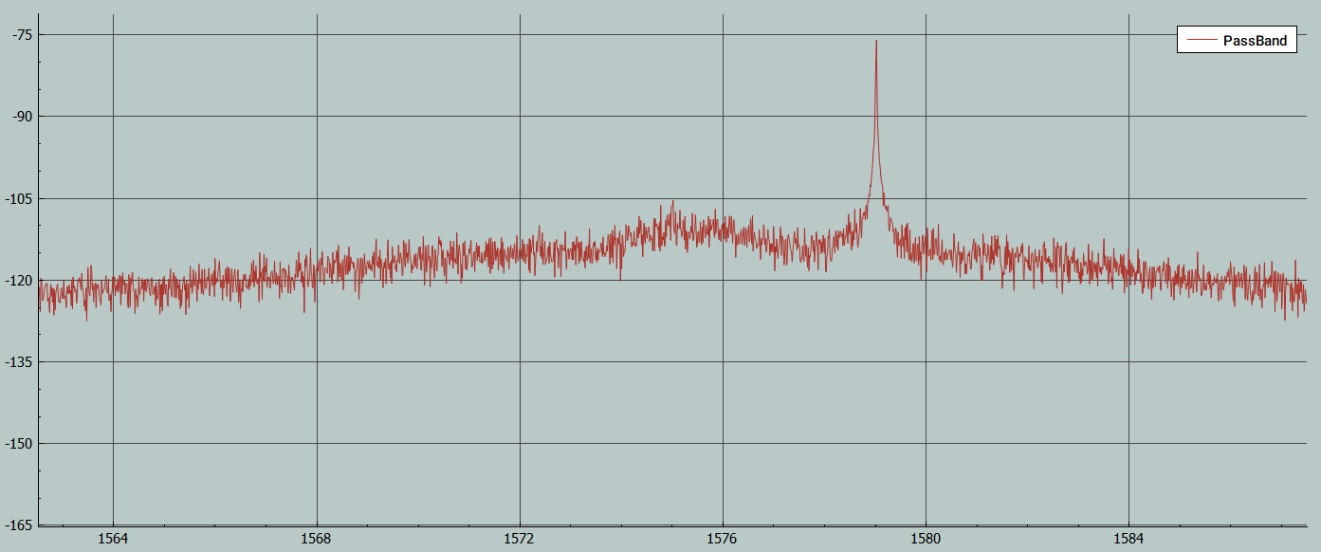
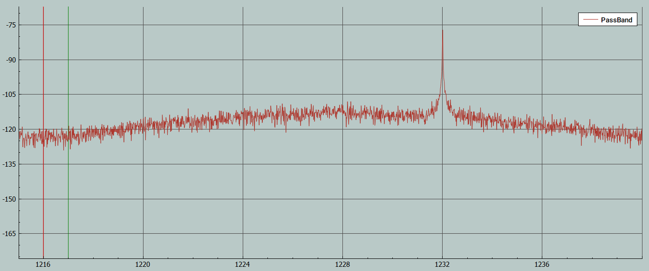
Frequency Power Spectrum Analyzer
Pass Band Data Plot
L1 Band
L2 Band
GPS L1 Minimum Bandwidth
GPS L2C Minimum Bandwidth
GAL E1 Minimum Bandwidth
GPS L2P Minimum Bandwidth
Notes:
I will start first by showing you the Interference Toolbox functionalities. Here on this slide, we can the frequency power spectrum of the receiver, when the interference signals are generated.

Slide 9
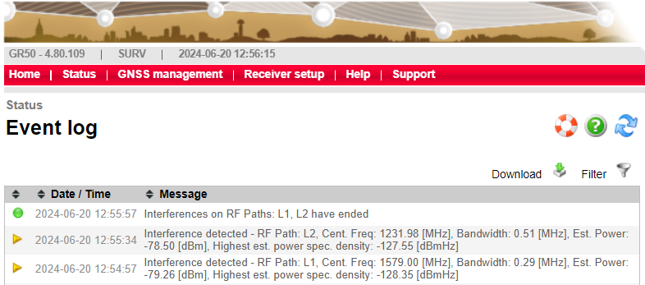
Interference Detection, Notification and Alerting

Slide 10
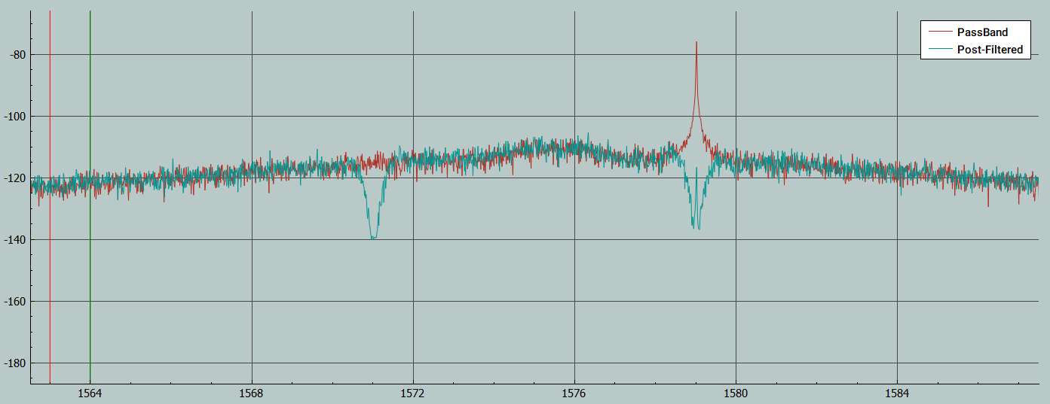
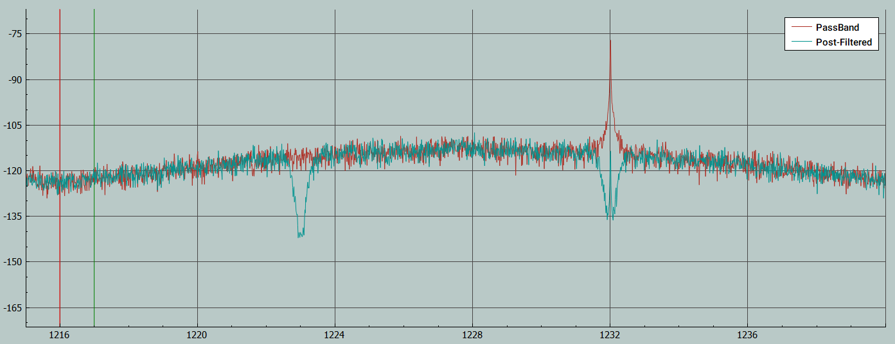
Interference Mitigation
Post Filter Data Plot
L1 Band
L2 Band
GPS L1 Minimum Bandwidth
GPS L2C Minimum Bandwidth
GAL E1 Minimum Bandwidth
GPS L2P Minimum Bandwidth

Slide 11
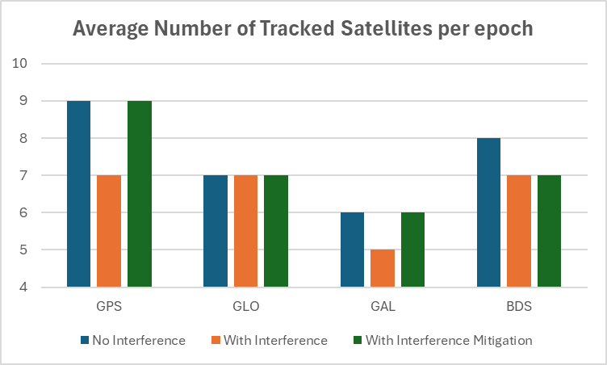
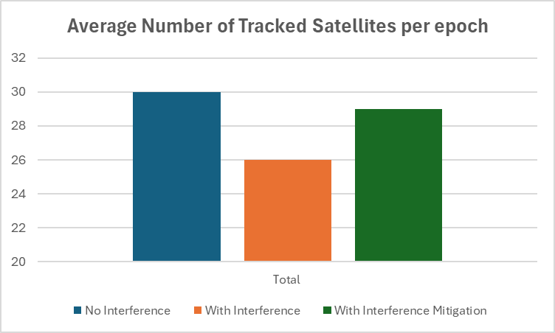
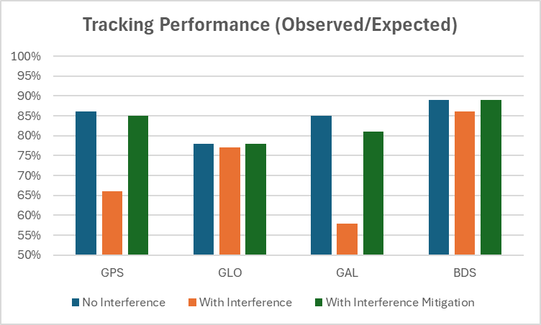
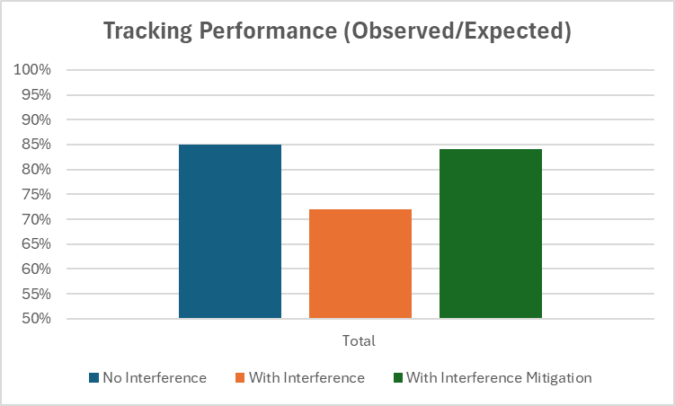
Tracking Performance

Slide 12
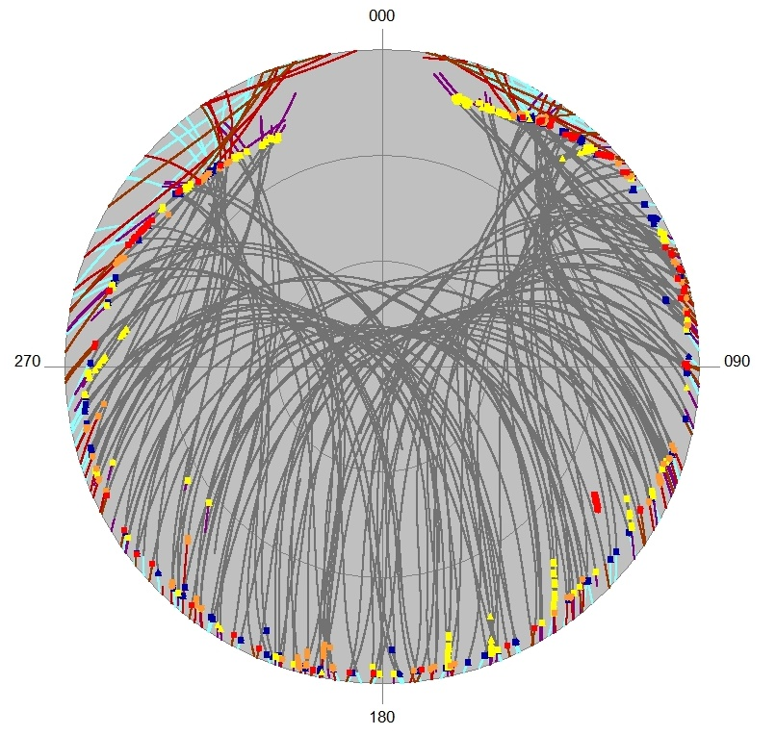
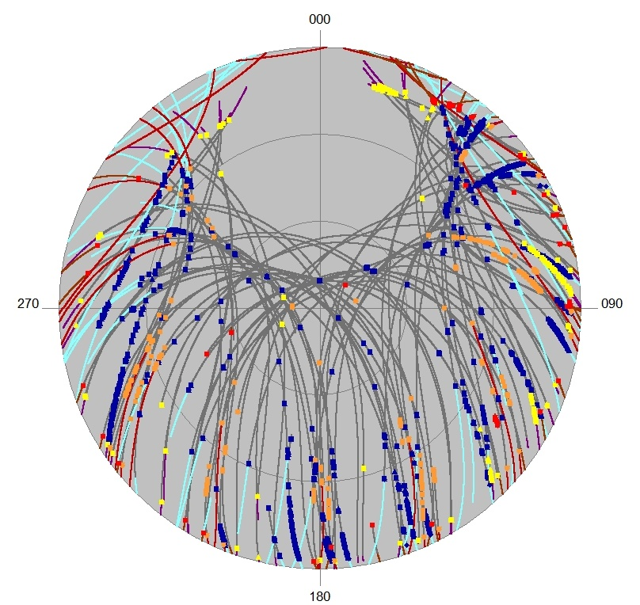
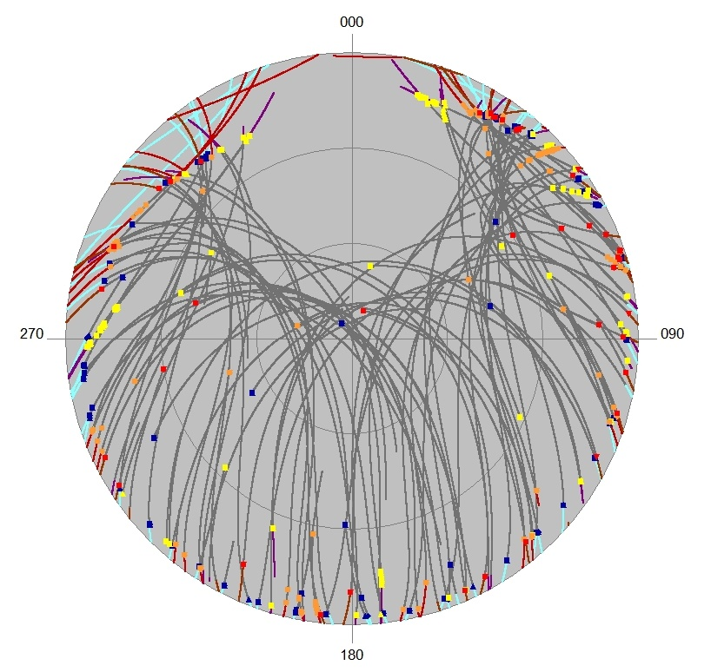
Flagged Loss of Lock
No Interference
With Interference
With Interference Mitigation

Slide 13
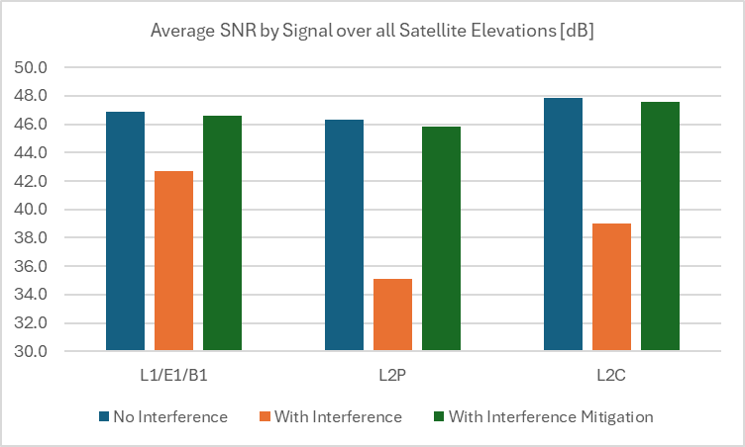
Signal to Noise Ratio (SNR)
Drop of 4.2 dB
Drop of 11.2 dB
Drop of 8.9 dB
Gain of 4 dB
Gain of 10.7 dB
Gain of 8.6 dB

Slide 14
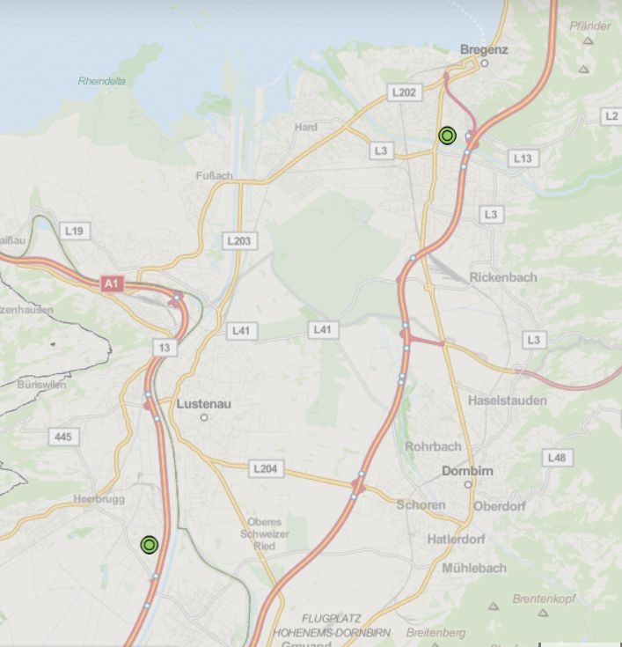
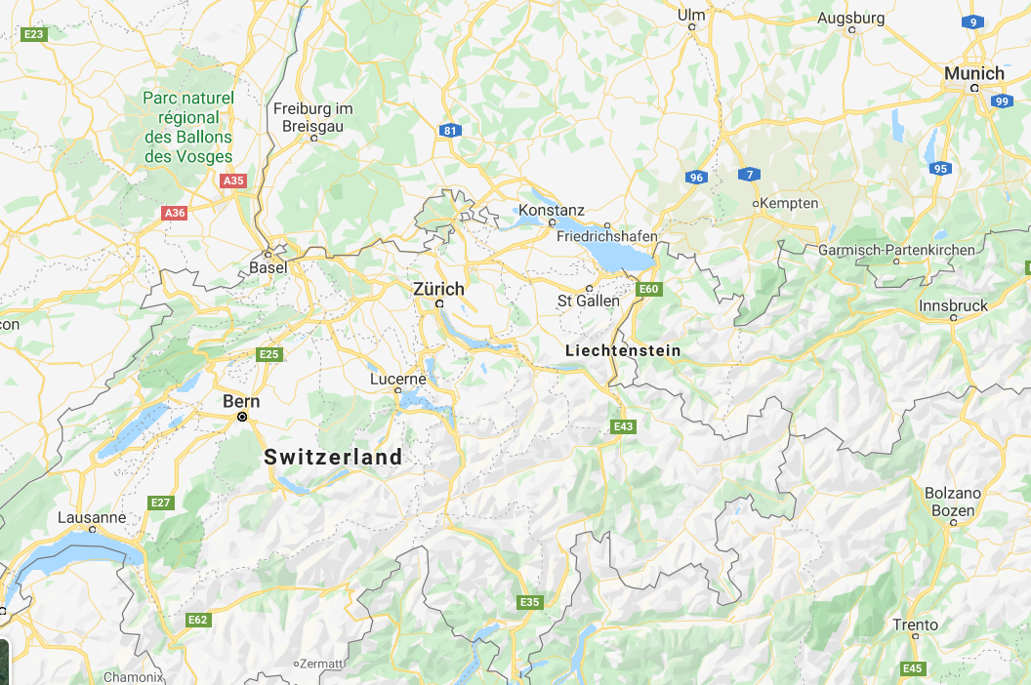
RTK Solution (Baseline 15 Km)
Interference Source
Reference Station
15 Km
Rover

Slide 15
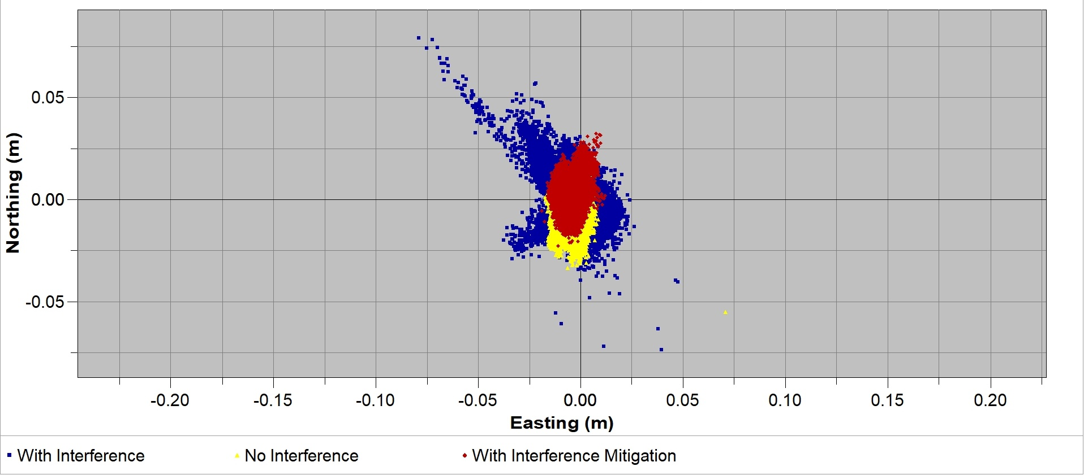
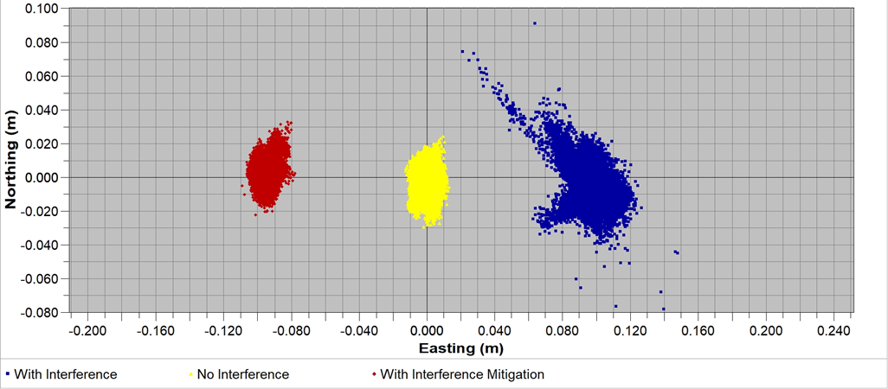
RTK Solution (Baseline 15 Km)

Slide 16
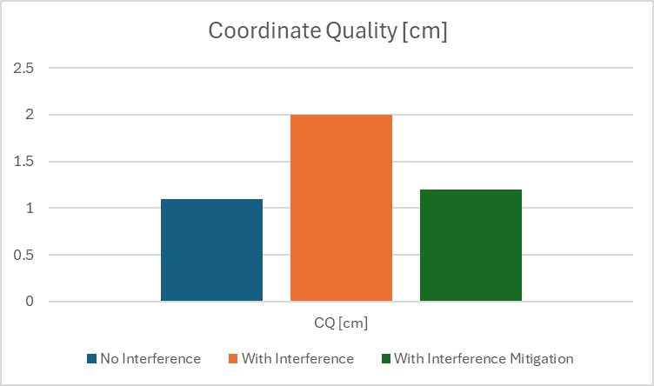
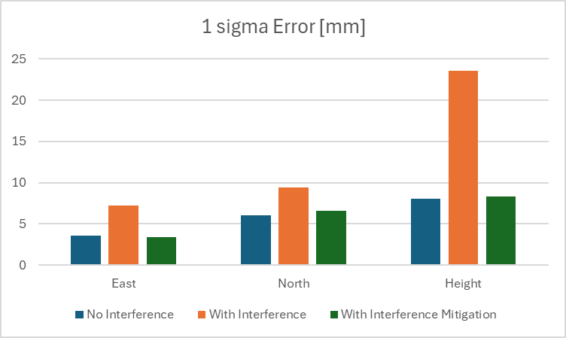
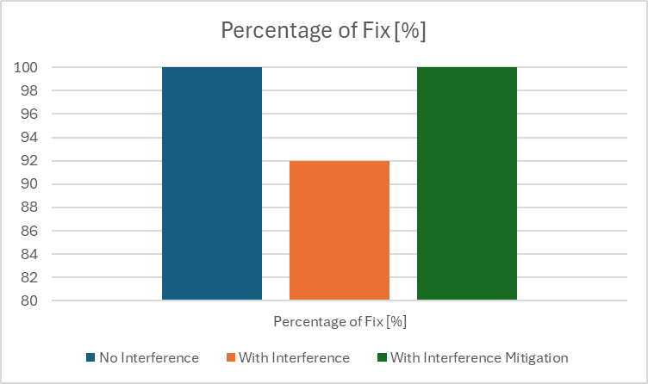
Positioning Performance

Slide 17
Key benefits of using Interference Detection and Mitigation Solution onboard GNSS receivers
Save Time and Costs
No Additional Hardware needed to detect interference
No need to displace your reference station
No need to temporary shut down of your reference station
24/7 Availability
Satellite tracking and signal quality can be largely preserved
Raw Observation and RTK corrections available all time
High quality Precise Positioning possible even with presence of RF Interference
New Opportunities
Easy and affordable way to implement a country wide grid of RF interference Mapping Tool
Collaborate with RF authorities to shut down illegal RF transmission

Slide 18
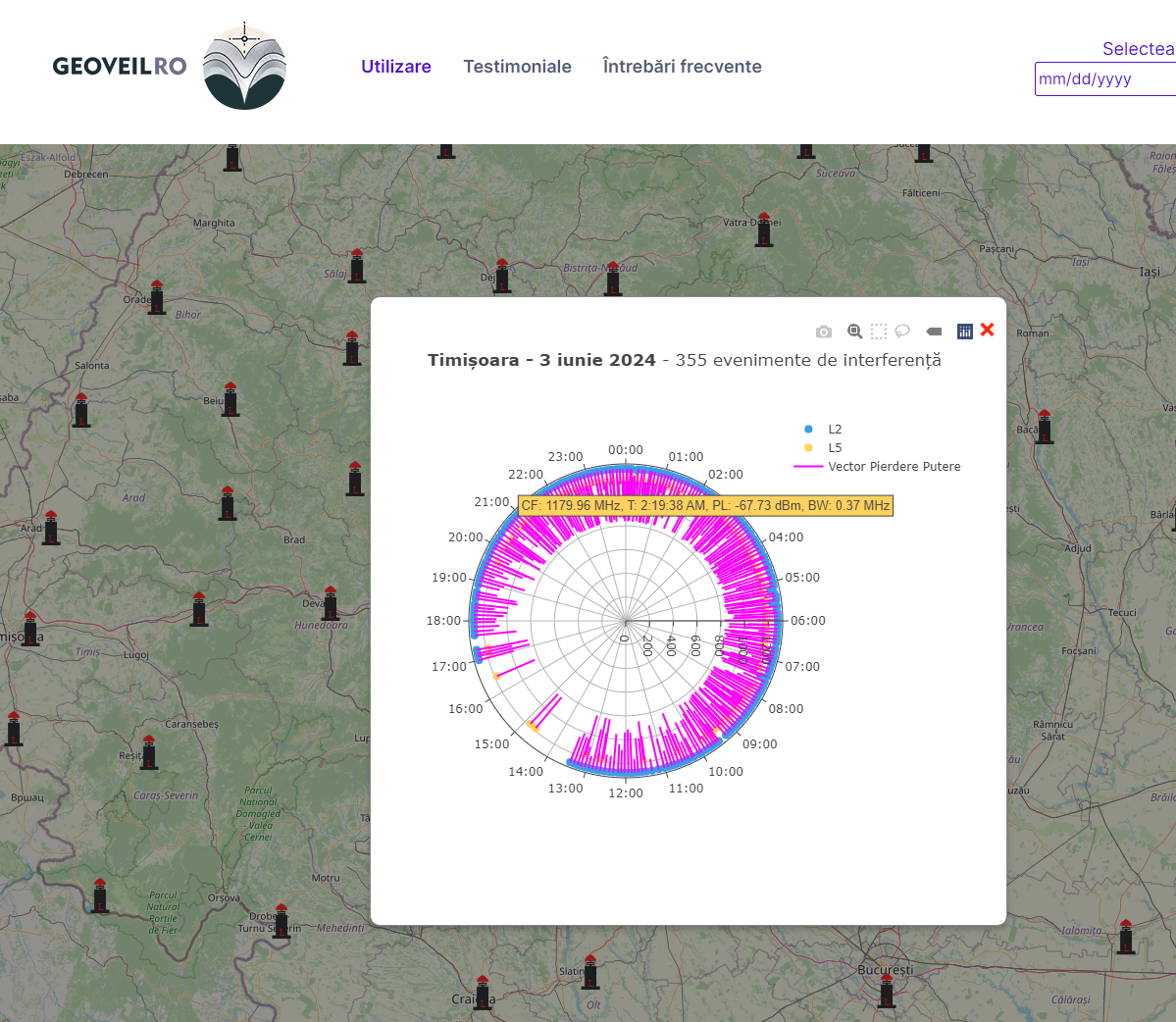
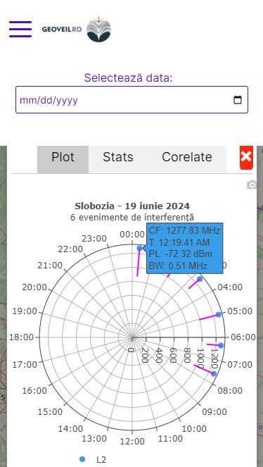
Interference Mapping Tool
GeoVeil Interference Monitoring App (geoveil.ro) – ROMPOS Network Romania
Objectives:
to monitor and analyse interference in ROMPOS GNSS stations, helping users understand disruptions and anomalies in signal reception (daily series available from February 2024)
support in surveying, and geosciences
in testing: correlated events analysis
Notes:
National Center for Cartography

Slide 19
Thank You!
Youssef Tawk
https://www.linkedin.com/in/yousseftawk/
youssef.tawk@leica-geosystems.com

