Slide 1




Galileo and the Future of Navigation
Marco FALCONE
ESA NAV Directorate
ESA UNCLASSIFIED – Releasable to the Public

Slide 2





Europe leading Satellite Navigation
More than 13 years of operation providing integrity messages to users with an extremely reliable guarantee
Fully interoperable with other Satellite Based Augmentation Systems
More than 4 Billion users worldwide
The most precise
GNSS in the World with
20 cm High Accuracy Service
Open Service Navigation Message Authentication broadcast
Available on all European airports and adopted by end users:
  > 920 LPV procedures published
  65% of instrumental runway ends equipped
EGNOS avionics available for most aircraft common models
Contributing to Safety of Life Dual Frequency Multi Constellation SBAS and Advanced Receiver Autonomous Integrity Monitoring (Horizontal A-RAIM)
Introduction of Two-Way Communication via Search & Rescue Return Link Service
Successful demonstration of Emergency Warning Satellite Services to targeted civil protection users

Slide 3
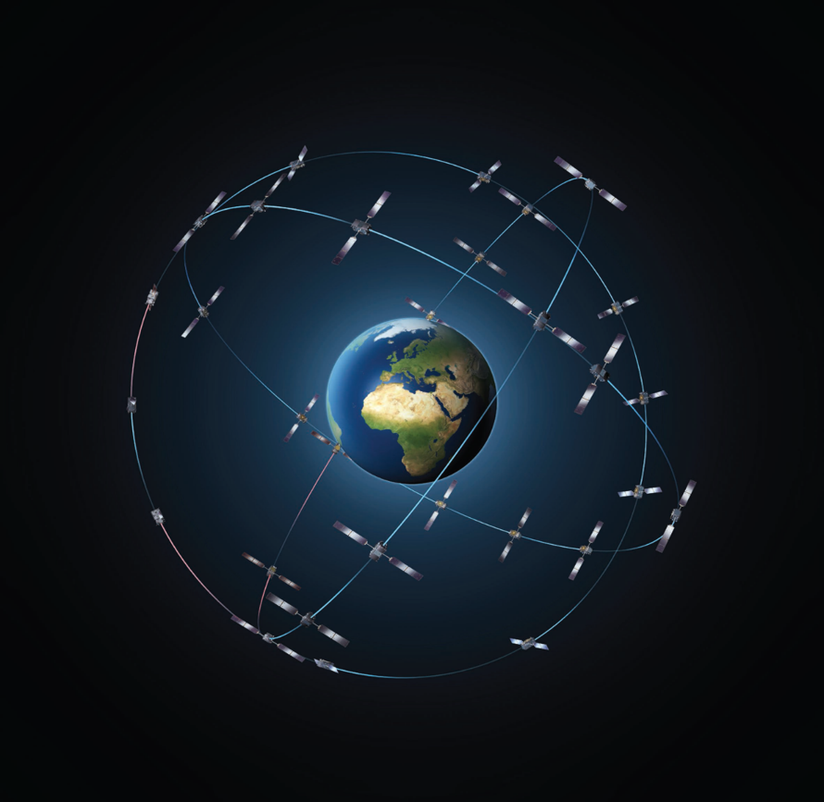
GALILEO IN OPERATION

Slide 4
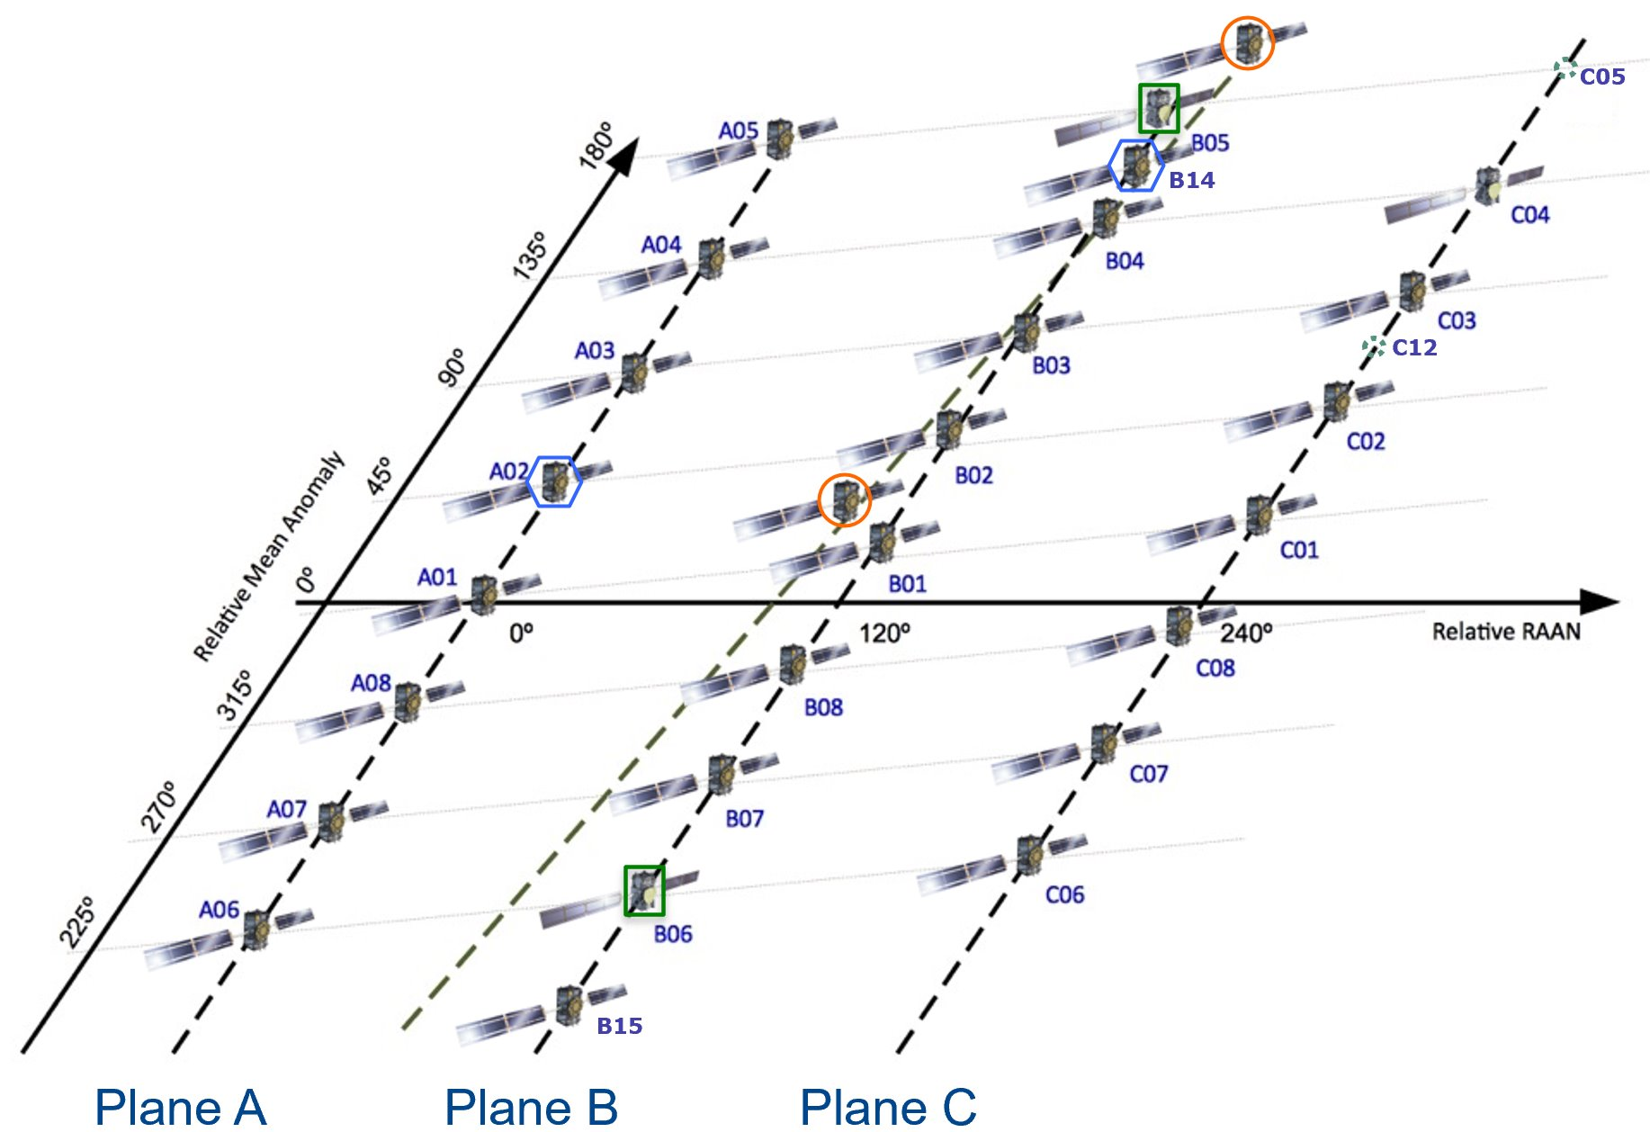
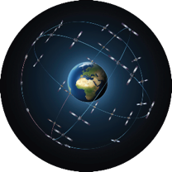


Galileo Constellation Status
Navigation (23 in service)
Search and Rescue (23 in service)
30 satellites in orbit
2 unhealthy (NAV P/L only)
2 inactive spares
2 no SAR (by design)
1 under decommissioning
2 in IOT
Satellite Family | Quantity | Average Age (years) | Oldest Satellite (years)
IOV | 4 (1*) | 12 | 12.5
FOC WO1/WO2 | 22 (3*) | 7.5 | 9.7
FOC Batch#3 | 4 | 1.2 | 2.4
TOTAL | 30 (4*) | 7.3 | 12.5
* Not set USABLE
As of 30th April 2024
ESA UNCLASSIFIED – Releasable to the Public

Slide 5
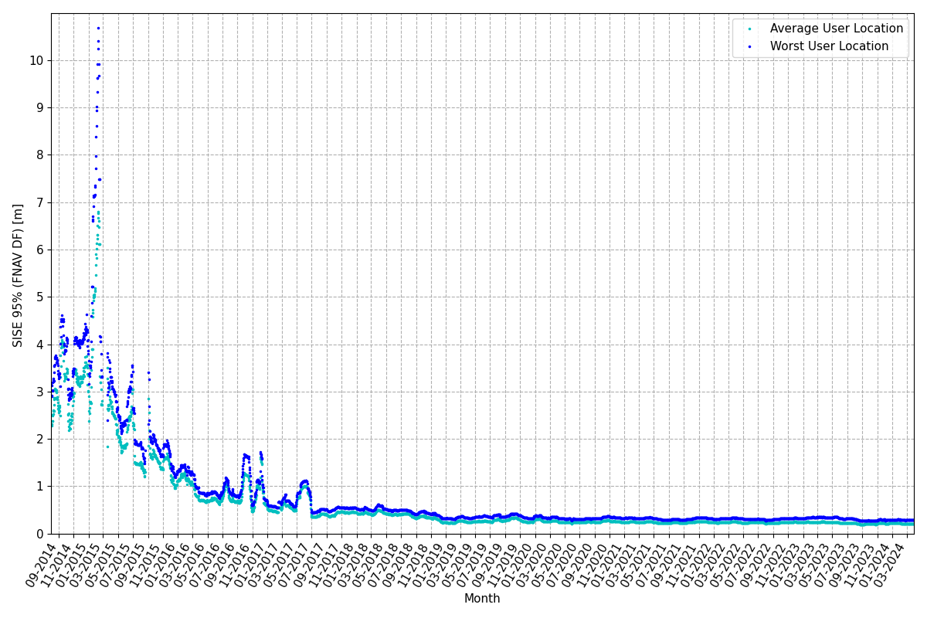
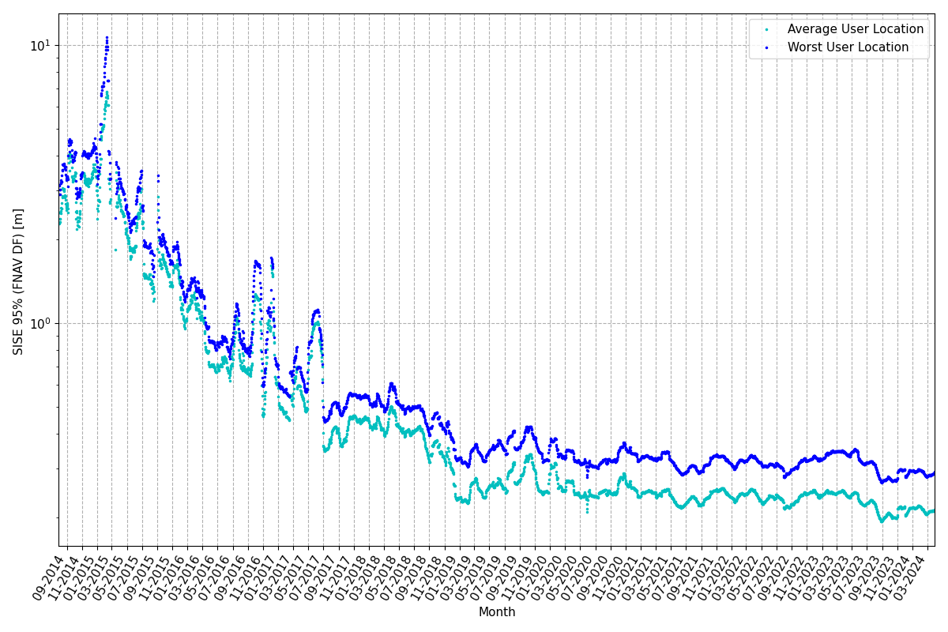
As-observed Ranging Performance STABLE (1/2)
2023
2023
y-axis linear scale
y-axis log scale
Very stable Signal In Space Ranging Error (SISE) trend → ~0.22m (95%) all satellites (FNAV) over 2023
ESA UNCLASSIFIED – Releasable to the Public

Slide 6
As-observed Ranging Performance STABLE (2/2)
Satellites with
RAFS
Satellites SISE RMS daily statistics
BEST SAT
WORST SAT
GSAT0222 0.008m
22nd July 2023
GSAT0210 2.25m
23rd March 2023
Constellation SISE RMS daily statistics
BEST DAY
WORST DAY
0.073m
12th September 2023
0.22m
2nd November 2023
Monthly SISE 95% statistics
BEST SAT
WORST SAT
GSAT0217 0.15m
August 2023
GSAT0101 0.36m
April 2023
2023 Statistics
SISE FNAV DF values computed at average user location (SISE Global Average)
SISE FNAV DF 95th monthly ranges
ESA UNCLASSIFIED – Releasable to the Public

Slide 7
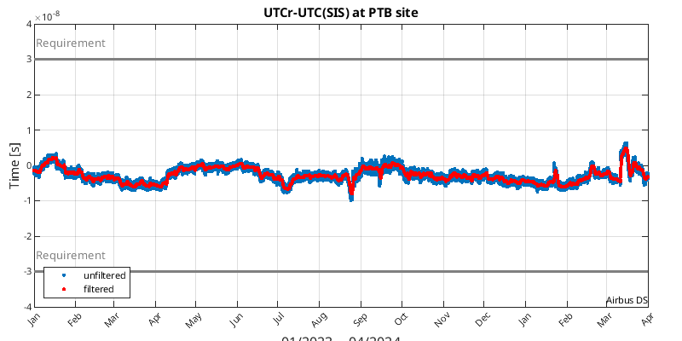
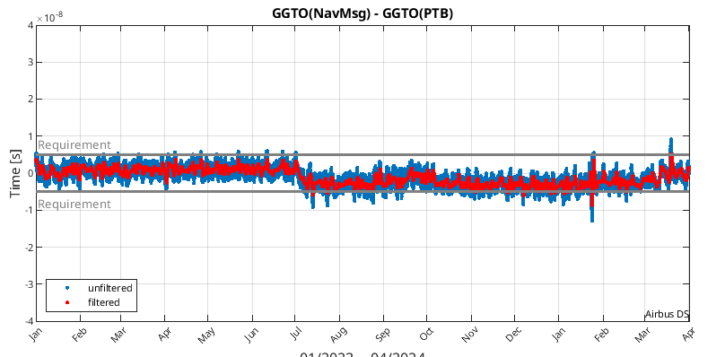
Galileo Timing Accuracy → STABLE
Broadcast UTC offset
GGTO accuracy
* requirement refers to GSRD requirement (5ns 95%)
* requirement refers to GSRD requirement (30ns 95%)
01/2023 – 04/2024
01/2023 – 04/2024
2023: ~5.65 ns (95%, filtered) < 30 ns target [OS SDD MPL]
2023: ~4.18 ns (95%, filtered) < 20 ns target
[OS SDD MPL]
Evaluated with calibrated timing GPS/Galileo receiver operated in UTC(k) laboratory (PTB, INRIM)
PTB data gap during: 22.10.2023 (both GGTO & UTC) and 21.11.2023 (UTC only)
In March 2024 -> jumps due to System Build 2.0 infrastructure migration
ESA UNCLASSIFIED – Releasable to the Public

Slide 8

Official use of Galileo Timing by BIPM
Galileo inclusion into the CircularT was recently announced by the Bureau International de Poid et Mesures (BIPM)
The inclusion of Galileo contributes to the redundancy of measurement methods used to generate UTC
It also increases the capability to detect abrupt anomalies as well as gradual drifts in the long-term, improving the reliability and accuracy of the computation of the UTC.
The integration of Galileo Timing measurements by BIPM in Circular-T represents the highest recognition possible of an international and independent institution to the quality of Galileo UTC measurements
ESA UNCLASSIFIED – Releasable to the Public

Slide 9


Galileo High Accuracy Service
What is it?
Providing Initial Service since 24/01/2023
Horizontal Accuracy: <20 cm
Vertical Accuracy: <40 cm
Convergence Time:
< 300 s (SL1)
< 100 s (SL2)
Availability: 99%
Galileo initial HAS:
offers real-time improved positioning performances with decimetre accuracy (in nominal conditions) on global scale (SL1).
provides free of charge high accuracy Precise Point Positioning (PPP) corrections through the Galileo signal (E6-B) and by terrestrial means (Internet).
Full HAS Capability:
  SL1 Global PPP positioning improved performance
  SL2 Regional PPP positioning with improved convergence
HAS corrections for orbits, clocks, code and phase biases and ionosphere for Galileo and GPS satellites.
Target Applications
Full Service Targets:
• Agriculture
• Rail
• Road
• Geomatics
• Aviation/Drones
• Maritime
• Space
High Level Architecture
G2STB
(source: European GNSS Service Centre)
ESA UNCLASSIFIED – Releasable to the Public

Slide 10
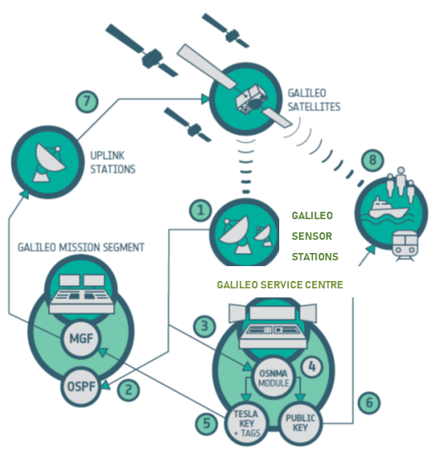

OS Navigation Message Authentication
What is it?
Summary of Capabilities
High Level Architecture
Open Service Navigation Message Authentication (OSNMA) is a data authentication function for the Galileo Open Service worldwide users, freely accessible and with no impact on the OS users and performance.
OSNMA provides receivers with the assurance that the received Galileo navigation message is coming from the system itself and has not been modified, thus increasing the likelihood of detecting spoofing attacks at the data level
GNSS receiver minimal capabilities: single frequency E1
Object of authentication: Navigation data (E1B I/Nav and E5b I/Nav)
No need to store raw GNSS signal at Receiver; the Receiver only stores a public key
No need of a network connection at Receiver level
Time to First Authentication: one to few minutes
Authentication availability: expected above 95%
ESA UNCLASSIFIED – Releasable to the Public

Slide 11



Galileo Signal Authentication Service (SAS)
What is it?
Implementation Status
High Level Architecture
Ranging Level Authentication of Galileo signals
Position authentication based on OSNMA (OS Message Authentication) and the Galileo signal (E6-C) by an assisted terrestrial channel (Internet).
E6-C Encryption: Satellites will broadcast encrypted E6C signals
CAS Products made available via terrestrial channel to Users.
Initial Service targeted in 2025
System CS Separate Encryption
All Satellites in constellation are already SAS Ready/CSSE.
Ground Segment
Element adaptations developed and undergoing qualification testing.
Additional Galileo Reference Receiver Chains (Next Gen) are manufactured and under deployment
System Testing planned in 2024
Galileo Satellite Constellation
Galileo Signal In Space E1/E5
Encrypted E6c
Encrypted
Signal Sequences
Galileo Service Center
Galileo SAS Users
ESA UNCLASSIFIED – Releasable to the Public

Slide 12
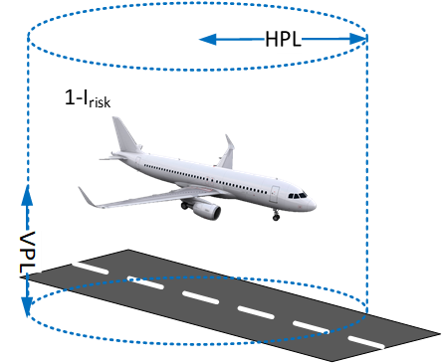
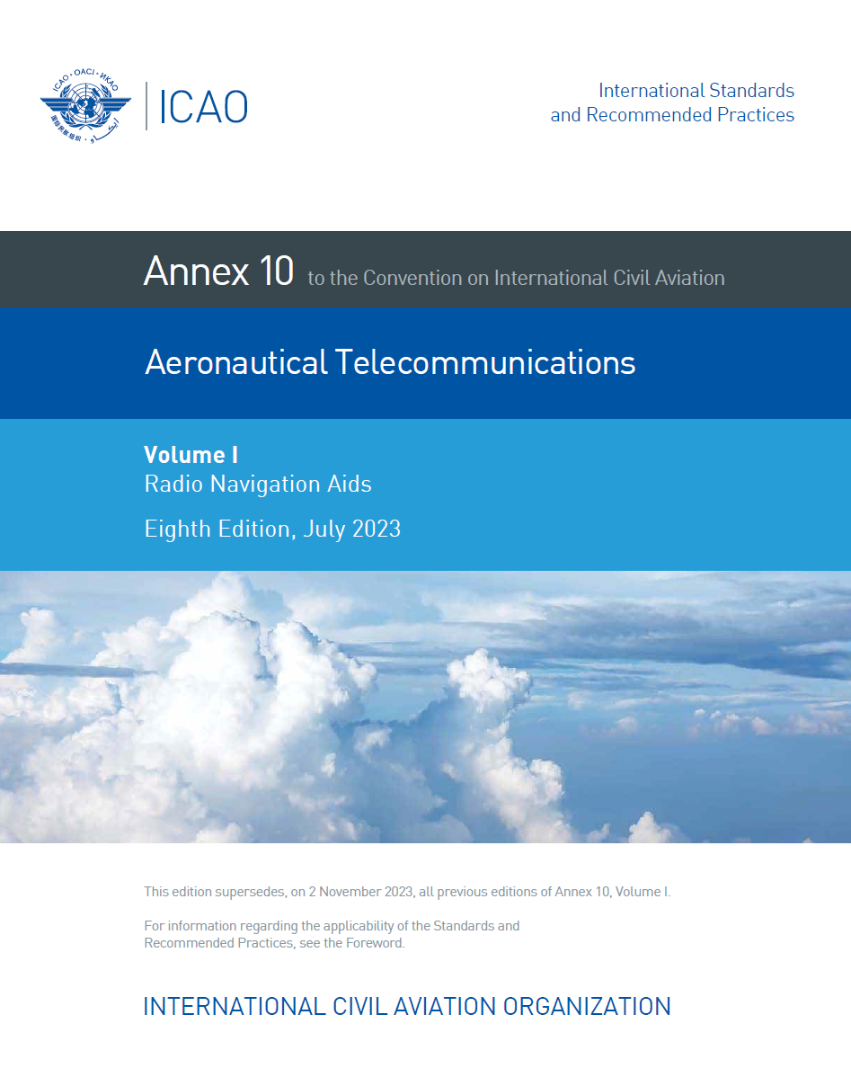
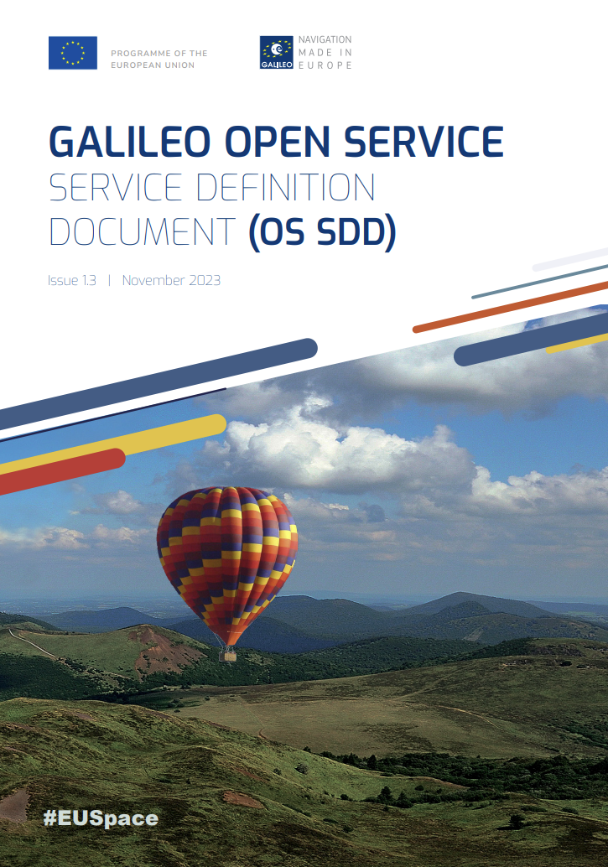
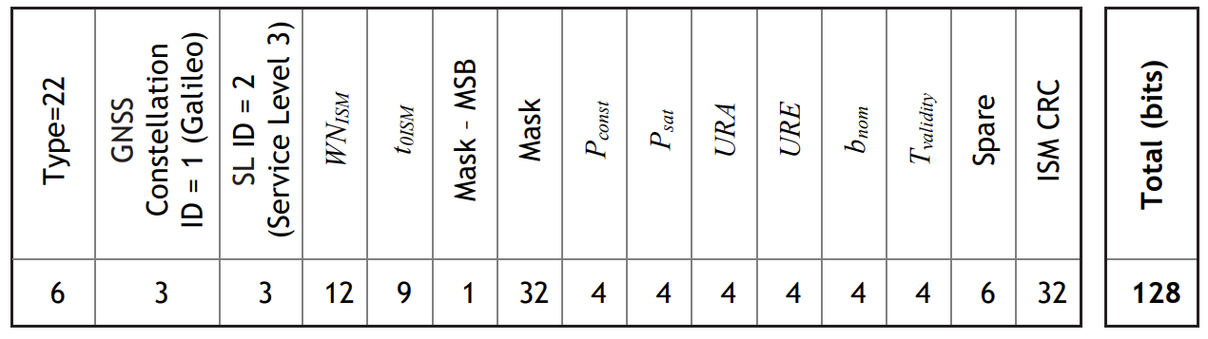
Galileo Safety of Life Service
As of March 2023, ICAO endorsed the use of Galileo for civil aviation via SARPS
  Compliance to Fault State, Fault Rates and Error Overabounding
  Commitments based on system design and performance monitoring already covered in the OS SDD v1.3 for Advanced Receiver Autonomous Integrity Monitoring (ARAIM) users
Once Galileo FOC is declared, the SARPS values will become applicable for any Galileo Satellite with healthy SIS
  Galileo will provide Navigation Service for enroute aircrafts Required Navigation Performance RNP 0.1 nm and RNP 0.3 nm using default values as per SARPS
The Integrity Support Message (ISM) for ARAIM users will be included in the Galileo 2nd Generation IOV phase as part of the Early Capabilities
  ISM message type already described in SIS ICD v2.1 included in I/NAV WT22
  Broadcast ISM parameters will enhance default SARPS values
ESA UNCLASSIFIED – Releasable to the Public

Slide 13
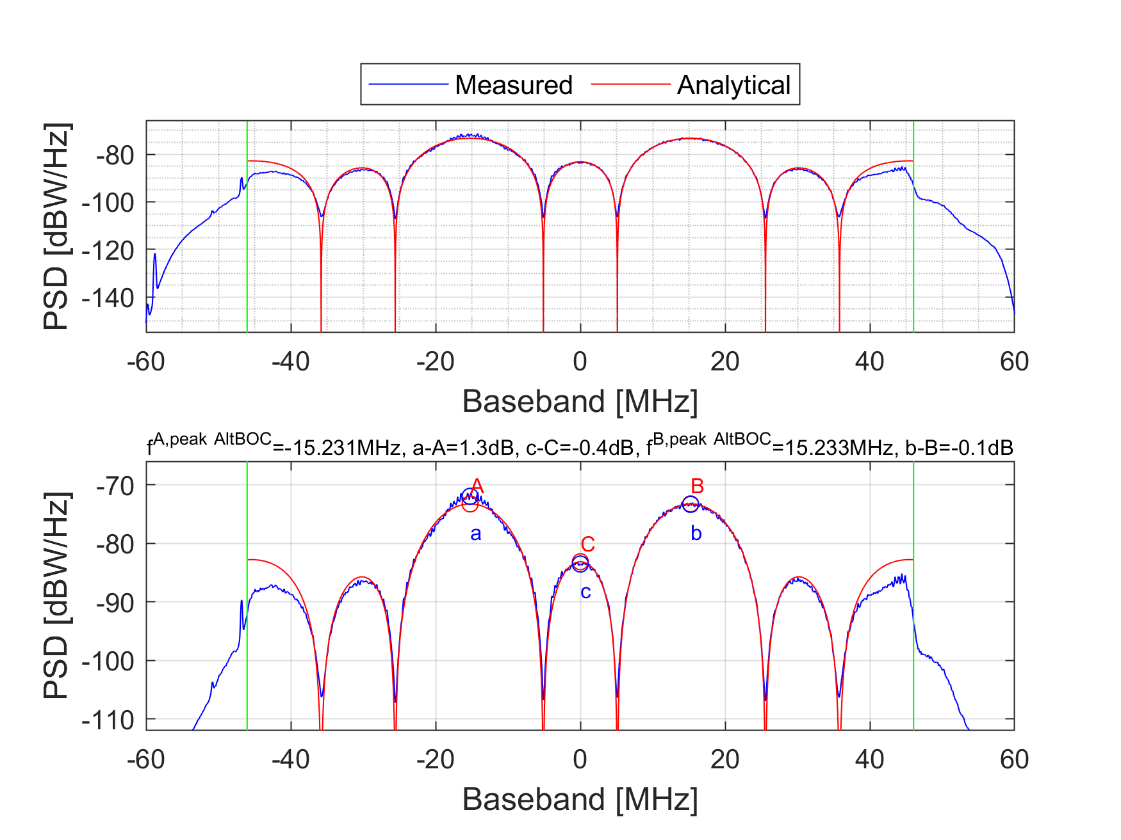

















Quasi Pilot (QP) in E5
GSAT202 and GSAT0201 successfully reconfigured for G1 E5 QP to evaluate benefit with live signal
  Reduced acquisition complexity by factor 6-8 wrt. E5a-Q
  2-times faster acquisition in challenging urban environment
Consultation with Chipset/Receiver and Signal Generator manufacturers (coordinated through EUSPA) – positive feedback:
  “G1 E5 QP does have clear benefits especially for E5/L5 SF receivers”
  “If a new component is added in E5, we will implement it”
  “G1 E5 QP may change our company strategy – go for E5/L5 only earlier”
  “Our company does not see a direct use case – nevertheless we may implement not to miss market opportunity”
Programme level decision needed in 2nd half 2024
Chipset/Receiver Manufacturers in Consultation
Continue to roll-out G1 E5 QP to FOC S/Cs
Prepare with GSOP OPS procedure/plan
Prepare for SIS-ICD Publication
Start Roll-out as “Pre-Operational Signal”
Signal Generator Manufacturers in Consultation
ESA UNCLASSIFIED – Releasable to the Public

Slide 14
GALILEO UNDER DEPLOYMENT

Slide 15
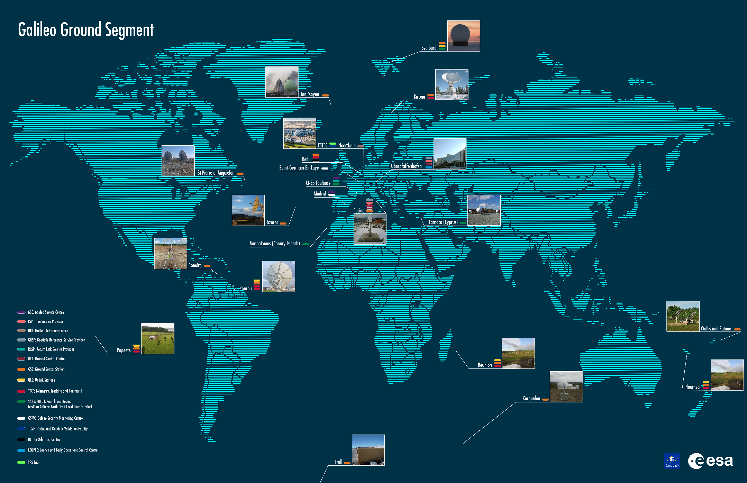
System Build 2.0 Migration
SB 2.0 infrastructure to support
OS FOC and PRS IOC
GMS 3.0.1.1:
Virtualised HW/SW infrastructure,
New Galileo Sensor Station sites (Wallis and Bonaire),
Complete deployment of GSS PRS Rx Chains and 3rd GSS chains in remote sites
System Extended Contingency mode covering up to 7 days with smooth performance degradation
Commercial Service Separate Encryption capability
GSF 3.0.2:
PRS Evolution through new enhanced Signal-In-Space
Point of Contact for PRS deployed at FR and ES Pilot Sites
SECMON 3.0.1.1: new state of the art security monitoring system
GCS 3.1: operational improvements

Slide 16

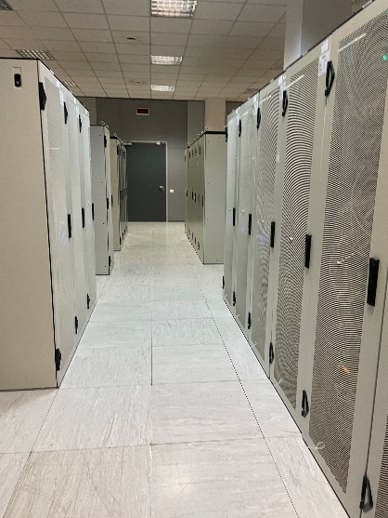
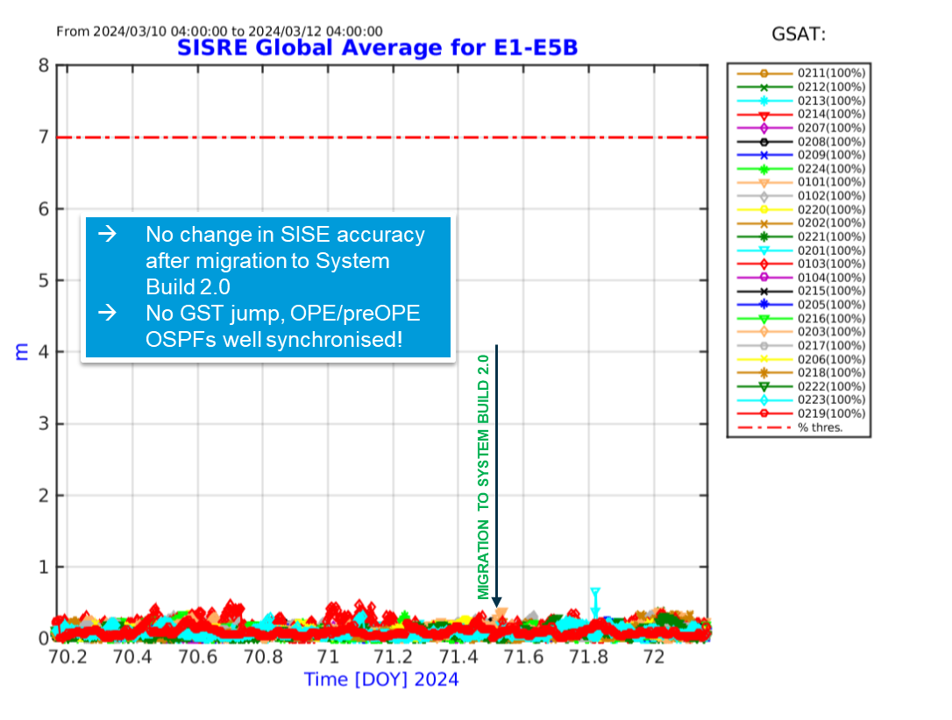
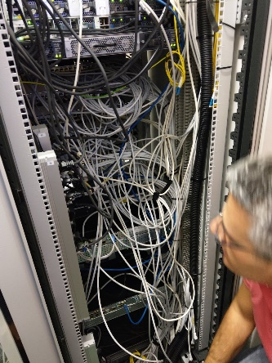
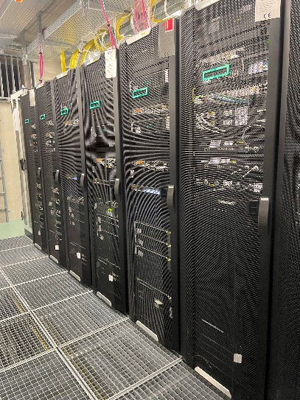
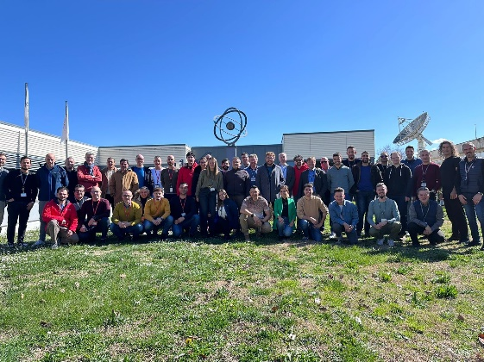
System Build 2.0 Migration in Figures
~400 items (HW/SW) deployed
Migration completed as per plan in 6 weeks
5 months of rehearsal
4 Billion of Galileo users NOT impacted
More than 200 cables moved
Capability to roll-back in 48 hours
~170 people involved

Slide 17

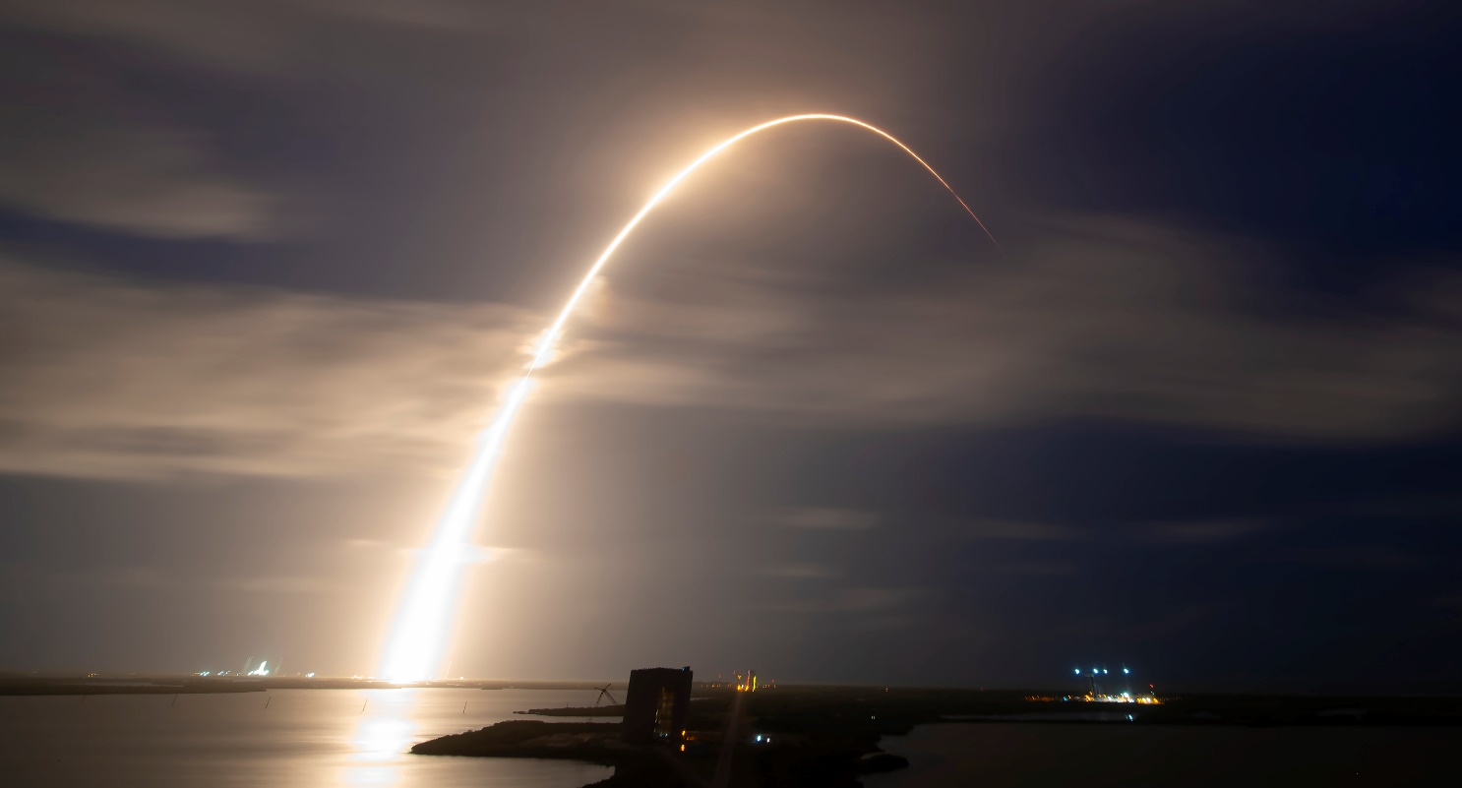
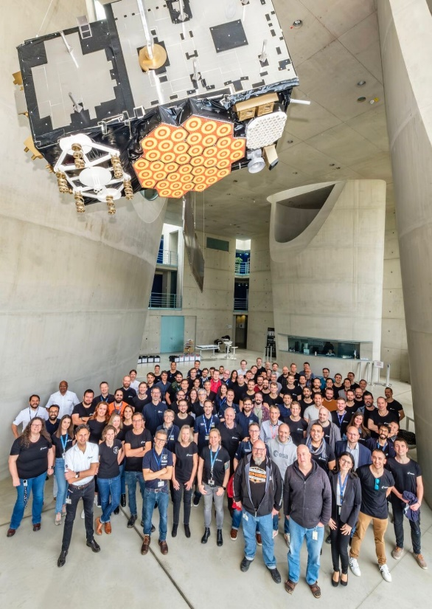
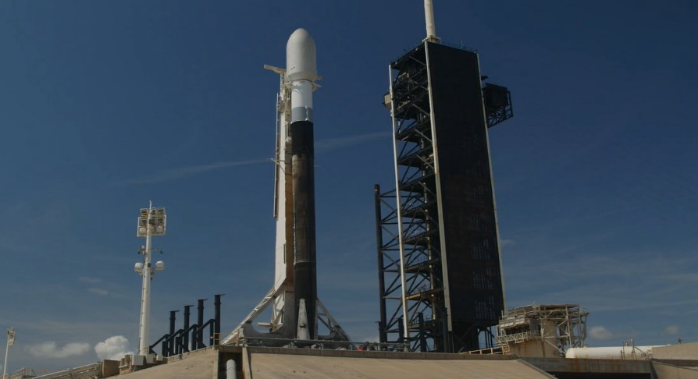
Galileo Launch 12 and Launch 13
EU-US Security Agreement
Launch 12
  Lift-off 28 April 2024 00:34 UTC
  Excellent orbit injection parameters
  Flawless Launch and Early Orbit Phase completed on 13 May 2024
  In Orbit Testing planned to be completed in August 2024
Next Launch 13 planned in September 2024
ARIANE 6 maiden flight in July to proceed with the further deployment of constellation in 2025
Lift-off

Slide 18
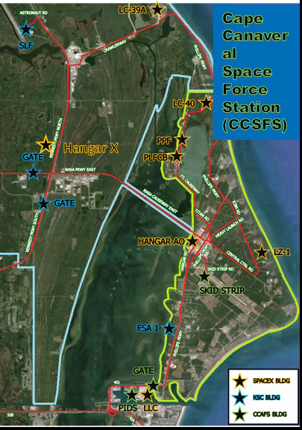
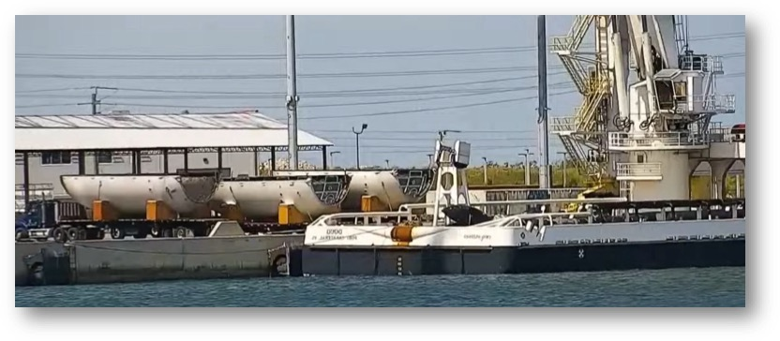
Redesigned Launch Campaign
Short launch campaign from 12 weeks down to 5 (due to Space X high cadence)
Optimised activities & double shift 6 days / week
30 March KSC (Florida) | Eutelsat 36D
31 March CCSFS (Florida) | Starlink
2 April VSFB (California) | Starlink
5 April CCSFS (Florida) | Starlink
7 April VSFB (California) | Starlink
7 April KSC (Florida) | Bandwagon/Rideshare
10 April CCSFS (Florida) | Starlink
11 April VSFB (California) | USSF-62
13 April CCSFS (Florida) | Starlink
17 April KSC (Florida) | Starlink
18 April CCSFS (Florida) | Starlink
23 April CCSFS (Florida) | Starlink
28 April KSC (Florida) | Galileo L12
SpaceX Re-uses all Booster and Fairing with short turn around time.
Only second stages are new and not re-used.
SpaceX aiming to qualify boosters up to 40 times, based on engine run time and ON/OFF cycles
Galileo L12 was final flight for Booster 1060
Booster recovery not possible due to trajectory
Fairings recoved few hours after launch

Slide 19
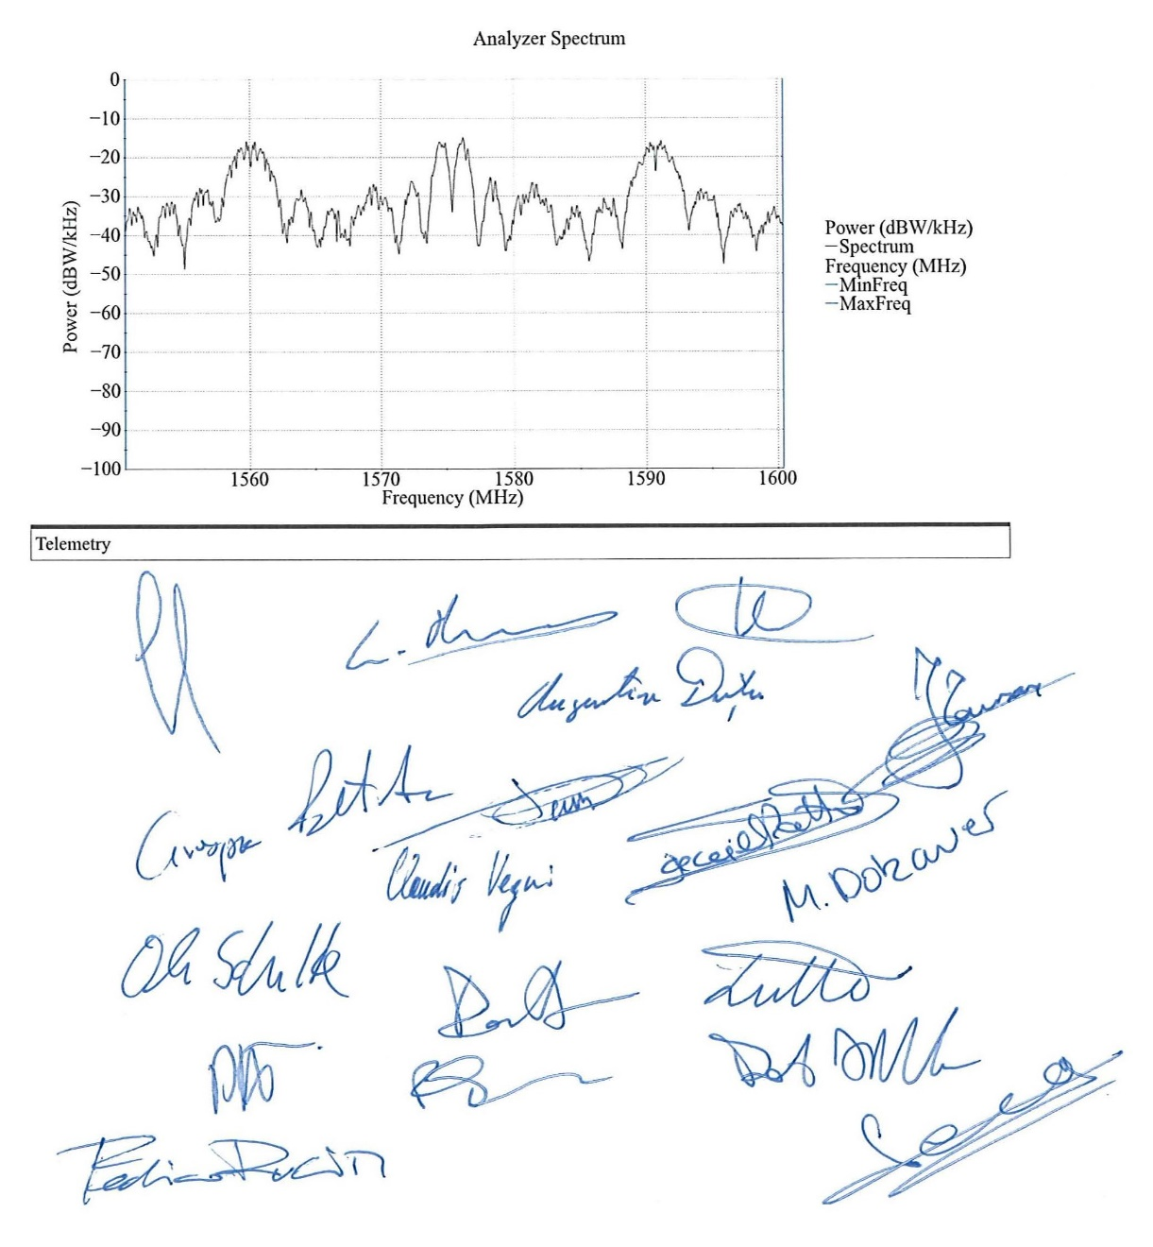
LEOP and In Orbit Testing
Satellites directly injected into Medium Earth Orbit
Excellent orbit injection parameters
Launch and Early Orbit Phase (LEOP) in GCC-D
After separation, the spacecraft performs autonomously the INIT sequence, rate damping and sun initial acquisition and performs the solar arrays deployment.
Completed successfully without any anomaly
Payload In Orbit Testing (IOT) in Redu
  Payload activated and successfully outgassed
  All signals fully assessed
  On the 21st of August, In Orbit Test Review will assess the operational status of both satellites and pronounce the green light for entry into service

Slide 20
Galileo Metadata status (First Gen Satellites)
Content definition
2011 Content defined by the Galileo Scientific Advisory Comitte and requested to European Comission (EC)
Release through ILRS web site: www.ilrs.gsfc.nasa.gov
2011 IOV (GSAT101-104) release of IOV Center of Mass (CoM)
Onwards: continuous mass and CoM information update for all new satellites and after maneuvers
Release though GSC web site: www.gsc-europa.eu
2016 IOV (GSAT101-104) values for CoM, NAVANT, Geometry, Delays, attitude
2017 FOC (GSAT201-214) values for CoM, NAVANT, Geometry, attitude
2019 FOC (GSAT215-222) values for CoM, NAVANT
2022 FOC (GSAT223-224) values for CoM, NAVANT
2024 FOC (GSAT225,227) values for CoM, NAVANT (expected, satellites under commissioning)

Slide 21
Metadata possible additional content
Galileo Scientific Advisory Committee recommendation for additional Metadata content
Non gravitational forces | Satellite Model | Box wing with Higher level of details concerning different materials used on the different satellite surfaces (area, optical properties, including nominal uncertainties), including front and back side optical properties for solar arrays.
 |  | 3D model for raytracing.
 |  | Infrared optical properties of surface materials for modelling of thermal Earth radiation effects.
 | Antenna(s) emissions | Transmit power for the calculation of the antenna thrust.
 | Thermal Emissions | Radiator emission power (at least mean value) for the different surfaces to allow for the calculation of the corresponding thrust.
 |  | Thermal properties of solar arrays (temperature and emissivities of front and back sides, thickness, heat capacity ) for modelling of re-radiation thrust in particular during shadow transits.
 |  | Thermal properties (temperature range, emissivity, heat capacity) of the relevant external elements for computing the variable radial thermal thrust.
Attitude | Yaw turns epoch | Information about the actual yaw turn switching epochs is needed to model the satellite orientation at these dates.
clock | Active clock | Notification of the active clock with corresponding time intervals also for the past to support reprocessing activities.
Phase centres | NAVANT | Phase centre offsets used for the generation of the broadcast orbits for the different services.
 |  | Transmit antenna group delay variations and nadir patterns.
 |  | Transmit antenna gain pattern for boresight angles up to 90 degrees.
 | Laser Retro Reflector | Phase centre dependence from azimuth and elevation.
 | Inter Satellite Ranging | Phase centre location and pointing information
Accuracies |  | Nominal accuracies of the metadata provided helps to assess the uncertainties of derived models of non-gravitational orbit perturbations.

Slide 22
GALILEO UNDER DEVELOPMENT

Slide 23
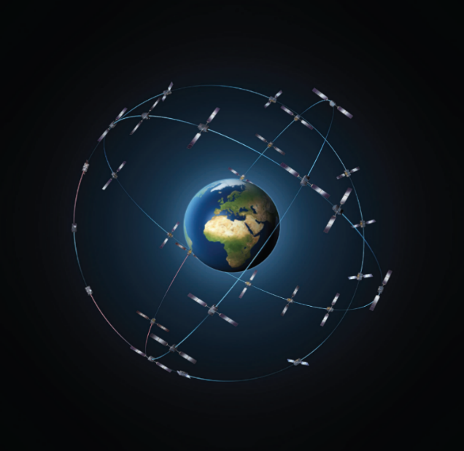
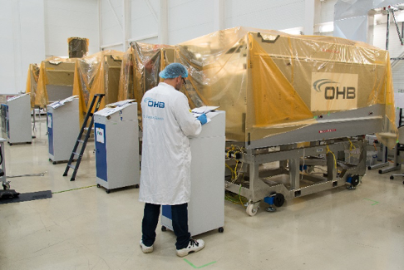
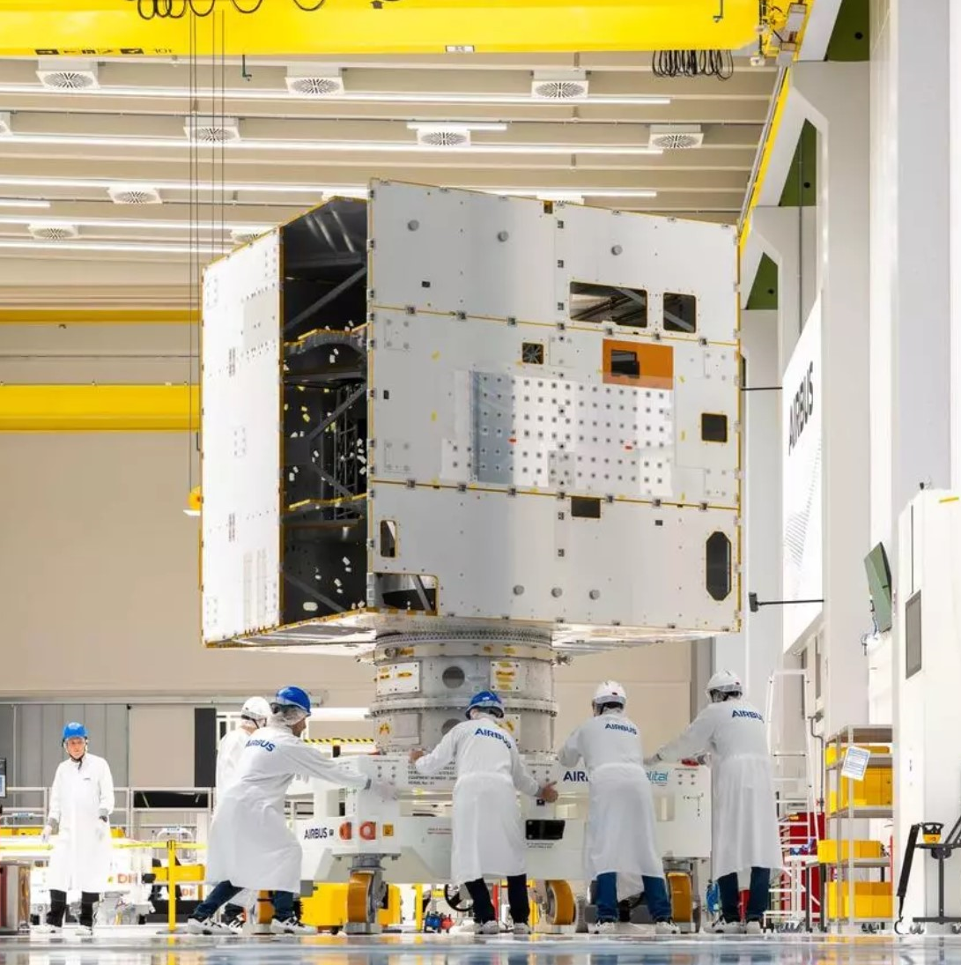
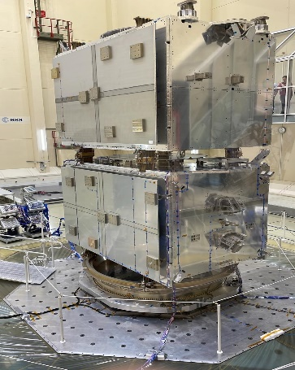
GALILEO Satellites Production
30 Satellites in Orbit
8 Satellites delivered
  FOC Batch 3
  In storage at OHB
12 Satellites under production
  2nd Generation
  6 Thales + 6 ADS
  Structure Models delivered
  Both SAT-CDRs completed

Slide 24
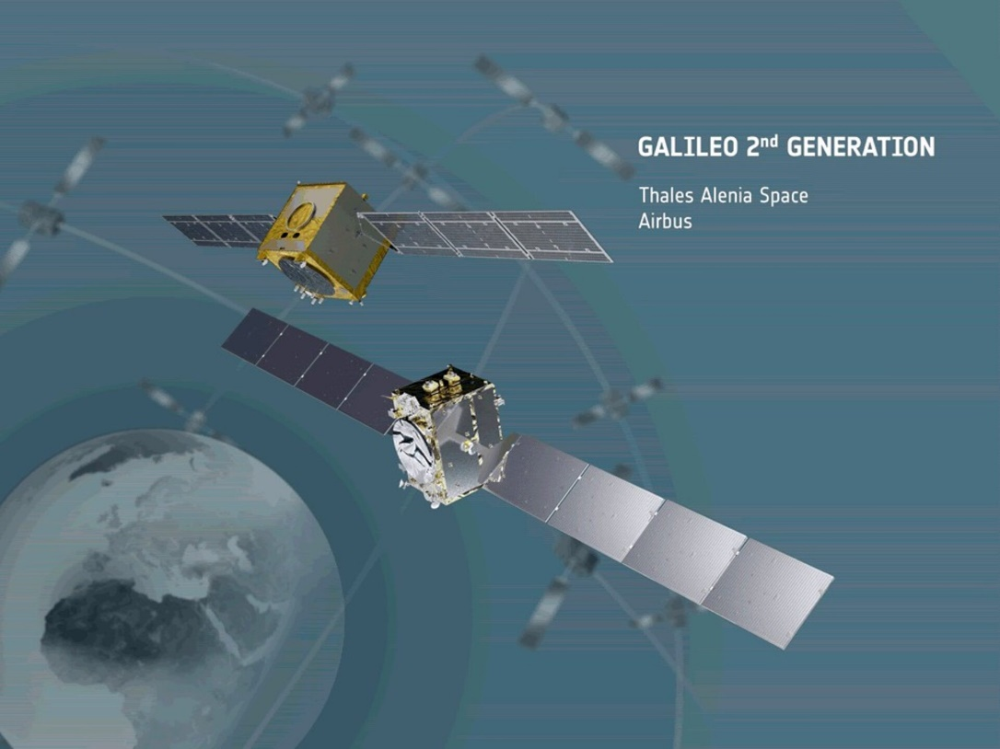
Galileo 2nd Gen Satellites: designed for the future
New signal generation capabilities: increased number of signal components and configurability
Improved EIRP
Inter Satellite Links
On Board Authentication
Minimised in-orbit maintenance activities
Increased data rate in the Ground to Space communication
Improved Time Reference (number of atomic clocks and their relevant monitoring functions)
Orbit Raising Capability – Dual Launch
15 years lifetime

Slide 25
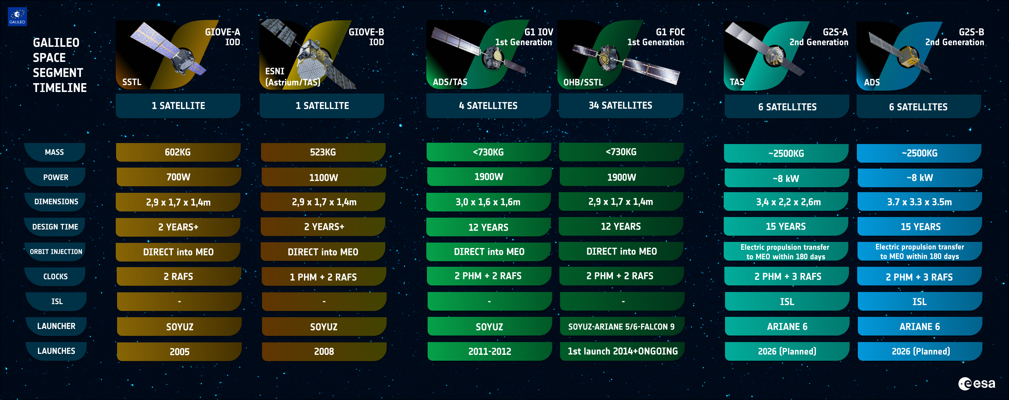
Evolution of the Galileo Satellites

Slide 26
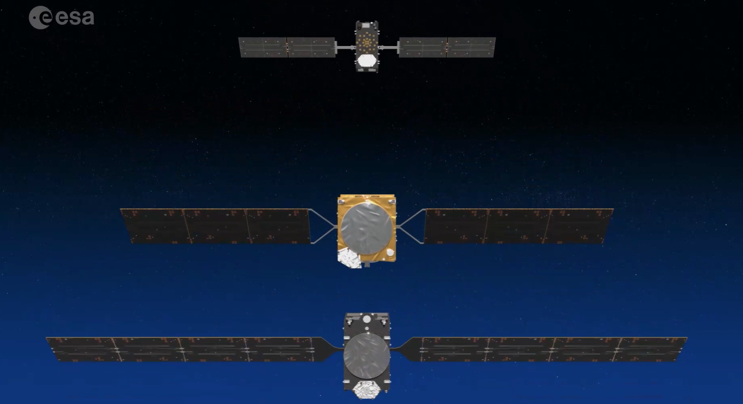
Galileo Satellites Classes
G1 FOC
G2 SB1-B
G2 SB1-A

Slide 27
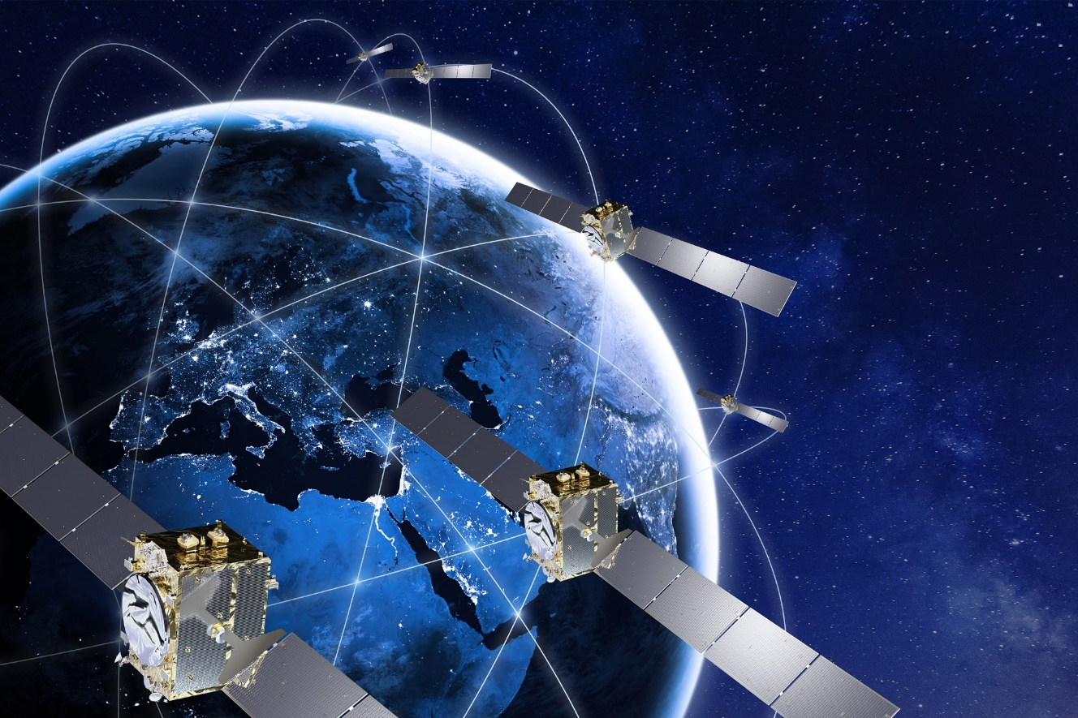
G2SB1-A (Sat Prime Thales Alenia Space)
Contract to develop and manufacture 6 Galileo 2nd Generation satellites was kicked off in Q1 2021,
Thales Alenia Space in Rome is Prime contractor for the G2SB1-A satellites,
Launch planned with Ariane-62,
Key focus on providing enhanced navigation capabilities while ensuring compatibility with G1 and continuity of legacy services.
Critical Design Review has been completed in March/April 2024,
Manufacturing of SAT PFM and FM2 is ongoing,
Comprehensive test campaigns with Satellite EM as well as Payload EM continue to support preparation for payload and Satellite Assembly Integration and Testing.
Launch mass: <2,500kg
S/A power: <11.5kW BoL
Lifetime: 15 year service lifetime
Payload Rx/Tx bands: L-Band, C-Band, UHF
Command & Control bands: S-Band, Ka-Band

Slide 28
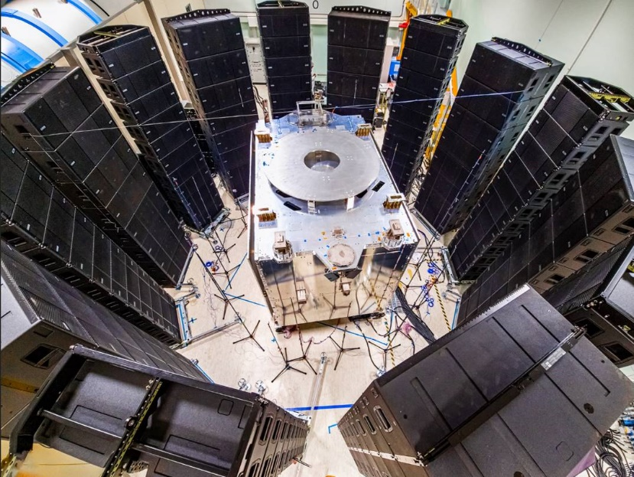
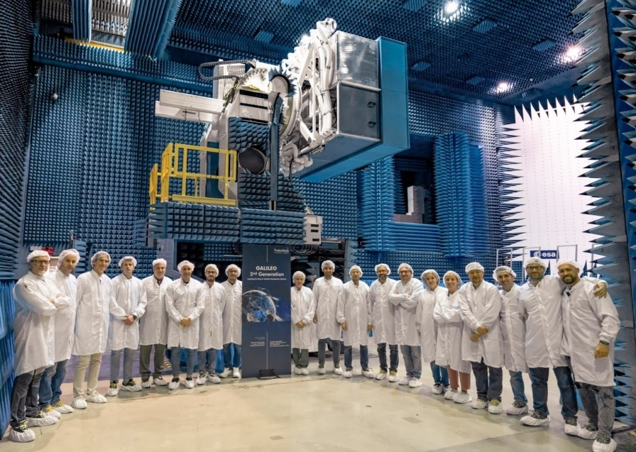
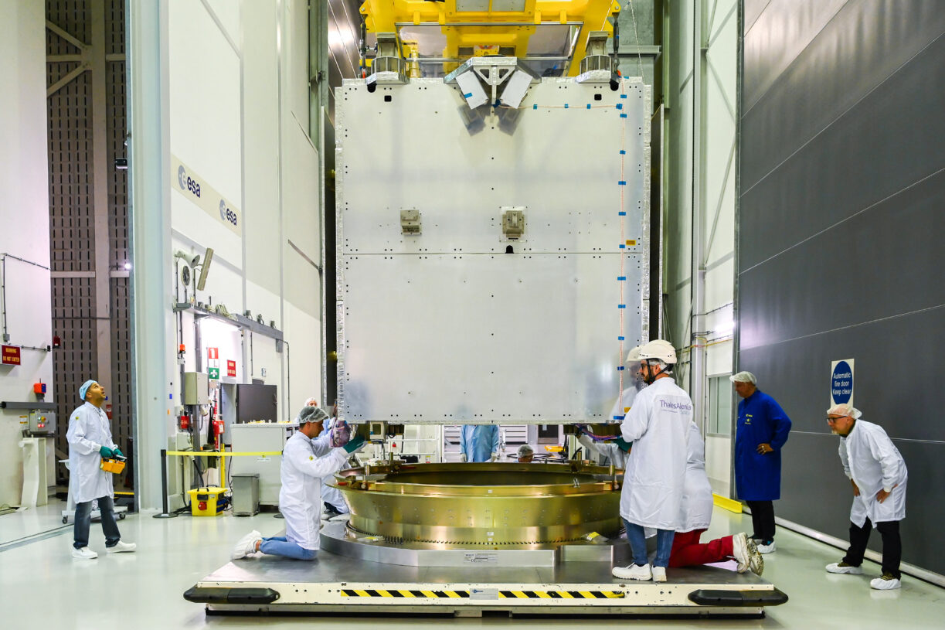
G2SB1A Satellite Testing
Satellite structure, launch adapter and separation mechanism successfully qualified for launch with Ariane-62 in stacked configuration
Payload radiated tests performed in HERTZ facility at Estec
Structure Model acoustic testing
Acoustic Testing
Structure Model with Launch Adapter
NAV Payload radiated testing
Complete stack on shaker

Slide 29
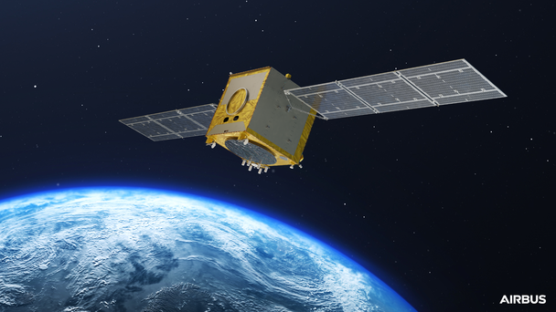
G2SB1-B (Sat Prime Airbus Defence and Space)
Contract to develop and manufacture six Galileo 2nd Generation satellites was kicked off in Q2 2021,
Airbus Defense and Space in Friedrichshafen is Prime contractor for the G2SB1-B satellites,
Launch planned with Ariane-62,
Key focus on providing enhanced navigation capabilities while ensuring compatibility with G1 and continuity of legacy services.
Critical Design Review has been completed in May 2024,
Manufacturing of SAT PFM and FM2 is ongoing,
Comprehensive test campaigns with Satellite EM as well as Payload EM continue to support preparation for payload and SAT AIT.
Launch mass: <2,400kg
S/A power: <9.1kW BoL
Lifetime: 15 year service lifetime
Payload Rx/Tx bands: L-Band, C-Band, UHF
Command & Control bands: S-Band, Ka-Band

Slide 30
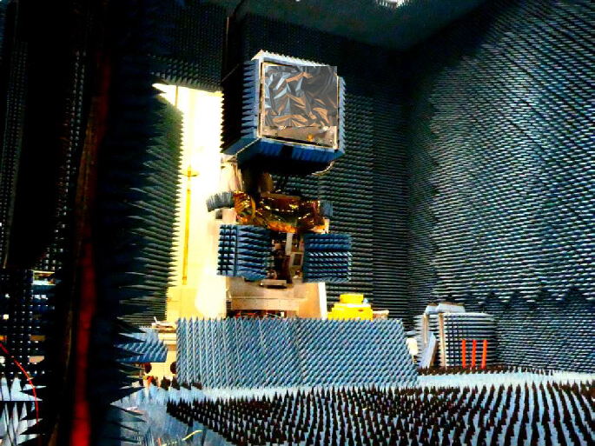
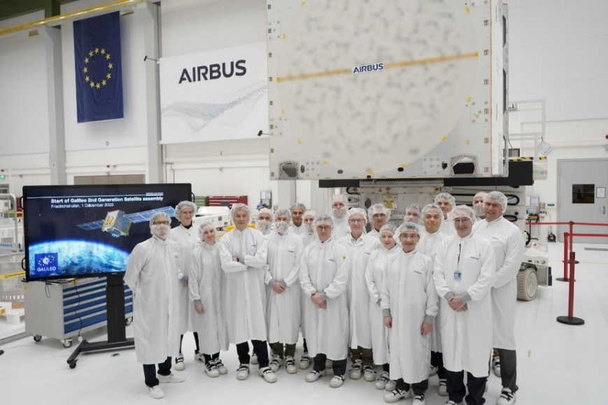
G2SB1B Satellite Testing
Flight Model 1 (FM1) Structure delivered End November 2023
1st Navigation Signal generation achieved on SGM EM
FM1 propulsion Module delivery planned in October 2024
FM2 structure to be delivered in July 2024
Readiness for SCTC Zero in ADS FDH confirmed in November 2024
Arrival to Airbus cleanroom in F’hafen
NAV Payload radiated signal testing

Slide 31
THE FUTURE

Slide 32
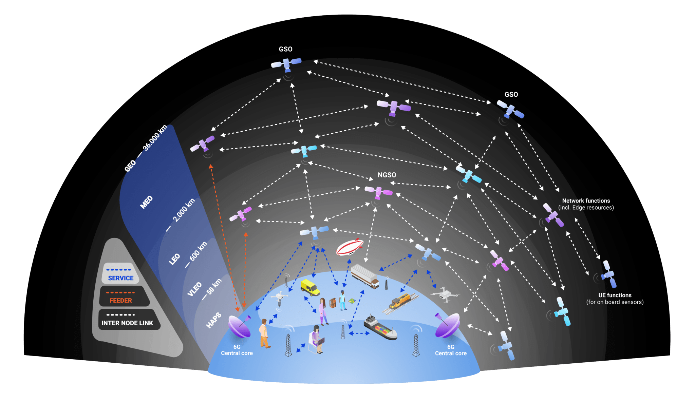
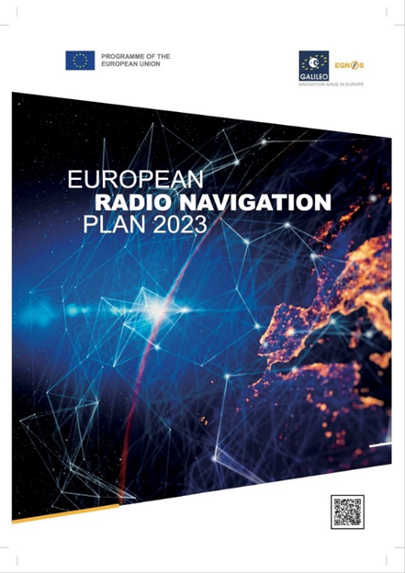
Future of Navigation
“The EU PNT ecosystem should become a System of PNT systems to achieve resilient PNT”
  provides highest resilience (Assured PNT)
  Complements current GNSS services with new capabilities / economic opportunities
Integration of Communication and Navigation (5G/6G NTN)
Time is the most critical part of PNT
Research on optical technology flourishing in Europe (optical ISL for enhanced robustness and performance)
Disruptive PNT Enabling Technologies (Quantum Sensors, AI and ML, Signals of Opportunity, Digital Twin for system EtE simulation)
Lunar and Space Exploration Communication and Navigation capabilities
Future GNSS will be multilayer
with IGSO, LEO, MEO and GEO constellations (layers)
Need for In orbit Demonstrator(s) for:
Technology In Orbit Validation
Downstream applications demonstration
User Segment development
Test Ranges experimentation
Support to standardization
ESA accelerating PNT innovation

Slide 33


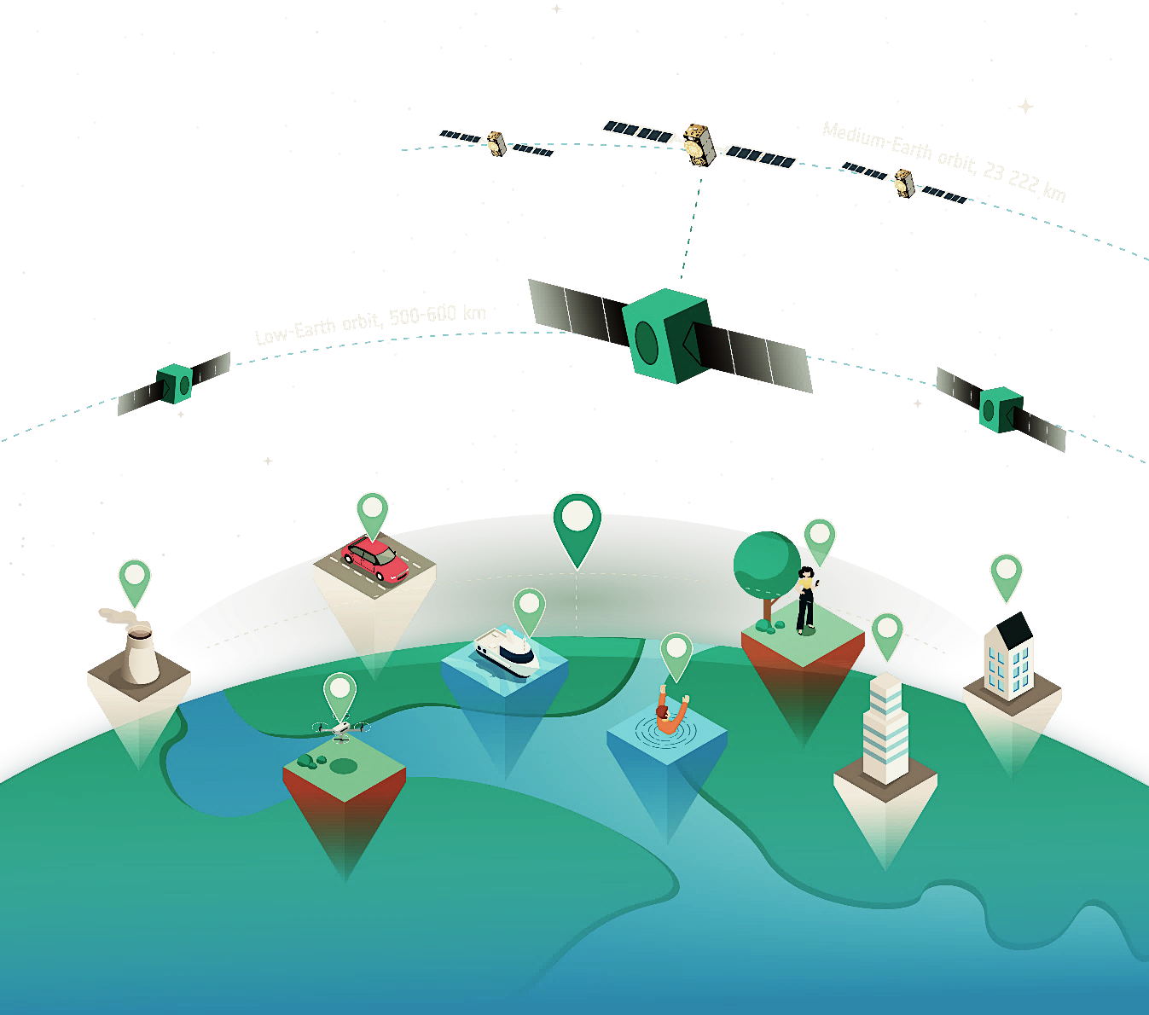

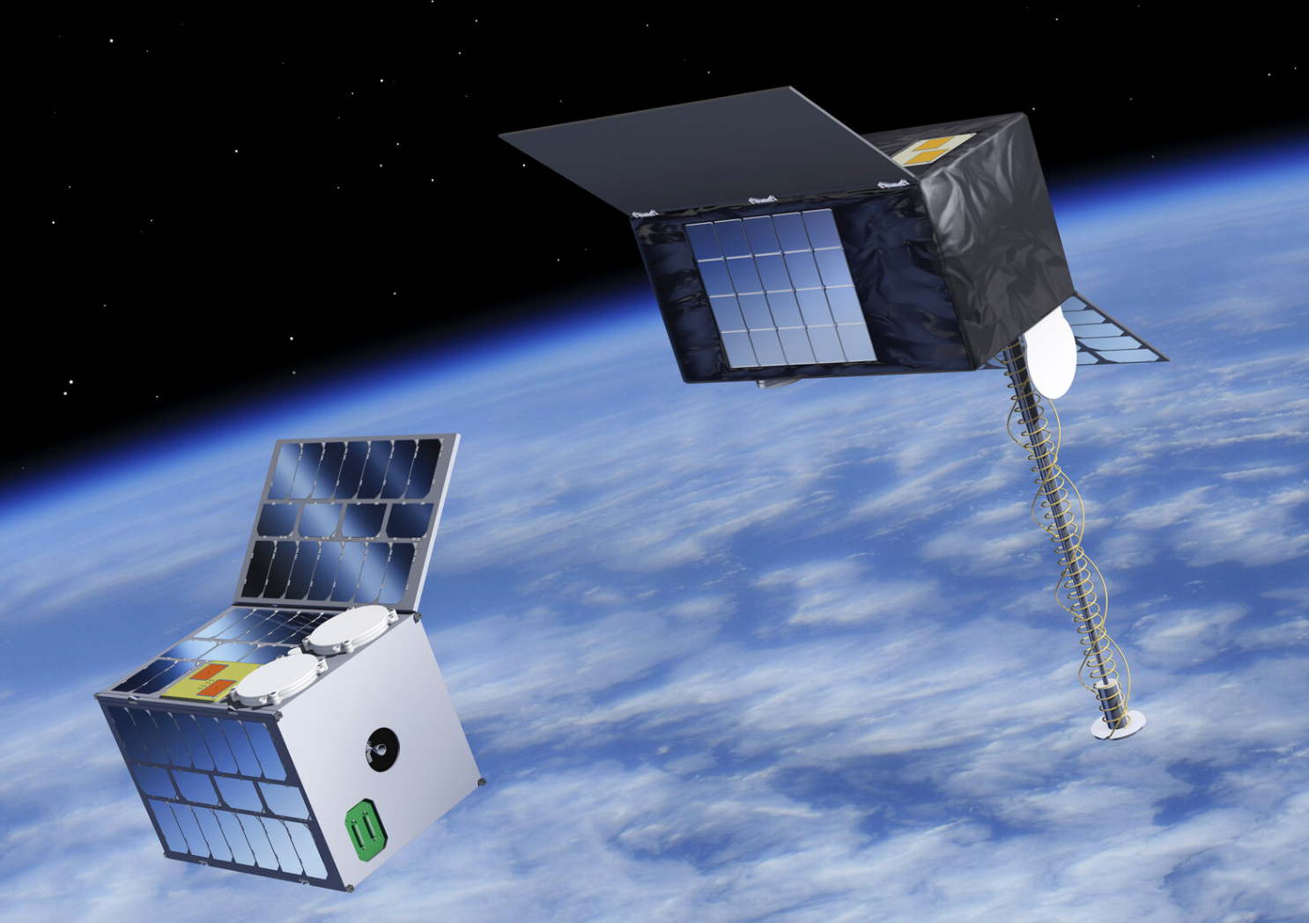
LEO-PNT first mission: In Orbit Demonstrator
12U Cubesat
Followed by 4x Microsats ~100kg
Quasi Polar Orbit ~550 km
L/S, C and UHF Signal In Space and 2-way payload (S-band)
16U Cubesat
Followed by 4x 20U Cubesats
Quasi Polar Orbit ~550 km
L/S, C and UHF Signal in Space and 2-way payload (UHF-band)
mini-constellation deployment
2025 - 2027
Resilience & Robustness
Galileo/EGNOS
Augmentation
New PNT from space (e.g. 6G)

Slide 34
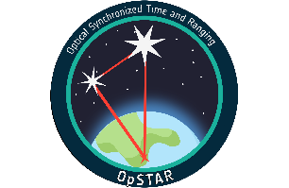
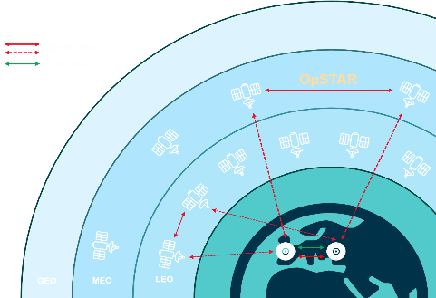
Optical Synchronized Time and Ranging In Orbit Demonstrator
Demonstrating Optical Inter-Satellite Link capabilities for PNT
Optical inter-satellite links for Time synchronisation & Ranging
Significant performance improvement at system/user level
New system architecture based on optical links
Open standards for O-ISL (physical, data link and network layers)
Mature technology for use at earliest opportunity

Slide 35
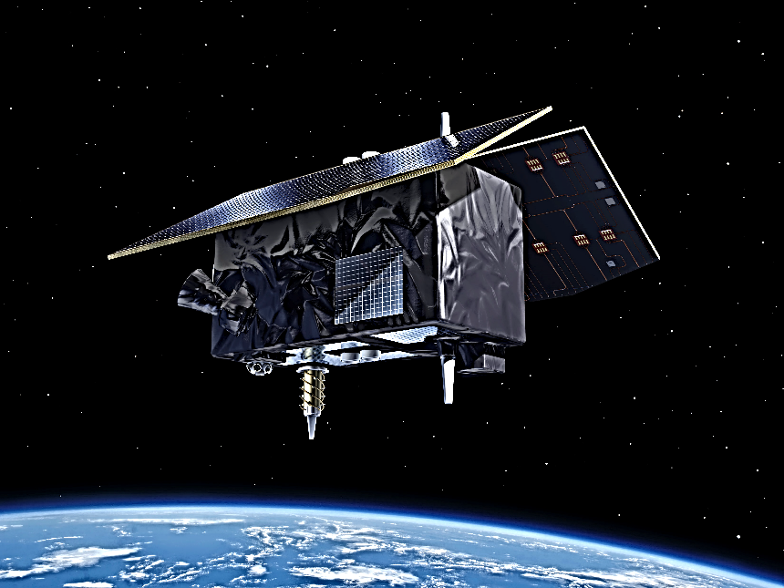

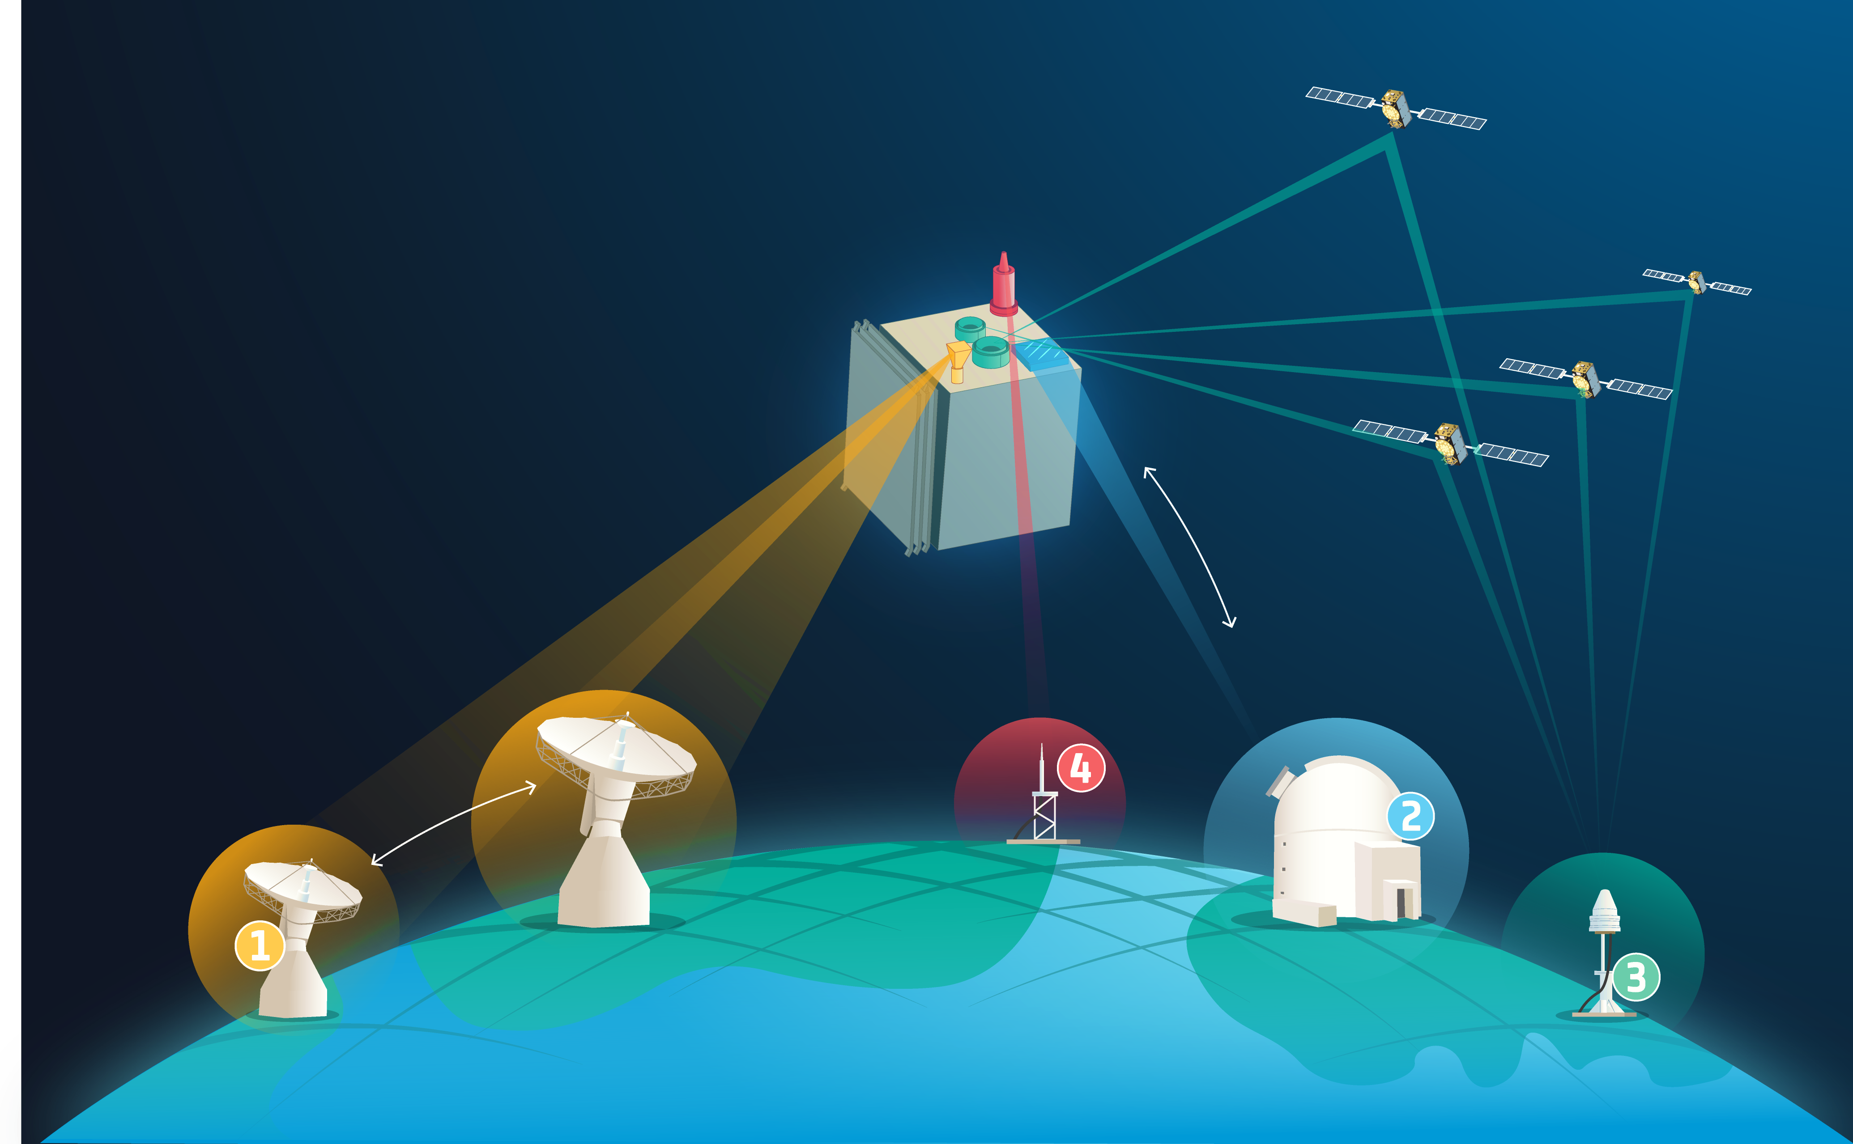
ESA’s GENESIS
At the foundation of navigation
Mission Objective is to contribute to improve ITRF accuracy and stability, with an aimed accuracy of 1 mm and a stability of 0.1 mm/year.
Mission scope
Design, development, qualification and calibration of the satellite (incl payloads) and ground segment
GENESIS in short
Launch and early operations including commissioning and in-orbit calibration
Operations (2 years, option for extension)
Data exploitation (Including processing, archiving and data distribution from ESA facilities)
250-300 kg Satellite
Orbit
~ 6000 Km Altitude,
~ 95 deg inclination
Very Precise on-Board Metrology
Launch in 2028
Four geodetic payloads:
VERY-LONG-BASELINE INTERFEROMETRY (VLBI) Transmitter
SATELLITE LASER RANGING (SLR) Retroreflector
GLOBAL SATELLITE NAVIGATION SYSTEMS (GNSS) Receiver (Nadir
and Zenith antennas)
DORIS Receiver

Slide 36


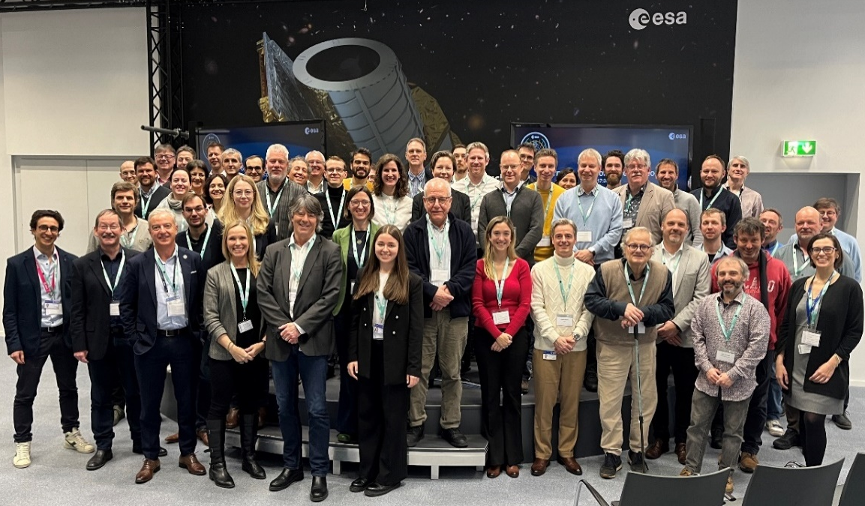
GENESIS Science Exploitation Team - Nominations
Coordinator
Co-Coordinator
WG1: ITRF & Combination of Techniques
WG3: VLBI
WG4: DORIS
Zuheir Altamimi
Institut national de l'information géographique et forestière – IGN
Florian Seitz
Deutsches Geodätisches Forschungsinstitut-Technischen Universität München – DGFI
WG2: GNSS
Rolf Dach
Universität Bern
Benjamin Männel
Deutsches GeoForschungsZentrum – GFZ
Rüdiger Haas
Chalmers Tekniska Högskola
Guilhem Moreaux
CLS-Collecte Localisation Satellites
WG5: Laser Ranging
Clément Courde
Centre national de la recherche scientifique-Géoazur
Francesco Vespe
ASI Space Geodesy Centre at Matera
Özgur Karatekin
Royal Observatory of Belgium – RoB
29th February Workshop @ ESOC
  Attendance from all relevant International Geodetical Services (Chairs or deputies):
    IAG, IERS, IGS, IVS, ILRS, IDS
  Strong commitment and engagement from the community
  Over 100 people onsite and online
“GENESIS – A Mission for the World”

Slide 37

Scientific and Fundamental Aspects of GNSS
The 9th Edition of the ESA International GNSS Scientific Colloquium will take place in Wroclaw (Poland) on 25-27 September 2024
This ESA Colloquium is today recognised as the worldwide reference conference on the topic of GNSS and Science.
Key topics:
Frequency Transfer, Timing and Clock Technologies
Reference Frames and Precise Orbit Determination
Navigation for Lunar and for Space Applications: Systems and Technologies
GNSS Science Transversal Aspects
Geodesy, Geophysics and Earth Sciences
Fundamental Physics and GNSS
GNSS Astronomy
Atmospheric Physics

Slide 38
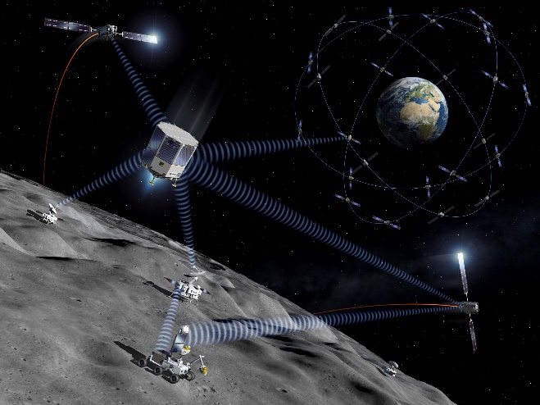
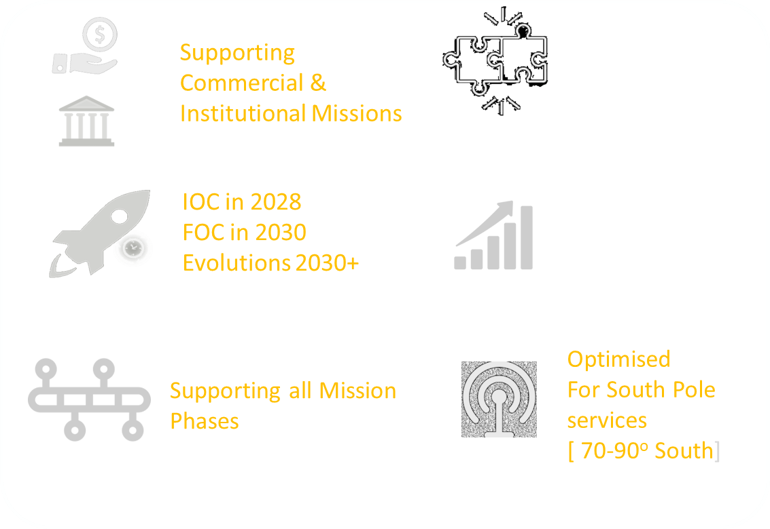

Ad Lunam : Moonlight Vision
To enable the delivery of interoperable Communications and Navigation Services that will support the current and next generations of institutional and commercial Lunar explorers

Slide 39







Moonlight Navigation Service Performances
Surface Rover | Lunar Lander | Lunar Orbiter
Ref: Navigation Performance of a Lunar Surface Rover Using LCNS Positioning Assuming Realistic ODTS Performances, EUROPEAN NAVIGATION CONFERENCE 2023 | Ref: Positioning and Velocity Performance Levels for a Lunar Lander using a Dedicated Lunar Communication and Navigation System, Navigation Journal 2022 | Ref: Navigation performance of Low Lunar Orbit satellites using a Lunar Radio Navigation Satellite System, ION-GNSS 2023
Real time
< 10 m (95%)
Post-processing
< 3 m (95%
Real time
< 100 m (95%)
LLO accuracies
< 50 m (95%)
Landing accuracy
3-5 meters
~20 meters
30-60 meters

Slide 40

NOVAMOON – First ever Lunar differential and Selenodetic station
Install the first-ever reference local differential station on the lunar surface
  This station placed on ESA’s Argonaut lander will compute Moonlight NAV satellite pseudorange error corrections and broadcast these via the Moonlight PNT Channel allowing decimeter level navigation accuracies over the whole Lunar South Pole (ARTEMIS area) to standard LunaNet users.
Install the first-ever International “geodetic” Reference station on the lunar surface
  Co-locating 4 geodetic techniques: GNSS/Moonlight, VLBI tx, last generation laser retroreflector and Two way DTE ranging allowing to locate the Argonaut lander station at cm-level accuracy on the lunar surface, setting the international standard station for Lunar Refence Frame realisation
Install the first-ever “Time-reference” station on the lunar surface
  setting the lunar international standard time (at ns-level) and establishing the basis for the lunar reference time definition.

Slide 41


ESA Shaping the Future of Navigation
Delivering on Time with high quality and high commitment
Continuously pushing for Innovation
30-year expertise on bringing satnav to Europe

